Slide 1
SCHOOL FINANCE INDICATORS DATABASE
School Finance in America
The State of Adequacy, Equity, and Opportunity, 2009–2024
Bruce D. Baker
University of Miami
SCHOOLFINANCE101.COM · SCHOOLFINANCEDATA.ORG
1

Slide 2
WHY FINANCE MATTERS
Money Matters
1
Up or down
Increases to school funding lead to improved student outcomes; cuts lead to worse outcomes.
2
Operating or capital
Operating dollars raise teacher wages and shrink class sizes; capital dollars improve facilities — often with a lag before students feel the benefit.
3
More for children in poverty
Progressive funding matters most: added dollars in high-poverty, historically underinvested settings return several times more than the same dollars elsewhere.
4
However it arrives
Whether funding increases come from legislative action, economic growth, federal stimulus, local votes, or judicial order — they improve outcomes.
SCHOOLFINANCE101.COM · SCHOOLFINANCEDATA.ORG
2

Slide 3
FRAMING THE PROBLEM
The Goals of School Finance Systems
Provide all children — regardless of where they live or attend school — equal opportunity to achieve common, adequate outcome goals.
Equal opportunity costs different amounts in different settings, and across children, individually and collectively, by needs and context.
State accountability systems set the common goals: they rate, rank, and evaluate schools on whether those goals are met.
A fair system requires funding sufficient to provide equal opportunity to meet these goals — goals often used to articulate constitutional rights.
KEY CITATIONS
“14 Conceptions of Equity and Adequacy in School Finance”
“16 Measurement of Cost Differentials”
SCHOOLFINANCE101.COM · SCHOOLFINANCEDATA.ORG
3

Slide 4
FRAMING THE PROBLEM
What Drives the Cost of Equal Opportunity
1
2
3
Higher outcome goals cost more
Some children cost more to reach
Some settings cost more to serve
All else equal, the per-pupil spending required to achieve higher and broader outcome goals is higher than for narrower, lower goals.
Collective, social-context effects like concentrated poverty, and specific student needs such as English learner status or disability.
Economies of scale in small, sparsely populated remote districts, and regional variation in the competitiveness of labor markets.
Baker & Weber, “Performance Standards and Educational Cost Indexes: You Can't Have One Without the Other.”
SCHOOLFINANCE101.COM · SCHOOLFINANCEDATA.ORG
4

Slide 5
01
PART ONE
National Overview
The School Finance Indicators Database (SFID) — how the nation is funding its public schools, state by state and district by district.
SCHOOLFINANCE101.COM · SCHOOLFINANCEDATA.ORG
5

Slide 6














2008
THE YEAR IN CULTURE
2008, Rewound
TOP 5 SONGS
TOP 5 MOVIES
TOP 5 TV SHOWS
1
Low
Flo Rida ft. T-Pain
1
The Dark Knight
$1.01B worldwide
1
American Idol (Wed.)
Fox
2
Bleeding Love
Leona Lewis
2
Iron Man
$585M worldwide
2
American Idol (Tue.)
Fox
3
No One
Alicia Keys
3
Indiana Jones and the
Kingdom of the Crystal Skull
$786M worldwide
3
Dancing with the Stars
ABC
4
Lollipop
Lil Wayne ft. Static Major
4
Hancock
$624M worldwide
4
CSI: Crime Scene Investigation
CBS
5
Apologize
OneRepublic ft. Timbaland
5
WALL-E
$521M worldwide
5
NCIS
CBS
Billboard Year-End Hot 100
Worldwide box office, calendar year 2008
Nielsen primetime ratings, 2008–09 season

Slide 7
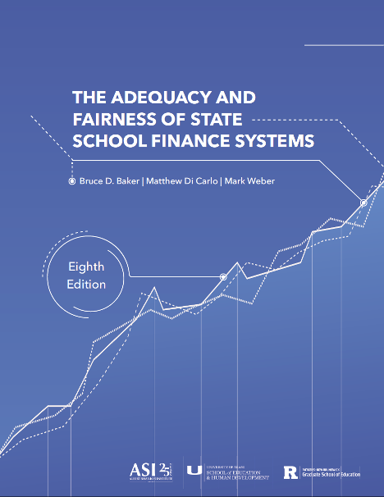
NATIONAL OVERVIEW
About the SFID Project
A joint project of the Albert Shanker Institute, the University of Miami School of Education & Human Development, and Rutgers Graduate School of Education.
EVERY YEAR WE PUBLISH
A national report
51 one-page state profiles
Full state- and district-level datasets
Online data visualizations
Supplemental reports using the data
SCHOOLFINANCE101.COM · SCHOOLFINANCEDATA.ORG
6

Slide 8
NATIONAL OVERVIEW
How We Evaluate States
Fiscal Effort
Statewide Adequacy
Equal Opportunity
How much do states spend on schools as a proportion of their economies?
How many of a state’s students attend school in underfunded districts?
Is funding less adequate in a state’s higher-poverty than in its lower-poverty districts?
SCHOOLFINANCE101.COM · SCHOOLFINANCEDATA.ORG
7

Slide 9
NATIONAL OVERVIEW — FISCAL EFFORT
Effort by State: What It Measures
Effort lets us identify the states that have the capacity to raise more revenue for their schools.
Effort
Total state/local K–12 revenue
÷ divided by
Gross state product
SCHOOLFINANCE101.COM · SCHOOLFINANCEDATA.ORG
8

Slide 10
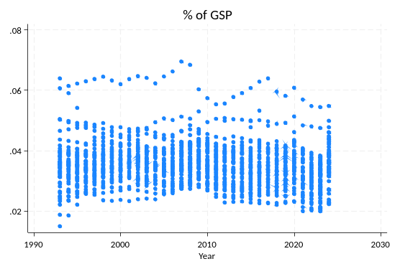
NATIONAL OVERVIEW — FISCAL EFFORT
Permanent Disinvestment
42 states
−$575B
had lower fiscal effort in 2023 than in 2006
total revenue “loss” since 2016 — roughly 10 percent
Two independent effort measures — K-12 revenue as a share of state income, and as a share of gross state product — both show the same downward drift since the mid-2000s.
SCHOOLFINANCE101.COM · SCHOOLFINANCEDATA.ORG
9

Slide 11
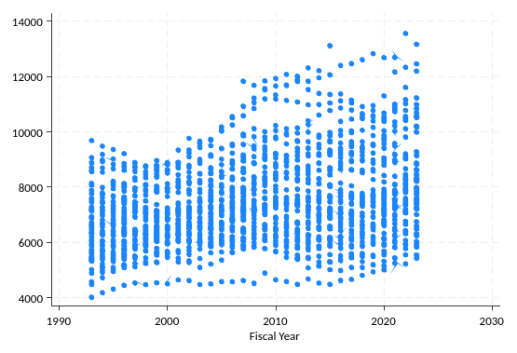
NATIONAL OVERVIEW — FISCAL EFFORT
The Great Divergence
A group of roughly 10–12 “education states” is increasingly pulling away from the rest of the nation — sustaining fiscal effort while most states let it slide.
SCHOOLFINANCE101.COM · SCHOOLFINANCEDATA.ORG
10

Slide 12
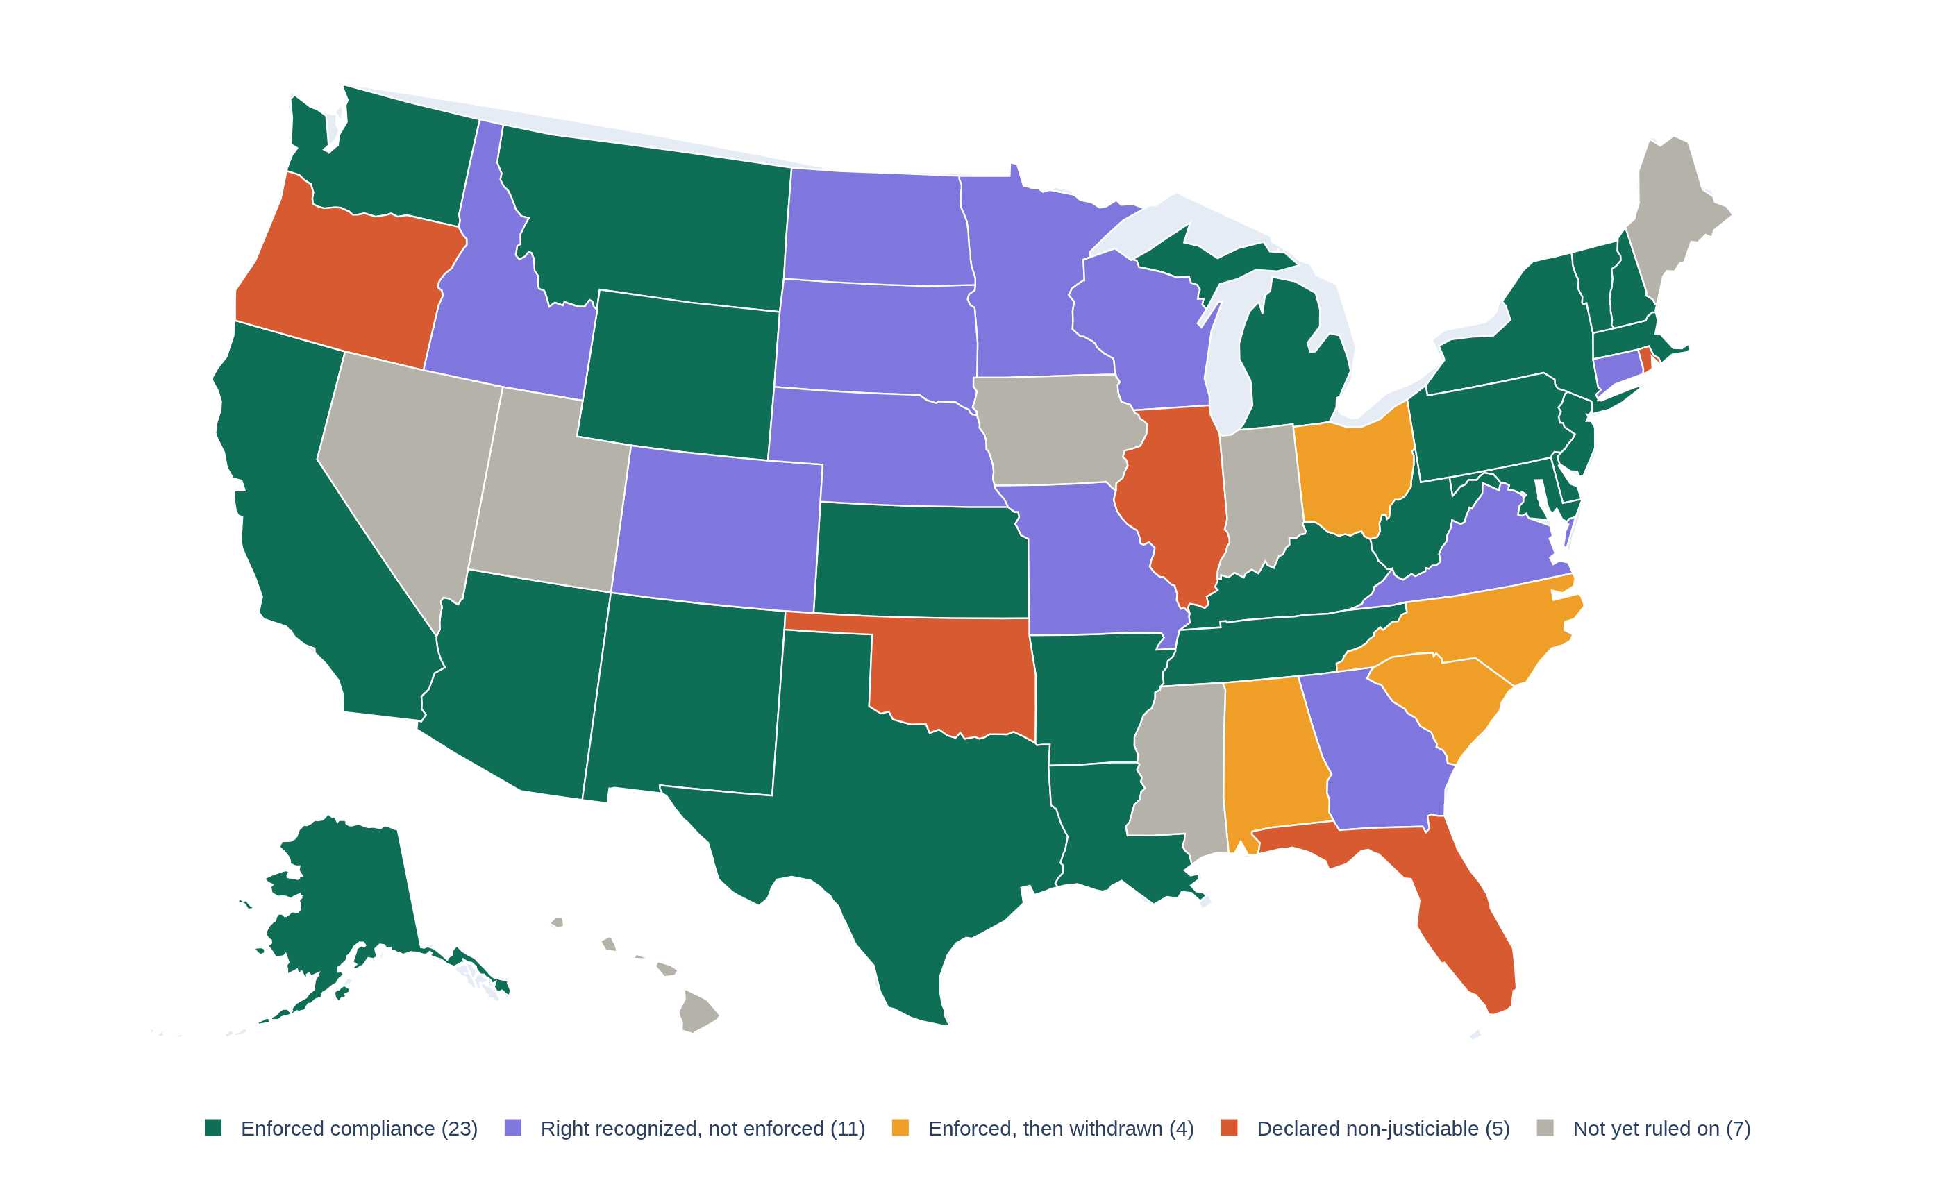
NATIONAL OVERVIEW — CONSTITUTIONAL PROTECTIONS
U.S. State Supreme Courts and the Right to Education
How each state’s highest court has treated its constitutional education clause
NC's April 2026 Leandro dismissal — “with prejudice” — is the most severe withdrawal to date. Category assignments should be independently verified before legal or policy use.
SCHOOLFINANCE101.COM · SCHOOLFINANCEDATA.ORG
11

Slide 13
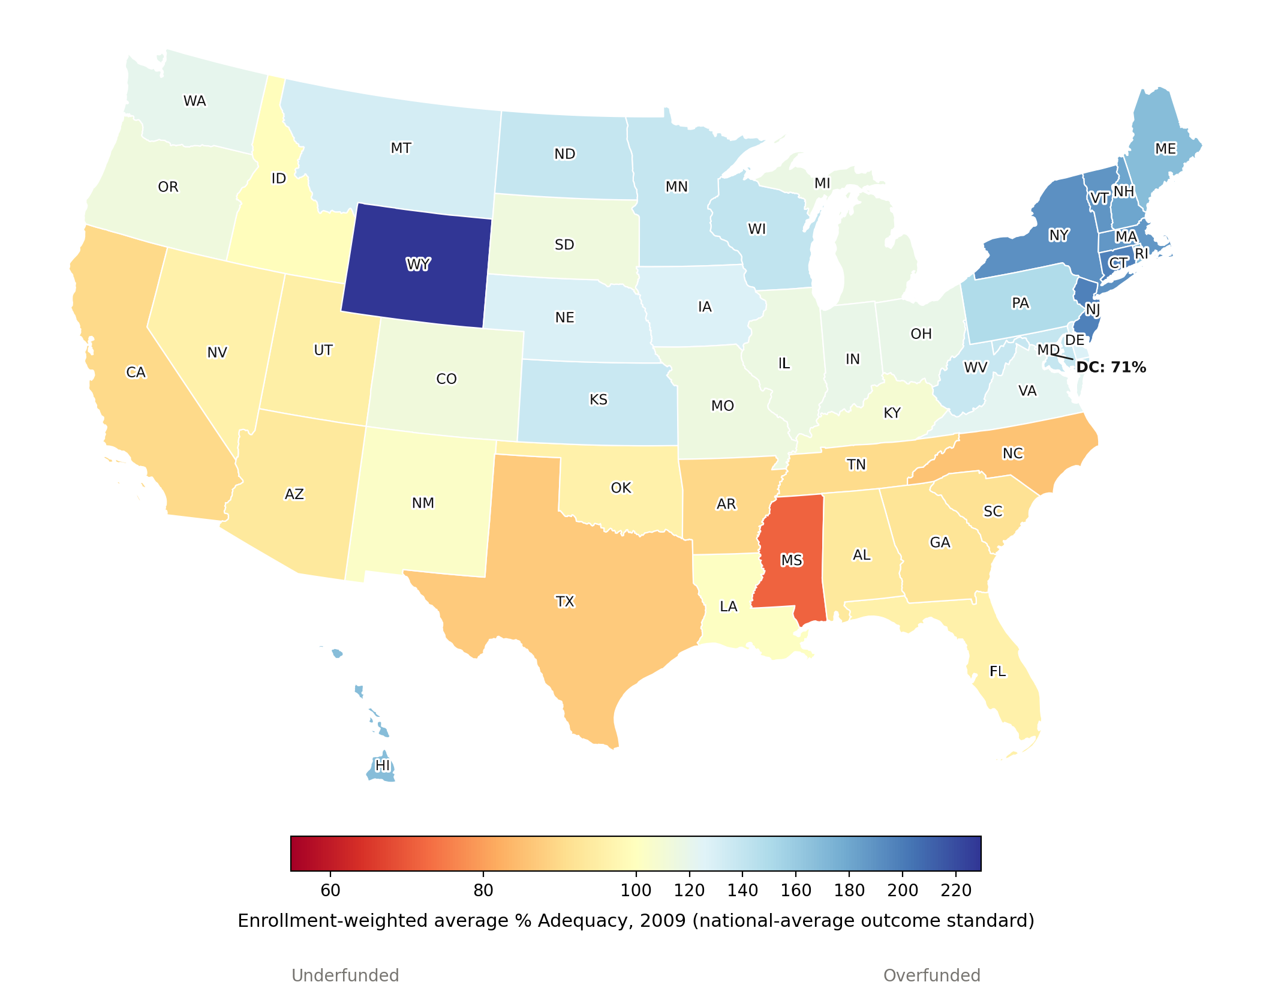
NATIONAL OVERVIEW — STATEWIDE ADEQUACY
State Funding Adequacy, 2009
National-average outcome standard · enrollment-weighted
In 2009, most states spent above the cost of achieving national-average outcomes. The Northeast (CT, NJ, NY, MA) and Wyoming were the most overfunded, while the South (MS, TX, NC, AR) and DC were the most underfunded.
117%
national enrollment-weighted average % of the cost of national-average outcomes
% Adequacy = current spending ÷ cost of national-average outcomes, averaged within state and enrollment-weighted. Alaska excluded. Source: NECM/SEDA merged file.
SCHOOLFINANCE101.COM · SCHOOLFINANCEDATA.ORG
12

Slide 14
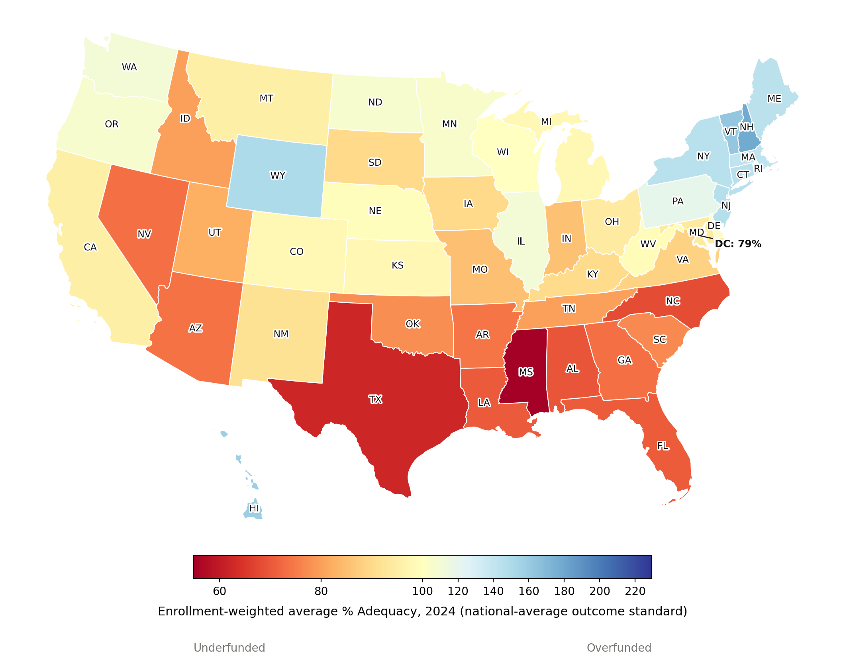
NATIONAL OVERVIEW — STATEWIDE ADEQUACY
State Funding Adequacy, 2024
National-average outcome standard · enrollment-weighted
By 2024 the map inverted. Most of the country — including nearly every state that was overfunded in 2009 — fell below the cost of national-average outcomes. Mississippi remained the most underfunded; only California and DC ended up better funded than in 2009.
93%
national enrollment-weighted average % of the cost of national-average outcomes
% Adequacy = current spending ÷ cost of national-average outcomes, averaged within state and enrollment-weighted. Alaska excluded. Source: NECM/SEDA merged file.
SCHOOLFINANCE101.COM · SCHOOLFINANCEDATA.ORG
13

Slide 15
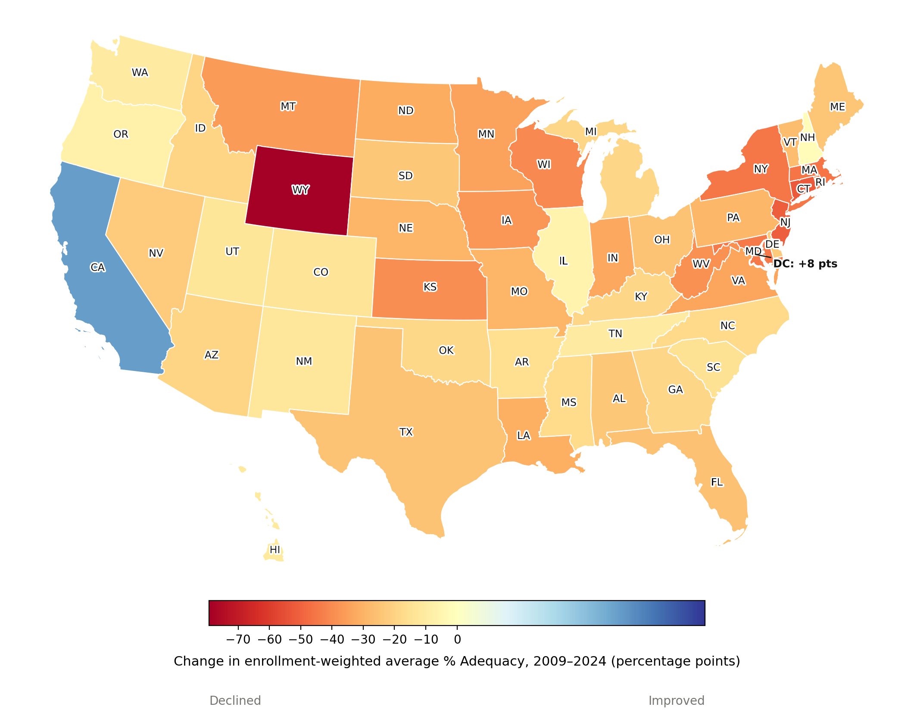
NATIONAL OVERVIEW — STATEWIDE ADEQUACY
State Funding Adequacy: The Change, 2009–2024
National-average outcome standard
48 of 50 states and DC became less well-funded, relative to the cost of national-average outcomes. Wyoming (−79 points) saw the steepest decline, having been the single most overfunded state in 2009. California and DC were the only two to improve.
−24 pts
median change in enrollment-weighted % adequacy, 2009–2024
Change = enrollment-weighted average % Adequacy in 2024 minus 2009 (percentage points), by state. Alaska excluded. Source: NECM/SEDA merged file.
SCHOOLFINANCE101.COM · SCHOOLFINANCEDATA.ORG
14

Slide 16
NATIONAL OVERVIEW — STATEWIDE ADEQUACY
Adequacy by Constitutional Enforcement Category
2009 vs. 2024 · national-average outcome standard · enrollment-weighted
Category | # States | All Districts |  |  | Highest-Poverty Quintile
 |  | 2009 | 2024 | Change | 2009 | 2024 | Change
Enforced compliance | 23 | 121.0% | 98.3% | -22.7 pp | 95.8% | 80.3% | -15.5 pp
Right recognized, not enforced | 11 | 122.6% | 92.9% | -29.7 pp | 94.5% | 77.5% | -17.0 pp
Enforced, then withdrawn | 4 | 100.3% | 79.1% | -21.2 pp | 72.3% | 62.3% | -10.0 pp
Declared non-justiciable | 5 | 106.3% | 88.0% | -18.3 pp | 78.2% | 78.7% | +0.5 pp
Not yet ruled on | 7 | 111.1% | 86.4% | -24.7 pp | 107.9% | 89.5% | -18.3 pp
All states (national) | 50 | 116.7% | 93.4% | -23.3 pp | 92.8% | 79.1% | -13.6 pp
Categories from the U.S. State Supreme Courts and the Right to Education map (National Overview — Constitutional Protections). "Highest-poverty quintile" districts are recomputed within each year, so 2009 and 2024 reflect that year's own highest-poverty fifth of districts, not a fixed set held constant over time.
% Adequacy = current spending ÷ cost of national-average outcomes, enrollment-weighted. Alaska and DC excluded. Category assignments should be independently verified before legal or policy use. Source: NECM/SEDA merged file.
SCHOOLFINANCE101.COM · SCHOOLFINANCEDATA.ORG

Slide 17
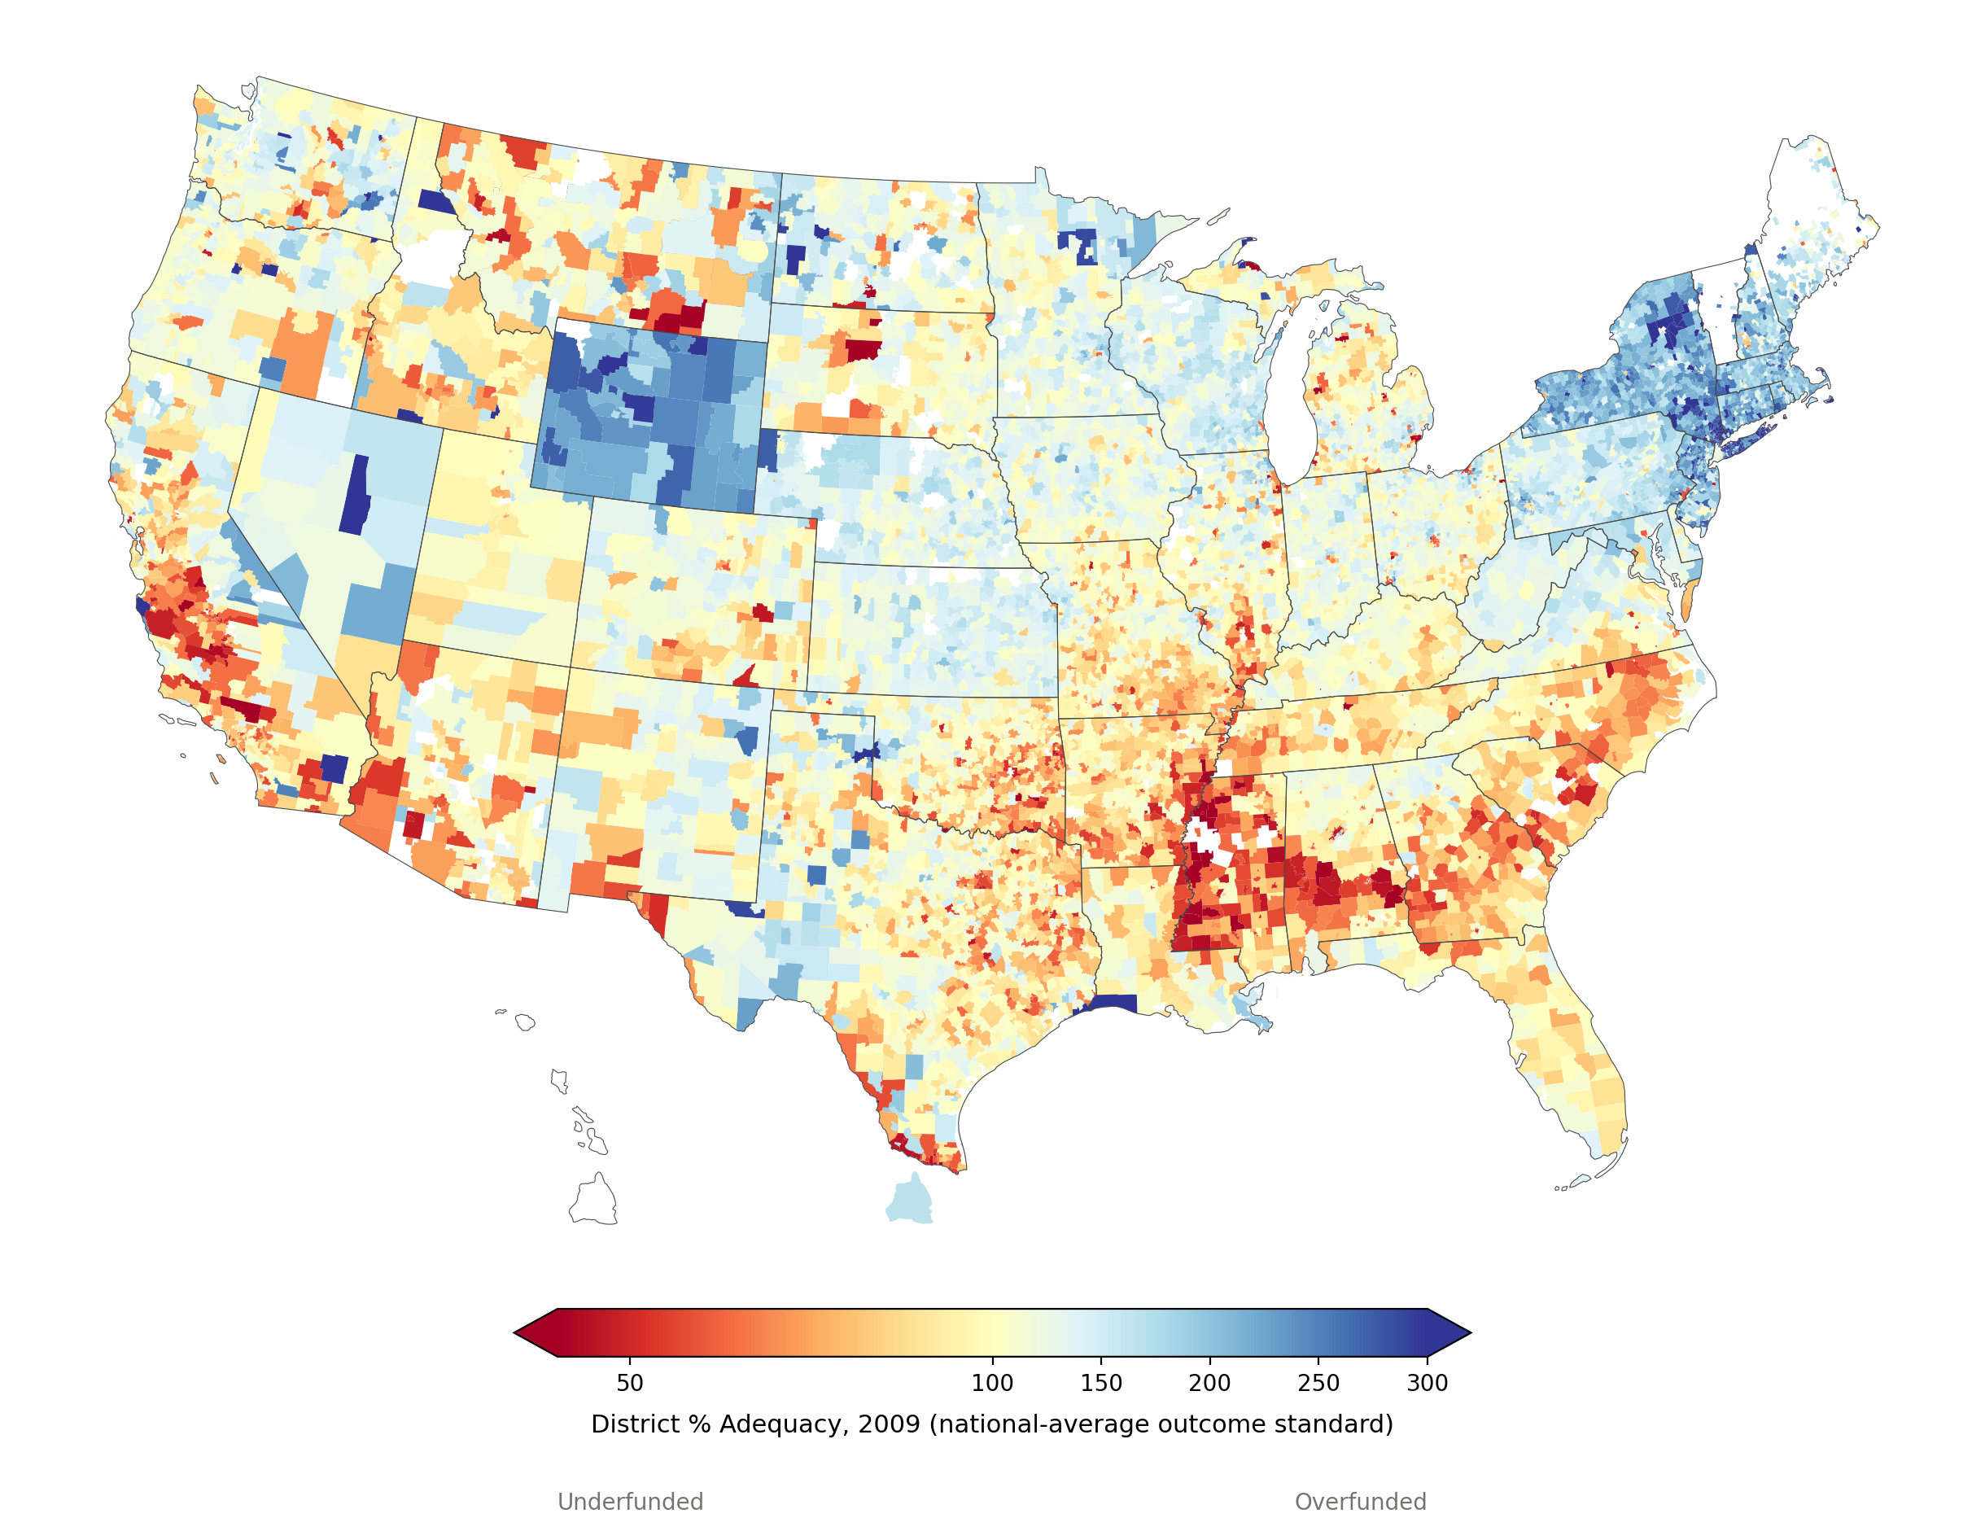
NATIONAL OVERVIEW — DISTRICT-LEVEL ADEQUACY
District-Level Funding Adequacy, 2009
National-average outcome standard
At the district level, the 2009 pattern is sharper than state averages suggest. New England and the NY–NJ corridor were overfunded almost district by district, while a dense band across the Deep South was already underfunded, alongside pockets of coastal California.
117%
enrollment-weighted national average
31%
of 13,255 districts below 100% adequacy
% Adequacy by district. Color scale capped 40–300%. Alaska excluded. District boundaries: US Census TIGER/Line. Source: NECM/SEDA merged file.
SCHOOLFINANCE101.COM · SCHOOLFINANCEDATA.ORG
15

Slide 18
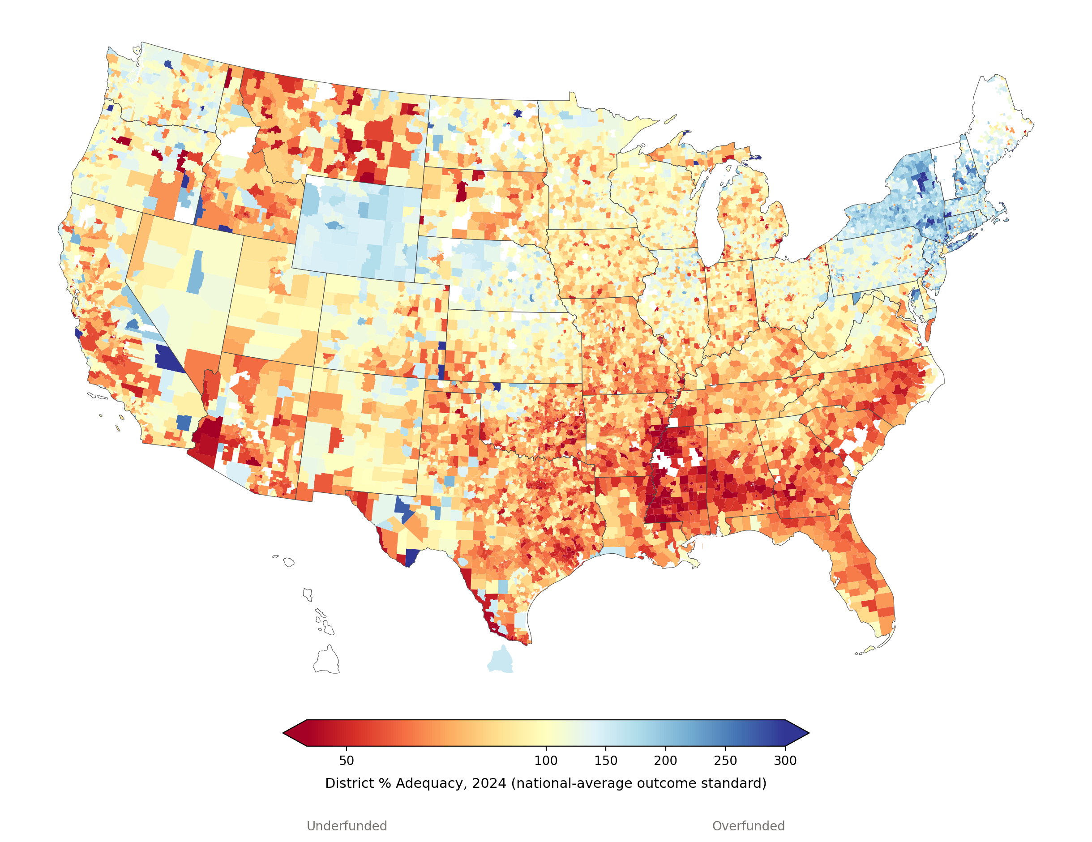
NATIONAL OVERVIEW — DISTRICT-LEVEL ADEQUACY
District-Level Funding Adequacy, 2024
National-average outcome standard
By 2024, underfunding deepened and spread well beyond the South — Montana, Idaho, and much of the Mountain West joined it. The Northeast held on to overfunding but visibly thinned out, and the share of underfunded districts nearly doubled nationwide.
93%
enrollment-weighted national average
54%
of 12,702 districts below 100% adequacy
% Adequacy by district. Color scale capped 40–300%. Alaska excluded. District boundaries: US Census TIGER/Line. Source: NECM/SEDA merged file.
SCHOOLFINANCE101.COM · SCHOOLFINANCEDATA.ORG
16

Slide 19
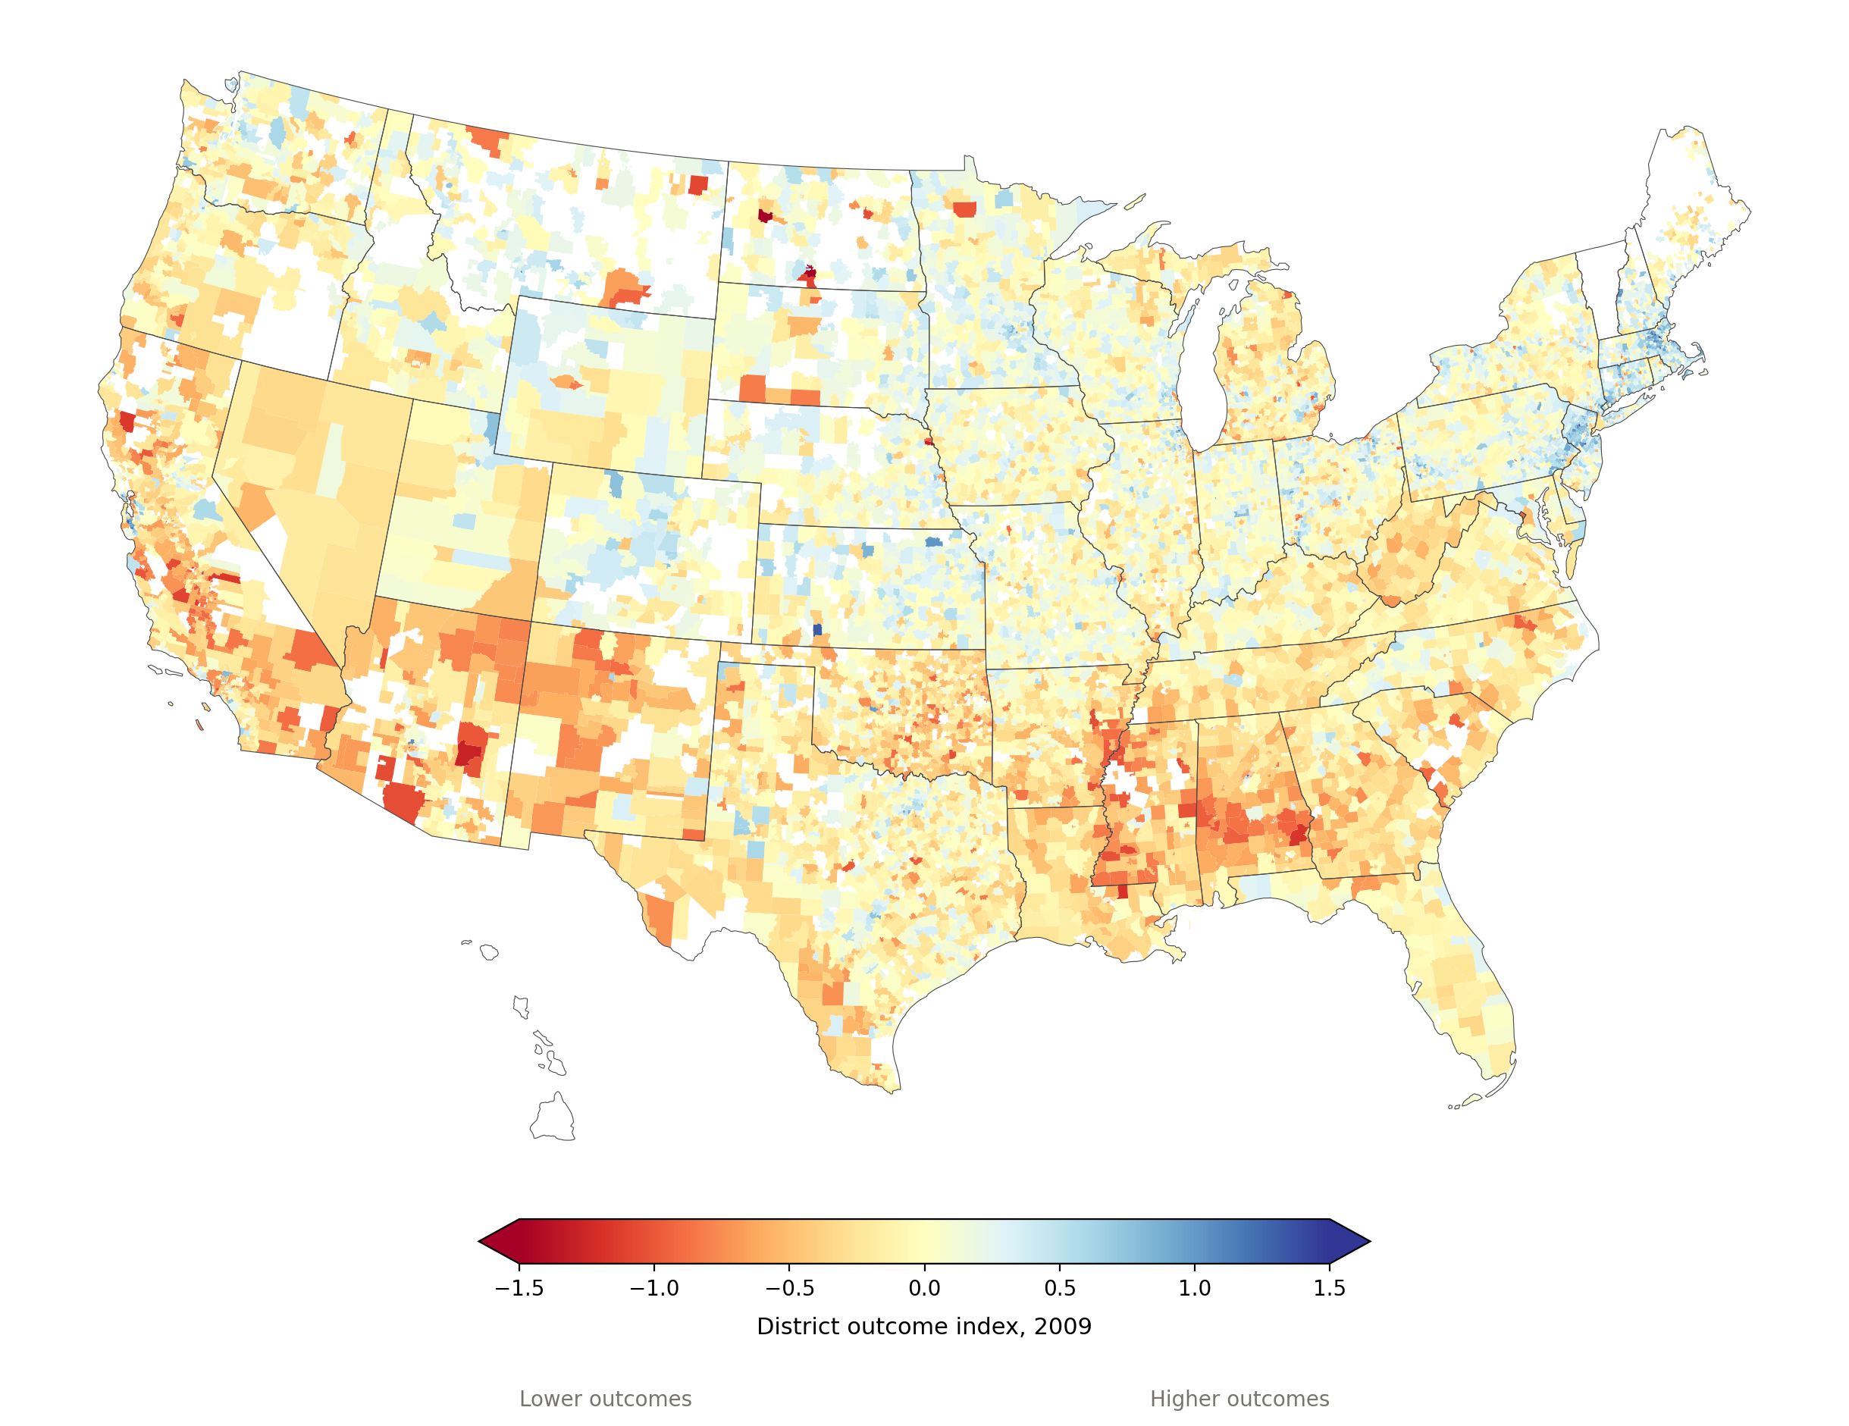
NATIONAL OVERVIEW — DISTRICT-LEVEL OUTCOMES
District-Level Outcomes, 2009
SEDA-based outcome index
Outcomes follow a different geography than funding. In 2009 the Southwest border region and Deep South already posted the lowest outcome scores, while much of the Midwest, Northeast, and Mountain West clustered close to or above the national average.
−0.06
enrollment-weighted national average outcome index
50%
of 11,198 districts below the national average
Outcome index: 0 = national average that year. Color scale capped −1.5 to +1.5. Alaska excluded. Source: NECM/SEDA merged file.
SCHOOLFINANCE101.COM · SCHOOLFINANCEDATA.ORG
17

Slide 20
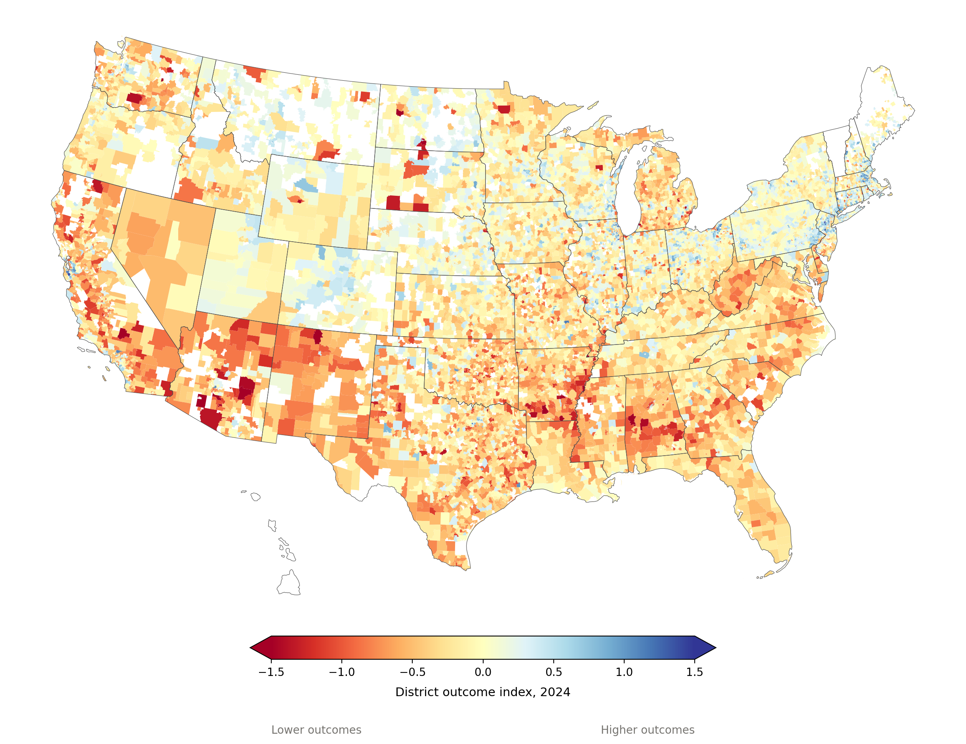
NATIONAL OVERVIEW — DISTRICT-LEVEL OUTCOMES
District-Level Outcomes, 2024
SEDA-based outcome index
By 2024, outcomes fell nationwide — not just in districts that were already lowest. The Southwest border region intensified sharply, particularly Arizona and New Mexico, even as many Northeastern and Mountain West districts held closer to their 2009 levels.
−0.18
enrollment-weighted national average outcome index
63%
of 11,190 districts below the national average
Outcome index: 0 = national average that year. Color scale capped −1.5 to +1.5. Alaska excluded. Source: NECM/SEDA merged file.
SCHOOLFINANCE101.COM · SCHOOLFINANCEDATA.ORG
18

Slide 21
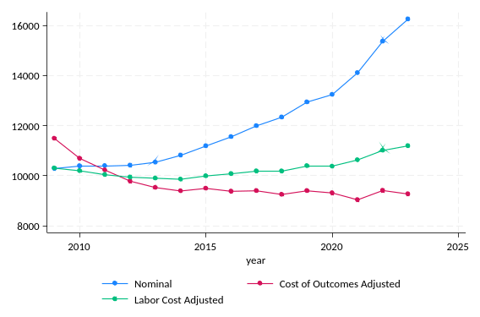
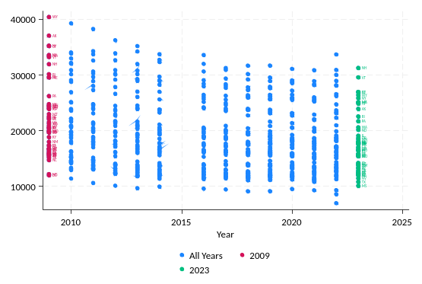
NATIONAL OVERVIEW — ADEQUACY TRENDS
Permanent Disinvestment
Spending with respect to the “cost” of achieving common outcome goals (2013–2015 reading/math scores) never rebounded.
SCHOOLFINANCE101.COM · SCHOOLFINANCEDATA.ORG
19

Slide 22
NATIONAL OVERVIEW — METHODOLOGY
How We Estimate Adequacy
In almost every district, we compare:
ACTUAL SPENDING
ADEQUATE SPENDING (estimated)
Estimates come from our national cost model, which controls for factors such as Census poverty, labor costs, district size, population density, and many others.
Available for over 12,000 school districts between 2009 and 2023
Updated annually, with roughly a three-year lag
Useful for comparing adequacy and equity within and between states
SCHOOLFINANCE101.COM · SCHOOLFINANCEDATA.ORG
20

Slide 23
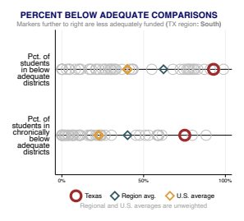
NATIONAL OVERVIEW — STATEWIDE ADEQUACY
Statewide Adequacy: A Texas Example
This graph is part of each state's annual profile. Markers further to the right mean less adequate spending — a larger share of students in underfunded districts.
Among the lowest in the nation
Statewide adequacy in Texas ranks among the lowest — even among the lowest in the South.
A low-effort state
Texas can raise substantially more revenue in-house than it currently does.
SCHOOLFINANCE101.COM · SCHOOLFINANCEDATA.ORG
21

Slide 24
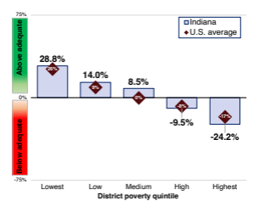
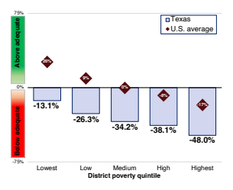
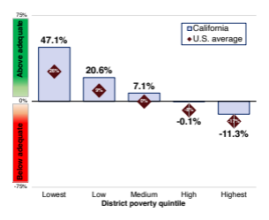
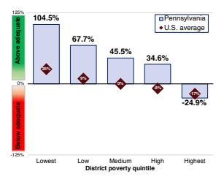
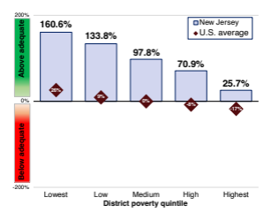
NATIONAL OVERVIEW — EQUAL OPPORTUNITY
Unequal Opportunity in Every State
Every single state has at least a moderate “opportunity gap” — funding adequacy falls as district poverty rises. Gaps are especially large in states with more adequate overall funding.
Bars show % adequacy by district poverty quintile relative to the U.S. average; downward slope = opportunity gap. Five illustrative states shown.
SCHOOLFINANCE101.COM · SCHOOLFINANCEDATA.ORG
22

Slide 25
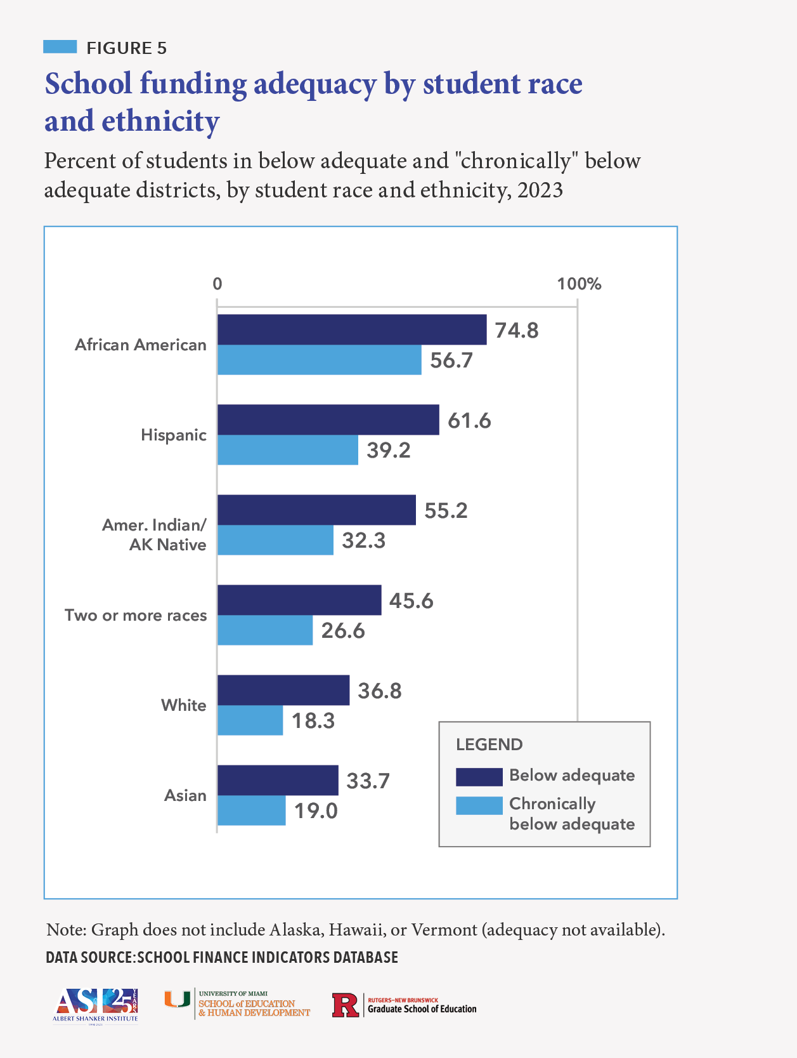
NATIONAL OVERVIEW — EQUAL OPPORTUNITY
Unequal Opportunity by Race
2×
the typical African American student is twice as likely as a white student to be in an underfunded district
3.5×
more likely to be in a “chronically underfunded” district, nationally
SCHOOLFINANCE101.COM · SCHOOLFINANCEDATA.ORG
23

Slide 26
02
PART TWO
State & Metro Trends and Patterns
Zooming in: how individual states, regions, and metro areas diverge from — and illustrate — the national pattern.
SCHOOLFINANCE101.COM · SCHOOLFINANCEDATA.ORG
24

Slide 27
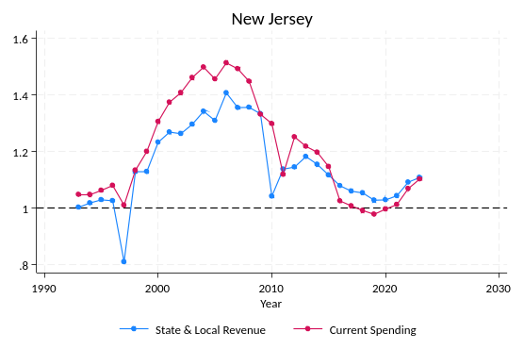
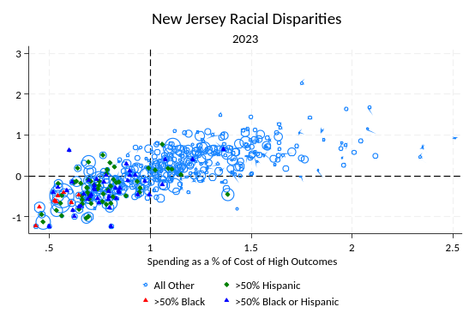
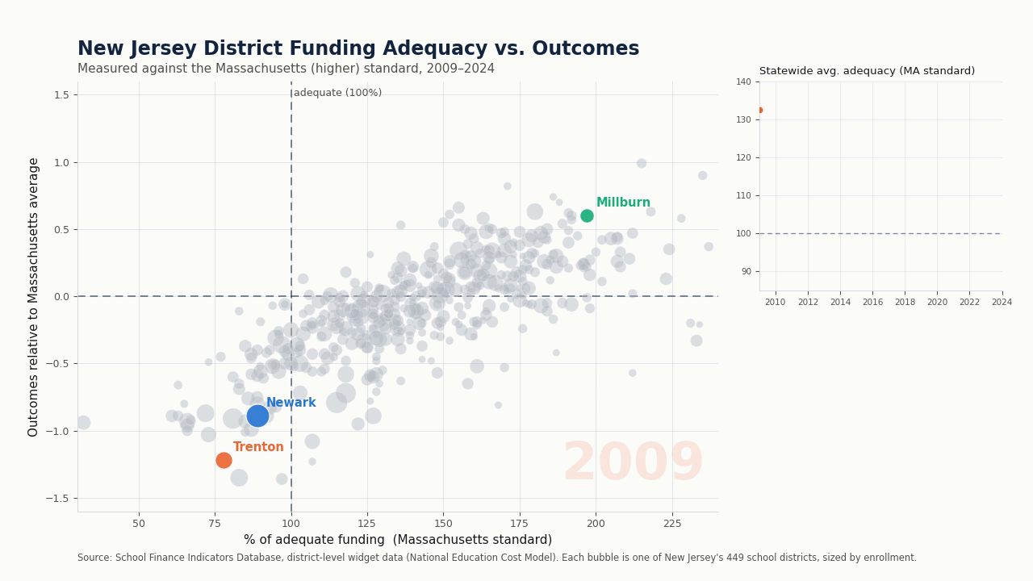
STATE TRENDS — NORTHEAST
New Jersey
State & local revenue vs. current spending relative to the national average (dashed line), 1990–2024
Spending as % of cost of high outcomes vs. outcome index, by district racial composition, 2023
▶ District outcomes vs. adequacy, 2009–2024 (Newark, Trenton & Millburn)
SCHOOLFINANCE101.COM · SCHOOLFINANCEDATA.ORG
25

Slide 28
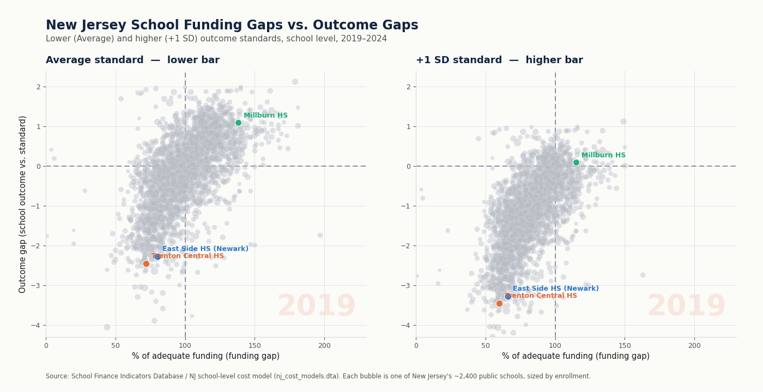
STATE TRENDS — NORTHEAST
New Jersey Schools: Funding & Outcome Gaps
Millburn HS: ~0
Near or above the +1 SD standard both years — an outlier among NJ high schools
−2.2 / −3.2
East Side HS (Newark) — outcome gap under the average vs. higher standard
−2.7 / −3.7
Trenton Central HS — the largest outcome gap of any NJ high school
▶ Funding gap vs. outcome gap, ~2,400 NJ schools, average and +1 SD standards, 2019–2024
SCHOOLFINANCE101.COM · SCHOOLFINANCEDATA.ORG
26

Slide 29
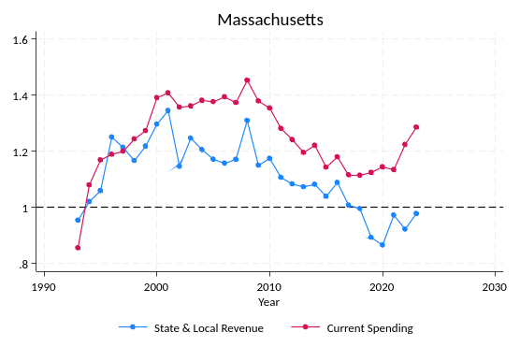
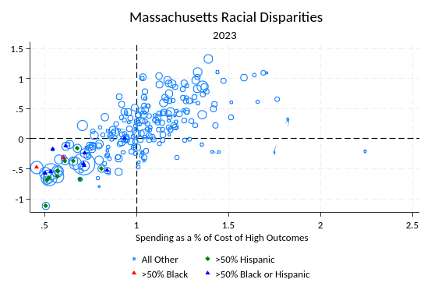
STATE TRENDS — NORTHEAST
Massachusetts
State & local revenue vs. current spending relative to the national average (dashed line), 1990–2024
Spending as % of cost of high outcomes vs. outcome index, by district racial composition, 2023
SCHOOLFINANCE101.COM · SCHOOLFINANCEDATA.ORG
27

Slide 30
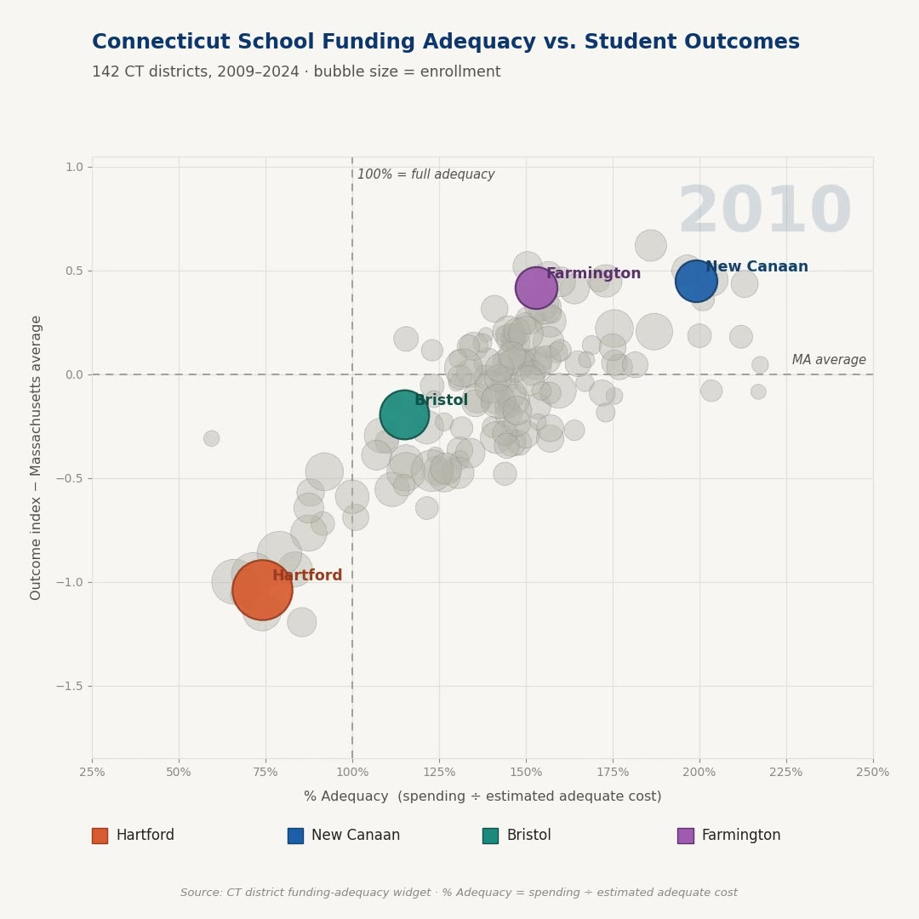
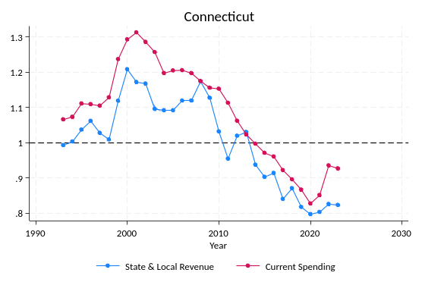
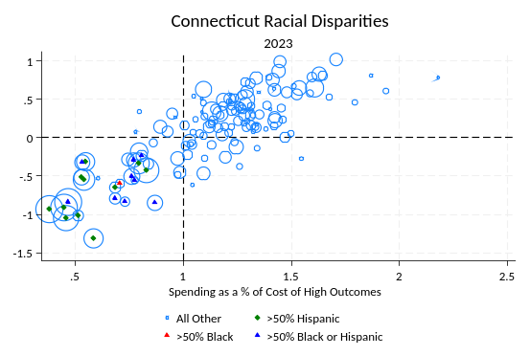

STATE TRENDS — NORTHEAST
Connecticut
State & local revenue vs. current spending, 1990–2024
Spending vs. outcomes by racial composition, 2023
▶ District outcomes vs. adequacy, 2009–2024 (Hartford & Bristol area)
Explore every CT district interactively — scan or visit the link in the appendix.
SCHOOLFINANCE101.COM · SCHOOLFINANCEDATA.ORG
28

Slide 31
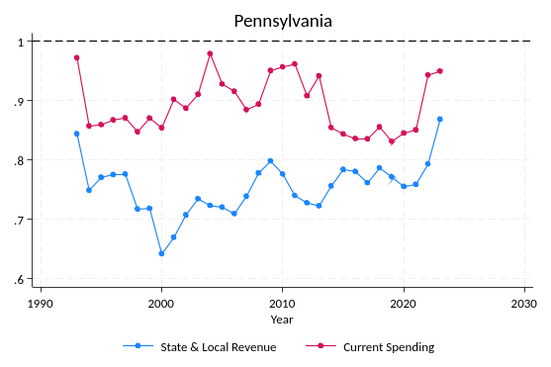
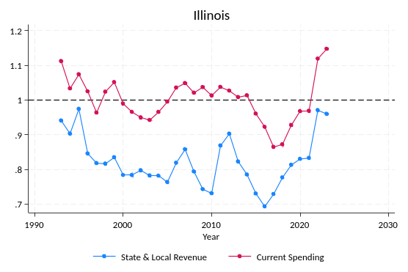
STATE TRENDS — MID-ATLANTIC & MIDWEST
Pennsylvania & Illinois
Pennsylvania — state & local revenue vs. current spending, 1990–2024
Illinois — state & local revenue vs. current spending, 1990–2024
SCHOOLFINANCE101.COM · SCHOOLFINANCEDATA.ORG
29

Slide 32
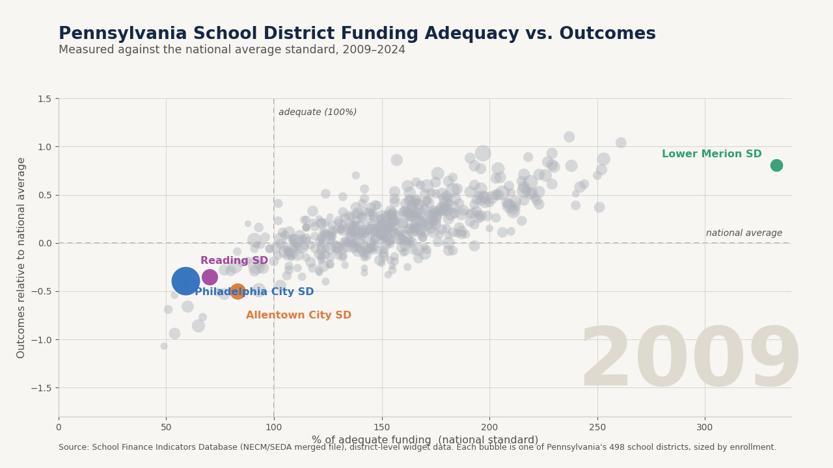

STATE TRENDS — PENNSYLVANIA
District Outcomes vs. Adequacy, 2009–2024
59% → 55%
Philadelphia City SD — adequacy for Pennsylvania's largest district, 2009 to 2024
333% → 226%
Lower Merion SD — far above adequate throughout, gap narrowing
70% → 51%
Reading SD — funding adequacy fell, outcome gap widened
▶ 498 PA districts vs. national-average outcomes, enrollment-weighted, 2009–2024
Explore interactively
SCHOOLFINANCE101.COM · SCHOOLFINANCEDATA.ORG
30

Slide 33
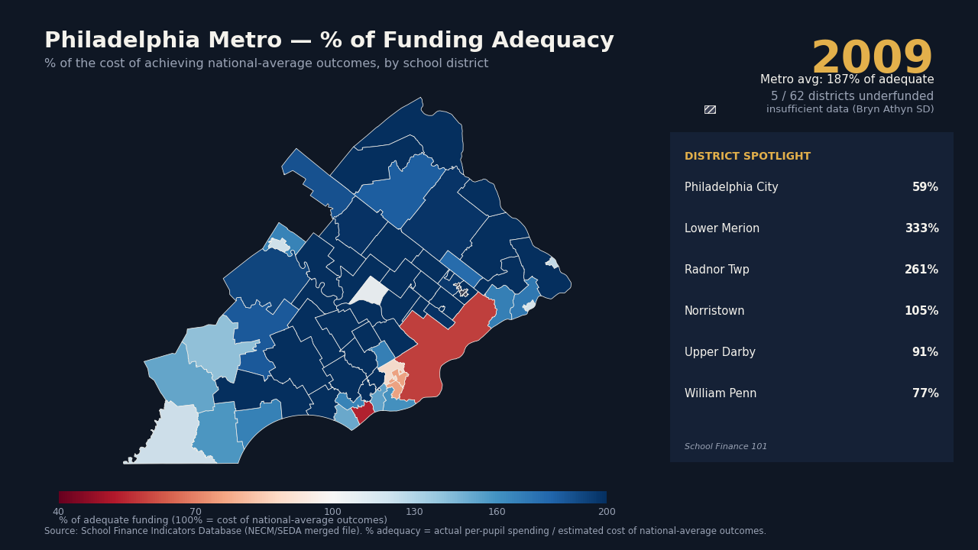
STATE TRENDS — PHILADELPHIA METRO
Watching the Shift, 2009–2024
−41 → −45
Philadelphia City SD's funding gap, 2009 to 2024
+233 → +126
Lower Merion — still far above adequate, but the gap has narrowed
10 of 62
metro districts flipped from overfunded to underfunded since 2009
▶ Funding gap to the cost of national-average outcomes, by Philadelphia-metro district
SCHOOLFINANCE101.COM · SCHOOLFINANCEDATA.ORG
31

Slide 34
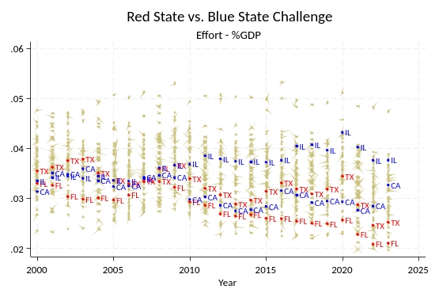
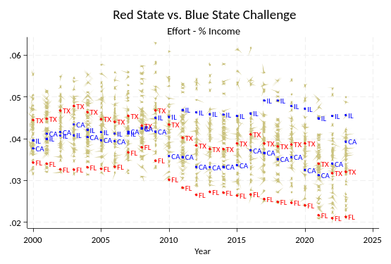
STATE TRENDS — RED STATE VS. BLUE STATE
Fiscal Effort: California, Illinois, Florida & Texas
Effort as % of gross state product, 2000–2024
Effort as % of state personal income, 2000–2024
SCHOOLFINANCE101.COM · SCHOOLFINANCEDATA.ORG
32

Slide 35
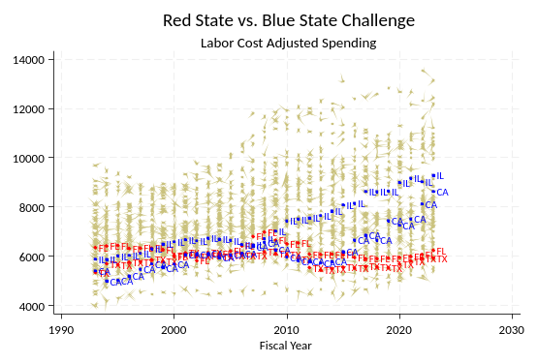
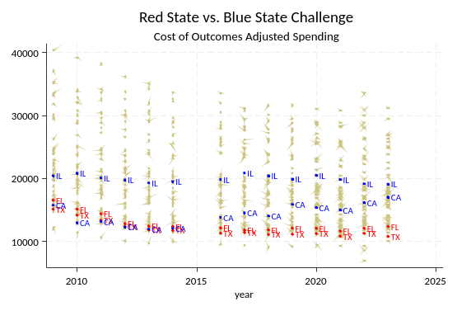
STATE TRENDS — RED STATE VS. BLUE STATE
Spending: California, Illinois, Florida & Texas
Labor-cost-adjusted per-pupil spending, 1990–2024
Cost-of-outcomes-adjusted per-pupil spending, 2010–2024
SCHOOLFINANCE101.COM · SCHOOLFINANCEDATA.ORG
33

Slide 36
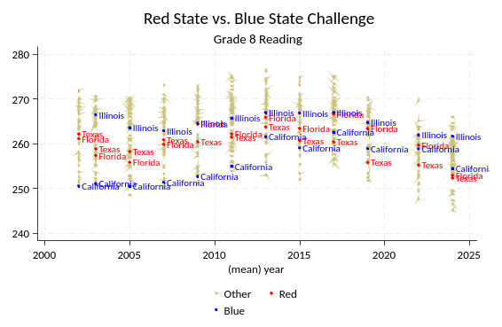
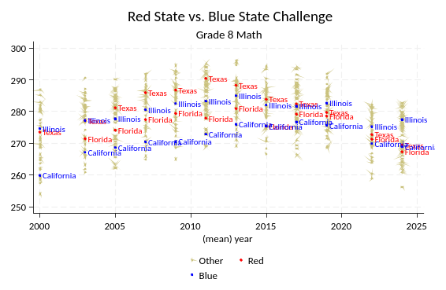
STATE TRENDS — RED STATE VS. BLUE STATE
Student Achievement: California, Illinois, Florida & Texas
Grade 8 NAEP reading, average scale score
Grade 8 NAEP math, average scale score
SCHOOLFINANCE101.COM · SCHOOLFINANCEDATA.ORG
34

Slide 37
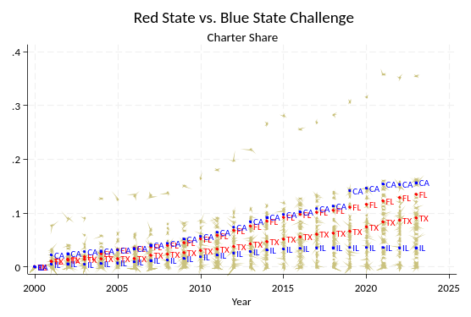
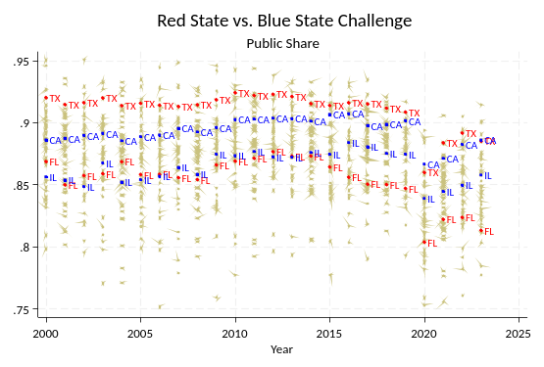
STATE TRENDS — RED STATE VS. BLUE STATE
Charter & Public Enrollment: California, Illinois, Florida & Texas
Statewide share enrolled in charter schools, 2000–2024
Statewide share enrolled in traditional public schools, 2000–2024
SCHOOLFINANCE101.COM · SCHOOLFINANCEDATA.ORG
35

Slide 38
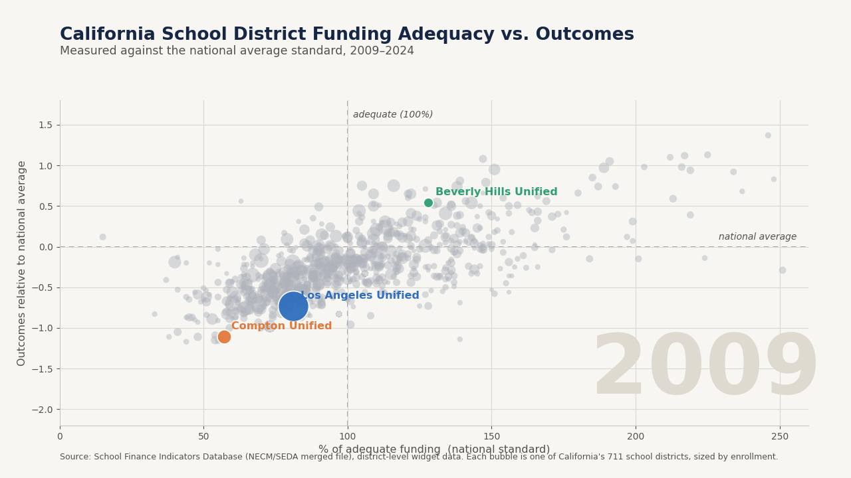

STATE TRENDS — CALIFORNIA
District Outcomes vs. Adequacy, 2009–2024
81% → 93%
LA Unified — adequacy for California's largest district, 2009 to 2024
128% → 184%
Beverly Hills Unified — well above adequate throughout, gap widening
57% → 74%
Compton Unified — outcome gap narrowed from −1.11 to −0.18
▶ 711 CA districts vs. national-average outcomes, enrollment-weighted, 2009–2024
Explore interactively
SCHOOLFINANCE101.COM · SCHOOLFINANCEDATA.ORG
36

Slide 39
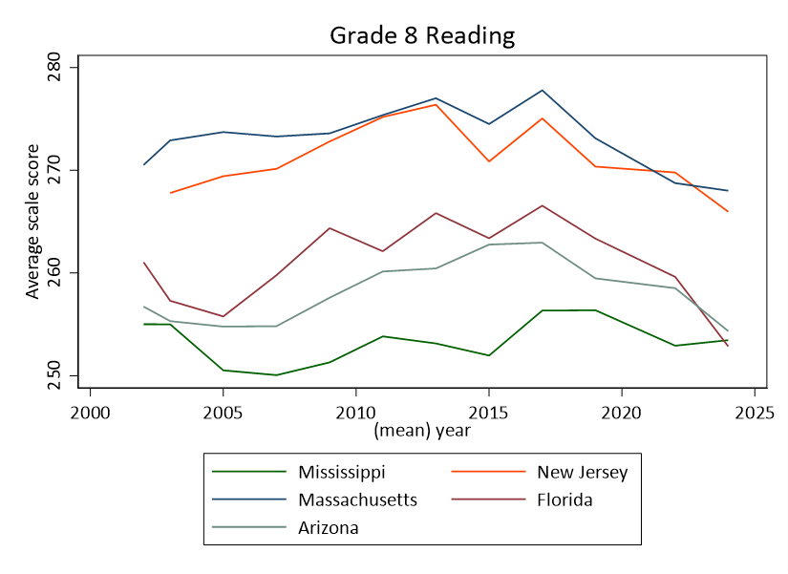
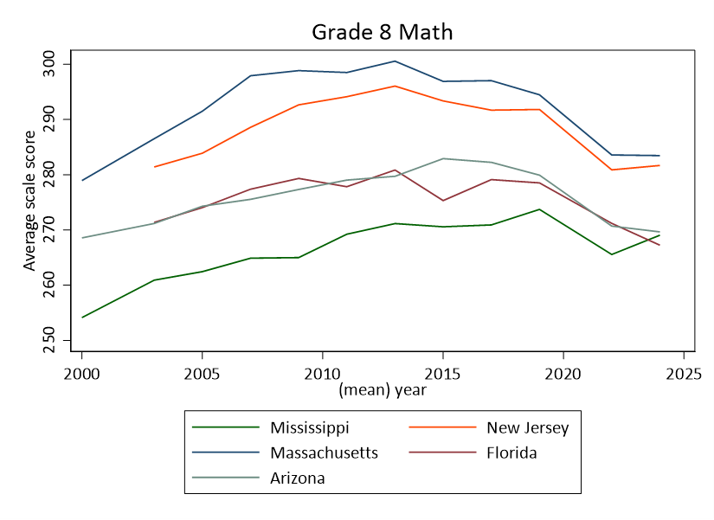
STATE TRENDS — THE SOUTH
Mississippi & the “Southern Surge”? Comparing MS, FL & AZ
Grade 8 NAEP reading, average scale score, 2000–2024
Grade 8 NAEP math, average scale score, 2000–2024
SCHOOLFINANCE101.COM · SCHOOLFINANCEDATA.ORG
37

Slide 40
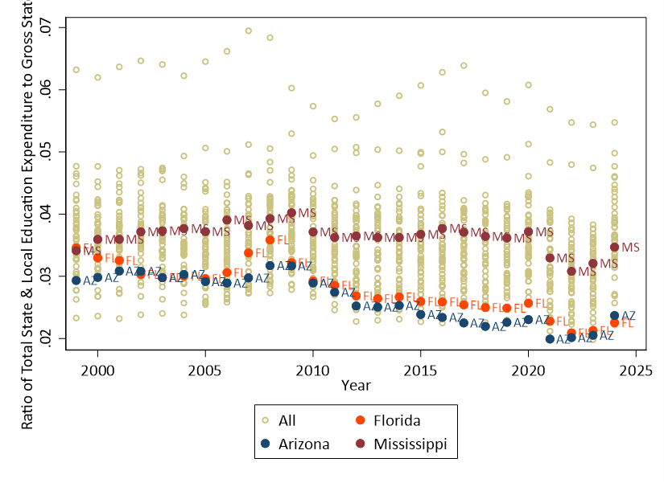
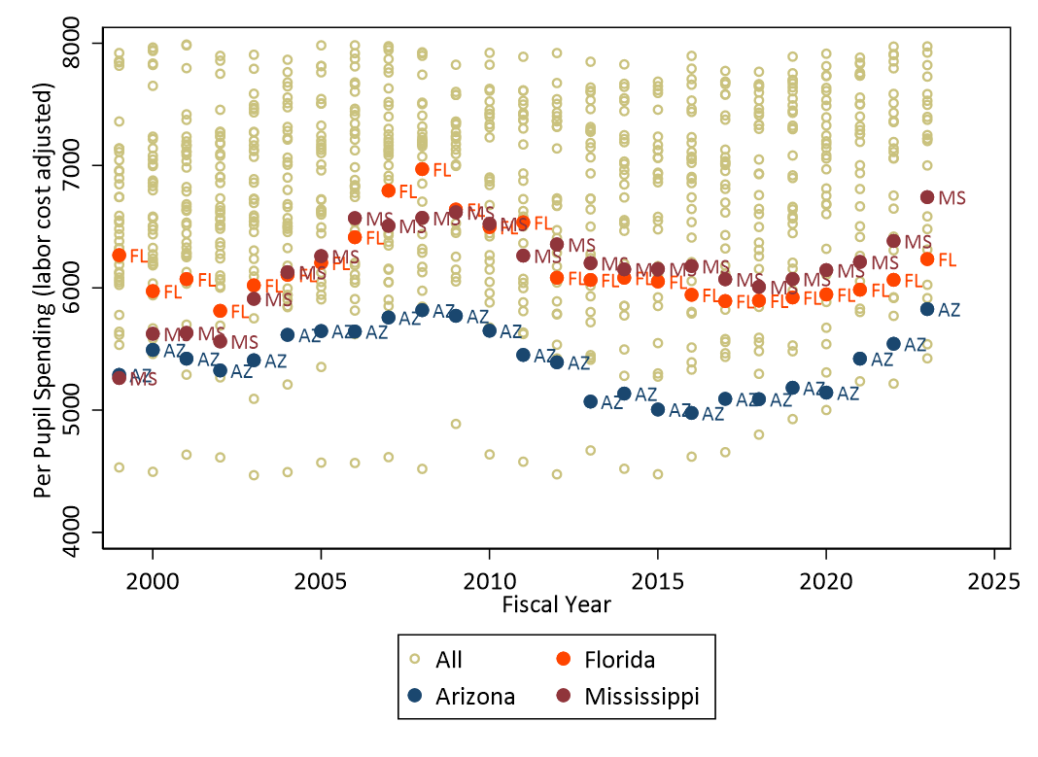
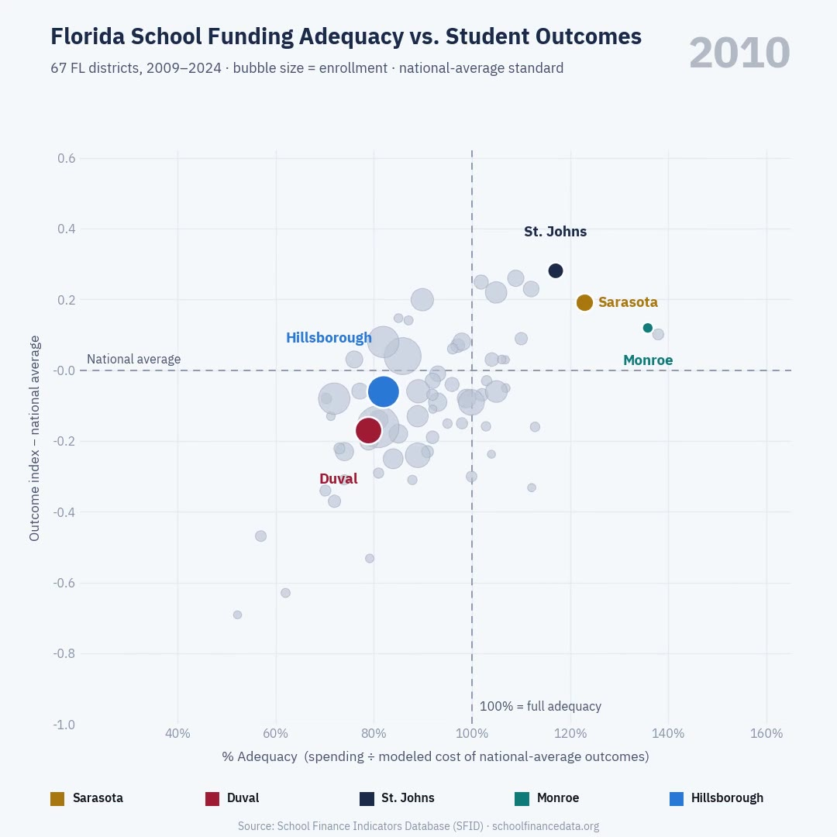
STATE TRENDS — THE SOUTH
Southern States: Effort & Spending
Effort: state & local revenue as % of gross state product
Labor-cost-adjusted per-pupil spending
▶ Florida district outcomes vs. adequacy, 2009–2024
SCHOOLFINANCE101.COM · SCHOOLFINANCEDATA.ORG
38

Slide 41
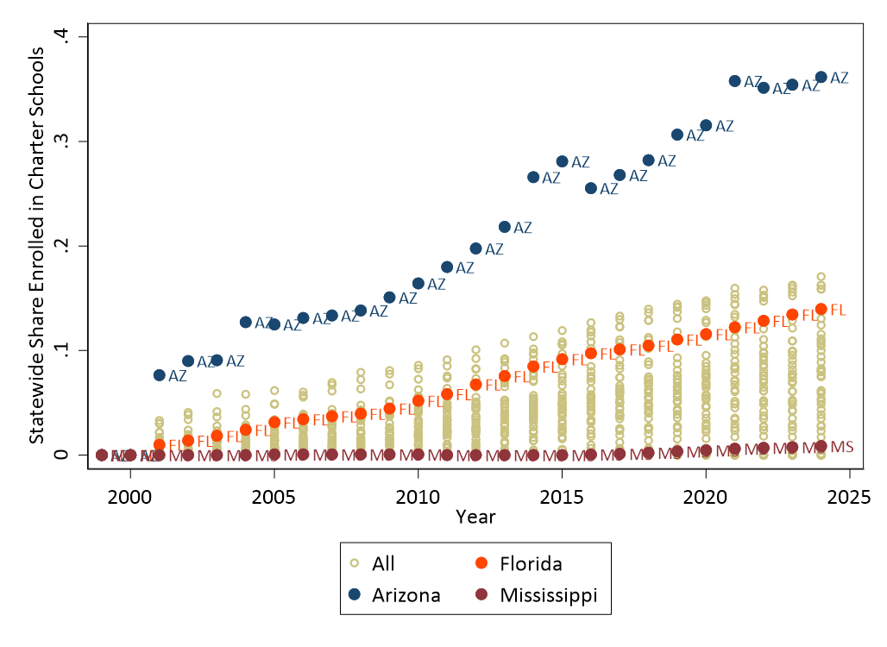
STATE TRENDS — THE SOUTH
Southern States: Charter Enrollment
Arizona's charter sector has grown far faster than Mississippi's or Florida's — one of several structural differences that complicate any simple comparison between the two states' NAEP trends.
SCHOOLFINANCE101.COM · SCHOOLFINANCEDATA.ORG
39

Slide 42
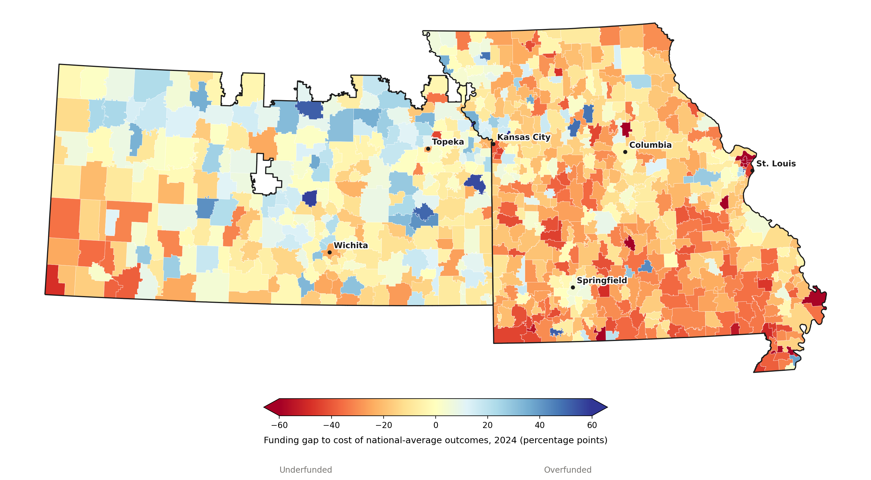

STATE TRENDS — KANSAS & MISSOURI
A Funding Gap Across a State Line
Funding gap to the cost of national-average outcomes, 2024
Missouri is substantially more underfunded than Kansas. Southern and eastern Missouri — especially near St. Louis — run consistently red, while much of Kansas sits close to neutral or blue. Jennings and Riverview Gardens are underfunded by 73 and 68 points; neighboring Clayton is overfunded by 85 — a 150+ point gap within one metro area.
98%
Kansas enrollment-weighted average · 52% of districts underfunded
85%
Missouri enrollment-weighted average · 83% of districts underfunded
Explore interactively
Funding gap = % Adequacy − 100. 9 recently-consolidated Kansas districts excluded for lack of a 2024 match. Source: NECM/SEDA merged file.
SCHOOLFINANCE101.COM · SCHOOLFINANCEDATA.ORG
40

Slide 43
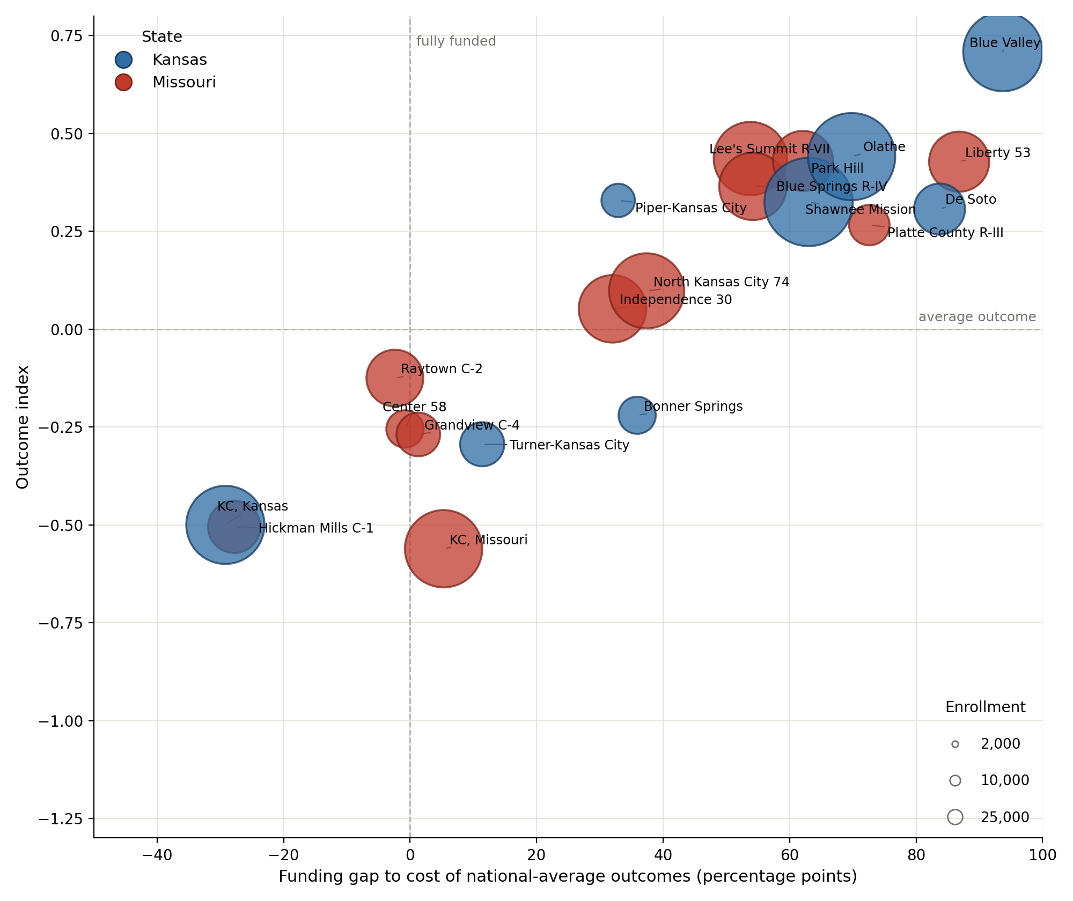

STATE TRENDS — KANSAS CITY METRO
Kansas City Metro: Funding vs. Outcomes
Funding gap vs. outcome index, enrollment-weighted, 2009
Funding gap vs. outcome index, enrollment-weighted, 2024
SCHOOLFINANCE101.COM · SCHOOLFINANCEDATA.ORG
41

Slide 44

STATE TRENDS — KANSAS CITY METRO
Watching the Shift, 2009–2024
KCMO: +5 → −40
Kansas City, Missouri's funding gap, 2009 to 2024
KCK: −29 → −23
Kansas City, Kansas — the only district in the cluster to improve
6 of 20
metro districts flipped from overfunded to underfunded since 2009
▶ Funding gap to the cost of national-average outcomes, by KC-metro district
SCHOOLFINANCE101.COM · SCHOOLFINANCEDATA.ORG
42

Slide 45

STATE TRENDS — SMALL CITIES
Small Cities Matter: Utica & Poughkeepsie, NY
New York's funding story is usually told through New York City and its wealthy suburbs. But the state's small legacy cities — high-poverty, low-wealth, and largely overlooked — often sit furthest from the adequacy standard.
666 New York districts plotted; small-city districts highlighted against the statewide average standard.
Utica and Poughkeepsie illustrate how small, high-poverty cities can trail both wealthy suburbs and rural districts.
▶ NY district outcomes vs. adequacy, small-city districts highlighted
SCHOOLFINANCE101.COM · SCHOOLFINANCEDATA.ORG
43

Slide 46
03
PART THREE
Setting the Record Straight
A handful of misleading graphs recur every year in every state. Here's why they're wrong — and what a fair comparison actually shows.
SCHOOLFINANCE101.COM · SCHOOLFINANCEDATA.ORG
44

Slide 47

COMMON MYTHS
Myth: The “Long-Term Trend” Graph
This graph — and nearly every state-specific version of it — shows per-pupil spending rising since a 2013 base year while NAEP scores fall from that same starting point. There's one for almost every state.
SCHOOLFINANCE101.COM · SCHOOLFINANCEDATA.ORG
45

Slide 48

COMMON MYTHS — WHY IT'S MISLEADING
Reason One: A Cherry-Picked Start Year
The graph starts in the very year NAEP scores begin to drop nationally — across every subject and grade level shown here, not just in Oregon.
SCHOOLFINANCE101.COM · SCHOOLFINANCEDATA.ORG
46

Slide 49

COMMON MYTHS — WHY IT'S MISLEADING
Reason Two: Ignoring the Recession's Lag
It also starts right around when funding losses from the Great Recession leveled off. Cuts made years earlier had lagged, negative effects on student outcomes that only showed up later.
SCHOOLFINANCE101.COM · SCHOOLFINANCEDATA.ORG
47

Slide 50

COMMON MYTHS — THE RECESSION EXPLANATION
Could Disappointing 2017 NAEP Scores Be Due to the Great Recession?
C. Kirabo Jackson's research: in the earlier period, as spending increased, so did outcomes — then came the recession.
C. Kirabo Jackson, “Could Disappointing 2017 NAEP Scores Be Due to the Great Recession?” educationnext.org
SCHOOLFINANCE101.COM · SCHOOLFINANCEDATA.ORG
48

Slide 51

COMMON MYTHS
Myth: The “Clouds of Doubt” Graph
This graph plots per-pupil spending against school proficiency rates with no adjustment for cost — intended to suggest that money doesn't buy outcomes, and that great results are achievable on a shoestring.
SCHOOLFINANCE101.COM · SCHOOLFINANCEDATA.ORG
49

Slide 52

COMMON MYTHS — THE FIX
What a Competent Comparison Looks Like
Adjust spending for the cost of achieving common outcomes, and the relationship flips: a clear, strong, positive relationship between resources and results.
SCHOOLFINANCE101.COM · SCHOOLFINANCEDATA.ORG
50

Slide 53

COMMON MYTHS — THE FIX
More Evidence: Funding Gaps Track Outcome Gaps
Districts spending further below the estimated cost of adequate outcomes also show larger outcome gaps — at both a statewide-average standard and a higher, +1 standard deviation, target.
SCHOOLFINANCE101.COM · SCHOOLFINANCEDATA.ORG
51

Slide 54
04
PART FOUR
The Road Ahead
Project 2029: what the evidence base suggests about analysis, risk, and the case for reinvestment.
SCHOOLFINANCE101.COM · SCHOOLFINANCEDATA.ORG
52

Slide 55
THE ROAD AHEAD — ANALYSIS
AI-Assisted Analysis of the District Cost Database
District income is the dominant level predictor of achievement — the single largest effect in the model — though the data can't yet speak to change over time.
The funding-adequacy gap is the strongest finance-related predictor of change: districts whose funding gap improves tend to see achievement rise.
Raw expenditure alone shows a small, sometimes counterintuitive relationship — a reminder that gross spending and adequacy-adjusted spending tell different stories.
Demographic composition remains significant net of other factors in every specification — plausibly partly compositional, and worth further unpacking.
Charter share shows a negligible relationship to achievement in this district-level analysis, in both levels and changes.
After further data cleaning, the core story held: income and the funding-adequacy gap remain the dominant predictors; nothing flipped sign in a concerning way.
Exploratory, AI-assisted statistical analysis of the SFID district cost database — not a peer-reviewed causal study.
SCHOOLFINANCE101.COM · SCHOOLFINANCEDATA.ORG
53

Slide 56
THE ROAD AHEAD — LEGAL RISK
Church-State Separation & Regulatory Authority at Risk
END GAME
If public financing exists for any private providers, religious providers can't be excluded from it.
This will include charter schools.
Even when receiving taxpayer financing, states may lose authority to regulate anything that conflicts with religious beliefs — including racially discriminatory admissions.
SCHOOLFINANCE101.COM · SCHOOLFINANCEDATA.ORG
54

Slide 57
THE ROAD AHEAD — POLICY DIRECTIONS
Directions from the National Report
Reinvestment in public PK–12 education systems
A new Reconstruction
A new federal aid program
Adequacy-based funding
State effort requirements
Guarding against unregulatable Christian nationalism
Reining in charter schooling
The risk of religious charter schools
Blurring lines between voucher and charter schooling
Clawing back vouchers
SCHOOLFINANCE101.COM · SCHOOLFINANCEDATA.ORG
55

Slide 58
THE ROAD AHEAD — DISCUSSION
Discussion: Messaging, Advocacy & Legal Strategy
Messaging & Public Advocacy
Distilling complicated school-finance messages for public impact.
Explaining the Trends
Why things feel worse — because, by these measures, they are.
Framing Legal Causes of Action
Understanding the intersection of federal statutory protections and state constitutional protections.
SCHOOLFINANCE101.COM · SCHOOLFINANCEDATA.ORG
56

Slide 59
APPENDIX
Explore the Data
Four interactive companion tools accompany this deck — every district, every year, searchable and exportable.
SCAN TO OPEN
SCAN TO OPEN
SCAN TO OPEN
SCAN TO OPEN
Connecticut District Explorer
Kansas & Missouri District Explorer
California District Explorer
Pennsylvania District Explorer
Every CT district's outcome vs. Massachusetts-benchmark adequacy, 2009–2024, with year slider and search.
707 KS/MO districts, toggle by state and by outcome standard, 2009–2024, with year slider and search.
711 CA districts, toggle between national and Massachusetts-average standards, 2009–2024, with year slider and search.
498 PA districts, toggle between national and Massachusetts-average standards, 2009–2024, with year slider and search.
Video companions embedded throughout this deck: Connecticut (Hartford & Bristol), New Jersey (Newark, Trenton & Millburn; plus a school-level view), Florida, the Kansas City metro, small-city New York (Utica & Poughkeepsie), California, Pennsylvania, and the Philadelphia metro district animations, 2009–2024.
SCHOOLFINANCE101.COM · SCHOOLFINANCEDATA.ORG
57

Slide 60
Thank You
Bruce D. Baker · University of Miami
SchoolFinance101.com · SchoolFinanceData.org
SOURCES
School Finance Indicators Database (Albert Shanker Institute · University of Miami · Rutgers GSE) · NECM/SEDA merged file · US Census TIGER/Line · C. Kirabo Jackson, EducationNext · State supreme/highest court rulings, compiled via legal research.
SCHOOLFINANCE101.COM · SCHOOLFINANCEDATA.ORG
58

