Slide 1

A ROADMAP FOR EQUAL EDUCATIONAL OPPORTUNITY
Reforming School Finance
in Connecticut
Bruce D. Baker
University of Miami
Prepared for the Governor's Commission on Education Funding · August 2026

Slide 2




WHAT THE RESEARCH SHOWS
Money Matters
A 2025 comprehensive review of the empirical literature confirms four consistent findings about school funding and student outcomes.
Money matters in both directions
Increases to school funding lead to improved student outcomes; decreases lead to worse outcomes.
Both operating and capital dollars matter
Operating dollars typically raise teacher wages and shrink class sizes; capital spending improves facilities, though with a longer lag before students benefit.
Money matters most where it's needed most
Additional dollars yield a several-fold larger return in previously low-spending and higher-poverty settings than in lower-poverty settings.
The source of the funding doesn't change the result
Legislative action, economic conditions, federal stimulus, local votes, or judicial orders — however new funding arrives, it improves outcomes.
REFORMING SCHOOL FINANCE IN CONNECTICUT
2
Beyond test scores, rigorous studies also link increased funding to higher educational attainment, higher adult income, lower mortality, and lower crime rates.

Slide 3
FRAMING THE PROBLEM
Goals of School Finance Systems
Provide all children — regardless of where they live or attend school — equal opportunity to achieve common, adequate outcome goals.
Providing equal opportunity costs different amounts in different settings, and across children by need and context.
State accountability systems set the common goals used to rate, rank, and evaluate schools.
A fair system funds what's sufficient to provide equal opportunity to meet those goals — goals often tied to state constitutional rights.
EQUITY
ADEQUACY
Equal opportunity
to achieve common
outcomes
Outcomes sufficient
for productive, engaged
citizenship
EQUAL
EDUCATIONAL
OPPORTUNITY
A well-designed funding system must:
Fully, publicly finance the cost of equal opportunity for every eligible child.
Raise revenue equitably and stably across institutions and settings.
REFORMING SCHOOL FINANCE IN CONNECTICUT
3

Slide 4
PART ONE
The Condition of Education
in Connecticut
Connecticut's average outcomes are strong — but the state has one of the least equitably funded public education systems in the nation.
REFORMING SCHOOL FINANCE IN CONNECTICUT
4

Slide 5

THE ADEQUACY & FAIRNESS OF STATE SCHOOL FINANCE SYSTEMS
Summaries from the National Report
EFFORT
STATEWIDE ADEQUACY
EQUAL EDUCATIONAL OPPORTUNITY
3.91%
156.6%
−148.1
of economic capacity devoted to K-12 schools — 0.78 points above the 3.13% U.S. average
the average CT student's district spends 56.6% above what's needed for national-average outcomes
opportunity-gap score (points); #1 would mean the most equal state
Rank #3 of 50
Rank #4 of 50
Rank #46 of 47
Connecticut's problem isn't spending capacity — it's how that spending is distributed. Source: schoolfinancedata.org/sites/default/files/data/profiles26_ct.pdf
REFORMING SCHOOL FINANCE IN CONNECTICUT
5

Slide 6


CT MIRROR OP-ED · BAKER, COTTO & GREEN
Recommendations from 2021
“Now is the time to fix Connecticut school finance” laid out a three-step process. Five years later, the state has taken none of these steps.
1
2
3
Study the need
Recalibrate the formula
Fund it
Conduct rigorous analyses: what is needed to achieve equal opportunity for all of the state's children to reach a sufficiently robust set of outcomes?
Redesign ECS to hit those cost targets through a) equitable local effort and b) sufficient state aid.
Raise sufficient tax revenues to support the system.
REFORMING SCHOOL FINANCE IN CONNECTICUT
6

Slide 7
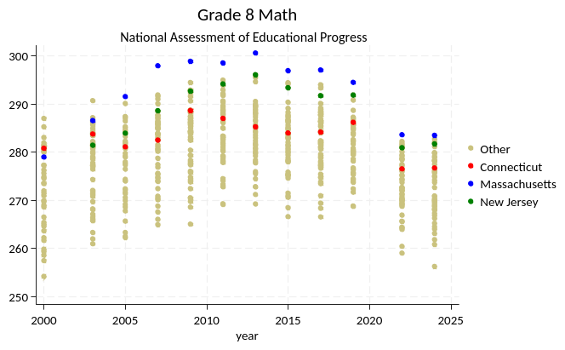
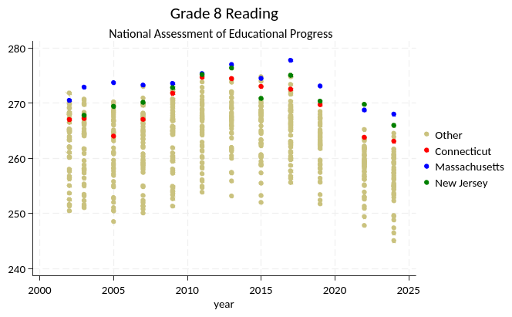
NATIONAL ASSESSMENT OF EDUCATIONAL PROGRESS, GRADE 8
CT Outcomes Are High — But Slipping vs. Peers
Connecticut's 8th-grade scores remain relatively high among all states, but the state trails its closest peers, Massachusetts and New Jersey, and has generally lost ground since the early 2010s.
Figure 1. Grade 8 Math
Figure 2. Grade 8 Reading
Source: National Assessment of Educational Progress (NAEP), U.S. Dept. of Education.
REFORMING SCHOOL FINANCE IN CONNECTICUT
7

Slide 8
METHODOLOGY
National Education Cost Model
Built from multiple years of data on schools and districts nationwide: 13,000 local education agencies, across 50 state systems, 12 years of data.
Identifies the statistical relationships in the diagram at right, using the best available state and federal data.
Projects the spending needed to achieve a given level of outcomes — across all children, and across all settings.
Student
Needs
Resource
Prices
Structural &
Geographic
Constraints
Cost
Measured
Student
Outcomes
Spending
+ Inefficiency
Efficiency
Controls
REFORMING SCHOOL FINANCE IN CONNECTICUT
8

Slide 9
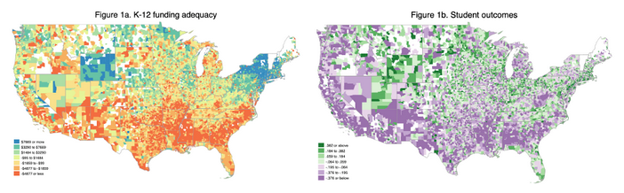
NATIONAL CONTEXT
Funding Gaps and Outcome Gaps Across the U.S.
K-12 funding adequacy (left) and student outcomes (right) both vary sharply by geography — and the two maps trace similar contours. Connecticut sits in a wealthy, high-adequacy region of the country, which is exactly why its internal inequities are so avoidable.
Figure 1a/1b. The Adequacy and Fairness of State School Finance Systems, 8th ed. (Baker, Di Carlo & Weber, 2026)
REFORMING SCHOOL FINANCE IN CONNECTICUT
9

Slide 10
CT WIDGET DATA · 142 DISTRICTS, 2009–2024
Connecticut's Funding Adequacy Has Eroded
Statewide, the average Connecticut district has gone from spending 45% above the level needed for national-average outcomes in 2009, to just 15% above it in 2024 — and the share of districts falling short of that bar has nearly tripled.
9.2% of districts (2009) → 25.4% (2024)
Statewide average adequacy ratio, by year
Share of CT districts spending below the funding level needed for national-average outcomes
Source: CT district finance & outcomes widget (% adequacy = current spending ÷ simulated cost of average outcomes).
REFORMING SCHOOL FINANCE IN CONNECTICUT
10

Slide 11
CT WIDGET DATA · 2024 SNAPSHOT
Where the Money Doesn't Match the Need
Each bubble is a Connecticut school district (bubble size = enrollment). Districts past 100% on the x-axis spend at or above what's needed for national-average outcomes; districts above 0 on the y-axis already outperform Massachusetts's average. The correlation between adequate funding and stronger outcomes is r = 0.74.
FOUR DISTRICTS
New Canaan
159% adequate · +0.91 outcome index
Low poverty; well above the adequacy bar and above MA's average outcomes.
Farmington
125% adequate · +0.53 outcome index
Comfortably funded, outcomes above the MA average.
New Britain
55% adequate · −1.67 outcome index
Barely half of what's needed; outcomes far below the MA average.
Bridgeport
41% adequate · −1.06 outcome index
The state's largest under-funded district by enrollment.
Source: CT district finance & outcomes widget, 2024. Bubble size = district enrollment.
REFORMING SCHOOL FINANCE IN CONNECTICUT
11

Slide 12
BAKER EEO BRIEF · TABLE 1
Four Districts, Two Realities
New Canaan spends more than double what it needs to hit the outcome target; Bridgeport spends about half. The gap between New Britain and Farmington is smaller in dollars but just as stark in results.
District | Current Spending / Pupil | % Free/Reduced Lunch | Spending as % of Adequacy Cost | Outcome Index
New Canaan | $27,979 | 0% | 221% | +1.02
Farmington | $23,030 | 16% | 174% | +0.78
New Britain | $24,023 | 76% | 77% | −1.31
Bridgeport | $20,514 | 81% | 50% | −0.93
Spending as % of Adequacy Cost (100% = target)
Outcome Index (0 = national average)
REFORMING SCHOOL FINANCE IN CONNECTICUT
12

Slide 13
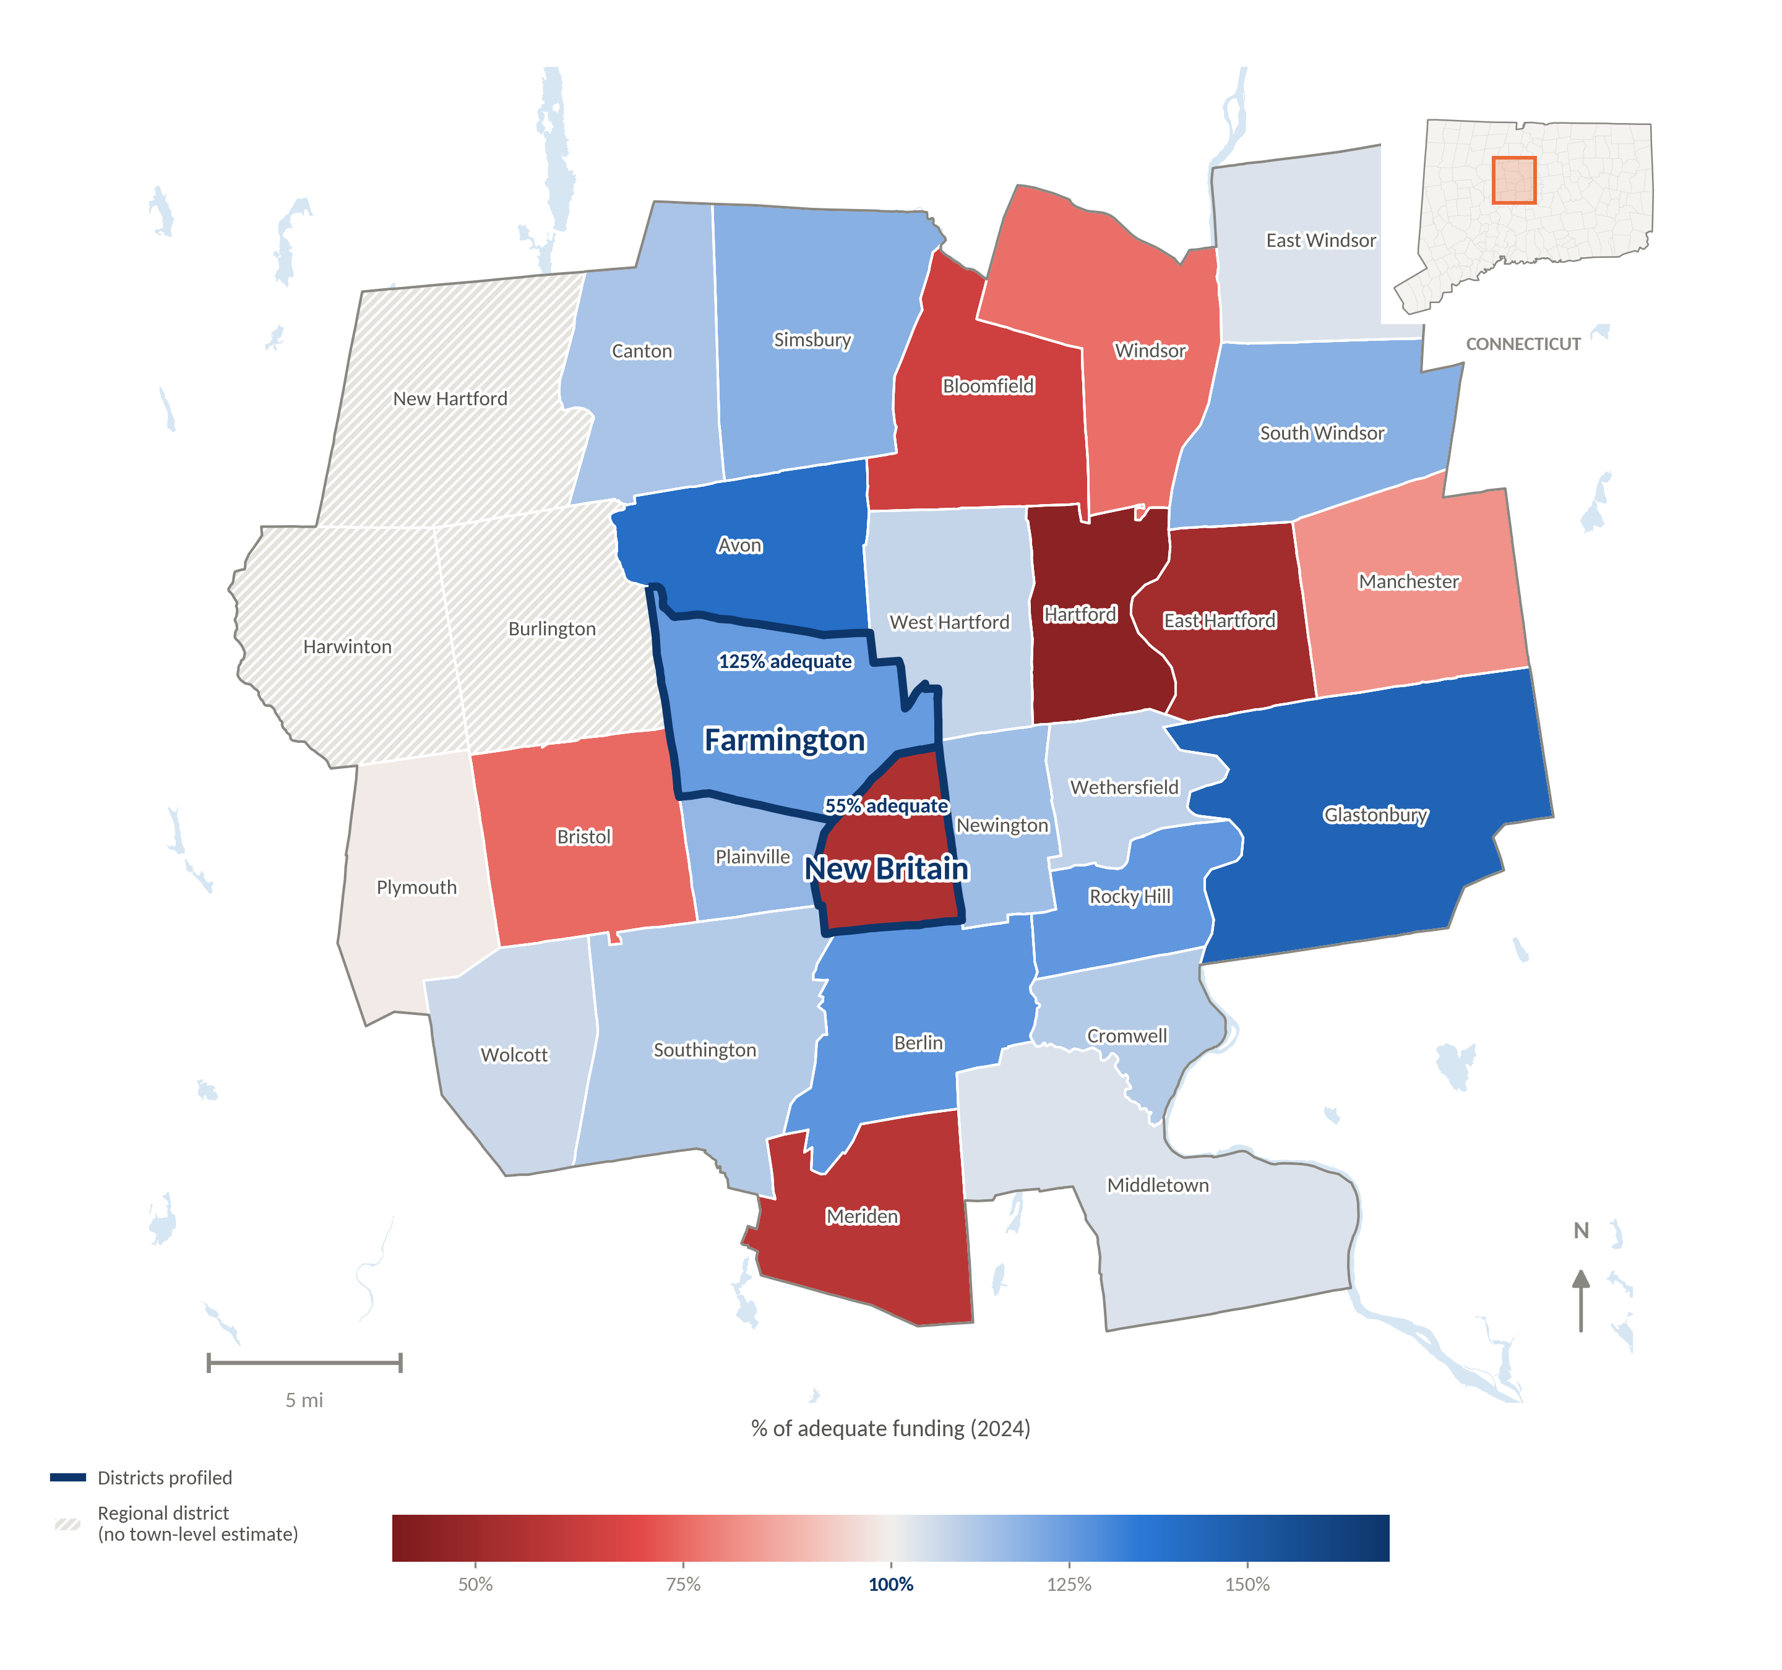
CT WIDGET DATA · HARTFORD AREA, 2024
The Hartford-Area Funding Divide
Farmington and New Britain sit less than ten miles apart, but Farmington spends 125% of what its students need while New Britain spends barely half — a gap that tracks town wealth, not need.
TWO DISTRICTS
Farmington
125% adequate · +0.53 outcome index
Comfortably funded, outcomes above the MA average.
New Britain
55% adequate · −1.67 outcome index
Barely half of what's needed; outcomes far below the MA average.
Source: CT district finance & outcomes widget, 2024. Town boundaries: U.S. Census TIGER/Line. % adequacy = current spending ÷ simulated cost model (100% = adequate).
REFORMING SCHOOL FINANCE IN CONNECTICUT
13

Slide 14
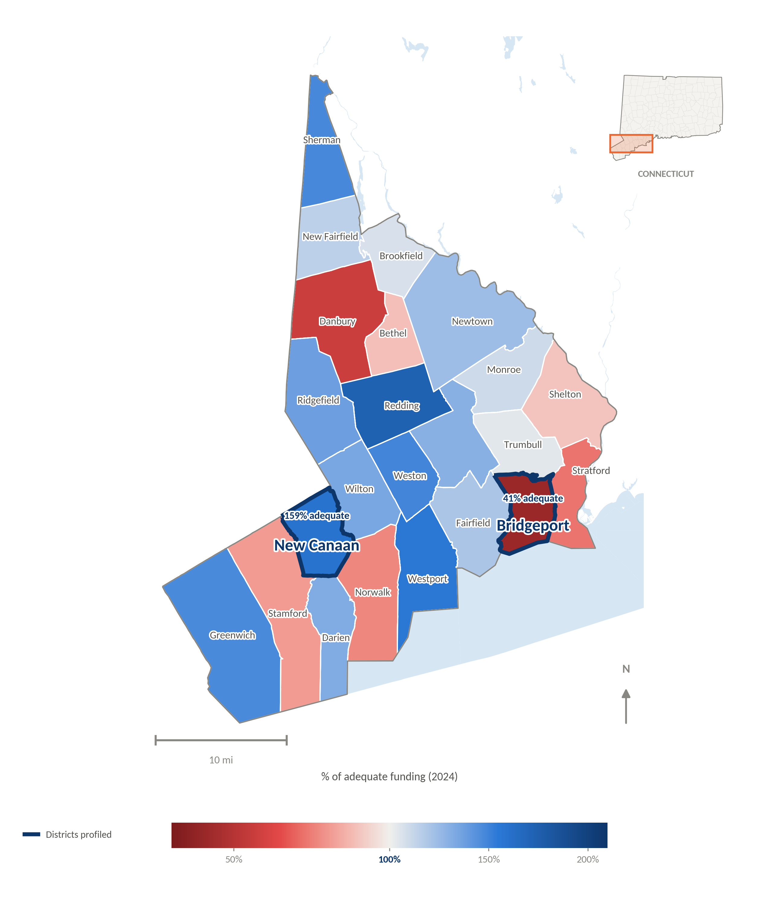
CT WIDGET DATA · FAIRFIELD COUNTY, 2024
Fairfield County's Funding Divide
Bridgeport and New Canaan sit in the same county, a 25-minute drive apart on the Merritt Parkway. New Canaan spends nearly four times the share of adequate funding that Bridgeport does.
TWO DISTRICTS
Bridgeport
41% adequate · −1.06 outcome index
The state's largest under-funded district by enrollment.
New Canaan
159% adequate · +0.91 outcome index
Low poverty; well above the adequacy bar and above MA's average outcomes.
Source: CT district finance & outcomes widget, 2024. Town boundaries: U.S. Census TIGER/Line. % adequacy = current spending ÷ simulated cost model (100% = adequate).
REFORMING SCHOOL FINANCE IN CONNECTICUT
14

Slide 15

Who is left in the lower-left corner?
“Every district in the lower left-hand corner — the least adequate spending and the lowest outcomes — is either majority Hispanic, majority Black, or a majority combination of the two.”
— Baker, Equal Educational Opportunity Problem brief, 2026
~50%
By 2023, the highest-poverty quintile of Connecticut districts was nearly 50% Hispanic on average — and that share has grown over time.
2021 → today
Baker, Cotto & Green warned of this systematic deprivation in a 2021 CT Mirror op-ed. Five years on, it has not changed — it has gotten worse.
REFORMING SCHOOL FINANCE IN CONNECTICUT
15

Slide 16
CT WIDGET DATA · 2009 VS. 2024
The Gap Has Widened, Not Narrowed
The same funding–outcome relationship holds in both years — but the entire cloud of Connecticut districts has drifted left (less adequately funded) over fifteen years.
2009
avg. adequacy 145.1%
2024
avg. adequacy 115%
Source: CT district finance & outcomes widget. Bubble size = district enrollment.
REFORMING SCHOOL FINANCE IN CONNECTICUT
16

Slide 17
PART TWO
How to Fix the Problem
In April 2026, Governor Lamont established a commission to reevaluate education funding. This is where that process should start.
REFORMING SCHOOL FINANCE IN CONNECTICUT
17

Slide 18





WHAT THE 2027 STUDY MUST COVER
Template Language for the RFP
The Governor's Commission should request a rigorous, independent study in 2027 to inform an overhaul of ECS in the 2028 legislative session.
Engage multiple constituencies
Estimate the full cost
Model rising or shifting standards
to determine desired outcomes and the programs/services needed to reach them.
comprehensively, for all children to meet the proposed standards.
and how costs change as expectations broaden or narrow.
Measure differences in student need
Account for school & district context
Adjust for regional wage differences
and how those needs drive cost.
scale, remoteness, sparsity, and grade ranges served.
in the competitive wages required to staff schools.
Produce per-pupil cost estimates
Evaluate current efficiency
Recommend a new formula
at the school and district level, net of all relevant programs and services.
of how districts and schools organize resources today.
reforming or replacing ECS to cover the cost of adequate outcomes.
REFORMING SCHOOL FINANCE IN CONNECTICUT
18

Slide 19

PROPOSED SEQUENCE
Path to a New Formula
2026
2027
2028 Session
Fall 2028
Governor's Commission convenes; RFP language finalized
Independent cost study conducted statewide
Legislature overhauls or replaces ECS using study findings
New formula begins phase-in
“It has now been 12 years since I first laid out the plight of majority-Hispanic Connecticut school districts. An entire cohort of children has passed from Grade 1 to 12 in that time — with conditions only worsening.”
REFORMING SCHOOL FINANCE IN CONNECTICUT
19

Slide 20
PART THREE
Applications of Education
Cost Modeling
How the same methodology has been used to reform funding formulas in Delaware, Oregon, Colorado, and beyond — select states.
REFORMING SCHOOL FINANCE IN CONNECTICUT
20

Slide 21

HOW THE COST MODEL IS BUILT
Framework for Outcome-Oriented Analysis
1a
1b
Needs (Risk) Analysis
Spending Analysis
Identify which student and community characteristics explain differences in outcomes.
Model what districts actually spend today, given context, fiscal capacity, and tastes.
2a
2b
Cost Modeling
Calibrating Formulas
Estimate what spending should be to hit outcome targets, net of inefficiency.
Translate modeled costs into state and local funding shares by student and district characteristics.
Needs and spending analysis (top) describe what is; cost modeling and formula calibration (bottom) prescribe what should be.
REFORMING SCHOOL FINANCE IN CONNECTICUT
21

Slide 22
OUTCOMES, SPENDING & EFFICIENCY
Selecting Measures
Recent and ongoing studies converge on four categories of measures.
Outcomes
Instruments
ELA & math assessments
Absenteeism
Cohort graduation & advanced diplomas
Dropout rates
Neighboring-district outcomes & demographics
Income/poverty ratio
Racial composition
Adult education levels
Spending Measures
Efficiency Measures
Annual operating expenditures per pupil
Excludes debt service & tuition transfers
Fiscal capacity (relative income, taxable wealth)
Public monitoring (demographics, aid share)
Competition density (market share)
[1] Weighted factor score via structural equation modeling. [2] Neighbor = other districts in the same labor-market area, or nearest schools outside the district. Source: Recent & ongoing NECM studies.
REFORMING SCHOOL FINANCE IN CONNECTICUT
22

Slide 23


WHAT DRIVES THE COST OF ADEQUACY
Identifying Student Needs & Context Measures
Need measures should explain the largest share of variation in outcomes; context measures capture how institutional, geographic, and labor-market factors shift the cost of meeting a given standard.
Individual Needs
Collective Needs
Institutional / Structural
English learners (by proficiency level)
Disability, by severity
Child poverty & income/poverty ratio
Racial isolation
Homelessness, migrant students
Grade-range distribution
Enrollment size / scale
Geographic Location
Input Prices
Population & enrollment sparsity
Regional comparable wage index for teachers
REFORMING SCHOOL FINANCE IN CONNECTICUT
23

Slide 24
FROM COST MODEL TO FORMULA WEIGHT
Delaware Example
2a
Estimate Cost Models
2b
Convert to Formula Weights
OTHER DELAWARE WEIGHTS
Students with disabilities: 3.40–3.75×
English learners: 1.15×
Vocational/technical programming: 4.58×
Run the cost function on Delaware's own school and district data.
Translate modeled cost differences into per-pupil funding weights.
79%
Low-income students should be funded about 79% higher than students who are not low-income — the estimated weight from Delaware's cost model, applied directly to its funding formula.
higher
Source: Assessment of Delaware Public School Funding, Exhibit 50 (Atchison, Baker, Levin, et al., 2023). Weights are exponentiated Poisson regression coefficients using an average-outcomes target.
REFORMING SCHOOL FINANCE IN CONNECTICUT
24

Slide 25

STATE COST-MODELING STUDIES, 2024–2025
More Recent Findings — Oregon & Colorado
Oregon
Colorado
Understanding the Cost of Providing Adequate Educational Opportunity in Oregon (Brooks, Levin, Baker & Salvato, 2025)
Equity and Adequacy of Colorado School Funding: A Cost-Modeling Approach (Atchison et al., 2024)
KEY FINDING
KEY FINDING
Actual spending profiles are strikingly flat relative to student economic disadvantage — a clear lack of progressivity in how dollars are currently distributed.
Spending profiles for low-income students and students with disabilities are non-monotonic — funding does not consistently increase with need.
olis.oregonlegislature.gov
cde.state.co.us
REFORMING SCHOOL FINANCE IN CONNECTICUT
25

Slide 26
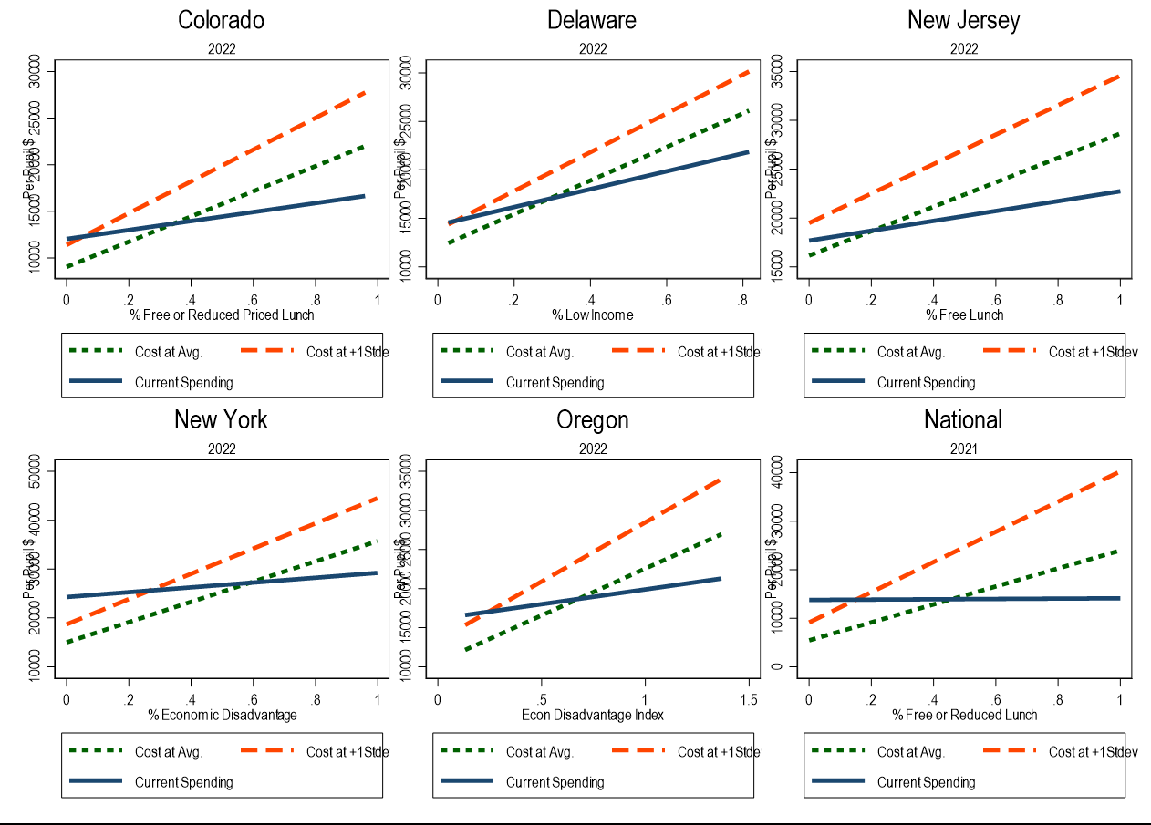
COLORADO · DELAWARE · NEW JERSEY · NEW YORK · OREGON (AND THE NATION)
Comparing School-Level Models Across Five States
The same cost-function approach — current spending vs. the cost of average and above-average outcomes, plotted against student economic disadvantage — replicates across states with very different funding systems.
REFORMING SCHOOL FINANCE IN CONNECTICUT
26

Slide 27
RECONCILING TWO TRADITIONS
Elements of a Comprehensive Study
1
Education Cost Model (ECM)
Estimate base per-pupil cost of adequacy, plus adjustments for need, price, scale, and context.
2
Identify Efficient Schools & Districts
Use the ECM to find schools/districts operating above, below, and at average efficiency; build resource & staffing profiles for each.
3
Resource Cost Model
Convene Professional Judgment Panels of practitioners to propose resource configurations that meet outcome goals, including civic, arts, and mental-health needs.
4
Reconciliation & Formula Development
Compare and reconcile findings from steps 1–3 into a single funding formula.
Outcome-oriented (cost function modeling)
Input-oriented (professional judgment)
REFORMING SCHOOL FINANCE IN CONNECTICUT
27

Slide 28
SELECTED BIBLIOGRAPHY
Recent Applications of Cost Modeling
PEER-REVIEWED ARTICLES & WORKING PAPERS
PROFESSIONAL REPORTS
Baker, B. D. (2024). How and Why Racial Isolation Affects Education Costs & the Provision of Equal Educational Opportunity. EdWorkingPaper No. 24-1047, Annenberg Institute, Brown University.
Baker, B. D., Weber, M., & Srikanth, A. (2021). Informing Federal School Finance Policy with Empirical Evidence. Journal of Education Finance, 47(1), 1-25.
Levin, J., Baker, B., Lee, J., Atchison, D., & Kelchen, R. (2022). An Examination of the Costs of Texas Community Colleges. REL 2023-142.
Kolbe, T., Baker, B. D., Atchison, D., Levin, J., & Harris, P. (2021). The additional cost of operating rural schools: Evidence from Vermont. AERA Open, 7.
Zhao, B. (2022). Estimating the cost function of Connecticut public K-12 education. Education Economics, 31(4), 439-470.
Gronberg, T. J., Jansen, D. W., & Taylor, L. L. (2017). Are charters the best alternative? Southern Economic Journal, 83(3), 721-743.
Colorado — Atchison, Levin, Levin, Kolar, Blair, Srikanth & Salvato (2024). Equity and Adequacy of Colorado School Funding.
Delaware — Atchison, Baker, Levin, Fatima, Trauth, Srikanth, Herberle, Gannon-Slater, Junk, Wallace & Baker (2023). Assessment of Delaware Public School Funding.
New Hampshire — Atchison, Baker, Levin & Kearns (2020). NH Commission to Study School Funding, Final Report.
Ohio — Levin, Brooks, Baker, Fatima, Blair, Salvato, Srikanth, London, Atchison, Jacobson, Hadley, Dotson, Harrington & Yeshitla (2025). Study of the Educational Costs of Serving Economically Disadvantaged Students.
Oregon — Brooks, Levin, Baker & Salvato (2025). Understanding the Cost of Providing Adequate Educational Opportunity in Oregon.
Vermont — Kolbe, Baker, Atchison & Levin (2019). Pupil Weighting Factors Report.
Nine states, one consistent methodology — the National Education Cost Model has now informed funding studies from coast to coast.
REFORMING SCHOOL FINANCE IN CONNECTICUT
28

Slide 29
FROM RESEARCH TO FORMULA
Policy Influence of Cost Modeling Studies
Formula Changes
Other State Uses
Texas Community College Formula — Levin, Baker, Lee, Atchison & Kelchen (2022), REL 2023-142.
Vermont K-12 Formula Weights — Kolbe, Baker, Atchison & Levin (2019), State of Vermont House & Senate Education Committees.
Kansas School Funding
Virginia Joint Legislative Audit & Review Commission Report — jlarc.virginia.gov
Missouri Department of Elementary & Secondary Education Report — dese.mo.gov
Connecticut's Governor's Commission can follow the same path: an independent cost study, translated directly into formula weights the legislature adopts.
REFORMING SCHOOL FINANCE IN CONNECTICUT
29

Slide 30
THE BOTTOM LINE
Connecticut is wealthy enough to fix this.
Study the need — a rigorous, independent cost study in 2027.
Recalibrate the formula — redesign ECS around the study's cost targets by the 2028 session.
Fund it — raise the tax revenue the system requires, and begin phase-in by Fall 2028.
Bruce D. Baker · University of Miami · Prepared for the Governor's Commission on Education Funding
REFORMING SCHOOL FINANCE IN CONNECTICUT
30

