Slide 1
POLICY BRIEF · NEW YORK STATE SCHOOL FINANCE
Fixing New York's
Foundation Aid Formula
Foundation Aid at 20: The Need for Cost-Based Reform
Bruce D. Baker
University of Miami, School of Education & Human Development
August 2026

Slide 2
FRAMING THE PROBLEM
What School Finance Systems Are For
01
Equal opportunity, not equal spending
Provide every child — regardless of where they live or attend school — an equal opportunity to achieve common, adequate outcome goals.
02
Costs are not uniform
Providing that equal opportunity costs different amounts in different settings, and for different children, individually and collectively, depending on their needs and context.
03
Accountability sets the bar
State accountability systems set common goals and rate, rank, and evaluate schools against them — goals often used to define constitutional rights to education.
04
Funding must match the goal
A fair finance system requires funding sufficient to provide equal opportunity to meet these common goals — for every district, not just some.
Foundation Aid at 20 | Bruce D. Baker, University of Miami
2

Slide 3
FRAMING THE PROBLEM
Basic Principles of “Cost” and “Equal Opportunity”
1
2
3
Higher outcomes cost more
Some children cost more to educate
Some settings cost more
All else equal, the per-pupil spending required to achieve higher and broader outcome goals is greater than the spending required to achieve narrower, lower goals.
Collective, social-context effects (concentrated poverty) and specific student needs (English learners, students with disabilities) raise the cost of reaching the same outcomes.
Economies of scale in small, sparsely populated, remote districts, and regional variation in the competitiveness of wages, both raise the cost of equal opportunity.
Foundation Aid at 20 | Bruce D. Baker, University of Miami
3

Slide 4
FRAMING THE PROBLEM
Two Ways to Measure Educational Cost
1
2
Outcome-Oriented
Input-Oriented
Education Cost Function Analysis
Resource Cost / Ingredients Method
Evaluate aggregate spending per student as a function of student outcomes and cost factors — need, labor price levels, scale of operations, and other institutional characteristics.
Determine the personnel and non-personnel resources — and their corresponding costs — associated with the educational services used to generate student outcomes.
Duncombe & Yinger, 2011; Levin et al., 2022
Levin et al., 2018; Baker & Morphew, 2007
Both approaches are used, in combination, to inform the cost-model findings presented later in this deck.
Foundation Aid at 20 | Bruce D. Baker, University of Miami
4

Slide 5
PART ONE
What's Wrong with New York's
Foundation Aid Formula?
Foundation Aid at 20 | Bruce D. Baker, University of Miami
5

Slide 6
HOW THE FORMULA WORKS
The Core Calculation
Adj. Foundation Amount ≈ Sound Basic Funding
How the Base is built
GEIE = IE − SEIE
Deflated GEIE = GEIE / PNI / RCI
Base = Avg. Deflated GEIE of
“Successful,” “Efficient” Districts
Base × PNI × RCI × TAFPU ≈ Sound Basic Funding
Note: PNI (pupil need) and TAFPU (weighted pupil count) components were never grounded in an empirical cost analysis — only the Base draws, however imperfectly, on real spending data.
Foundation Aid at 20 | Bruce D. Baker, University of Miami
6

Slide 7
HOW THE FORMULA WORKS
None of the Required Conditions Are Met
✕
Required: Instructional spending is all a district needs to operate.
Reality: Instructional spending is only ~65% (national) to ~75% (New York) of current operating expense — the rest is left unfunded by the formula's design.
✕
Required: PNI and RCI rest on thorough cost analyses.
Reality: No empirical analysis was ever provided to validate the weights on the components of the Pupil Need Index, by the rigorous methods of the day.
✕
Required: Special-education spending removed from the Base is restored via TAFPU.
Reality: No empirical analysis was ever provided to validate the weights on children with disabilities embedded in TAFPU.
Foundation Aid at 20 | Bruce D. Baker, University of Miami
7

Slide 8
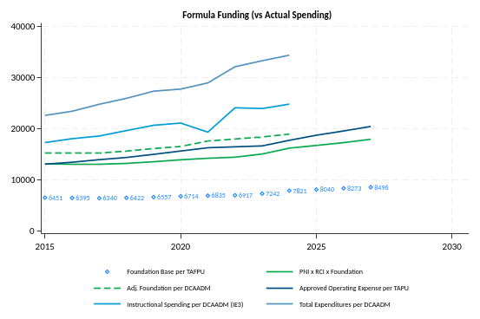
THE WIDENING GAP
Formula Funding Has Drifted from Reality
Even instructional spending alone now outpaces what the formula presumes adequate — by several thousand dollars per pupil.
Total operating spending has pulled even further away from the formula's implicit budget.
Figure 4. Foundation Aid Funding in Context
Foundation Aid at 20 | Bruce D. Baker, University of Miami
8

Slide 9
THE WIDENING GAP
The Base Has Fallen Far Behind
Recalculating the Foundation Aid base using districts' actual instructional-spending growth (2015–2027) tells a very different story than the adopted base.
$8,496
$10,229–
$13,795
$5,000–
$10,000
FY 2027 adopted Foundation Aid base per pupil
What the base should be, recalculated from actual instructional-spending growth for successful districts
Per-pupil gap between the formula's own implicit adequacy target and actual funding by 2027
For Poughkeepsie specifically: the gap between actual and corrected Foundation Aid reaches roughly $10,000 per pupil by 2027 — nearly double the average gap across the eight tracked small city districts.
Foundation Aid at 20 | Bruce D. Baker, University of Miami
9

Slide 10
PART TWO
Preliminary Insights from
Cost Modeling
Foundation Aid at 20 | Bruce D. Baker, University of Miami
10

Slide 11
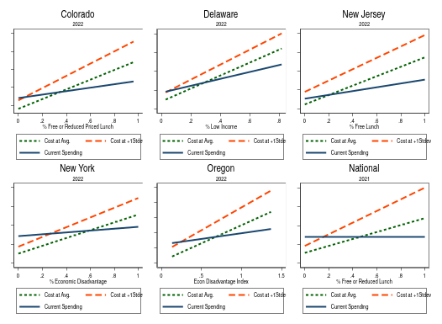
EMPIRICAL COST MODELING
New York's Funding Isn't Progressive Enough
.877
Correlation between New York's state-specific cost model and the National Education Cost Model
Cost models across five states and the nation agree: the cost of equal opportunity rises faster with student poverty than current spending does.
Figure 8. Current spending vs. modeled cost, by child poverty — six states + national
Foundation Aid at 20 | Bruce D. Baker, University of Miami
11

Slide 12
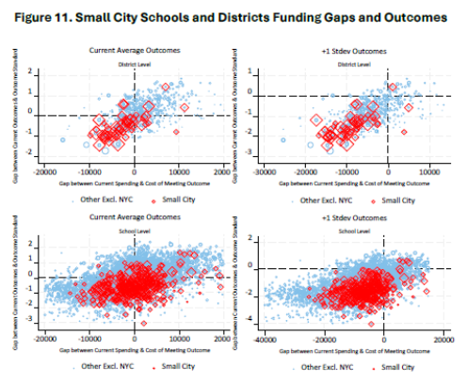
SMALL CITY DISTRICTS
Small City Districts Are Underfunded
46 of 57
small city districts spend below the cost of achieving current state-average outcomes
54 of 57
small city districts spend below the cost of achieving a higher outcome standard — gaps exceeding $15,000 per pupil in some districts
Districts with more adequate funding post higher outcomes than those with less — at every level examined.
Foundation Aid at 20 | Bruce D. Baker, University of Miami
12

Slide 13
WHERE THIS LEAVES US
Three Conclusions
01
The calculation is disconnected from cost.
The formula's method and measures do not rationally determine what districts need to spend — or what they actually spend — to achieve adequate outcomes.
02
The gap keeps growing.
The foundation formula has continued to drift further, over time, from funding even its own (already inadequate) hypothetical sound-basic-funding level.
03
Expectations have changed; the formula hasn't.
Standards, goals, and the context of the education system have changed — broader and higher expectations, alongside greater needs and cost pressures statewide.
Foundation Aid at 20 | Bruce D. Baker, University of Miami
13

Slide 14
WHAT NEW YORK SHOULD DO
Recommendations
Short Term
Longer Term
• Raise the base to reflect actual instructional spending of successful, efficient districts — a minimum of 10.75% above next year's inflation-adjusted base.
• Add and increase student-need adjustments — including for homeless, foster-care, and migrant students — and raise the English-learner weight, moving each toward 1.0 additional funding.
Over the next year and a half — with intent to reform Foundation Aid for FY 2028 — the state should conduct a rigorous, independent analysis of the spending required to achieve current, desired outcome goals for all children, in every school and district statewide.
Foundation Aid at 20 | Bruce D. Baker, University of Miami
14

Slide 15
THE ASK
Commission a Rigorous Cost Study
in the FY 2028 Budget
to inform an overhaul or replacement of the Foundation Aid formula for FY 2029.
1
Engage multiple constituencies to determine desired outcomes and the programs and services needed to provide every child equal educational opportunity.
2
Produce a comprehensive, inclusive estimate of the cost for all children to meet those standards — accounting for student needs, district structure, geography, and regional wages.
3
Deliver school- and district-level per-pupil cost estimates, and recommendations for reforming or replacing Foundation Aid to meet the needs of every school and district.
Foundation Aid at 20 | Bruce D. Baker, University of Miami
15

Slide 16
LEARN MORE
Additional Resources
AIR Equity Analysis Report (October 2024)
AIR Student Outcomes and Student Needs Report (October 2024)
Bruce D. Baker
AIR Using Cost Modeling to Inform School Funding Policies Report (November 2024)
University of Miami
School of Education &
Human Development
AIR's Review of the Rockefeller Report (December 2024)
AIR's Equity Issues in Raising Revenue Report (January 2025)
Companion policy brief:
“Foundation Aid at 20: The Need for Cost-Based Reform”
August 2026
AIR's Review of the 2025-26 Executive Budget Projections (February 2025)
Full bulletins and reports: cee.tc.columbia.edu/ny-school-funding-project
Foundation Aid at 20 | Bruce D. Baker, University of Miami
16

