Slide 1

SCHOOL FINANCE 101 · POLICY BRIEFING
New Jersey's Equal
Educational Opportunity Problem
198% → 147%
Statewide adequacy, National standard
132% → 98%
Statewide adequacy, Massachusetts standard
Why the state's school funding formula is falling further behind — and what fixing it would require
13% → 41%
STATEWIDE ADEQUACY (MASSACHUSETTS STANDARD), 2009–2024
Districts below the MA standard since 2009
Bruce D. Baker
University of Miami · Co-Director, School Finance Indicators Database
Saturday, September 5, 2026

Slide 2
INTRODUCTION
From Abbott v. Burke to SFRA
1985
The New Jersey Supreme Court's Abbott v. Burke decisions begin: large funding gaps between rich and poor districts are found to violate the state constitution's “thorough and efficient” clause.
1985–2007
A generation of Abbott-era remedies reshapes aid for the state's 31 highest-poverty districts, but leaves the rest of the state's formula untouched.
Jan. 2008
New Jersey replaces Abbott-era remedies with the School Funding Reform Act (SFRA) — one weighted student-funding formula for every district statewide, sized to the actual cost of educating different student populations.
Source: N.J. Supreme Court, Abbott v. Burke line of decisions; N.J.S.A. 18A:7F-43 et seq. (SFRA, 2008).
NEW JERSEY'S EQUAL EDUCATIONAL OPPORTUNITY PROBLEM
2

Slide 3
INTRODUCTION
How SFRA's Formula Works
Three steps set every district's state aid target.
1
2
3
Base amount
Weighted enrollment
Adequacy budget
The revenue needed to educate an English-proficient elementary student without economic disadvantage.
Add a cost weight to every student for what they need: poverty, English-learner status, grade level, special education, county vocational.
Weighted enrollment × base amount sets the target; a Local Fair Share (property value + income) sets required local tax effort; state aid is meant to cover the rest.
$12,451
0.47–0.57 / 0.50 / 0.15
State aid
per pupil (2023)
poverty / ELL / HS grade weights
= adequacy budget − local fair share
Source: Baker, B. & Weber, M., “Unlocking Academic Success,” New Jersey Policy Perspective, Sept. 2023.
NEW JERSEY'S EQUAL EDUCATIONAL OPPORTUNITY PROBLEM
3

Slide 4
INTRODUCTION
Has SFRA Delivered?
Two independent New Jersey Policy Perspective analyses say no.
100,000+ ³
21% ⁴
$3.5B ⁴
NJ students attended schools funded more than $5,000/pupil below their own SFRA target, 2018
actual extra funding for low-income students, vs. the 47–57% SFRA's own weights call for
estimated statewide annual funding gap versus SFRA's adequacy targets
80% ⁴
$26.55B ⁵
0.63–0.65 ⁵
of NJ's Black and Latino/Hispanic students attend inadequately resourced schools
less spent 2016–22 than if funding effort had simply held at its 2006 level (13.1% short)
recommended poverty weight, up from SFRA's current 0.47–0.57
NEW JERSEY'S EQUAL EDUCATIONAL OPPORTUNITY PROBLEM
4

Slide 5
INTRODUCTION
Two Principles Behind This Brief
Consistent with a large body of research on school spending: money matters, and it matters more for children in poverty and historically underfunded districts — regardless of why funding changed.
1
It costs more to achieve higher outcomes than lower ones.
A standard set at the national average and a standard set at Massachusetts's average are not the same finish line — the higher bar costs more to clear. That's why this brief reports both.
2
It costs more to achieve the same outcomes in some places, and with some populations, than others.
Cost differences across districts and schools are real and predictable — student poverty, English-learner and special-education shares, and regional labor costs. The same logic behind SFRA's own weights, just not yet calibrated to match them.
NEW JERSEY'S EQUAL EDUCATIONAL OPPORTUNITY PROBLEM
5

Slide 6
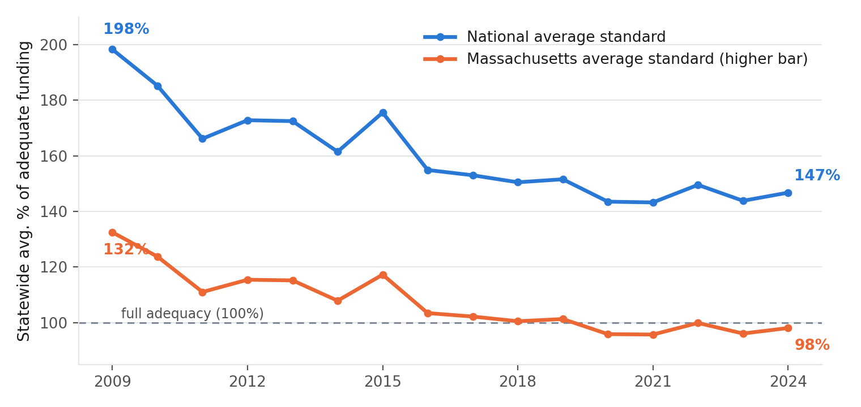
DISTRICT FINDINGS
Statewide Adequacy Is Sliding — Fast
198% → 147%
Statewide adequacy, National standard
132% → 98%
Statewide adequacy, Massachusetts standard — below full adequacy for the first time
13% → 41%
Share of districts funded below the Massachusetts standard since 2009
Statewide enrollment-weighted average funding adequacy, National and Massachusetts standards, 2009–2024. Source: School Finance Indicators Database, district-level widget data, 449 NJ districts.
NEW JERSEY'S EQUAL EDUCATIONAL OPPORTUNITY PROBLEM
6

Slide 7
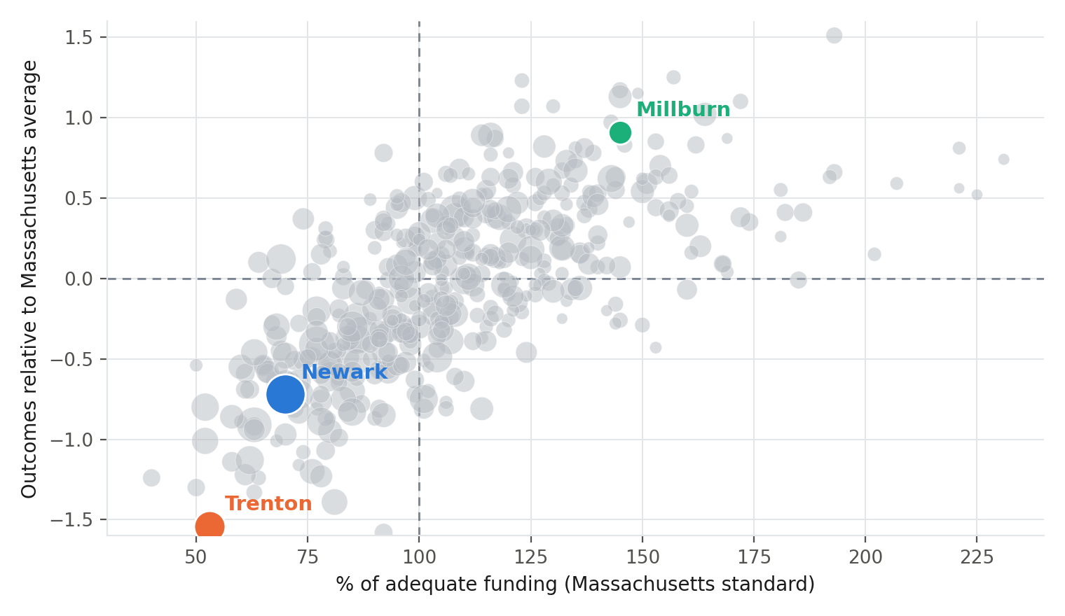
DISTRICT FINDINGS
More Money, Better Outcomes
Every one of New Jersey's 449 districts, 2024.
Better-funded districts cluster toward better outcomes — and the districts funded furthest below the line also perform furthest below it.
Newark: 104% national / 70% MA standard
Trenton: 79% national / 53% MA standard
Millburn: 217% national / 145% MA standard
Each bubble is one of New Jersey's 449 school districts in 2024, sized by enrollment. Outcome value is that district's outcome index minus the Massachusetts statewide average that year.
NEW JERSEY'S EQUAL EDUCATIONAL OPPORTUNITY PROBLEM
7

Slide 8
DISTRICT FINDINGS
Six Districts, Two Standards
District | Enrollment | % Adequate (National) | % Adequate (Massachusetts) | Outcome vs. National Avg. | Outcome vs. MA Avg.
Trenton | 15,459 | 79% | 53% | −1.23 | −1.54
Irvington | 7,770 | 78% | 52% | −0.70 | −1.01
Camden | 7,117 | 122% | 81% | −1.07 | −1.39
Newark | 42,791 | 104% | 70% | −0.40 | −0.72
Princeton | 3,827 | 199% | 133% | 1.04 | 0.73
Millburn | 4,737 | 217% | 145% | 1.23 | 0.91
Camden looks reasonably well funded overall (122% of the national standard) — yet its outcomes remain nearly a full standard deviation below the national average. Money is necessary for equal opportunity, but the relationship between a single funding ratio and outcomes is not perfectly mechanical.
NEW JERSEY'S EQUAL EDUCATIONAL OPPORTUNITY PROBLEM
8

Slide 9
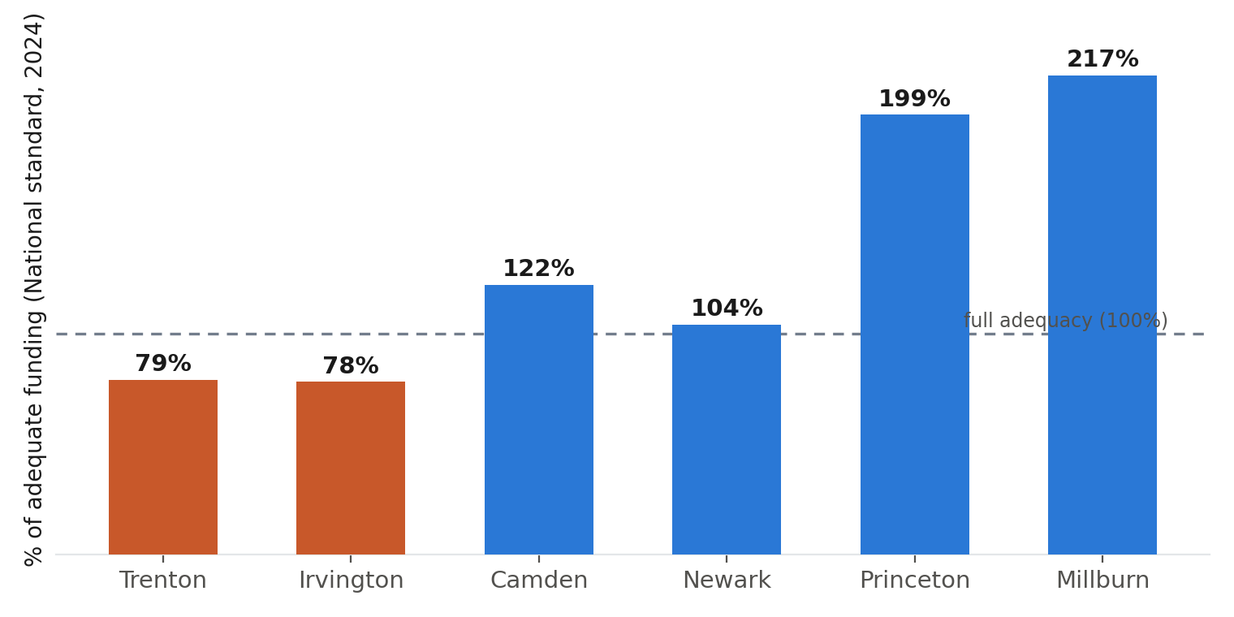
DISTRICT FINDINGS
The Same Six Districts, Side by Side
Funding adequacy (National standard), Table 1's six districts, 2024. Source: School Finance Indicators Database.
NEW JERSEY'S EQUAL EDUCATIONAL OPPORTUNITY PROBLEM
9

Slide 10
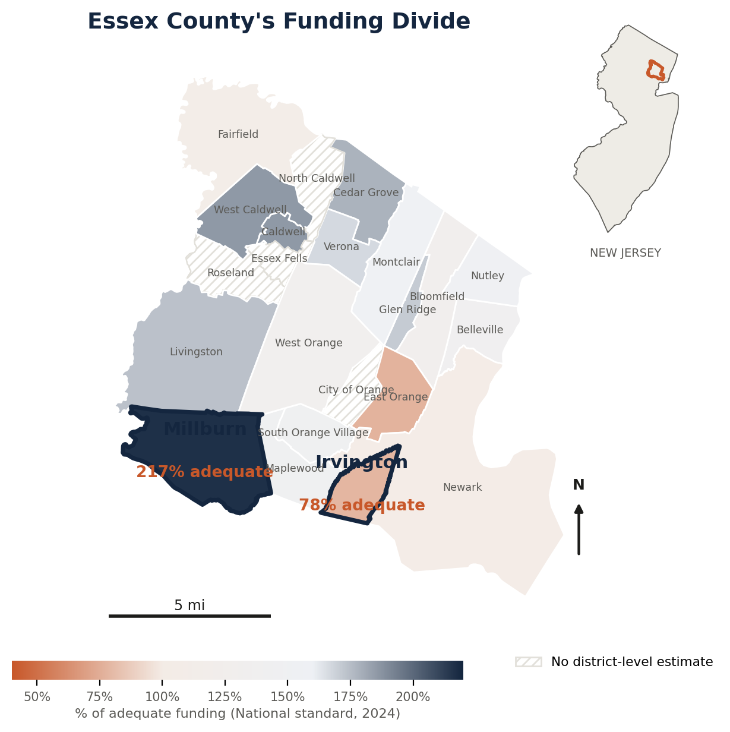
WHERE THE DIVIDE SHOWS UP
Essex County's Funding Divide
Less than 5 miles apart.
Irvington and Millburn sit on opposite sides of the adequacy line, in the same county, drawing on the same regional labor market and the same state formula.
The gap is not about distance — it's about how SFRA's local-share mechanics interact with two towns' very different property tax bases.
Irvington (78% adequate) and Millburn (217% adequate) and their neighboring towns, Essex County, 2024. Municipal boundaries: U.S. Census TIGER/Line, 2023.
NEW JERSEY'S EQUAL EDUCATIONAL OPPORTUNITY PROBLEM
10

Slide 11
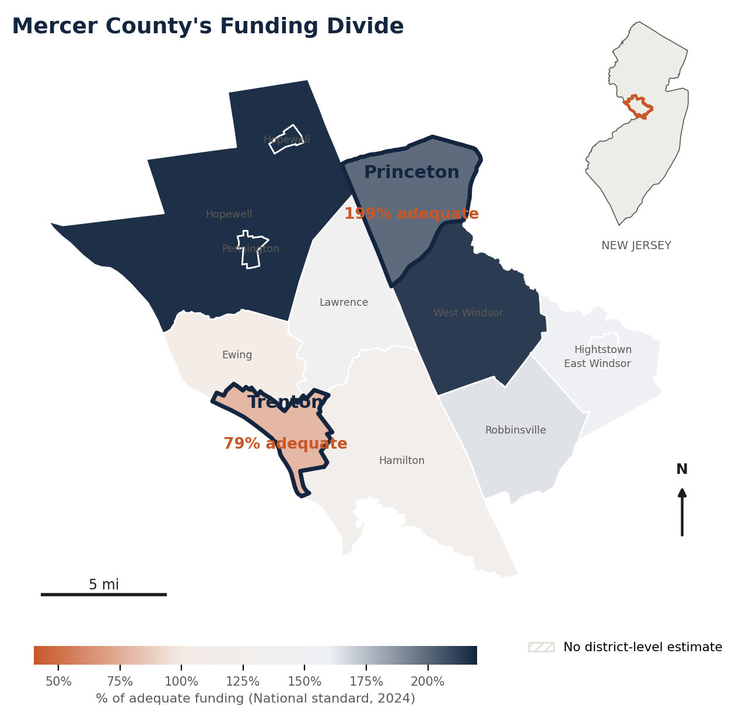
WHERE THE DIVIDE SHOWS UP
Mercer County's Funding Divide
About 10 miles apart.
New Jersey's capital and one of the country's wealthiest university towns sit on opposite sides of the same adequacy line as Irvington and Millburn.
These two pairs are not isolated cases — they are the geography behind the statewide pattern seen earlier.
Trenton (79% adequate) and Princeton (199% adequate) and their neighboring towns, Mercer County, 2024. Municipal boundaries: U.S. Census TIGER/Line, 2023.
NEW JERSEY'S EQUAL EDUCATIONAL OPPORTUNITY PROBLEM
11

Slide 12
SCHOOL-LEVEL FINDINGS
The Same Divide, School by School
District-level averages are themselves an average of school-level realities. A separate School Finance Indicators Database cost model — built at the individual-school level for roughly 2,400 New Jersey public schools, 2019–2024 — lets us look inside districts rather than across them, against two standards: an “Average” (lower) bar, and a “+1 SD” (higher) bar one full standard deviation above it.
53–61%
of NJ schools funded below the lower, “Average” standard, 2019–2024
82–87%
of NJ schools funded below the higher, “+1 SD” standard, 2019–2024
NEW JERSEY'S EQUAL EDUCATIONAL OPPORTUNITY PROBLEM
12

Slide 13
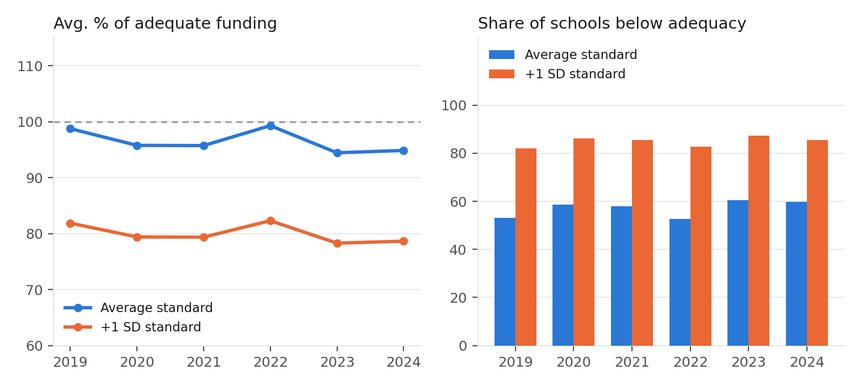
SCHOOL-LEVEL FINDINGS
Even the Lower Bar Isn't Being Met
Statewide average school funding adequacy (left) and share of schools funded below adequacy (right), both standards, 2019–2024. Source: NJ school-level cost model, ~2,400 schools per year.
NEW JERSEY'S EQUAL EDUCATIONAL OPPORTUNITY PROBLEM
13

Slide 14
SCHOOL-LEVEL FINDINGS
Three Schools, 2024
East Side High School
Trenton Central HS — Main Campus
Millburn High School
Newark · 2,091 students
Trenton · 2,058 students
Millburn · 1,382 students
% of adequate funding
% of adequate funding
% of adequate funding
71% Average
68% Average
131% Average
59% +1 SD
56% +1 SD
108% +1 SD
Outcome gap
Outcome gap
Outcome gap
−1.54 Average
−0.75 Average
1.87 Average
−2.54 +1 SD
−1.75 +1 SD
0.87 +1 SD
Source: NJ school-level cost model (nj_cost_models.dta). The companion animated video tracks these three schools across all six years.
NEW JERSEY'S EQUAL EDUCATIONAL OPPORTUNITY PROBLEM
14

Slide 15
RECOMMENDATIONS
How to Fix the Problem
New Jersey does not need a new legal or analytical framework — it needs to finish applying the one its own Supreme Court and Legislature already built.
1
2
3
Study
Recalibrate
Fund it
Commission a rigorous, independent cost study: what does it cost, district by district and school by school, to give every student a genuine opportunity to meet a robust outcome standard?
Update SFRA's cost weights and base amount to hit those targets — equitable local effort plus state aid sufficient to close the gap in every district, not just a favored few.
Appropriate the revenue the recalibrated formula calls for, on a multi-year phase-in the state actually commits to — not a target deferred whenever the budget is tight.
A credible Step 1 study should report costs under more than one outcome standard (as this brief does), account for regional labor costs and student needs, and recommend specific, dollar-denominated changes to SFRA's formula.
NEW JERSEY'S EQUAL EDUCATIONAL OPPORTUNITY PROBLEM
15

Slide 16
APPENDIX
Sources & Notes
1. Baker, B. & Weber, M. “New Jersey's School Funding Reform Act.” New Jersey Policy Perspective, Sept. 24, 2024.
2. Baker, B. & Weber, M. “Unlocking Academic Success: Revitalizing New Jersey's School Funding Formula for Student Achievement.” NJPP, Sept. 2023.
3. Weber, M. “Resetting School Funding for New Jersey's Next Decade.” New Jersey Policy Perspective, Oct. 29, 2025.
4. Baker, B. “Estimating the Costs of an Adequate Education in New Jersey.” New Jersey Policy Perspective, 2026.
5. School Finance Indicators Database, district-level widget data (National Education Cost Model, merged with SEDA outcome data) — schoolfinancedata.org
6. School Finance Indicators Database, New Jersey school-level cost model (nj_cost_models.dta)
7. Enrollment and district identifiers, National Center for Education Statistics, Common Core of Data
8. New Jersey Supreme Court, Abbott v. Burke line of decisions, beginning 1985
9. New Jersey School Funding Reform Act of 2008 (N.J.S.A. 18A:7F-43 et seq.)
10. U.S. Census Bureau, TIGER/Line Shapefiles, 2023 (county and county subdivision boundaries)
NEW JERSEY'S EQUAL EDUCATIONAL OPPORTUNITY PROBLEM
16

Slide 17
ABOUT THE AUTHOR
Bruce D. Baker
Professor, Department of Teaching and Learning, University of Miami
Bruce D. Baker studies how states raise and distribute school funding, and what that funding buys in student outcomes. He co-directs and helped build the School Finance Indicators Database, the national resource behind the figures in this brief, and writes about school finance policy at School Finance 101 (schoolfinance101.com). He is the author of three recent Harvard Education Press books on school funding and equity, and was named a Fellow of the American Educational Research Association in 2024. His research has been cited by the U.S. Supreme Court on racial inequities in school funding.
Blog: schoolfinance101.com · Data: schoolfinancedata.org
NEW JERSEY'S EQUAL EDUCATIONAL OPPORTUNITY PROBLEM
17

