Slide 1
SCHOOL FINANCE INDICATORS DATABASE · NECM / SEDA ANALYSIS
School Finance in
Kansas & Missouri
Funding Adequacy, Student Outcomes & Trends, 2009–2024
Bruce D. Baker | University of Miami
Summary briefing prepared for policymakers · September 2026

Slide 2
WHY THIS MATTERS
Money Matters — In Both Directions
1
Funding changes move outcomes
2
Operating and capital dollars both matter
Increases to school funding improve student outcomes; cuts reduce them — the relationship runs both ways, and shows up whether the money is added or taken away.
More operating funding shows up in wages and smaller classes; capital investment improves facilities — often with a lag before students feel the benefit.
3
The impact is largest where poverty is highest
4
It doesn't matter how the money arrives
Progressive funding yields a several-fold larger return on investment in previously low-spending, higher-poverty districts than in lower-poverty ones.
Whether funding increases come from legislative action, economic growth, federal stimulus, local voters, or judicial order — the effect on outcomes is the same.
Source: School Finance Indicators Database (SFID) research synthesis, Baker et al.
1

Slide 3
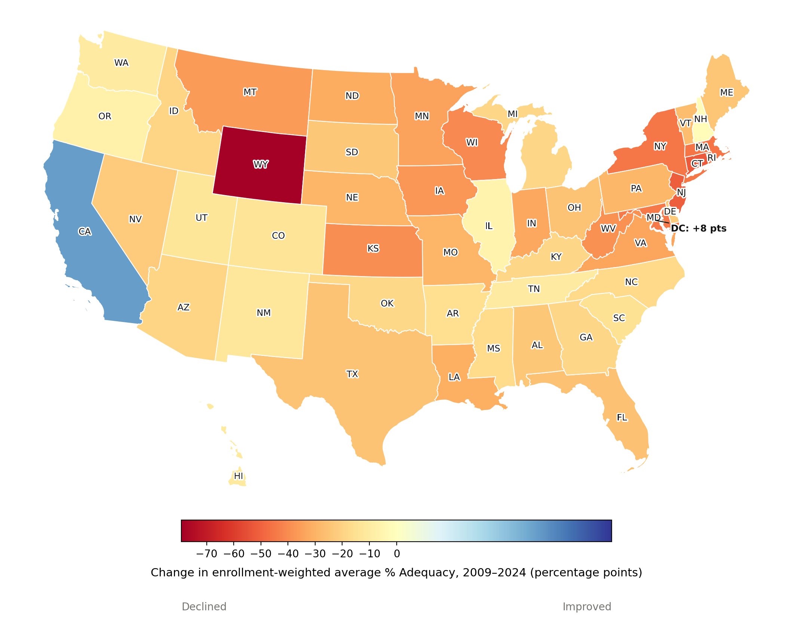
NATIONAL CONTEXT
Funding Adequacy Eroded Nationwide
117% → 93%
ENROLLMENT-WEIGHTED NATIONAL AVERAGE % ADEQUACY, 2009 → 2024
48 of 50 states and DC became less well-funded, relative to the cost of national-average outcomes, between 2009 and 2024.
Wyoming (−79 points) saw the steepest decline, having been the single most overfunded state in 2009.
California and DC were the only two states to improve.
Median change across all states: −24 percentage points.
Source: NECM/SEDA merged file. % Adequacy = current spending ÷ cost of national-average outcomes. Alaska excluded.
2

Slide 4
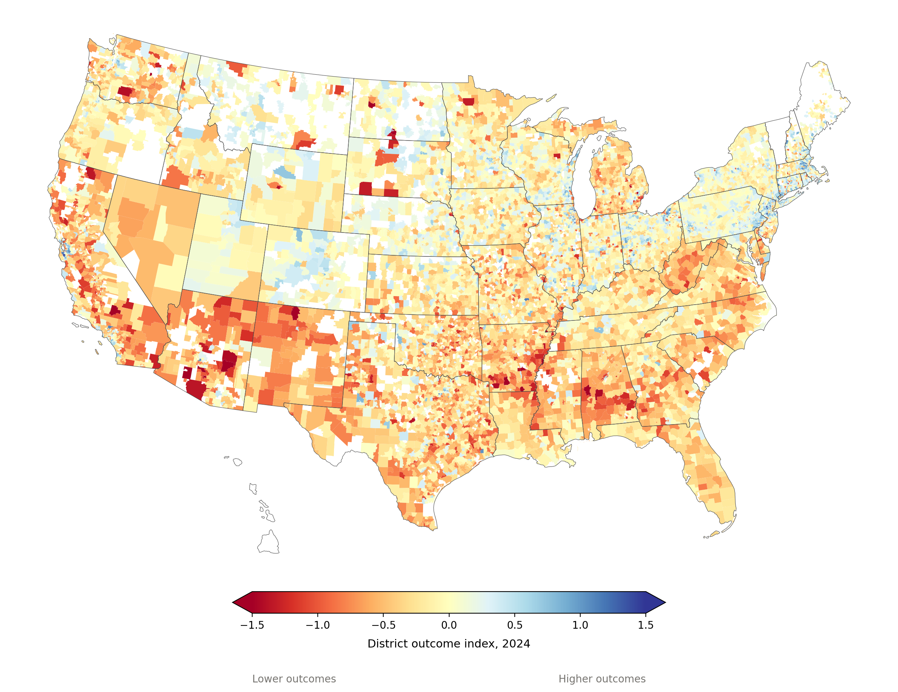
NATIONAL CONTEXT
Student Outcomes Have Fallen Nationwide
−0.18
ENROLLMENT-WEIGHTED NATIONAL AVERAGE OUTCOME INDEX, 2024 (0 = NATIONAL AVERAGE)
63%
OF 11,190 DISTRICTS SCORE BELOW THE NATIONAL AVERAGE OUTCOME — UP FROM 50% IN 2009
By 2024, outcomes fell nationwide, not just in the districts that were already lowest.
The Southwest border region intensified sharply — Arizona and New Mexico in particular.
Many Northeastern and Mountain West districts held closer to their 2009 levels.
Source: NECM/SEDA merged file. Outcome index is SEDA-based (0 = national average that year). Alaska excluded.
3

Slide 5
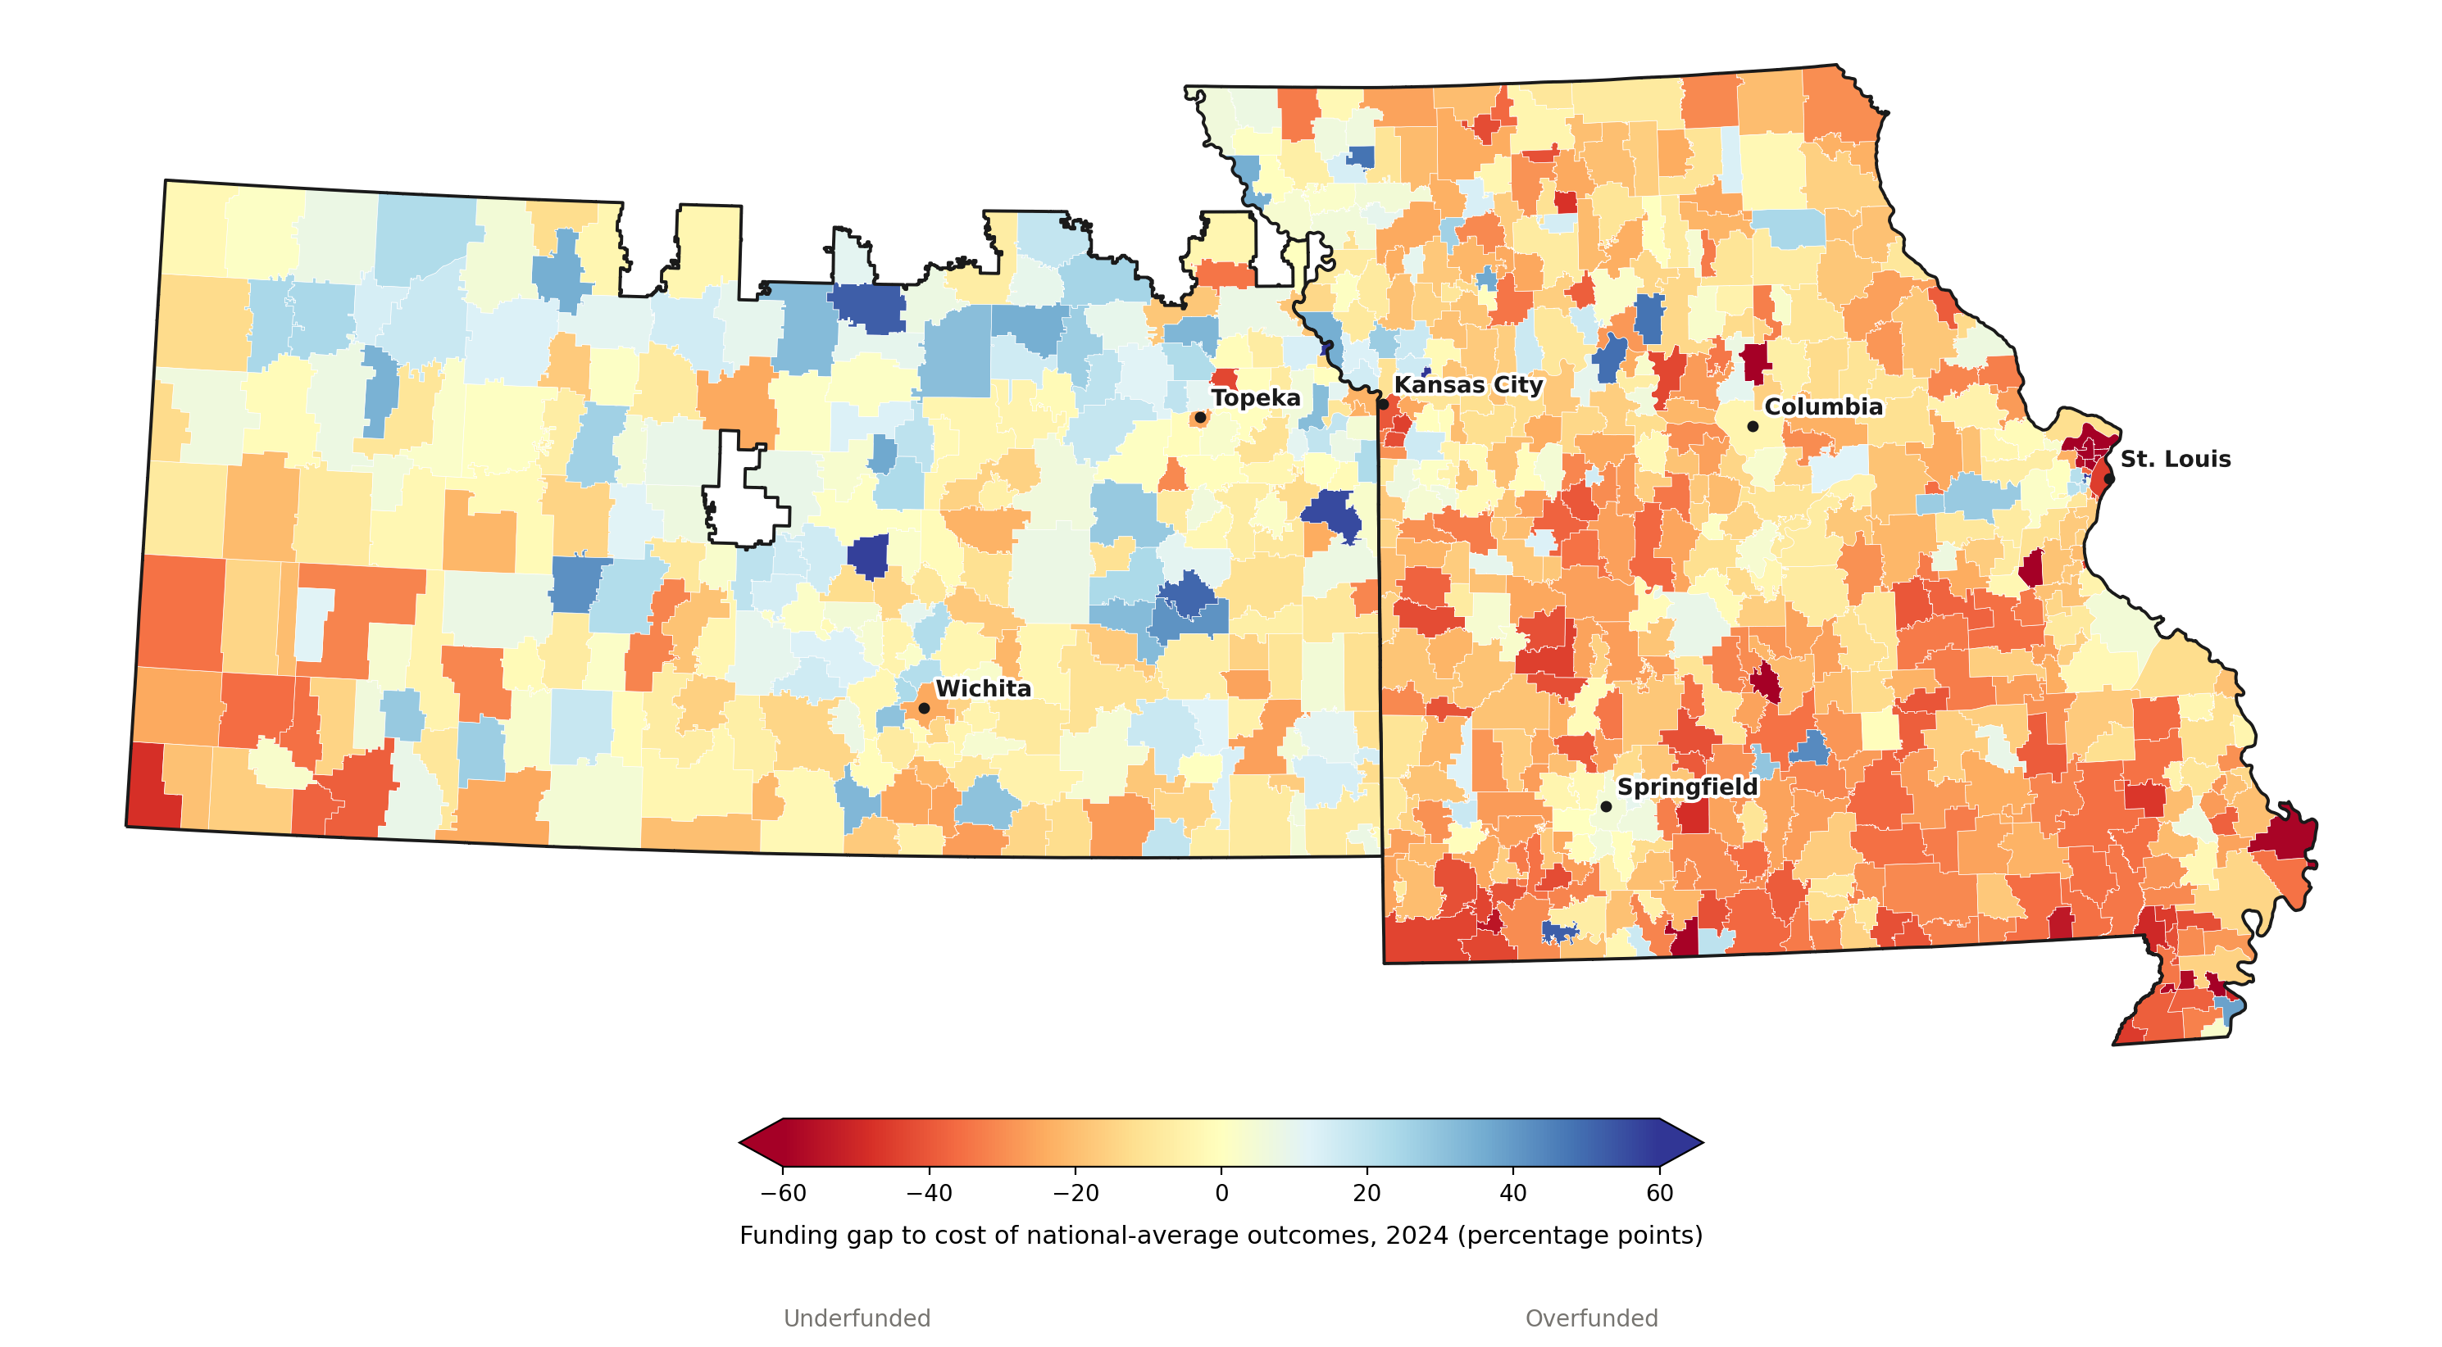
KANSAS & MISSOURI
Missouri Is Substantially More Underfunded Than Kansas
KS 98%
ENROLLMENT-WEIGHTED AVERAGE · 52% OF DISTRICTS UNDERFUNDED
MO 85%
ENROLLMENT-WEIGHTED AVERAGE · 83% OF DISTRICTS UNDERFUNDED
Southern and eastern Missouri, especially near St. Louis, run consistently underfunded, while much of Kansas sits close to neutral.
The St. Louis area shows both extremes side by side: Jennings and Riverview Gardens are underfunded by 73 and 68 points, while neighboring Clayton is overfunded by 85 points — a 150+ point gap within one metro area.
Source: NECM/SEDA merged file, 2024. Funding gap = % Adequacy − 100. 9 recently-consolidated Kansas districts excluded for lack of a 2024 match.
4

Slide 6
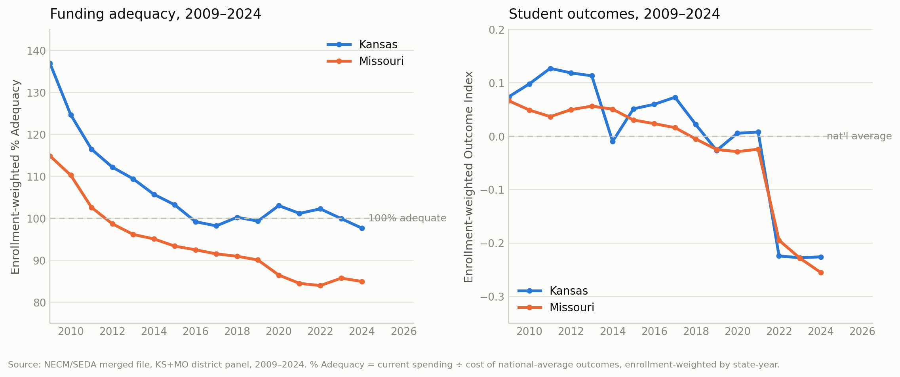
KANSAS & MISSOURI
Both States Have Slid Toward Underfunding Since 2009
137% → 98%
115% → 85%
+0.07 → −0.23
+0.07 → −0.26
KANSAS % ADEQUACY
MISSOURI % ADEQUACY
KANSAS OUTCOME INDEX
MISSOURI OUTCOME INDEX
Source: NECM/SEDA merged file, KS+MO district panel 2009–2024. Enrollment-weighted by state-year.
5

Slide 7
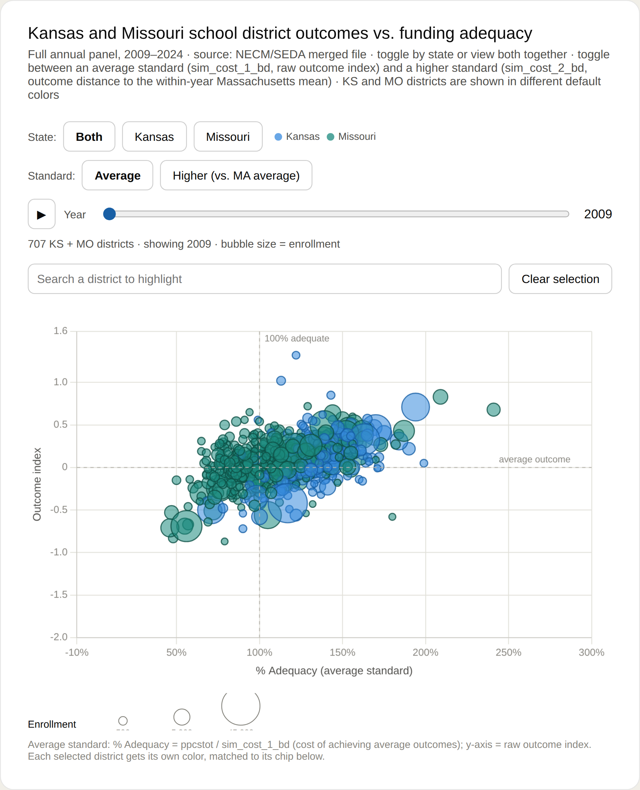
EXPLORE THE DATA
Every Kansas & Missouri District — 2009
Live, interactive companion
Every Kansas and Missouri district, 2009–2024, is plotted on the interactive bubble-chart widget accompanying this briefing — filter by state, toggle the funding standard, scrub the year slider, and search any district by name.
707 KS + MO districts, colored by state.
Most districts cluster above 100% adequacy — funded at or beyond the cost of average outcomes.
Kansas (blue) skews further right than Missouri (teal) at this point in time.
Source: NECM/SEDA merged file. Bubble size = enrollment. x-axis: % Adequacy (avg. standard); y-axis: outcome index.
6

Slide 8
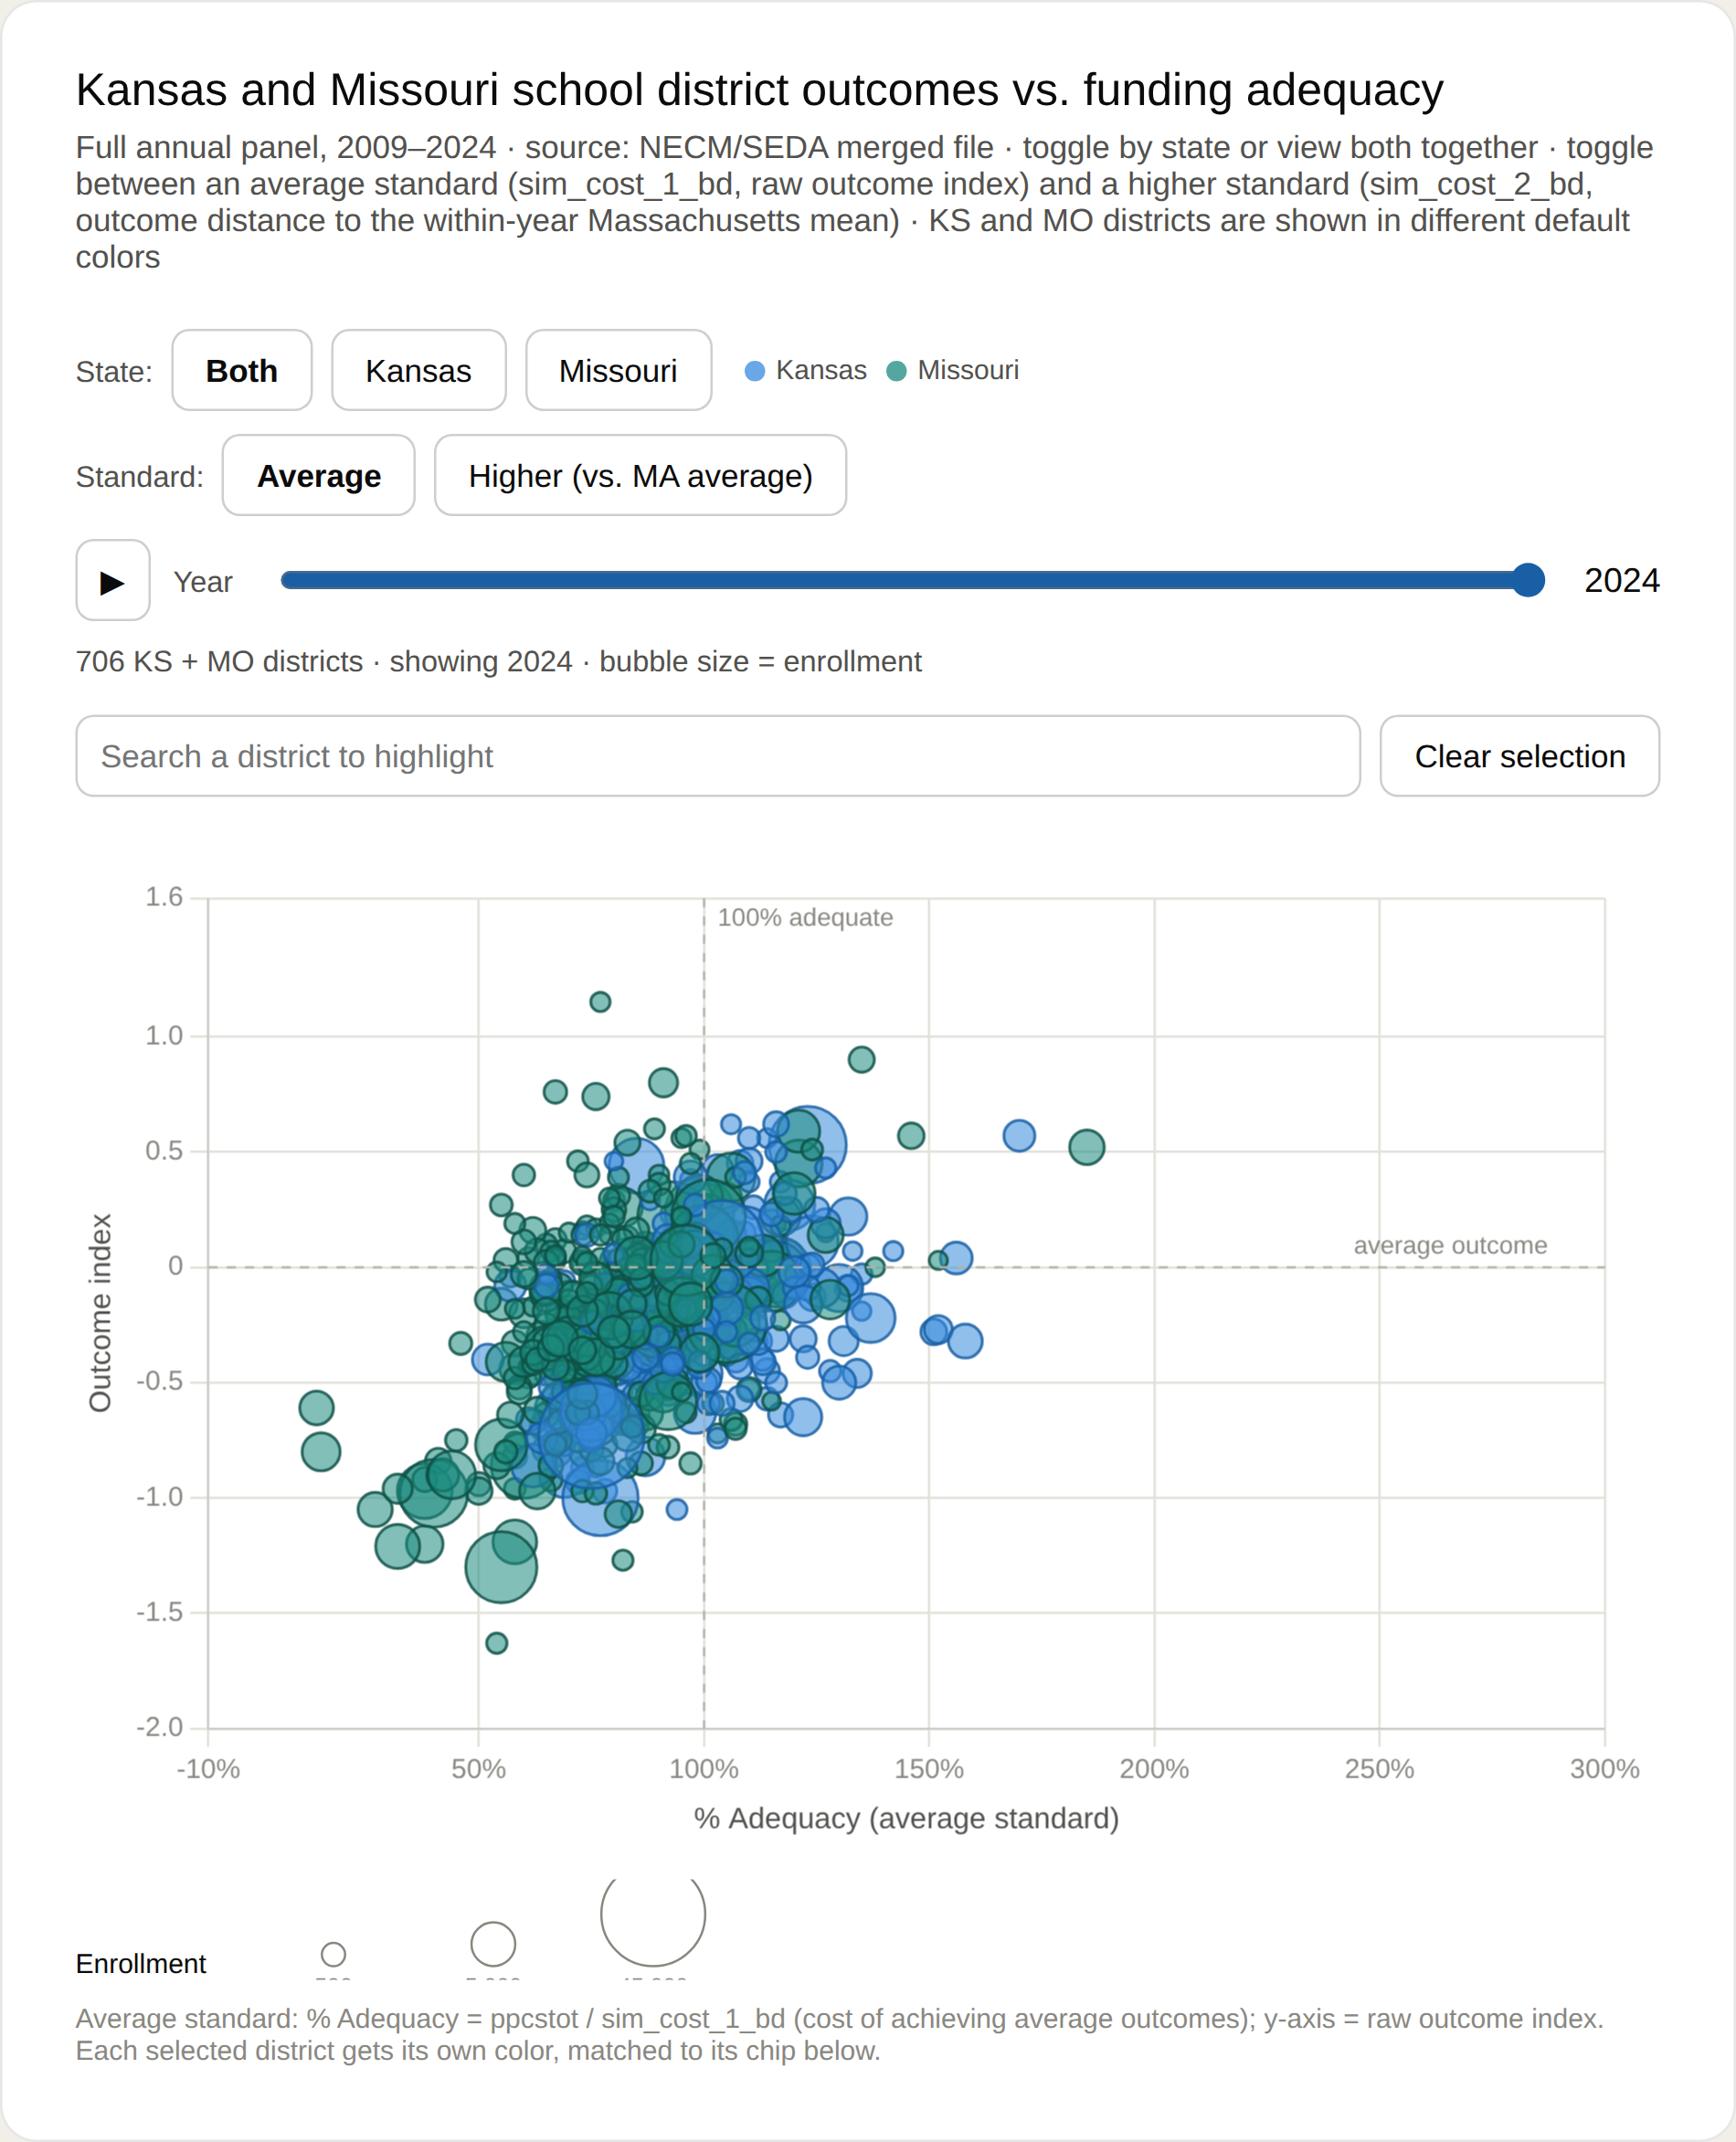
EXPLORE THE DATA
Every Kansas & Missouri District — 2024
Live, interactive companion
Every Kansas and Missouri district, 2009–2024, is plotted on the interactive bubble-chart widget accompanying this briefing — filter by state, toggle the funding standard, scrub the year slider, and search any district by name.
The same 707 districts, fifteen years later.
The whole cloud has shifted left, below the 100%-adequate line, for both states.
Missouri's leftward shift is the more severe of the two — consistent with the state map.
Source: NECM/SEDA merged file. Bubble size = enrollment. x-axis: % Adequacy (avg. standard); y-axis: outcome index.
7

Slide 9
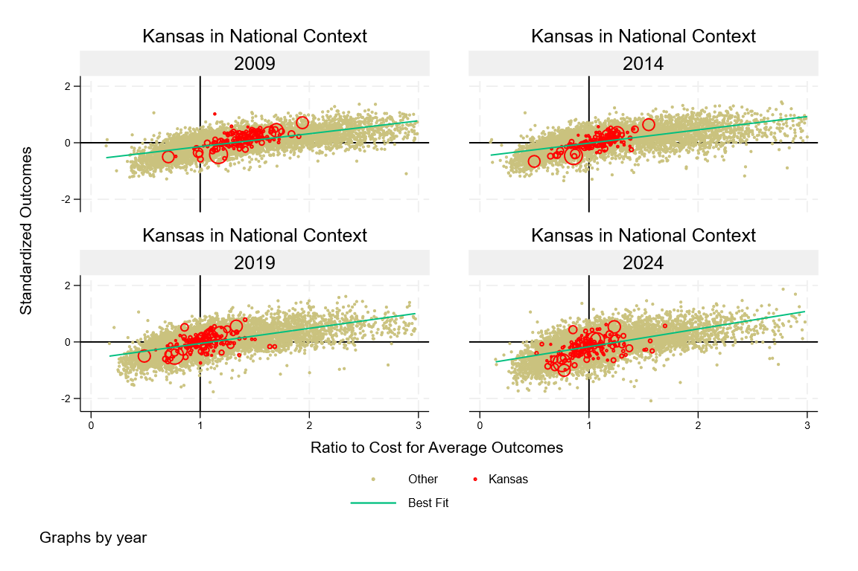
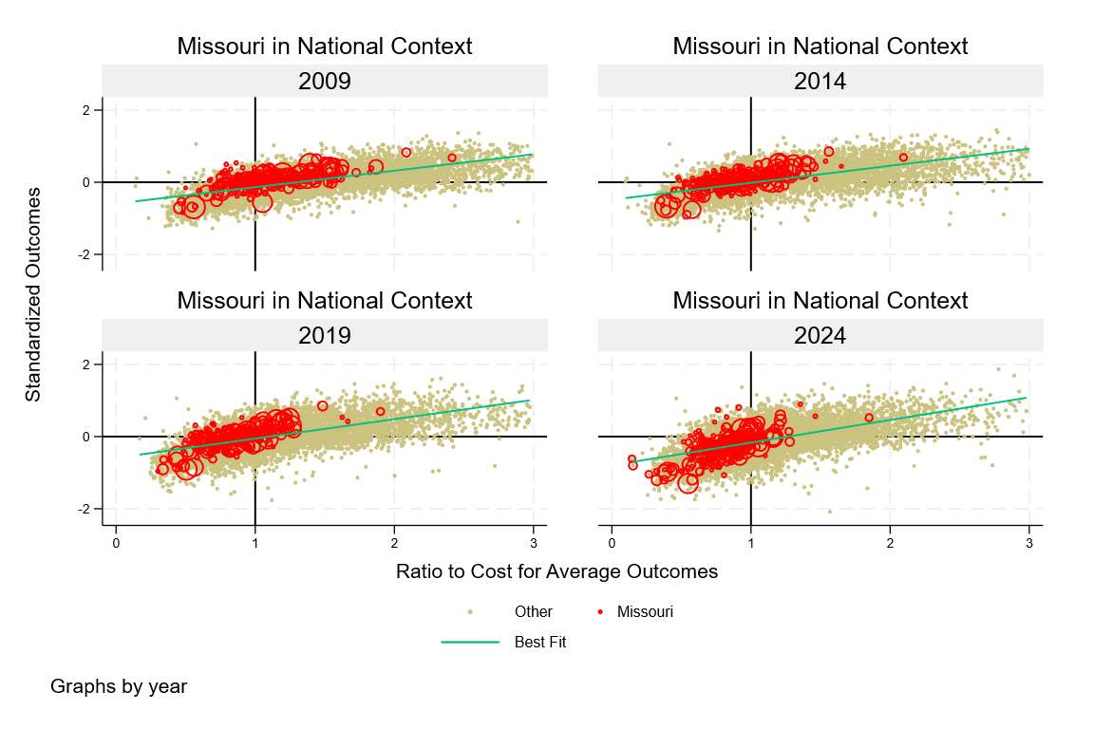
KANSAS & MISSOURI IN NATIONAL CONTEXT
Both States Trail the National Best-Fit Line — Increasingly
KANSAS
MISSOURI
Each panel plots Kansas (left) or Missouri (right) districts in red against every other U.S. district, at four points between 2009 and 2024, with the national best-fit line for spending vs. outcomes. In both states, districts increasingly sit below and to the left of that line by 2024 — the same “adequacy backsliding” seen in the state-level trend, now visible district by district against the rest of the country.
Source: NECM/SEDA merged file, national district panel 2009–2024.
8

Slide 10
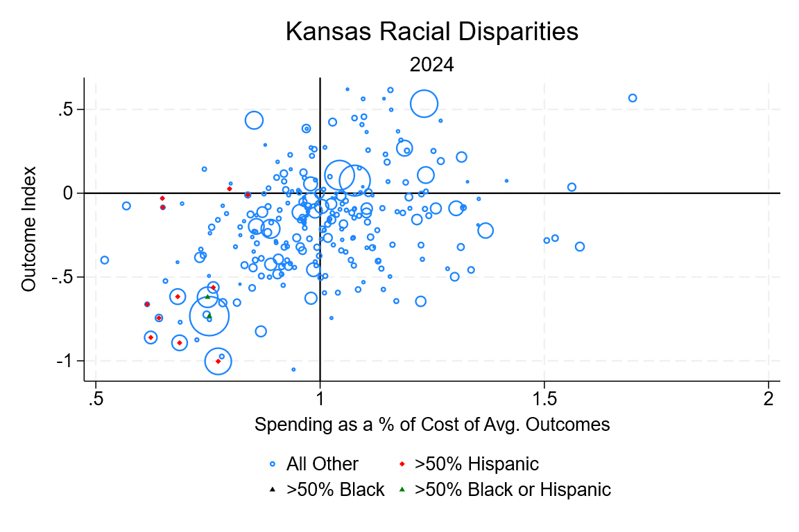
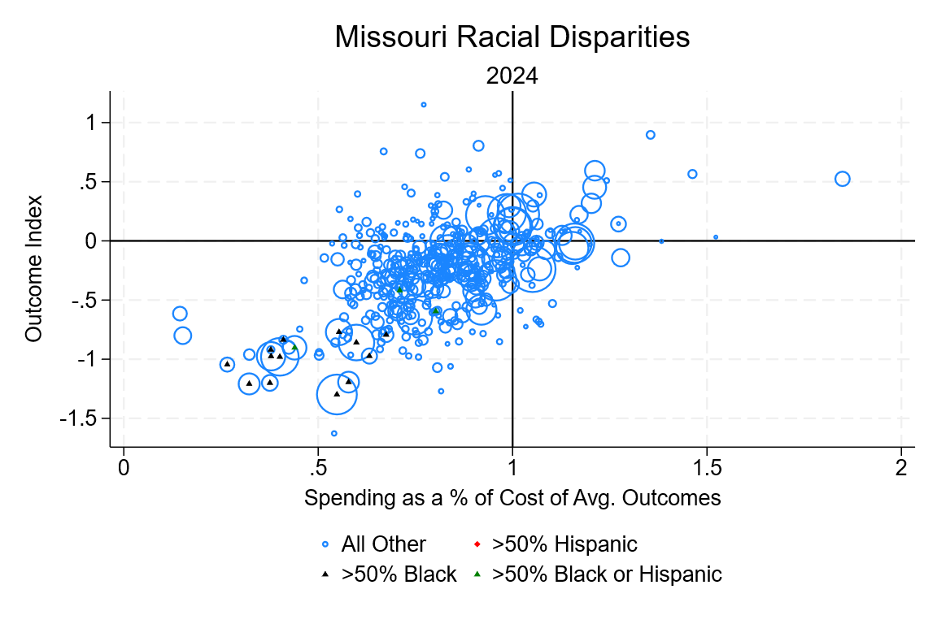
EQUITY
Funding Gaps Are Concentrated in Higher-Black and Hispanic Districts
KANSAS
MISSOURI
Nationally, the typical African American student is twice as likely as a white student to be in an underfunded district, and 3.5 times more likely to be in a “chronically underfunded” one. The same pattern shows up within Kansas and Missouri: districts that are majority Black or Hispanic (triangles and diamonds) cluster in the lower-left of both charts — below-average outcomes and below-100% funding adequacy.
Source: NECM/SEDA merged file, 2024. Bubble size = enrollment.
9

Slide 11
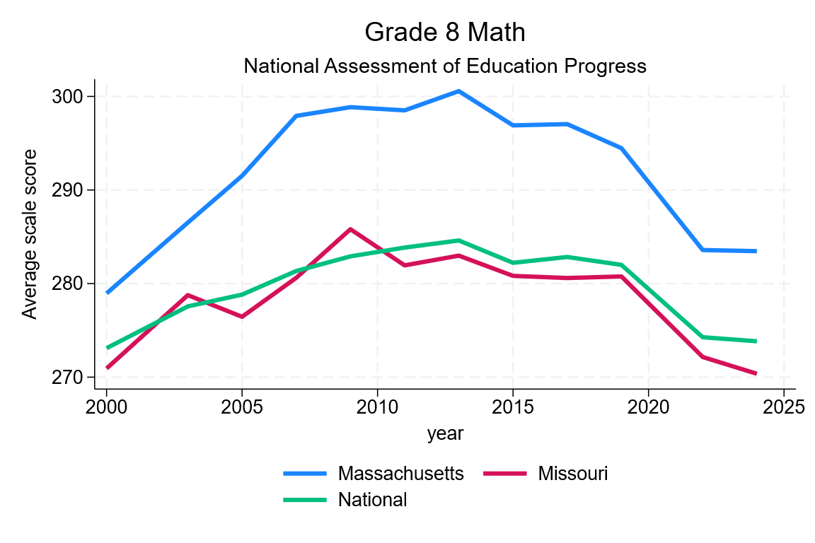
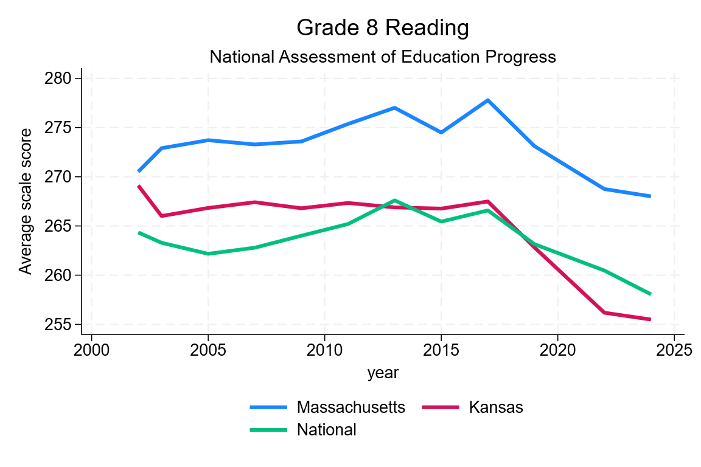
STUDENT ACHIEVEMENT
Achievement Has Fallen From Its Pre-Pandemic Peak
KANSAS
MISSOURI
Grade 8 NAEP math scores for Kansas (left) and Missouri (right), benchmarked against Massachusetts — the nation's highest-scoring state — and the national average. Both states tracked close to or above the national average through the mid-2010s; both have fallen since 2019, with Missouri's 2024 score now below the national average and Kansas's roughly at it.
Source: National Assessment of Educational Progress (NAEP), Grade 8 Math, 2000–2024.
10

Slide 12
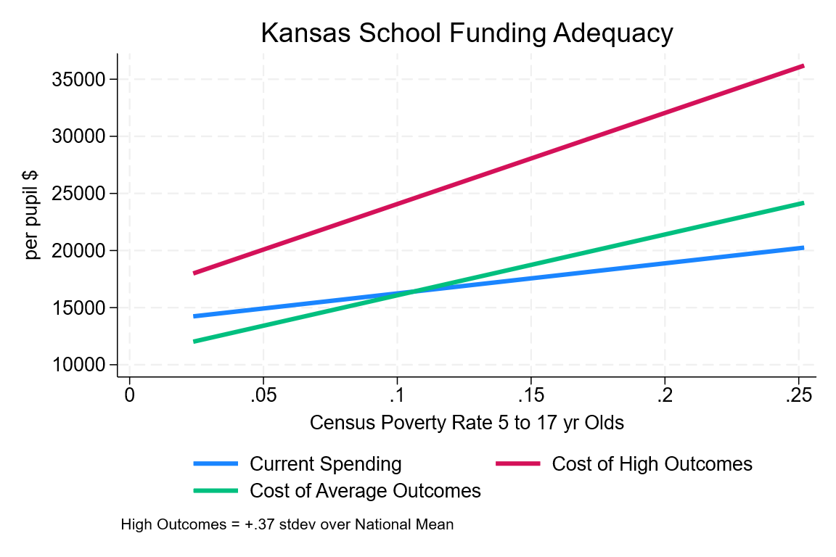
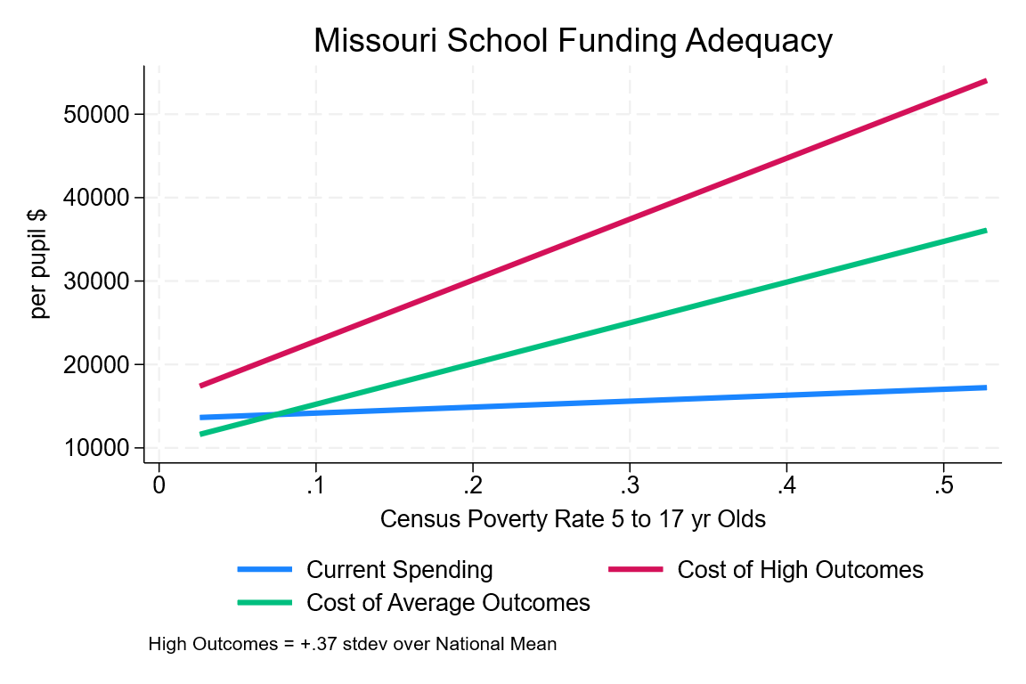
COST & POVERTY
Cost Rises Faster Than Spending as Poverty Increases
KANSAS
MISSOURI
In both states, current spending (blue) rises only modestly with a district's child poverty rate, while the estimated cost of average outcomes (green) and especially high outcomes (red/pink) rise much more steeply. The gap between what districts spend and what higher-poverty districts would need to spend to hit common outcome goals widens sharply as poverty increases.
Source: National cost model, NECM/SEDA merged file. “High outcomes” = +0.37 standard deviations over the national mean.
11

Slide 13
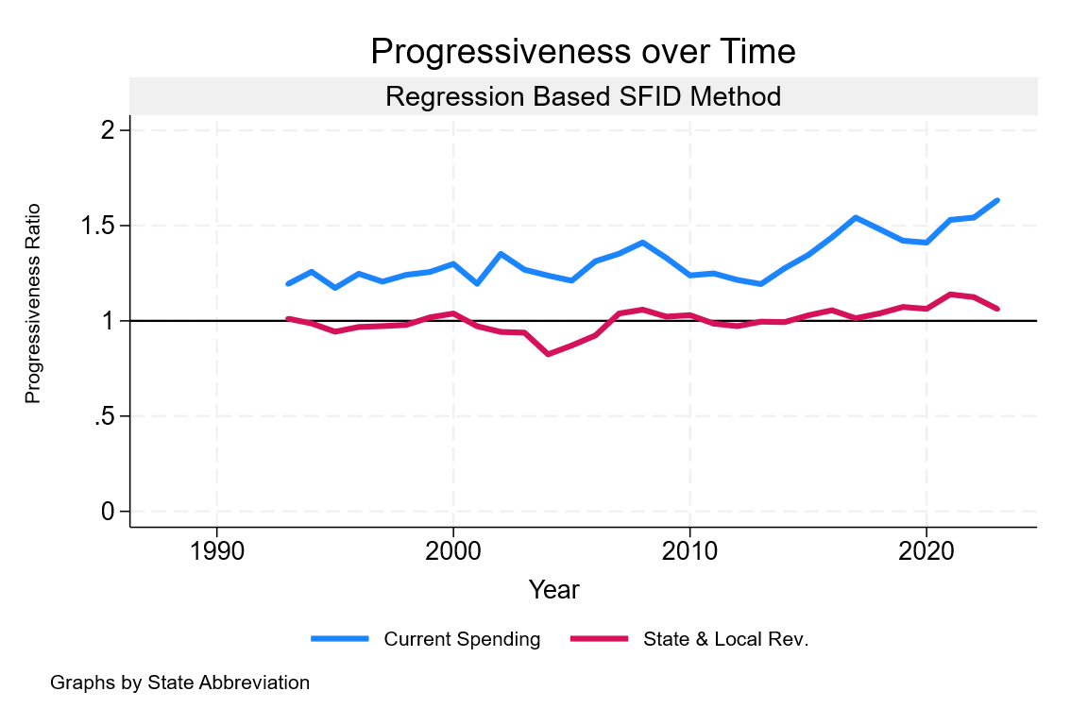
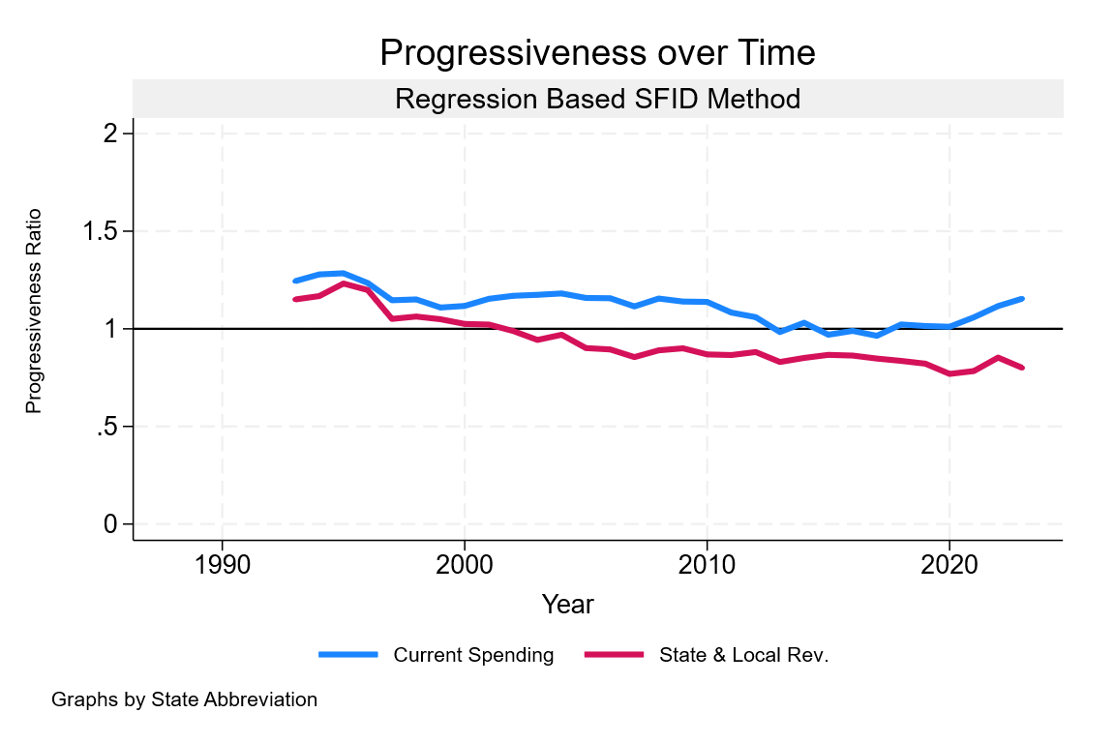
REVENUE & SPENDING
School Spending Is More Progressive Than State & Local Revenue
KANSAS
MISSOURI
The progressiveness ratio compares dollars per pupil in higher- vs. lower-poverty districts; a ratio above 1.0 means higher-poverty districts receive more. Current spending (blue) has run consistently progressive and risen further in both states since 2010. State & local revenue alone (red/pink) has hovered close to flat — near 1.0, sometimes below it — meaning the progressivity in final spending is being driven by targeting elsewhere in the system, not by the underlying revenue base.
Source: SFID regression-based progressiveness method, 1993–2023.
12

Slide 14
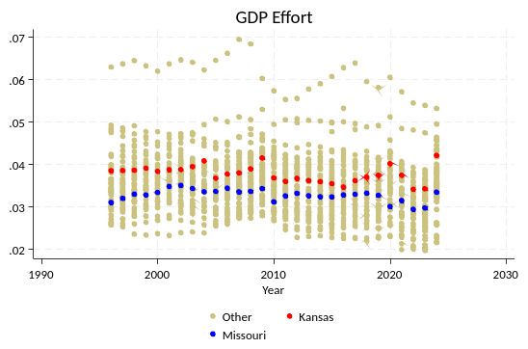
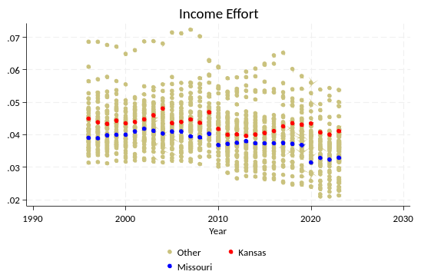
FISCAL EFFORT
Fiscal Effort Has Lagged Both States' Economic Growth
−0.44 pts
−0.41 pts
KANSAS 2023 EFFORT vs. 2006 (PRE-RECESSION)
MISSOURI 2023 EFFORT vs. 2006 (PRE-RECESSION)
ranked #24 in the nation · revenue foregone: $3.26B (6.1%) since 2016
ranked #23 in the nation · revenue foregone: $7.46B (8.5%) since 2016
Effort = total state/local K-12 revenue ÷ gross state/personal product or income. Source: SFID effort series, 1996–2023.
13

Slide 15
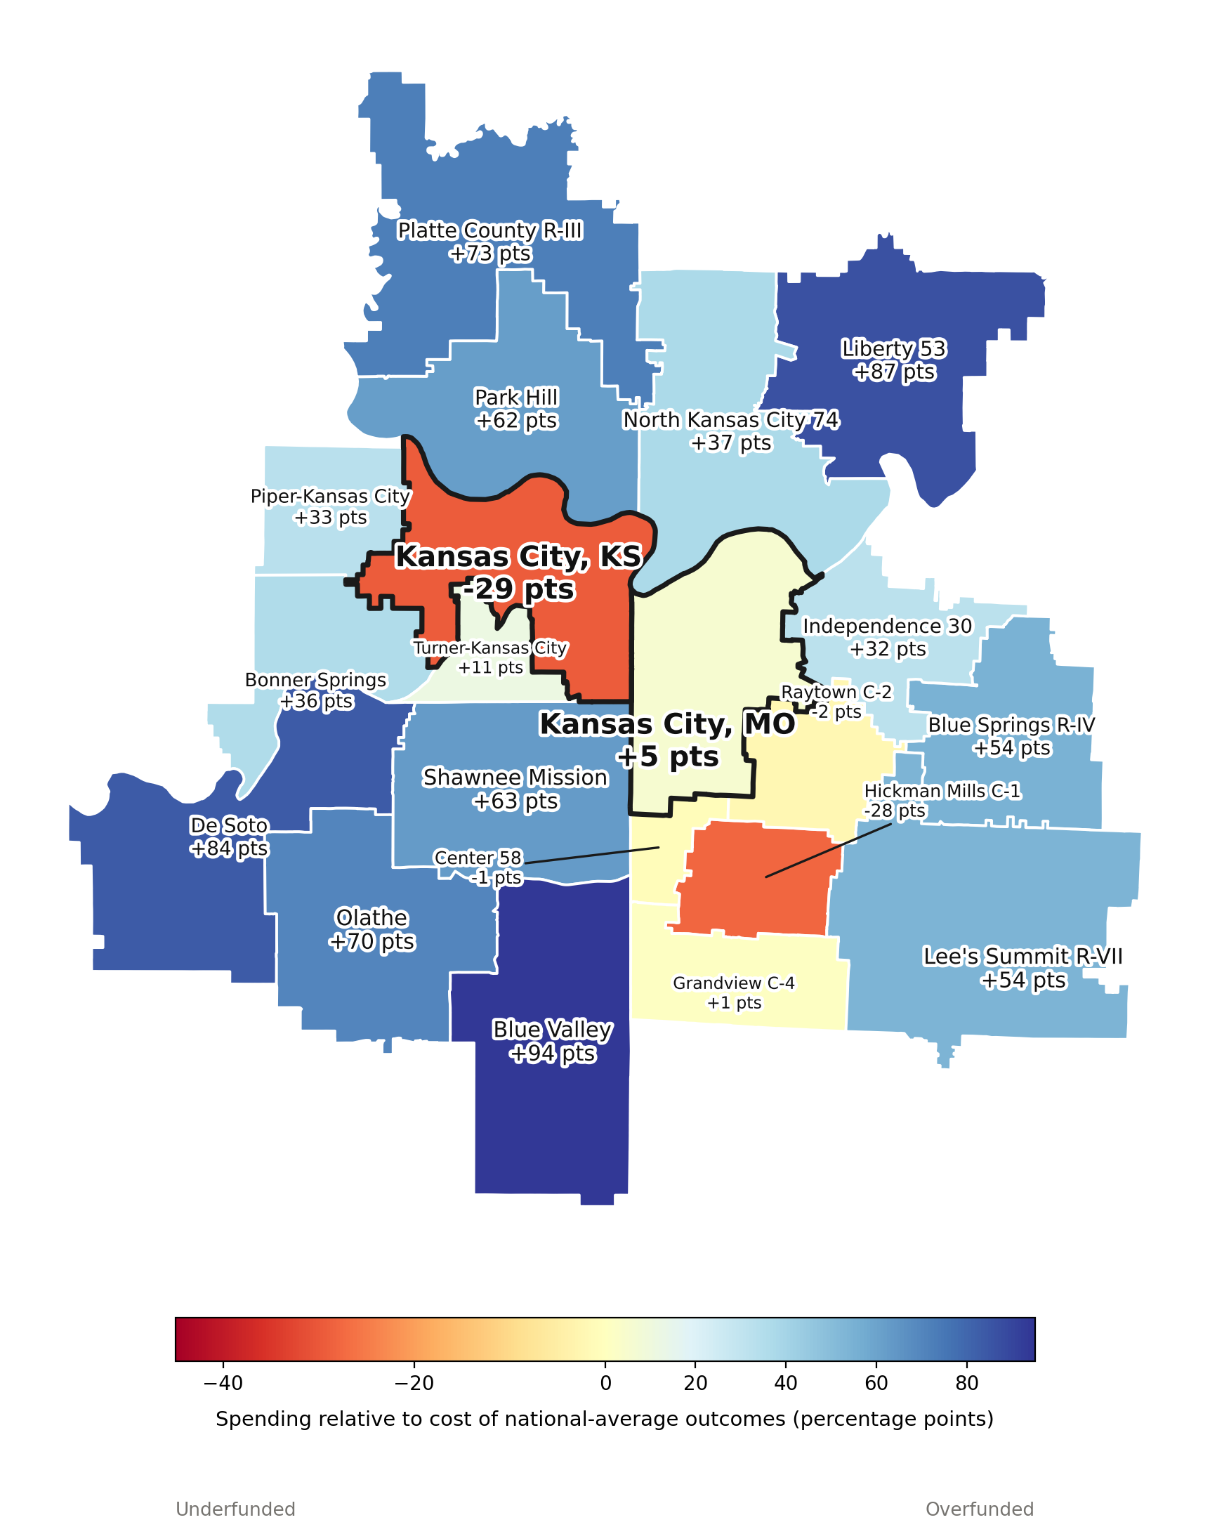
KANSAS CITY METRO SPOTLIGHT
Two School Systems, One Metro — 2009
KANSAS CITY, KS
−29 pts
20,317 students
KANSAS CITY, MO
+5 pts
19,788 students
Kansas City, Kansas Public Schools was the most underfunded district in the metro. Most suburbs on both sides of the state line were substantially overfunded, led by Blue Valley at +94 points. Kansas City, Missouri sat close to fully funded.
Source: NECM/SEDA merged file, 2009. Funding gap = % Adequacy − 100 vs. cost of national-average outcomes.
14

Slide 16
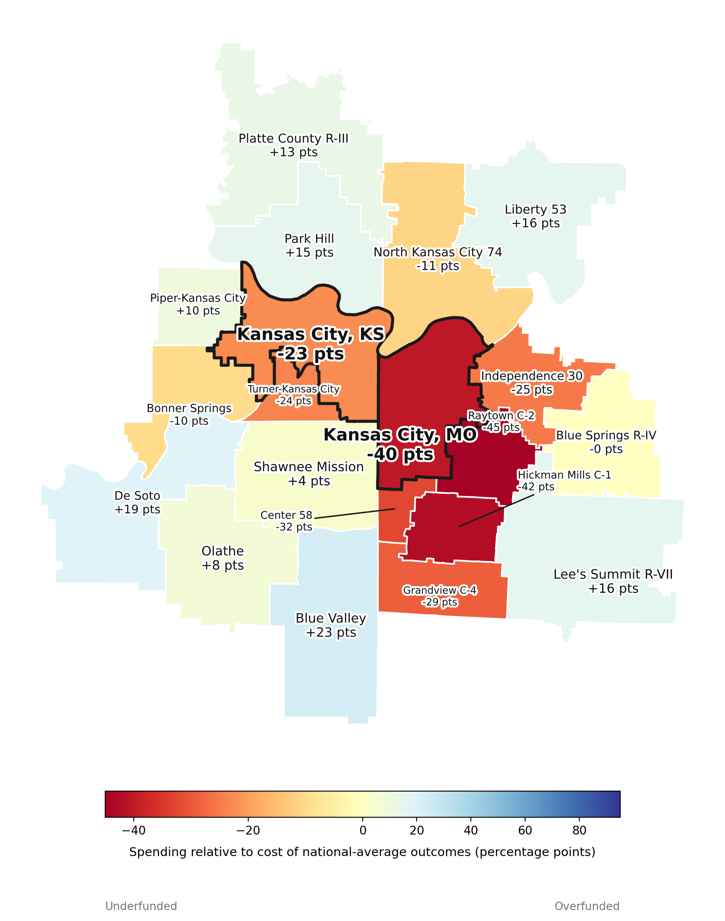
KANSAS CITY METRO SPOTLIGHT
Two School Systems, One Metro — 2024
KANSAS CITY, KS
−23 pts
21,132 students
KANSAS CITY, MO
−40 pts
14,694 students
By 2024 the entire metro shifted toward underfunding. Kansas City, Missouri went from +5 to −40 points — the sharpest reversal in the cluster — while Kansas City, Kansas was the only district to improve. KCMO enrollment fell ≈26% over the same period; 6 of 20 metro districts flipped from overfunded to underfunded.
Source: NECM/SEDA merged file, 2024. Same color scale as 2009 map for direct comparison.
15

Slide 17
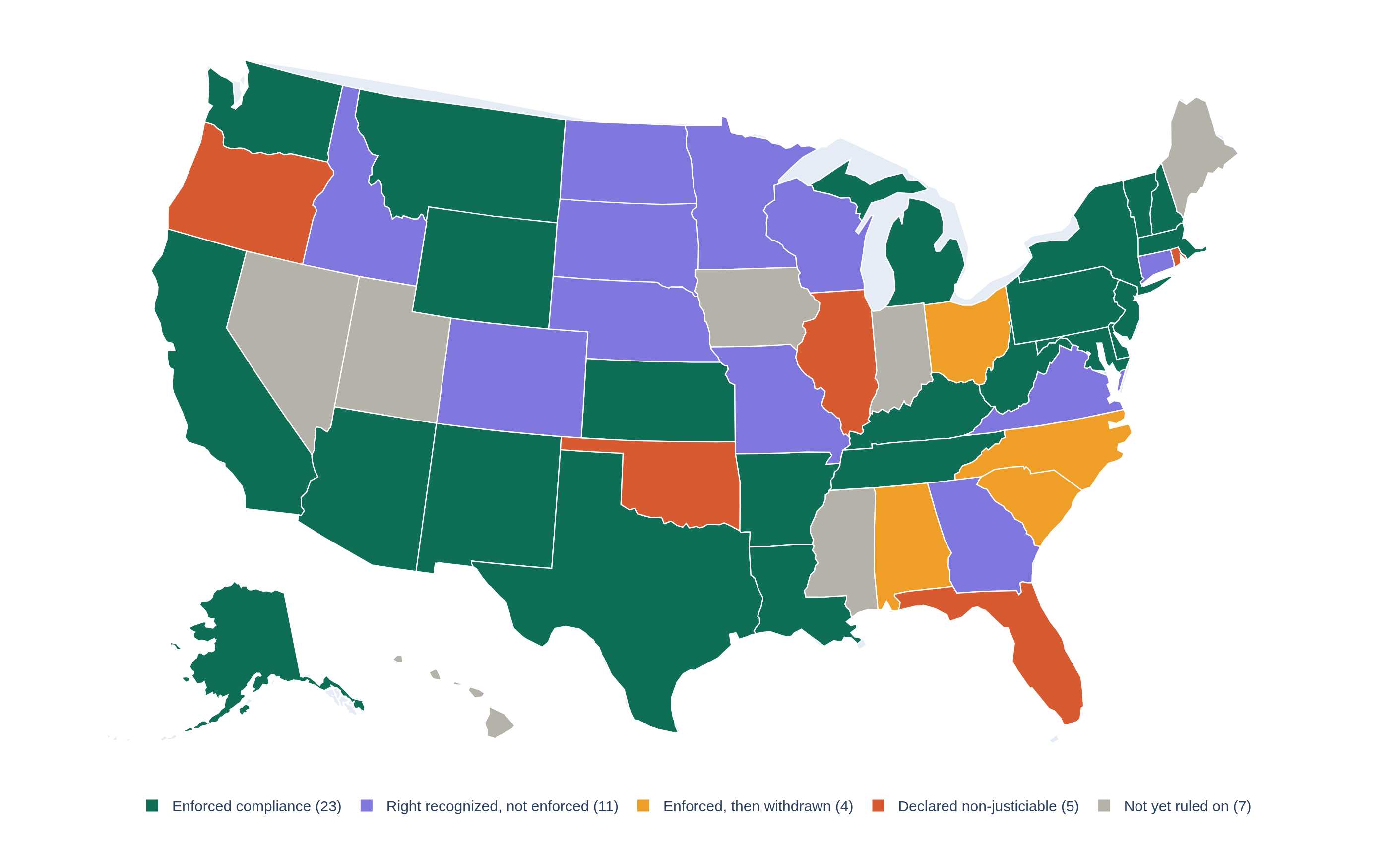
LEGAL LANDSCAPE
Courts Have Taken Different Paths in Kansas and Missouri
Kansas
ENFORCED COMPLIANCE — courts found a violation and ordered (and secured) a remedy
Missouri
RIGHT RECOGNIZED, NOT ENFORCED — the constitutional education clause has not driven a compliance order
How a state's highest court has treated its constitutional education clause shapes what legal and legislative options are realistically on the table.
Kansas's litigation history (Gannon and predecessors) produced enforced funding remedies; Missouri's has not reached that point.
Source: State supreme/highest court rulings compiled via legal research; see companion spreadsheet for full case citations.
16

Slide 18
ADDRESSING THE SKEPTICS
A Common Counter-Argument, and Why It's Incomplete
As adequacy and outcomes have declined, a small set of charts keeps recirculating in state legislatures — including Kansas's and Missouri's — to argue that school funding doesn't affect student outcomes. Both rely on a comparison that looks rigorous but leaves out the one variable that makes it meaningful: cost.
1
The “long-term trend” graph
2
The “clouds of doubt” scatterplot
Plots cumulative spending growth against NAEP score changes from a single base year — almost always a year chosen right before scores began to fall nationally, making recent spending look like it caused the decline.
Plots raw per-pupil spending against raw proficiency rates, district by district, with no adjustment for poverty, cost, or need — then reads the weak raw correlation as proof that money doesn't matter.
The next two slides walk through both, using the same Oregon data cited in that state's own 2025 legislative cost study — because the flaw is in the comparison, not the state.
Source: Edunomics Lab (Georgetown University); C. Kirabo Jackson, EducationNext; American Institutes for Research / Baker, 2025.
17

Slide 19
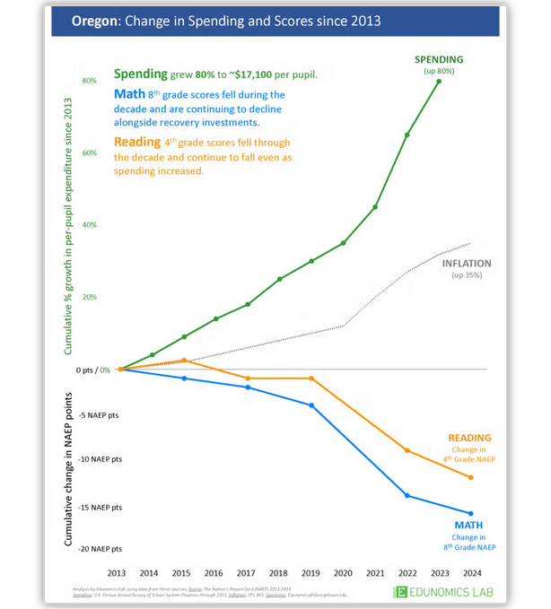
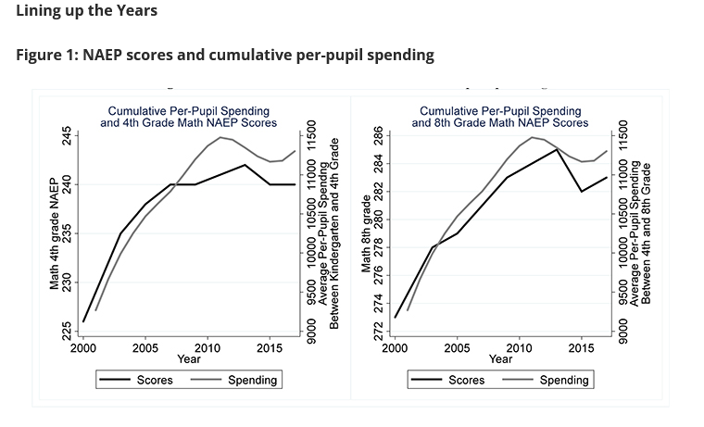
ADDRESSING THE SKEPTICS
The “Long-Term Trend” Graph Picks Its Base Year Carefully
THE CLAIM
THE FULLER PICTURE
A widely circulated state-level graphic: spending up 80% since 2013 while NAEP scores fall — the base year is set right where scores peak.
Jackson (EducationNext): scores and spending moved together through the 2000s; the Great Recession's funding cuts hit outcomes only after a multi-year lag.
2013 is not an arbitrary starting point — it's close to the year NAEP scores peaked nationally, before the Great Recession's funding cuts worked their way through to classrooms. Research on the timing (Jackson, EducationNext) finds spending and scores tracked together in the years before that, and that recession-era cuts affected outcomes only with a lag of several years. Starting the clock at the peak turns a delayed response to disinvestment into an apparent case against funding.
Source: Edunomics Lab, Oregon example (chart style used in multiple states); C. Kirabo Jackson, “Could the Disappointing 2017 NAEP Scores Be Due to the Great Recession?”, EducationNext.
18

Slide 20
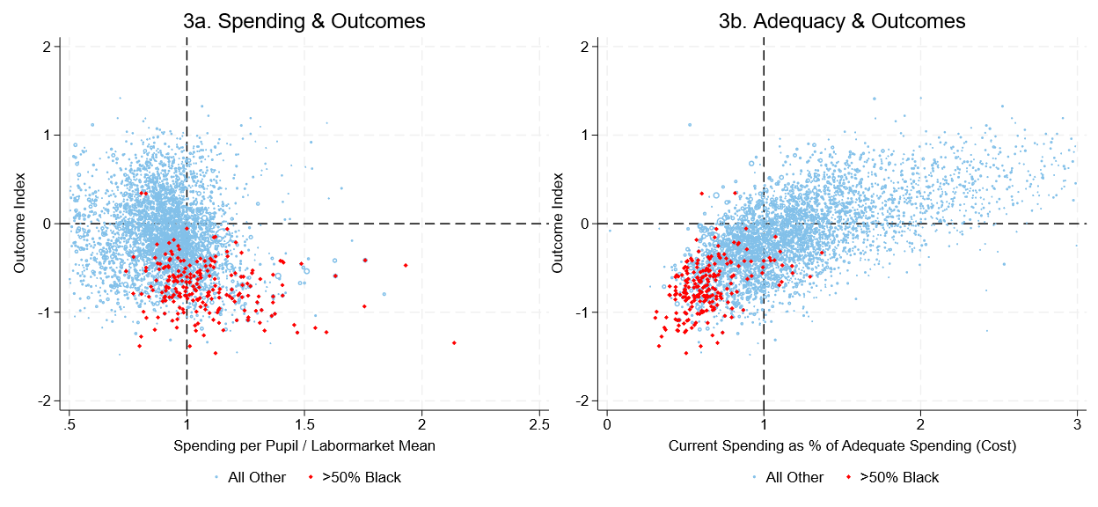
ADDRESSING THE SKEPTICS
Adjust for Cost, and the “Clouds of Doubt” Clear
3a: No Cost Control
SPENDING ÷ LABOR-MARKET MEAN vs. OUTCOME INDEX — THE RAW COMPARISON BEHIND THE “CLOUDS OF DOUBT” ARGUMENT
3b: Cost-Adjusted
CURRENT SPENDING AS % OF ADEQUATE (COST-BASED) SPENDING vs. OUTCOME INDEX — SAME DISTRICTS, SAME YEAR
Panel 3a is the “raw” scatter used to argue money doesn't matter: spending relative to the local labor market against outcomes, with almost no visible slope.
Panel 3b plots the same districts against the same outcome measure — but on the x-axis, spending is compared to the estimated cost of adequate outcomes rather than to a flat labor-market benchmark. The relationship becomes clear and positive.
In both panels, majority-Black districts (red) cluster in the lower-left: below-average outcomes, and — once cost is accounted for — below-adequate funding. The raw comparison obscures that pattern; the cost-adjusted one names it.
Source: American Institutes for Research & Bruce D. Baker, “Understanding the Cost of Providing Adequate Educational Opportunity in Oregon,” prepared for the Oregon Legislative Policy and Research Office, Feb. 2025.
19

Slide 21
KEY TAKEAWAYS
What the Data Show
1
Both states have moved from overfunded to underfunded relative to the cost of national-average outcomes since 2009 — Missouri more severely than Kansas.
2
Outcomes have declined alongside funding in both states, consistent with the broader national pattern: money matters, in both directions.
3
Underfunding is not evenly distributed — it concentrates in higher-poverty, higher-Black and -Hispanic districts, and within-metro gaps can exceed 100 points.
4
Kansas City's two school systems diverged sharply: Missouri's side swung from overfunded to the steepest decline in the metro; Kansas's side was the only one to improve.
5
Fiscal effort — what states choose to raise relative to their economies — has lagged pre-recession levels in both states, foregoing billions in potential K-12 revenue.
6
Kansas and Missouri courts have taken different paths on enforcement, shaping the legal options available going forward.
20

Slide 22
DISCUSSION
Implications for Policymakers
Messaging & public advocacy
Distilling complicated school finance evidence into terms that hold up in public debate and committee testimony.
Explaining why things feel worse — because they are
Funding adequacy and outcomes have both declined since 2009 in Kansas and, more sharply, in Missouri; the trend lines back up what districts are reporting.
Framing legal causes of action
Kansas's enforced-compliance history and Missouri's unenforced right create different starting points for litigation or legislative strategy.
Understanding federal and state protections together
Federal statutory protections (e.g., Title I, IDEA) intersect with state constitutional adequacy and equity obligations — neither substitutes for the other.
Adapted from the SFID project discussion agenda.
21

Slide 23
DATA, METHODS & SOURCES
About This Analysis
The School Finance Indicators Database
Adequacy estimates
This briefing
A joint project publishing, every year: a national report, 51 one-page state profiles, full state- and district-level datasets, online data visualizations, and supplemental reports.
From a national cost model controlling for Census poverty, labor costs, district size, population density, and other factors. Available for 12,000+ districts, 2009–2023, updated annually with a ~3-year lag.
Built from the NECM/SEDA merged file (district-year panel, 2009–2024) and the accompanying interactive Kansas + Missouri data-visualization widget.
Bruce D. Baker · University of Miami
Prepared September 2026 · Companion files: interactive widget (HTML), underlying district-year data (CSV/JSON)

