Slide 1

POLICY BRIEF
Florida School Funding
Adequacy, Equity, and Outcomes in the
Nation's Third-Largest School System
August 2026
Analysis of the School Finance Indicators Database (SFID)
Florida district panel, 2009–2024

Slide 2



EXECUTIVE SUMMARY
A Growing Gap Between Spending and the Cost of Outcomes
Florida spends less on its public schools than independent, need-adjusted cost models say is required to produce even average student outcomes — and that gap has widened sharply since 2009. The shortfall is not evenly shared: it falls hardest on high-poverty and majority Black/Hispanic districts, and shows up directly in the state's declining NAEP results.
70%
$15.7B
99.5%
of the cost of average outcomes funded in 2024 — down from 96% in 2009
statewide annual funding gap to reach national-average outcomes, 2024
of students in majority Black/Hispanic districts are in underfunded, below-average districts
Key Findings
School Finance Indicators Database (SFID) · Florida

Slide 3
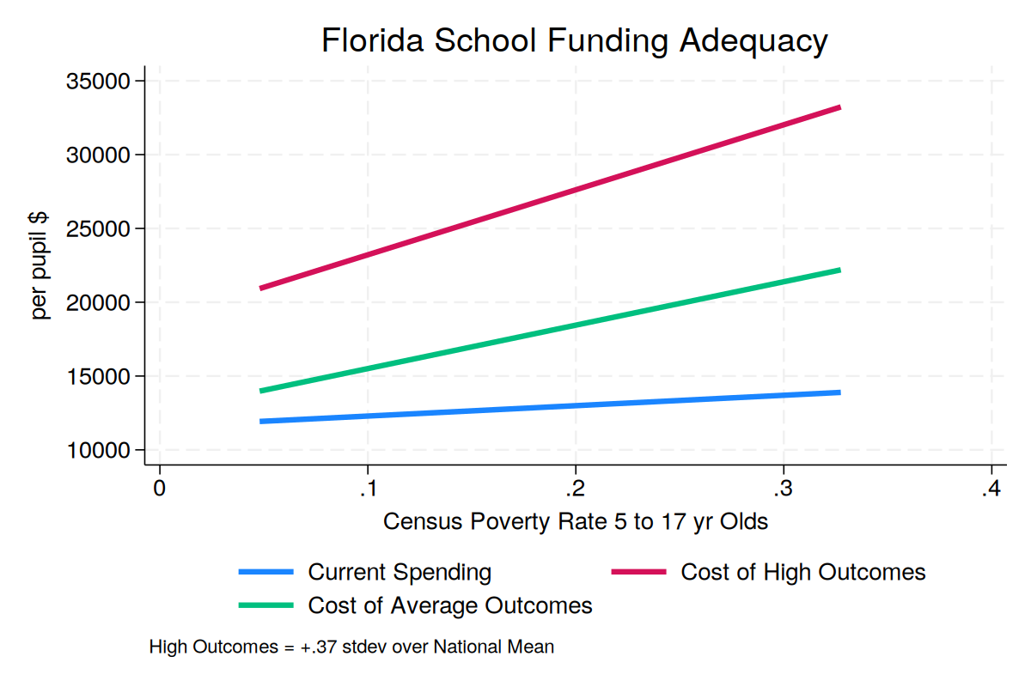
01 — ADEQUACY
The Cost of Adequate Outcomes Rises With Poverty — Spending Barely Does
The SFID estimates, district by district, what it would cost to reach national-average or high outcomes given each district's poverty rate, regional wages, and size.
At 2024 statewide relationships, the cost of average outcomes rises from about $14,000 per pupil at low poverty to $22,000 at high poverty — a $8,000 spread.
Current spending rises only from about $12,000 to $14,000 over that same range — leaving the largest dollar gaps exactly where poverty, and cost, are highest.
Figure. Current spending vs. cost of average / high outcomes by district child-poverty rate, 2024.
The Adequacy Gap
School Finance Indicators Database (SFID) · Florida

Slide 4
01 — ADEQUACY
Statewide, the Gap Has Widened in Nearly Every Year Since 2009
The Adequacy Gap
School Finance Indicators Database (SFID) · Florida

Slide 5
01 — ADEQUACY
The Statewide Dollar Gap Grew Elevenfold in Fifteen Years
$1.4B
gap in 2009
↓ grew to
$15.7B
gap in 2024
Closing the remaining gap would require a 44% increase over current statewide spending.
The Adequacy Gap
School Finance Indicators Database (SFID) · Florida

Slide 6
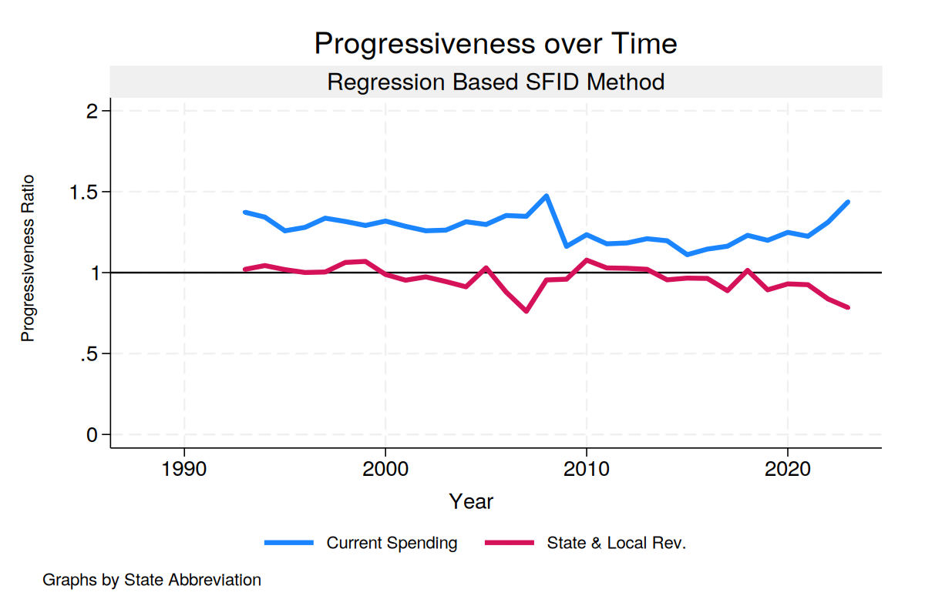
02 — EQUITY
State-and-Local Dollars No Longer Favor High-Poverty Districts
A progressivity ratio above 1.0 means higher-poverty districts get more per pupil, need-adjusted; below 1.0 means they get less.
Total spending (blue) stays progressive — but that's carried almost entirely by federal Title I and IDEA dollars.
State & local revenue (red) — the part Tallahassee controls — has drifted from neutral to regressive, falling to about 0.8 by the latest year.
Figure. Progressivity ratio of total spending vs. state & local revenue only, 1993–2023. 1.0 = poverty-neutral.
Equity
School Finance Indicators Database (SFID) · Florida

Slide 7
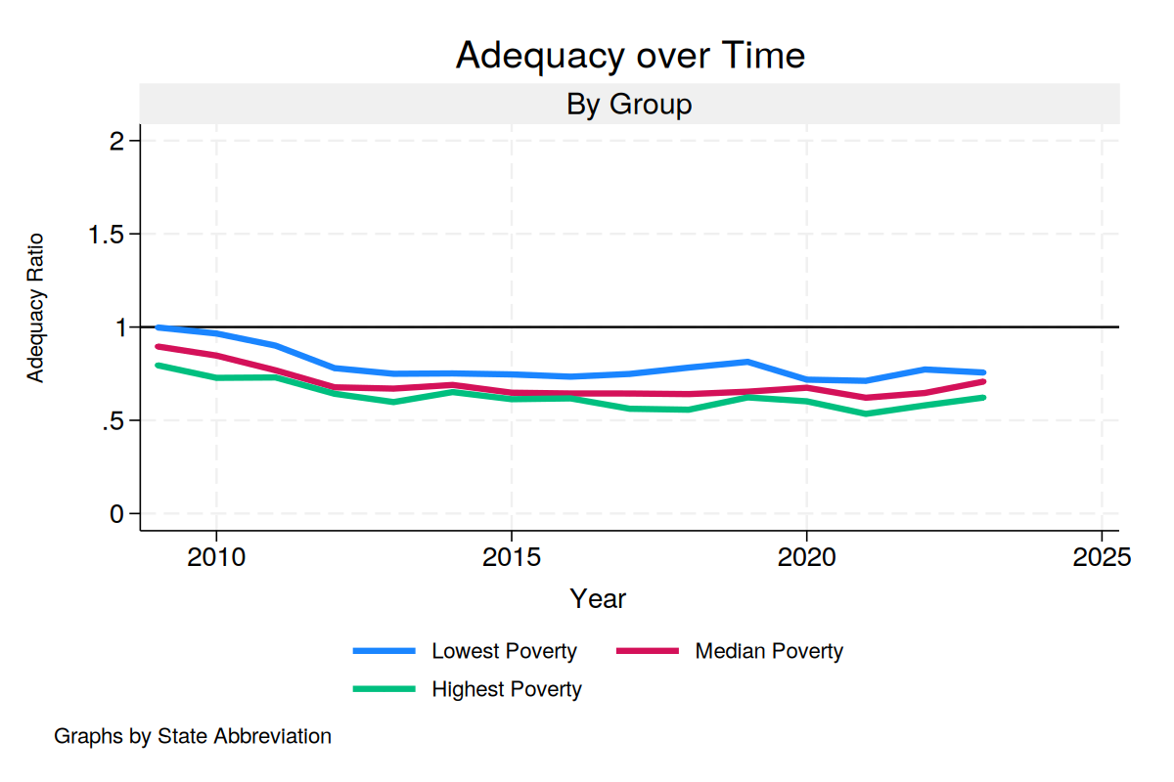
02 — EQUITY
High-Poverty Districts Have Fallen Furthest From Adequate Funding
Every poverty group has moved further from adequate funding since 2009.
The decline is steepest — and the resulting level lowest — among the highest-poverty districts.
By the most recent year: lowest-poverty districts fund ~75–78% of adequate cost; highest-poverty districts fund only ~60–62%.
Figure. Adequacy ratio (spending ÷ cost of national-average outcomes) by district poverty tercile, 2009–2023.
Equity
School Finance Indicators Database (SFID) · Florida

Slide 8
02 — EQUITY
Underfunding Falls Hardest on Majority Black and Hispanic Districts
Classifying districts by whether they are majority Black/Hispanic, and by whether they sit in the “inadequate & below-average” quadrant (underfunded relative to cost, and producing below-average outcomes):
99.5%
91.7%
of students in majority Black/Hispanic districts
of students in all other districts
attend a district that is both underfunded relative to cost and producing below-average outcomes.
attend a district in that same underfunded / below-average quadrant — a smaller, but still very high, share.
Essentially no majority Black/Hispanic district “beats the odds” on an inadequate budget (0% reach above-average outcomes while underfunded), versus 7.1% of other underfunded districts that do.
Equity
School Finance Indicators Database (SFID) · Florida

Slide 9
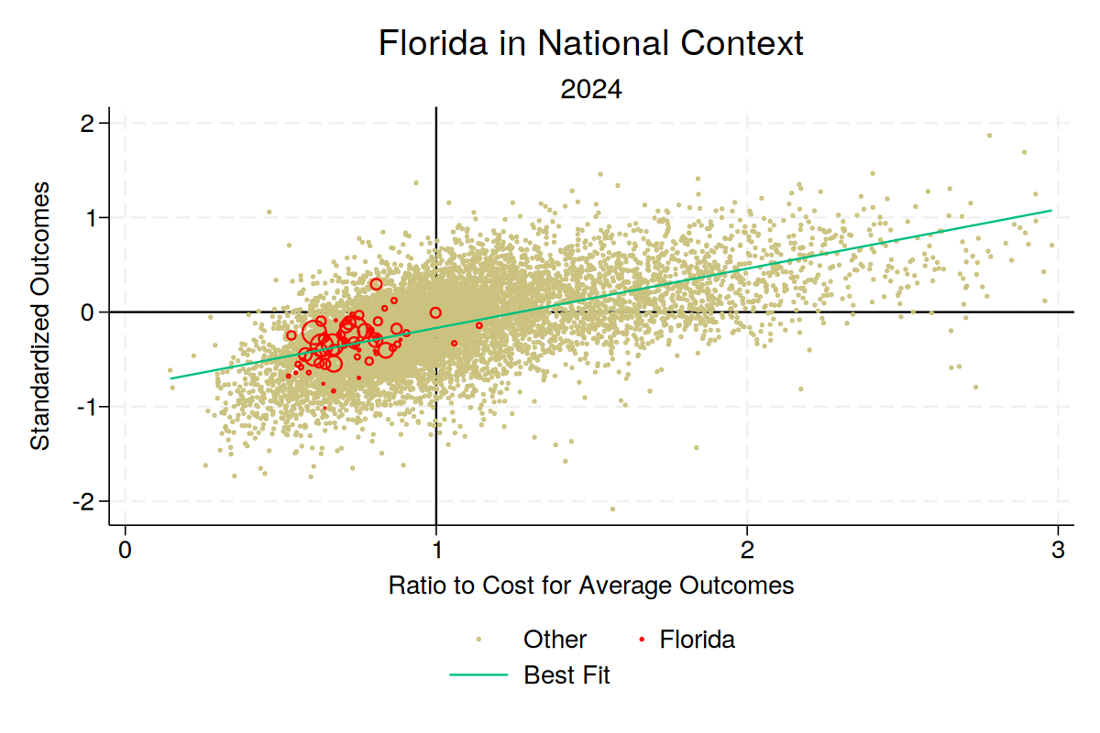
03 — OUTCOMES
Florida's Results Track Its Funding Level, Nationally
Every U.S. district sits somewhere on a national relationship between funding adequacy and standardized outcomes.
Florida districts (red) cluster tightly on that national trend line, in the underfunded / below-average quadrant.
Florida is not an outlier below the pattern — it is getting the outcomes its funding level predicts, not managing to out-perform it.
Figure. Standardized outcomes vs. ratio of spending to cost of average outcomes, all U.S. districts, 2024 (Florida in red).
Outcomes
School Finance Indicators Database (SFID) · Florida

Slide 10
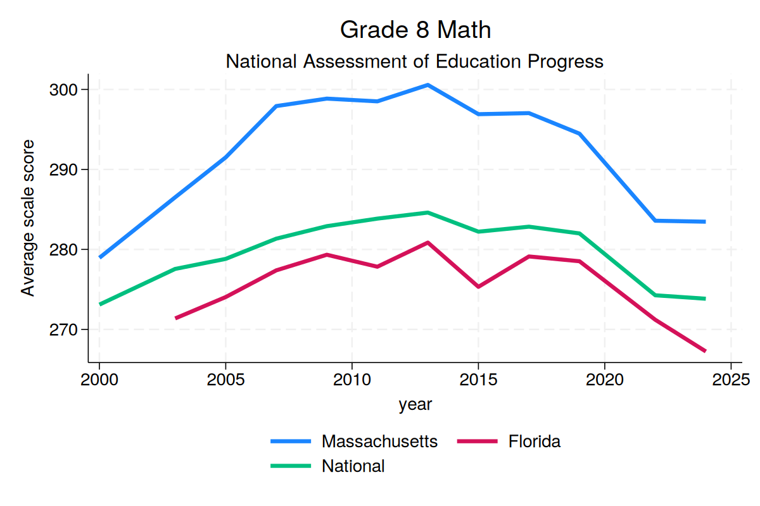
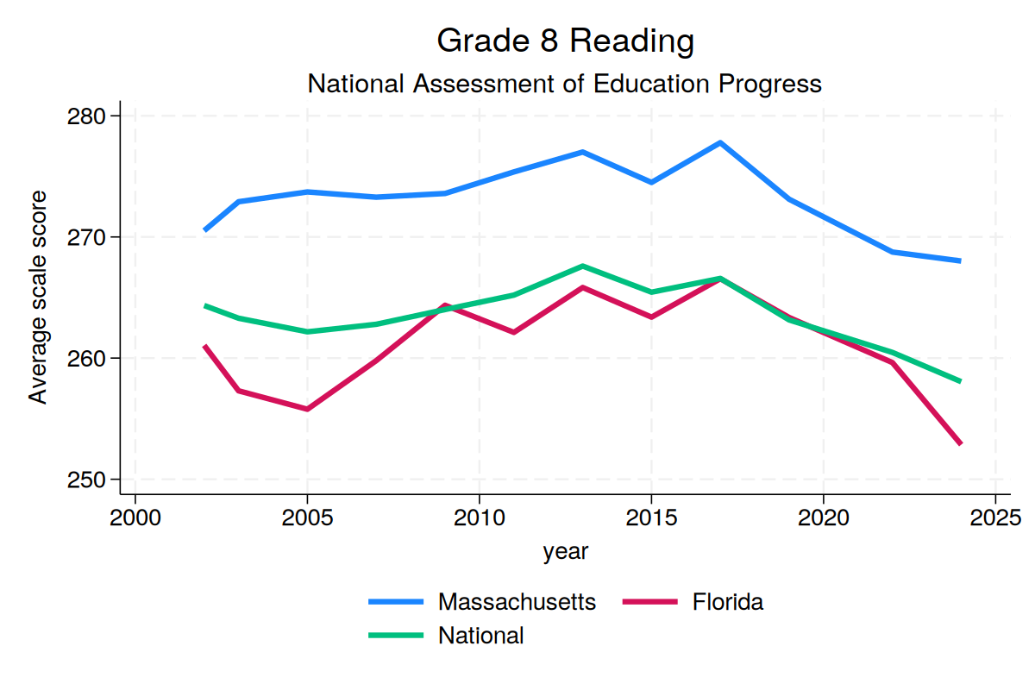
03 — OUTCOMES
NAEP Scores Have Fallen Faster in Florida Than Nationally Since 2019
Grade 8 Math: FL −12 pts (2019–2024) vs. National −8 pts
Grade 8 Reading: FL −13 pts (2017–2024) vs. National −9 pts
Outcomes
School Finance Indicators Database (SFID) · Florida

Slide 11

04 — POLICY IMPLICATIONS
Three Steps to Close the Gap
Close the adequacy gap, not just the appropriations gap.
Benchmark K-12 appropriations explicitly against a cost model instead of enrollment growth or prior-year spending — the only way to close a $15.7 billion shortfall.
Restore weight for poverty in the state-and-local formula.
Federal aid alone cannot keep the system need-responsive. Strengthen poverty (and concentration-of-poverty) weighting in the Florida Education Finance Program base formula.
Track the districts furthest from adequacy.
A standing state dashboard of district-level adequacy, updated with the annual FEFA calculation, would show whether formula changes close the gap where it's largest.
Policy Implications
School Finance Indicators Database (SFID) · Florida

Slide 12
ABOUT THIS ANALYSIS
Data & Methodology
This brief is based on the School Finance Indicators Database (SFID), maintained by the Albert Shanker Institute and the Rutgers Graduate School of Education (Bruce D. Baker, Matthew Di Carlo, and colleagues). SFID combines U.S. Census Bureau F-33 school finance data, the Stanford Education Data Archive, and NAEP results to produce annual, need-adjusted cost and outcome estimates for every U.S. school district.
Data cover Florida's 67 county school districts, school years 2009–2024 (NAEP and SEDA outcome series extend 2000–2025 where available). Findings describe association, not a single causal estimate — cost figures are modeled and carry uncertainty at the individual district-year level; statewide and multi-year patterns are the most reliable signal.
Full national data and methodology: schoolfinancedata.org
About This Analysis
School Finance Indicators Database (SFID) · Florida

