Slide 1

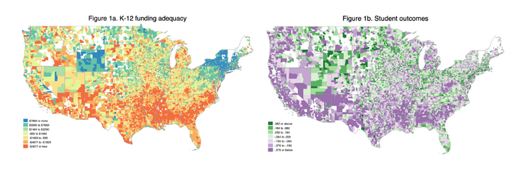

SchoolFinance101.com
SchoolFinanceData.org
Financing a High-Quality System of Free Public Schools for Florida’s Children
Bruce D. Baker
University of Miami

Slide 2

Florida Constitution
SchoolFinance101.com
SchoolFinanceData.org
Article IX, Section 1
  “Adequate provision shall be made by law for a uniform, efficient, safe, secure, and high quality system of free public schools that allows students to obtain a high quality education…”
    Ratified by voters in 1998 & 2002
not merely “adequate” but “high quality;”
  FLSC called this “puffing”
not merely the system of public schools itself, but the education obtained from that system;
  FLSC considered this an unmanageable standard (& unrelated to funding because funding has nothing to do with school quality)
the system shall be uniform, efficient, safe and secure;
the system shall be one of “free public schools.”
CITIZENS FOR STRONG SCHOOLS v. State, 262 So. 3d 127 - Fla: Supreme Court 2019

Slide 3
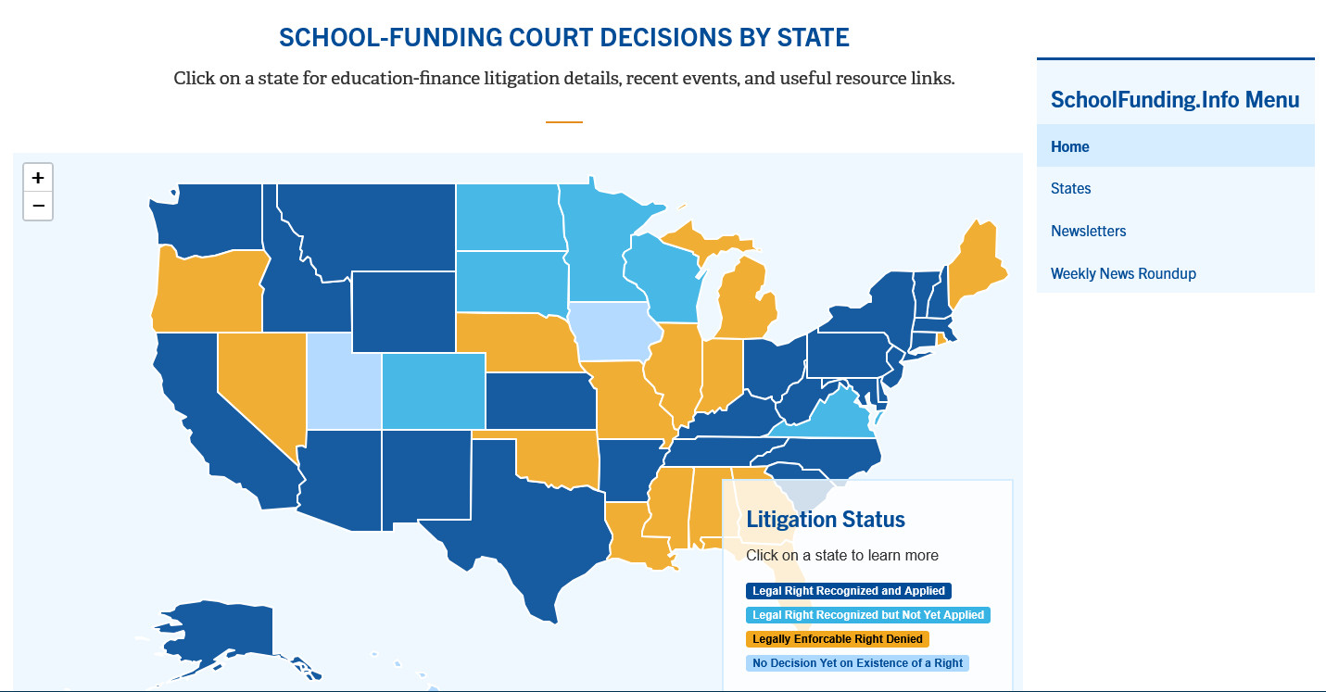
SchoolFinance101.com
SchoolFinanceData.org

Slide 4
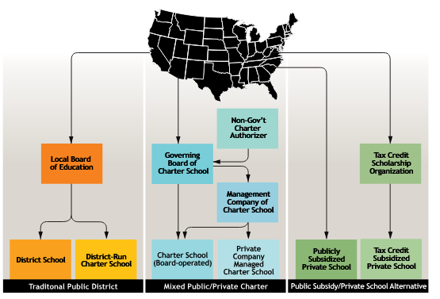
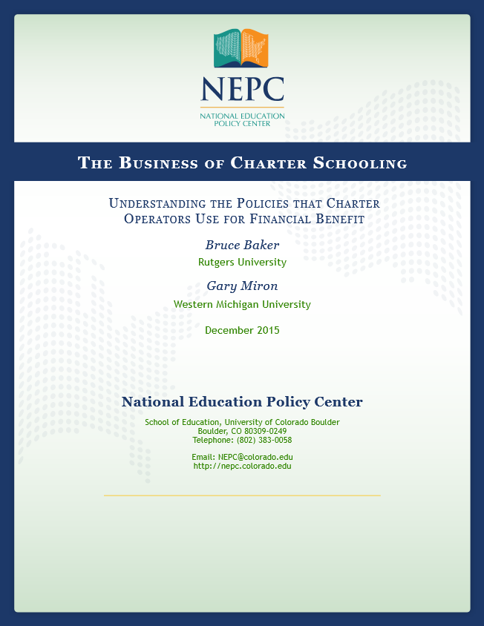
SchoolFinance101.com
SchoolFinanceData.org

Slide 5
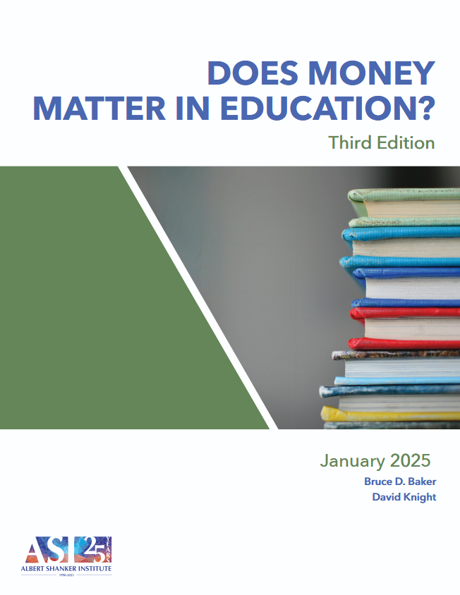
Money Matters
SchoolFinance101.com
SchoolFinanceData.org
Money matters whether it’s going up or down: Increases to school funding lead to improved student outcomes and decreased in funding lead to decreases in outcomes;
Money matters whether that money is driven into annual operating expenditures or capital investments: Increased funding for annual operations typically leads to better teacher wages and smaller class sizes, showing positive effects on student outcomes. Increases to capital spending, from improved classroom facilities, to heating/cooling system improvements lead to improved student outcomes, but often with a lag between when the money is raised and spent and when students have access to the improved facilities.
Money matters more- and has a more profound impact – for children experiencing poverty and in school districts and communities in which states have historically underinvested: Progressive funding matters, often yielding a several fold difference in the return on investment to spending additional dollars in previously low spending and/or higher poverty settings than in lower poverty settings.
Money matters regardless of how changes in funding come about: That is, whether funding increases result from legislative action, fluctuations in economic conditions, federal stimulus, local voter approval or judicial order increases to funding yield improvements to student outcomes.

Slide 6
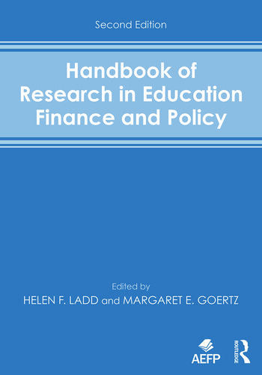
Goals of School Finance Systems
SchoolFinance101.com
SchoolFinanceData.org
The goal of school finance systems is to provide all children, regardless of where they live or attend school, equal opportunity to achieve common, adequate outcome goals
  Providing equal educational opportunity toward common goals costs different amounts in different settings, and across children (individually and collectively) by needs and contexts
  In the U.S., State accountability systems set common goals - rate, rank and evaluate schools on whether they meet those goals
  A fair system requires funding sufficient to provide equal opportunity to meet these goals (which are often used for articulating constitutional rights)
14 Conceptions of Equity and Adequacy in School Finance
16 Measurement of Cost Differentials

Slide 7
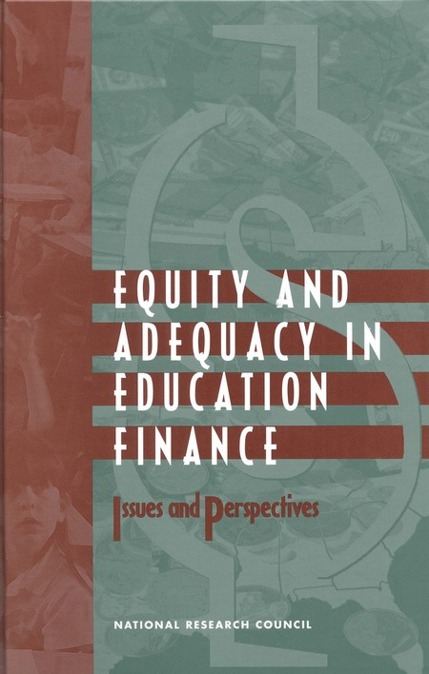
Basic Principles of “Costs” & “Equal Opportunity”
SchoolFinance101.com
SchoolFinanceData.org
It costs more to achieve higher than lower outcomes
  All else equal, the per pupil spending required to achieve higher, and broader outcome goals is higher than the per pupil spending required to achieve narrower and/or lower goals
It costs more to achieve the same outcomes with some children than others
  Collective, social context effects (poverty)
  Specific student needs (ELL, Disability)
It costs more to achieve the same outcomes in some settings than others
  Economies of Scale – Small, sparsely populated remote school districts
  Regional variations in the competitiveness of wages (labor market effects)
16 Measurement of Cost Differentials
8
Performance Standards and Educational Cost Indexes: You Can't Have One Without the Other

Slide 8
Recommendation #1 – Phase 1:
SchoolFinance101.com
SchoolFinanceData.org
Engage in the work of setting a manageable standard of “high quality” public schooling for Florida’s children by engaging in analyses of the costs associated with providing each and every child in Florida with equal educational opportunity to achieve high education outcomes.
  Establish a statewide commission on school funding.
  Engage stakeholders in setting standards of excellence for Florida children.
  Engage experts to estimate the costs associated with meeting those standards, applying appropriately rigorous methods.

Slide 9
Recommendation #1 – Phase 2:
SchoolFinance101.com
SchoolFinanceData.org
Guided by those estimates, reform the school finance formula and increase state aid to schools so as to provide them with the necessary resources for all children to have equal educational opportunity to achieve high education outcomes. That is, meet the constitutional standard ratified by Florida voters in 1998 and 2002. This should include estimates of commensurate funding for charter schools, based on needs and costs.
  Take eliminating or reducing property taxes off the table. The most effective form of property tax relief is increased state aid, as would occur under implementation of this recommendation.

Slide 10
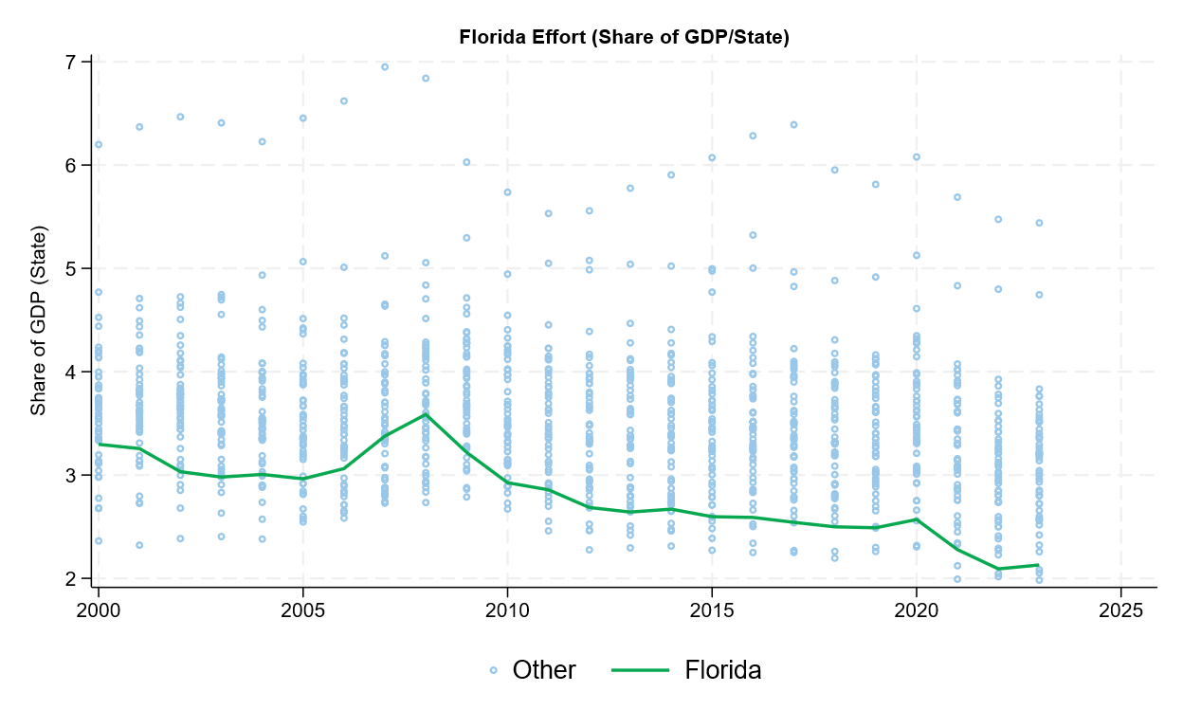
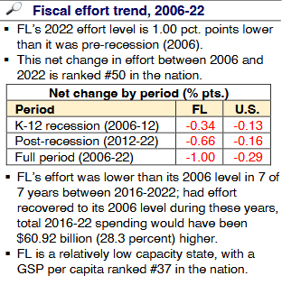
Race to the bottom on effort
SchoolFinance101.com
SchoolFinanceData.org
Data source: School Finance Indicators Database (State Panel). https://www.schoolfinancedata.org/download-data/

Slide 11
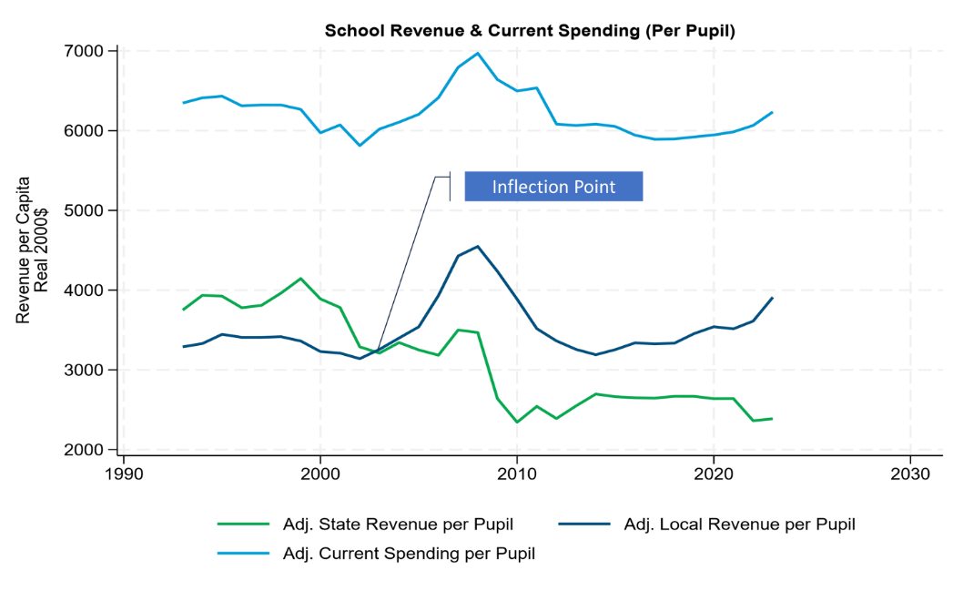
Increased Dependence on Property Taxes
SchoolFinance101.com
SchoolFinanceData.org
Data source: School Finance Indicators Database (District Panel). Revenue and enrollment data from U.S. Census Fiscal Survey of Local Governments (F33, public school district finances). Inflation adjustment based on BLS employment cost index, applied to education comparable wage index.

Slide 12
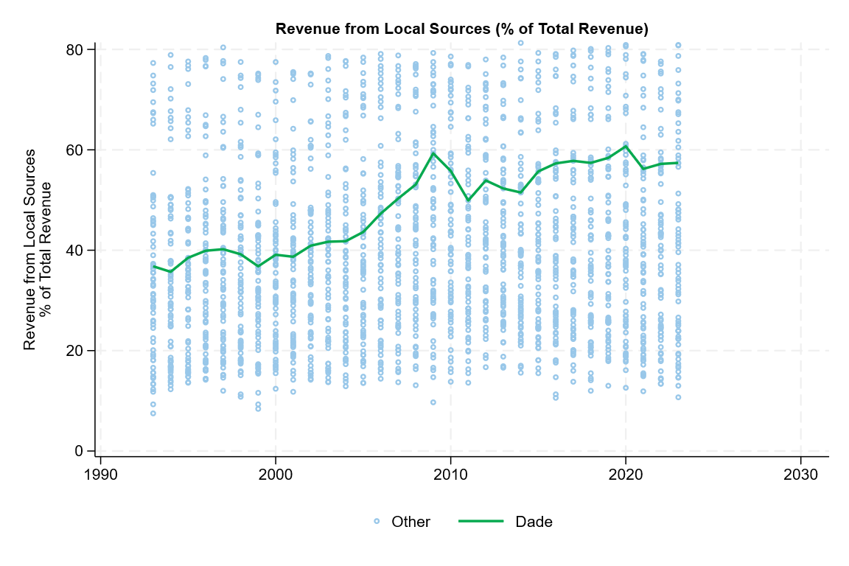
Increased Dependence on Property Taxes
SchoolFinance101.com
SchoolFinanceData.org
Data source: School Finance Indicators Database (District Panel). Revenue and enrollment data from U.S. Census Fiscal Survey of Local Governments (F33, public school district finances).

Slide 13
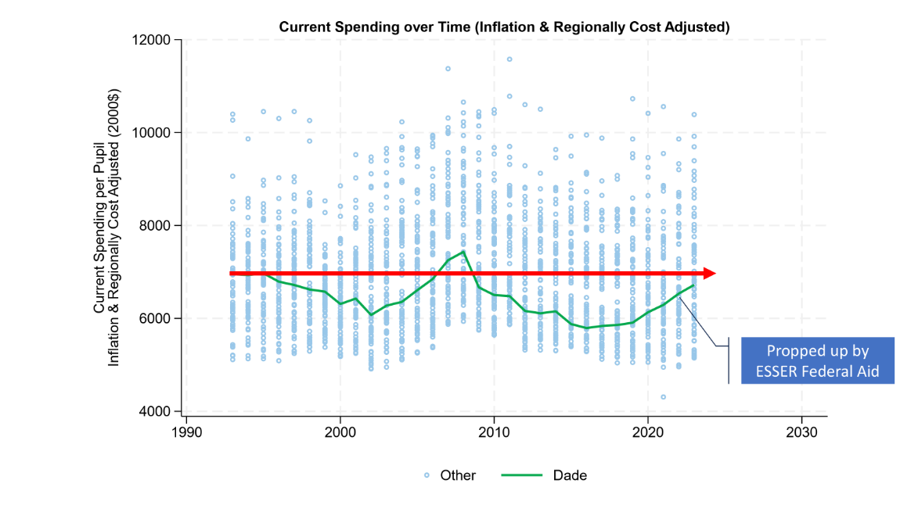
Consequences – Spending
SchoolFinance101.com
SchoolFinanceData.org
Data source: School Finance Indicators Database (District Panel). Revenue and enrollment data from U.S. Census Fiscal Survey of Local Governments (F33, public school district finances). Inflation adjustment based on BLS employment cost index, applied to education comparable wage index.

Slide 14
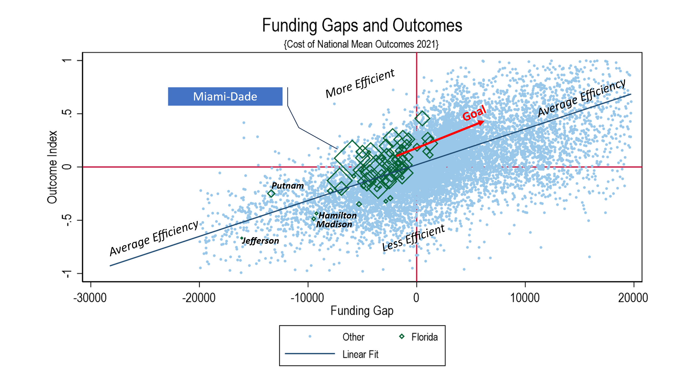
Middling outcomes on lower middling spending
SchoolFinance101.com
SchoolFinanceData.org
Data Source: School Finance Indicators Database (District Cost Database) https://www.schoolfinancedata.org/download-data/

Slide 15

No attention to cost & need in FEFP
SchoolFinance101.com
SchoolFinanceData.org
On average, kids in schools w/larger shares of low income children have fewer state & local resources per pupil

Slide 16
Recommendation 2 – Part 1:
SchoolFinance101.com
SchoolFinanceData.org
Impose a moratorium on charter school expansion, including the Schools of Hope Program. The existing charter school sector in Florida is compromising equity, eroding efficiency and producing poor educational outcomes for those it serves.
  New York’s Success Academies have no proven track record of serving children like those they’d be called upon to serve in Miami-Dade, having served very few English learners and underserving Latino communities in New York. Like Miami-Dade’s current charter sector, they have also underserved low-income populations and children with disabilities. Introduction of Success Academies in Miami-Dade will likely exacerbate equity concerns that are already significant.

Slide 17
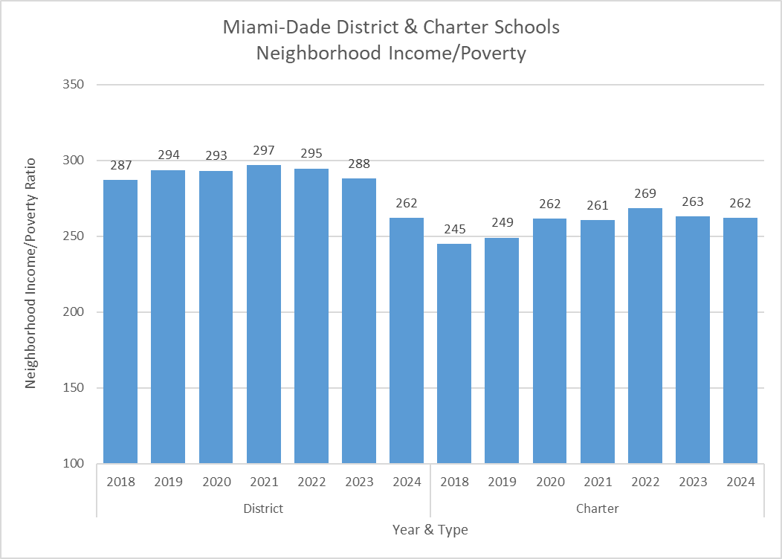

Segregative inefficiency & inequity
SchoolFinance101.com
SchoolFinanceData.org
Charters are in lower income neighborhoods
NCES Neighborhood Poverty Index: https://nces.ed.gov/programs/edge/Economic/NeighborhoodPoverty
FLDOE Enrollment & Assessment Data: https://www.fldoe.org/accountability/data-sys/edu-info-accountability-services/pk-12-public-school-data-pubs-reports/index.stml & https://edudata.fldoe.org/AdvancedReports_Tableau.html?StudentEnrollments=true

Slide 18
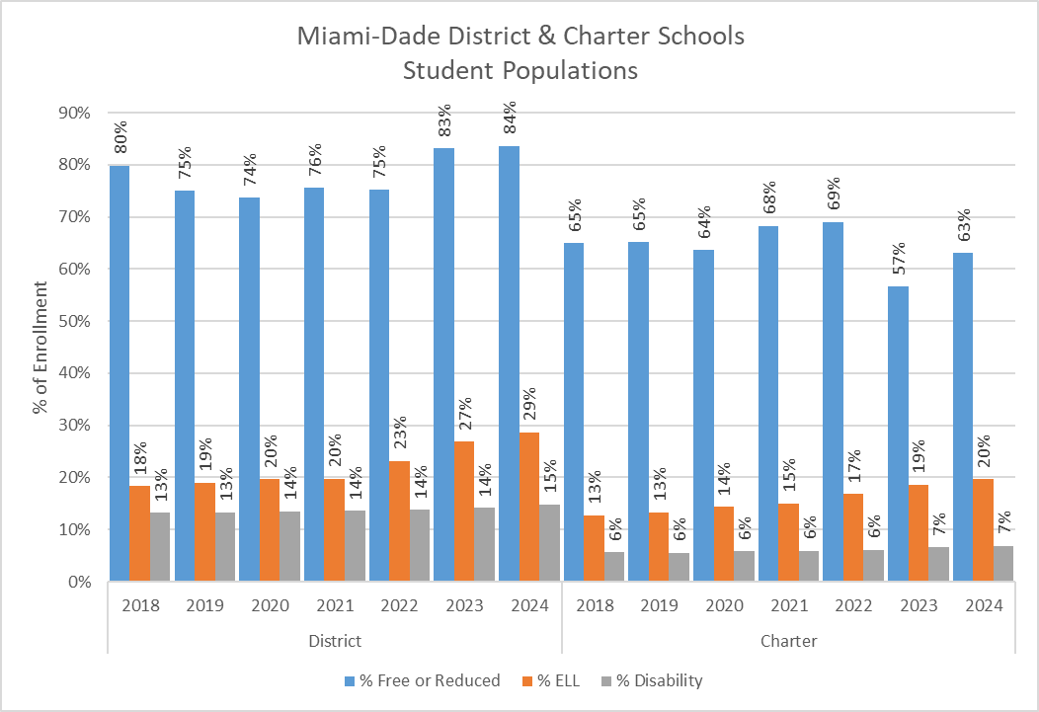
Segregative inefficiency & inequity
SchoolFinance101.com
SchoolFinanceData.org
Charters serve fewer low income children
FLDOE Enrollment & Assessment Data: https://www.fldoe.org/accountability/data-sys/edu-info-accountability-services/pk-12-public-school-data-pubs-reports/index.stml & https://edudata.fldoe.org/AdvancedReports_Tableau.html?StudentEnrollments=true
Charters serve far fewer ELL children or w/Disabilities

Slide 19
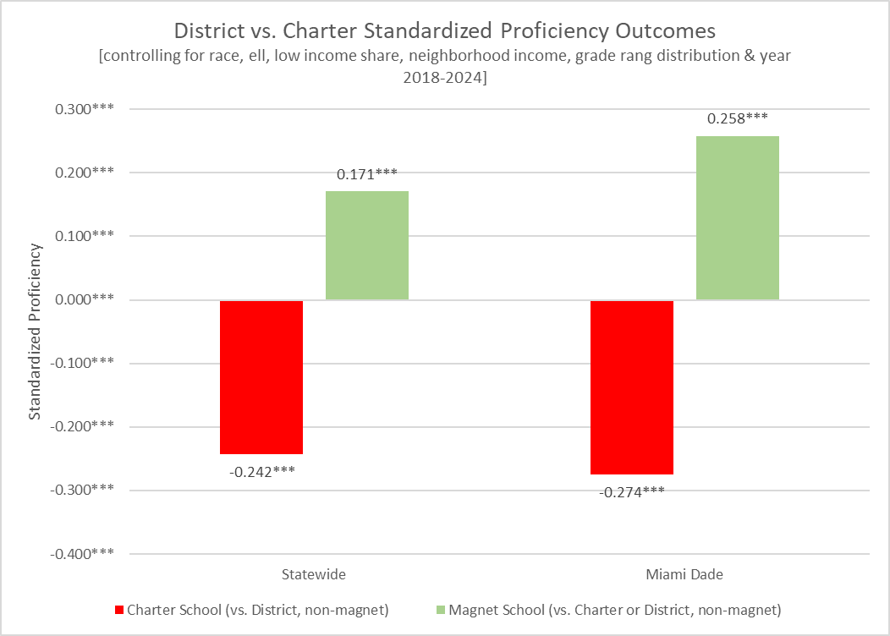

Low Outcomes of Florida Charter Schools
SchoolFinance101.com
SchoolFinanceData.org
FLDOE Enrollment & Assessment Data: https://www.fldoe.org/accountability/data-sys/edu-info-accountability-services/pk-12-public-school-data-pubs-reports/index.stml & https://edudata.fldoe.org/AdvancedReports_Tableau.html?StudentEnrollments=true

Slide 20
Low Outcomes of Florida Charter Schools
SchoolFinance101.com
SchoolFinanceData.org
FLDOE Enrollment & Assessment Data: https://www.fldoe.org/accountability/data-sys/edu-info-accountability-services/pk-12-public-school-data-pubs-reports/index.stml & https://edudata.fldoe.org/AdvancedReports_Tableau.html?StudentEnrollments=true

Slide 21
Schools of Hope: NYC Success Academies?
SchoolFinance101.com
SchoolFinanceData.org

Slide 22
Recommendation 2 – Parts 2 & 3
SchoolFinance101.com
SchoolFinanceData.org
Recommendation 2 – Part 2: Establish new regulations for evaluating existing charter operators and vetting new charter operators to ensure improved equity in the distribution of students by their needs across schools. Adopt and enforce stricter regulations pertaining to student outcomes.
Recommendation 2 – Part 3: Adopt updated charter school legislation to ensure that charter schools are sufficiently “public,” required to operate as if “state actors,” protecting children’s constitutional rights and abiding by all relevant federal statutes.

Slide 23
SchoolFinance101.com
SchoolFinanceData.org

Slide 24
SchoolFinance101.com
SchoolFinanceData.org

Slide 25

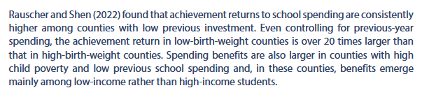
Recommendation 3
SchoolFinance101.com
SchoolFinanceData.org
Freeze expansion of the voucher program to free up state resources to support a fully funded, overhauled public school finance formula, to provide a uniform system of free public schools.
$$ for High Poverty Public Districts
Vouchers for Existing Private Enrollments
https://sociologyofdevelopment.com/wp-content/uploads/2022/10/rauscher-and-shen-2022-no-3.pdf

Slide 26
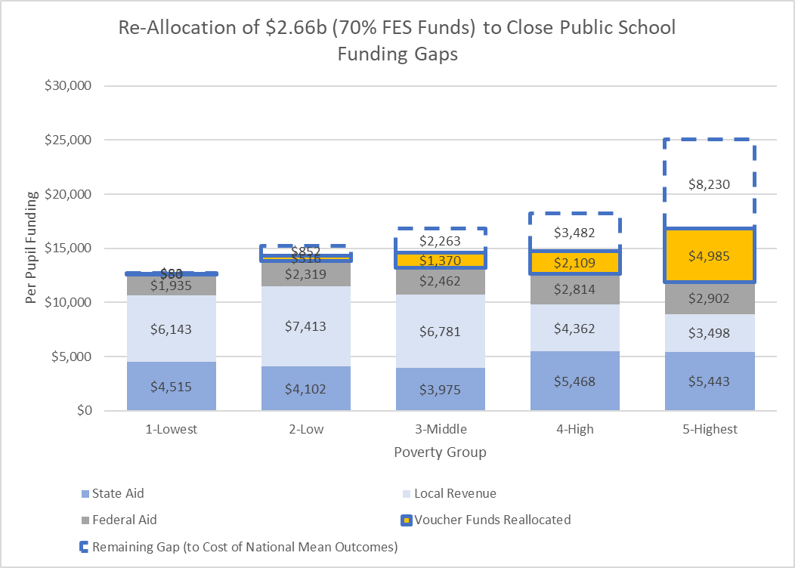
Re-allocation of voucher funds for ROI
SchoolFinance101.com
SchoolFinanceData.org
Data Source: School Finance Indicators Database (District Cost Database) https://www.schoolfinancedata.org/download-data/

Slide 27
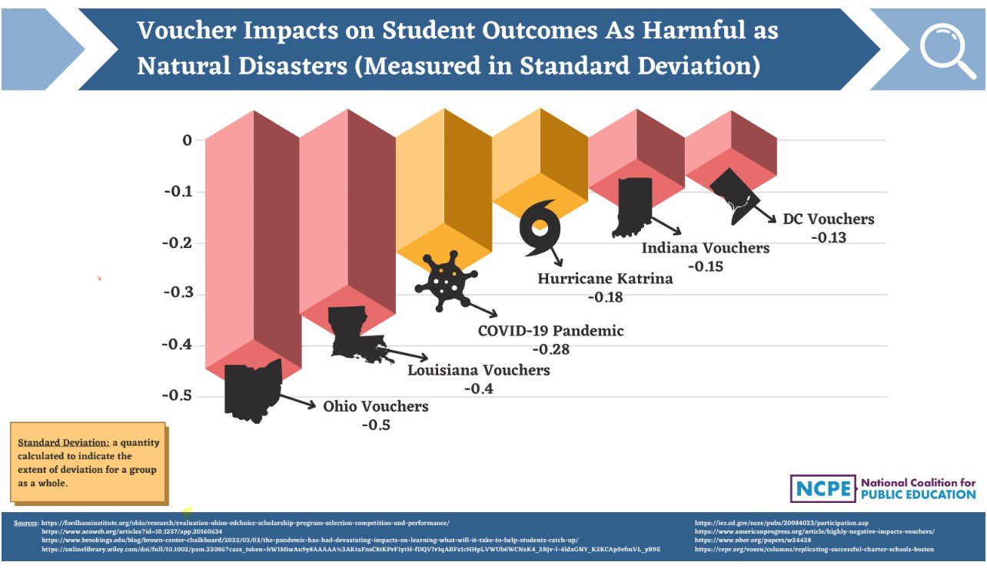

Voucher Effects for Switchers
SchoolFinance101.com
SchoolFinanceData.org

Slide 28
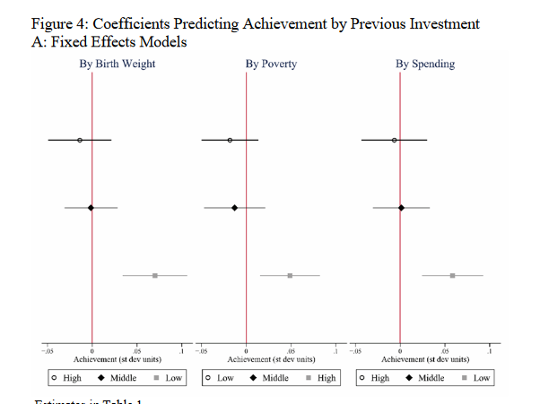

Return on Investment by Prior Spending & Need
SchoolFinance101.com
SchoolFinanceData.org
https://sociologyofdevelopment.com/wp-content/uploads/2022/10/rauscher-and-shen-2022-no-3.pdf

Slide 29
SchoolFinance101.com
SchoolFinanceData.org
Appendices
Bruce D. Baker
University of Miami

Slide 30

Recent Applications of Cost Modeling
SchoolFinance101.com
SchoolFinanceData.org
Professional Reports
Colorado – Atchison, D., Levin, S., Levin, J., Kolar, A., Blair, D., Srikanth, A., & Salvato, B. (2024). Equity and Adequacy of Colorado School Funding: A Cost-Modeling Approach. https://www.cde.state.co.us/cdedepcom/schoolfinancecostmodelingadequacystudyreport
Delaware – D. Atchison, B.D. Baker, J. Levin, S. Fatima, A. Trauth, A. Srikanth, C. Herberle, N. Gannon-Slater, L. Junk, K., Wallace, L., & Baker, B. (2023) Assessment of Delaware Public School Funding. https://education.delaware.gov/wp-content/uploads/2023/12/23-22933_1_Delaware_Full_Report-FMT-ed103023-Version-2.pdf
New Hampshire – Atchison, D., Baker, B.D., Levin, J., Kearns, C. (2020) New Hampshire Commission to Study School Funding, Final Report. https://carsey.unh.edu/sites/default/files/media/2020/09/20-12685_nh_final_report_v10.pdf
Ohio – Levin, J., Brooks, Baker, B., C., Fatima, S., Blair, D., Salvato, B., Srikanth, A., London, B., Atchison, D., Jacobson, A., Hadley, L., Dotson, B., Harrington, H., Yeshitla, B. (2025). Study of the Educational Costs of Serving Students Who Are Economically Disadvantaged. https://education.ohio.gov/getattachment/About/Annual-Reports/Economic-Disadvantage-Finance-Study-American-Institutes-for-Research.pdf.aspx?lang=en-US
Oregon – Brooks, C., Levin, J., Baker, B., & Salvato, B. (2025). Understanding the Cost of Providing Adequate Educational Opportunity in Oregon. https://olis.oregonlegislature.gov/liz/2025R1/Downloads/CommitteeMeetingDocument/291280
Vermont – Kolbe, T., Baker, B.D., Atchison, D., Levin, J. (2019) Pupil Weighting Factors Report. https://legislature.vermont.gov/assets/Legislative-Reports/edu-legislative-report-pupil-weighting-factors-2019.pdf
Peer Reviewed Articles & Working Papers
Baker, B. D. (2024). How and Why Racial Isolation Affects Education Costs & the Provision of Equal Educational Opportunity. EdWorkingPaper No. 24-1047. Annenberg Institute for School Reform at Brown University.
Baker, B. D., Weber, M., & Srikanth, A. (2021). Informing Federal School Finance Policy with Empirical Evidence. Journal of Education Finance, 47(1), 1-25.
Gronberg, T. J., Jansen, D. W., & Taylor, L. L. (2017). Are charters the best alternative? A cost frontier analysis of alternative education campuses in Texas. Southern Economic Journal, 83(3), 721-743.
Levin, J., Baker, B., Lee, J., Atchison, D., & Kelchen, R. (2022). An Examination of the Costs of Texas Community Colleges. REL 2023-142. Regional Educational Laboratory Southwest.
Kolbe, T., Baker, B. D., Atchison, D., Levin, J., & Harris, P. (2021). The additional cost of operating rural schools: Evidence from Vermont. AERA Open, 7, 2332858420988868.
Zhao, B. (2022). Estimating the cost function of Connecticut public K–12 education: implications for inequity and inadequacy in school spending. Education Economics, 31(4), 439-470.

Slide 31
Policy Influence of Cost Modeling Studies
SchoolFinance101.com
SchoolFinanceData.org
Formula Changes
Texas Community College Formula
  Levin, J., Baker, B., Lee, J., Atchison, D., & Kelchen, R. (2022). An Examination of the Costs of Texas Community Colleges. REL 2023-142. Regional Educational Laboratory Southwest. https://ies.ed.gov/sites/default/files/rel-southwest/document/2025/07/REL_2023142.pdf
Vermont K12 Formula Weights
  Kolbe, T., Baker, B.D., Atchison, D., Levin, J. (2019) Pupil Weighting Factors Report. State of Vermont, House and Senate Committees on Education. https://legislature.vermont.gov/assets/Legislative-Reports/edu-legislative-report-pupil-weighting-factors-2019.pdf
Kansas School Funding
Other State Uses of NECM/SFID
Virginia Joint Legislative Audit & Review Commission Report
  https://jlarc.virginia.gov/landing-2023-virginias-k-12-funding-formula.asp
Missouri Department of Elementary and Secondary Education Report
  https://dese.mo.gov/media/pdf/missouri-school-funding-march-2023

Slide 32
SchoolFinance101.com
SchoolFinanceData.org

Slide 33
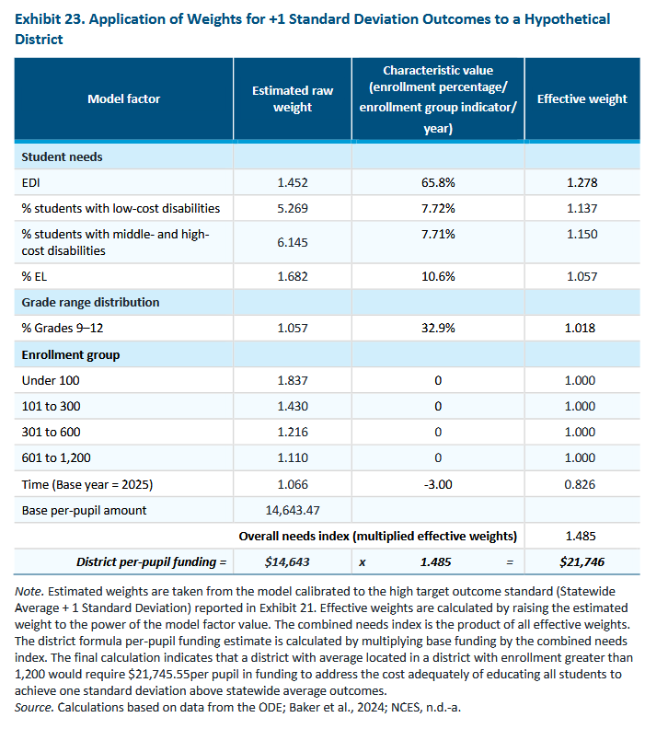
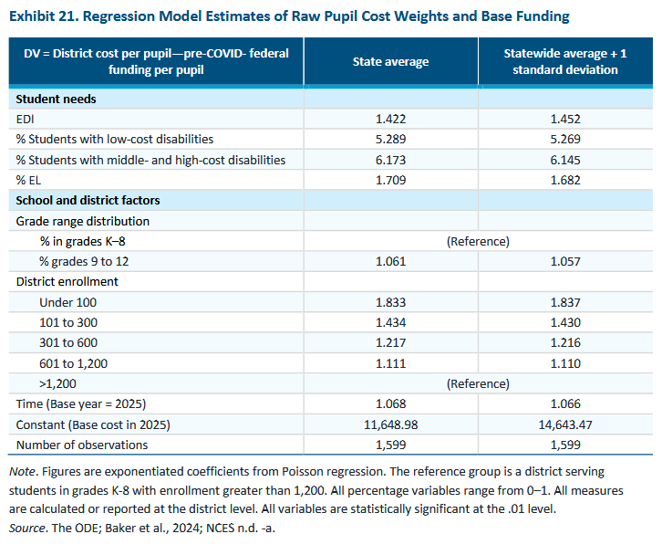
SchoolFinance101.com
SchoolFinanceData.org
Oregon
https://olis.oregonlegislature.gov/liz/2025R1/Downloads/CommitteeMeetingDocument/291280

Slide 34
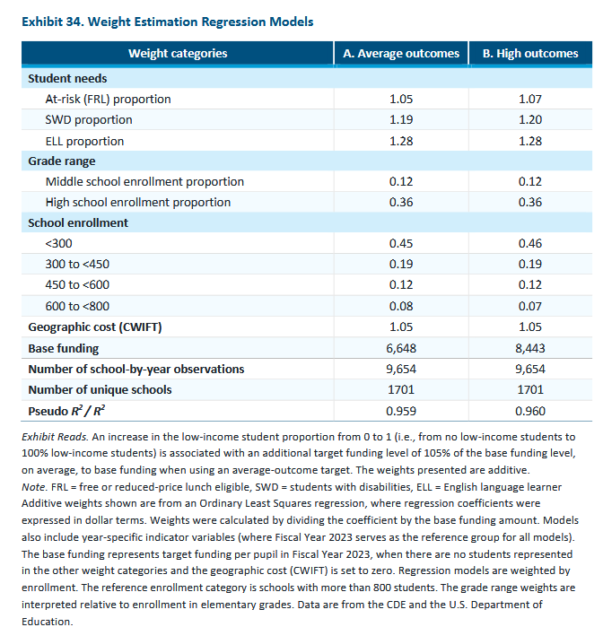
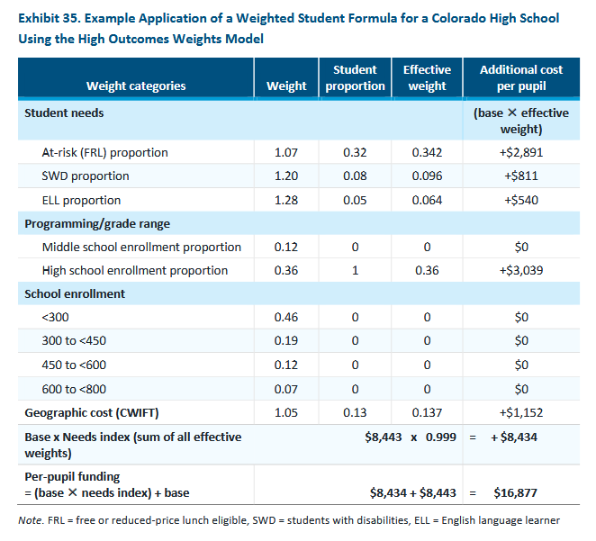
SchoolFinance101.com
SchoolFinanceData.org
Colorado
https://www.cde.state.co.us/cdedepcom/schoolfinancecostmodelingadequacystudyreport

Slide 35
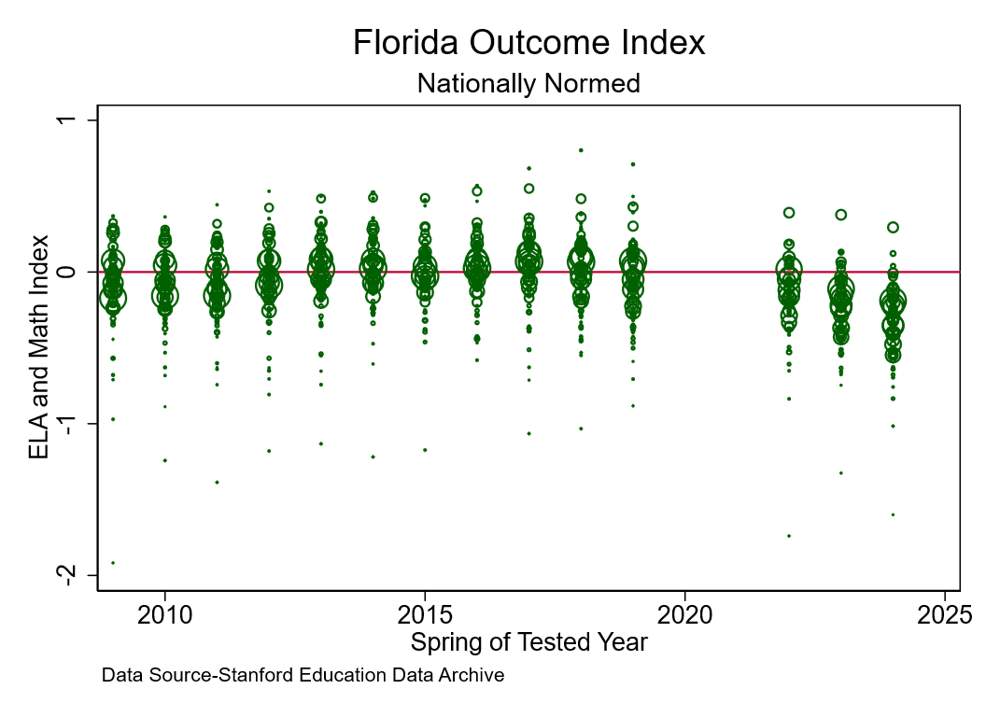

Slide 36
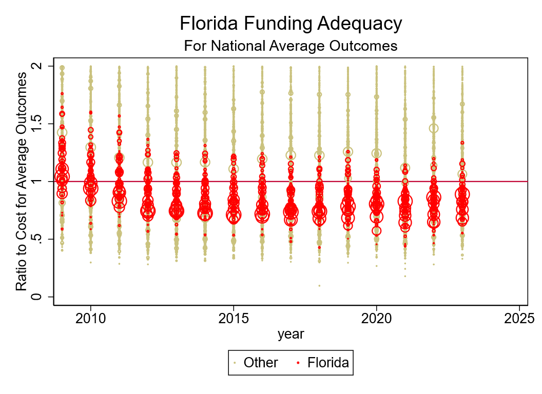
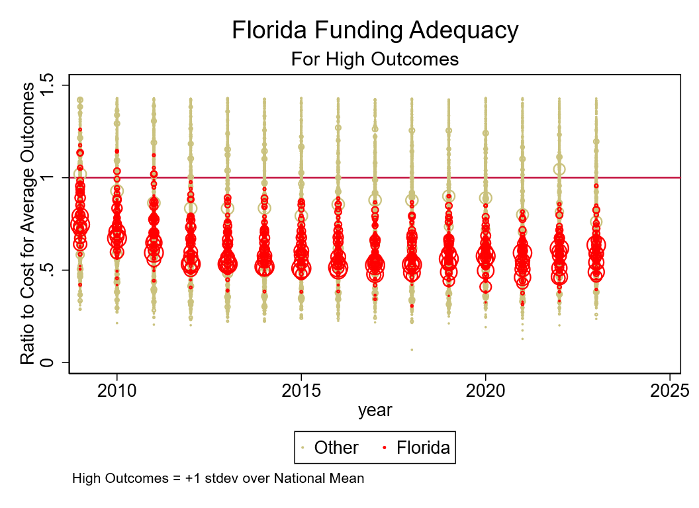

Slide 37
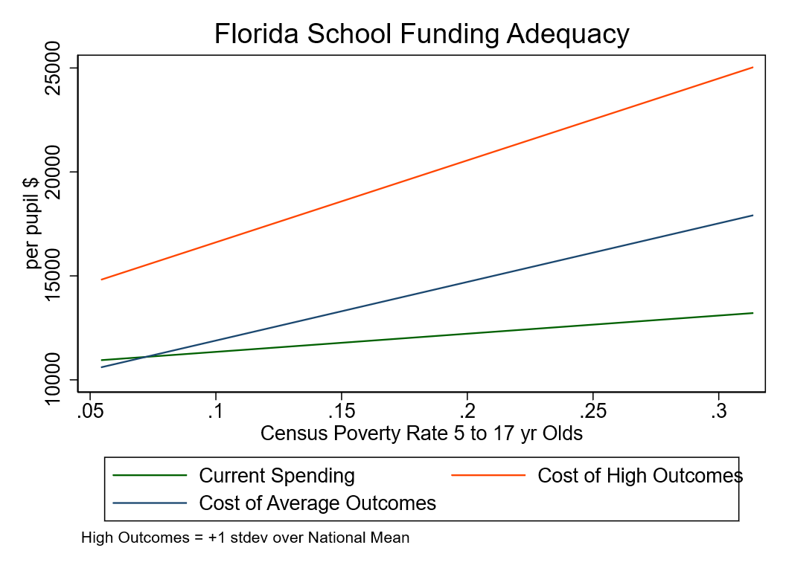

Slide 38
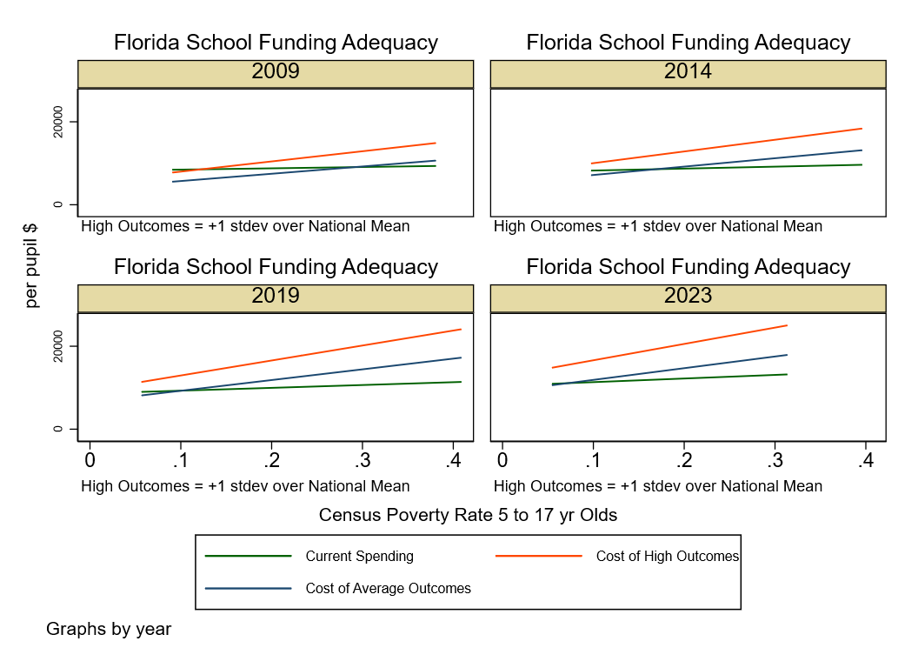

Slide 39
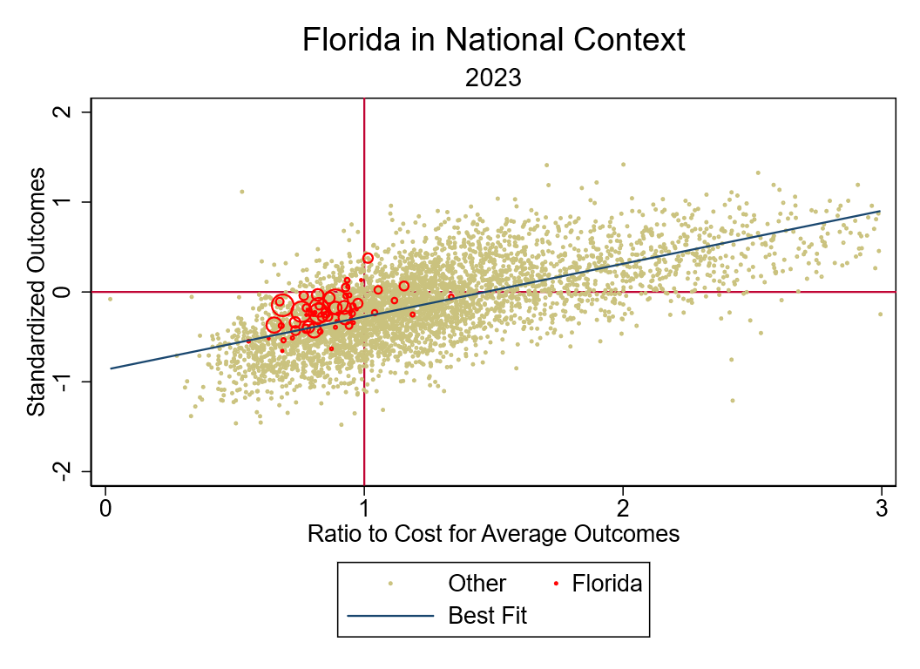

Slide 40
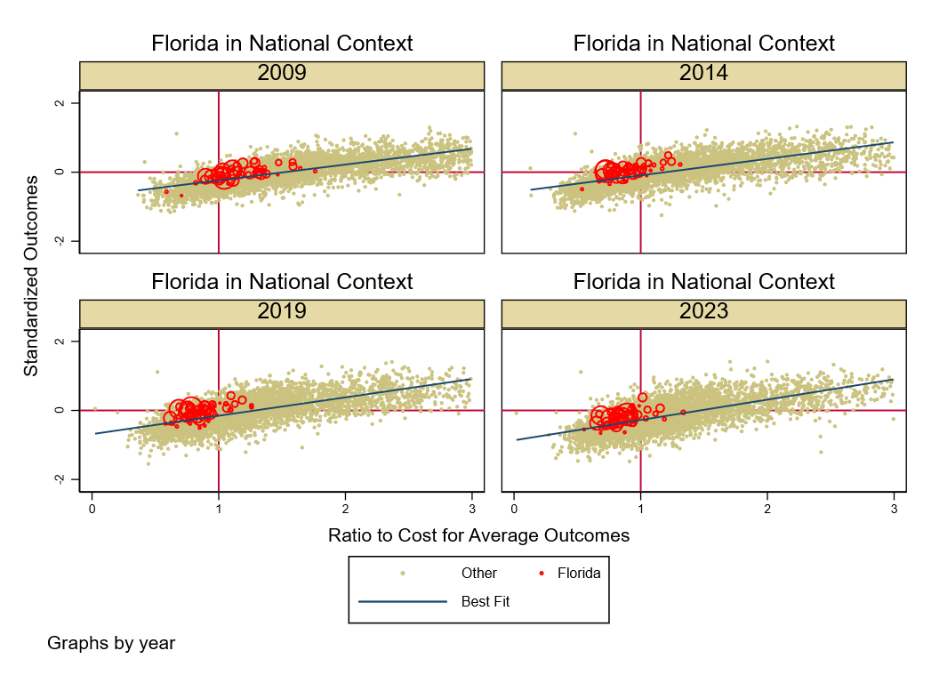

Slide 43
Share of Economic Capacity Spent on K12 Public Ed
Labor Cost Adj. per Pupil Spending

Slide 44
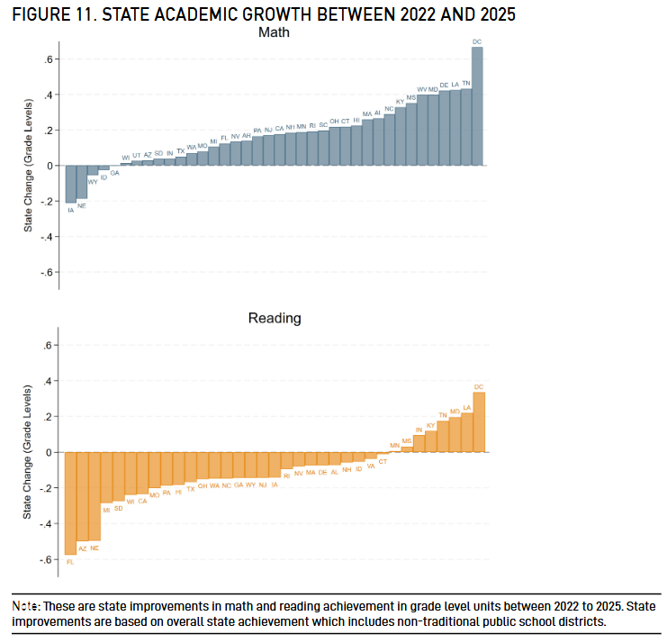
Arizona & Florida – Race to the Bottom

