Slide 1

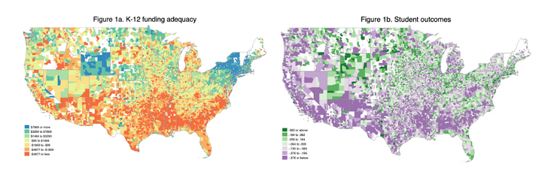

SchoolFinance101.com
SchoolFinanceData.org
Framework for Evaluating and Reforming School Finance Systems
Bruce D. Baker
University of Miami

Slide 2
Overview
SchoolFinance101.com
SchoolFinanceData.org
Conceptual Framing
Empirical Approaches
Goals of gov’t school finance systems
Equal Opportunity & Adequacy
School Finance Indicators
Input vs. Outcome Orientated Methods
From Spending to Cost Models
Framework for Cost Modeling
Lessons Learned

Slide 3

Goals of School Finance Systems
SchoolFinance101.com
SchoolFinanceData.org
The goal of school finance systems is to provide all children, regardless of where they live or attend school, equal opportunity to achieve common, adequate outcome goals
  Providing equal educational opportunity toward common goals costs different amounts in different settings, and across children (individually and collectively) by needs and contexts
  In the U.S., State accountability systems set common goals - rate, rank and evaluate schools on whether they meet those goals
  A fair system requires funding sufficient to provide equal opportunity to meet these goals (which are often used for articulating constitutional rights)
14 Conceptions of Equity and Adequacy in School Finance
16 Measurement of Cost Differentials

Slide 4

Basic Principles of “Costs” & “Equal Opportunity”
SchoolFinance101.com
SchoolFinanceData.org
It costs more to achieve higher than lower outcomes
  All else equal, the per pupil spending required to achieve higher, and broader outcome goals is higher than the per pupil spending required to achieve narrower and/or lower goals
It costs more to achieve the same outcomes with some children than others
  Collective, social context effects (poverty)
  Specific student needs (ELL, Disability)
It costs more to achieve the same outcomes with some children than others in some settings than others
  Economies of Scale – Small, sparsely populated remote school districts
  Regional variations in the competitiveness of wages (labor market effects)
16 Measurement of Cost Differentials
8
Performance Standards and Educational Cost Indexes: You Can't Have One Without the Other

Slide 5
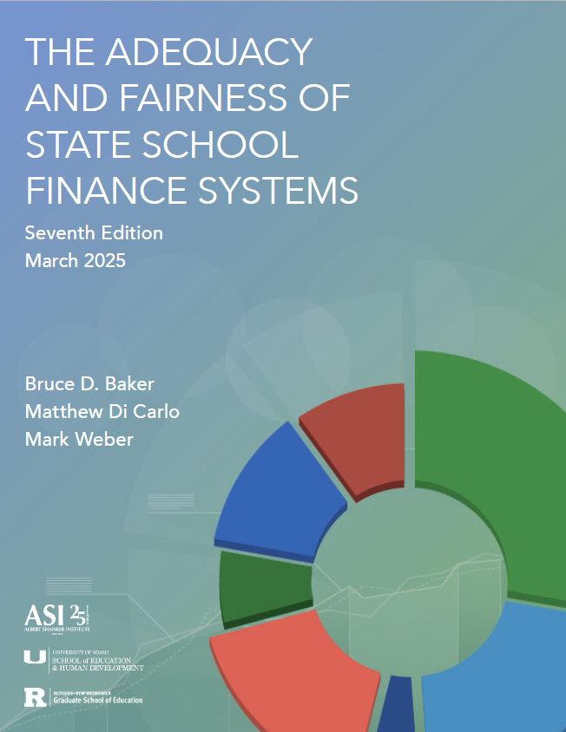
U.S. School Finance Indicators Database
SchoolFinance101.com
SchoolFinanceData.org
Adequacy
  Funding with respect to (cost of achieving) Outcome Benchmark
Equal Opportunity
  within states to achieve common outcomes across contexts by race & poverty
Effort
  Share of state capacity spent on k-12 education, where capacity is measured by: GDP-State and Aggregate Personal Income

Slide 6
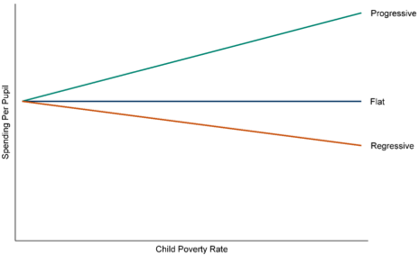
Progressiveness vs. Adequacy
(SFID, Urban Institute & Ed Trust)
SchoolFinance101.com
SchoolFinanceData.org
Several U.S. organizations track “progressiveness” of spending (and revenue)
A progressive funding is one in which higher levels of resources exist in schools serving students with greater needs (e.g. child poverty)
  Progressiveness improves equal educational opportunity
  But without information on the magnitude needed for providing EEO
  And without information on the level of funding needed for adequate educational programs and services

Slide 7
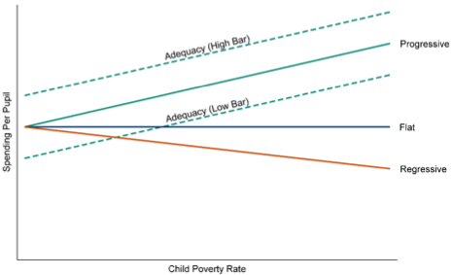
Progressiveness vs. Adequacy
SchoolFinance101.com
SchoolFinanceData.org
Adequacy addresses the level of funding needed for providing adequate educational programs and services
  Adequacy most often gauged against the outcome goals desired;
To achieve equal opportunity and adequacy, we must address both the level and slope.

Slide 8
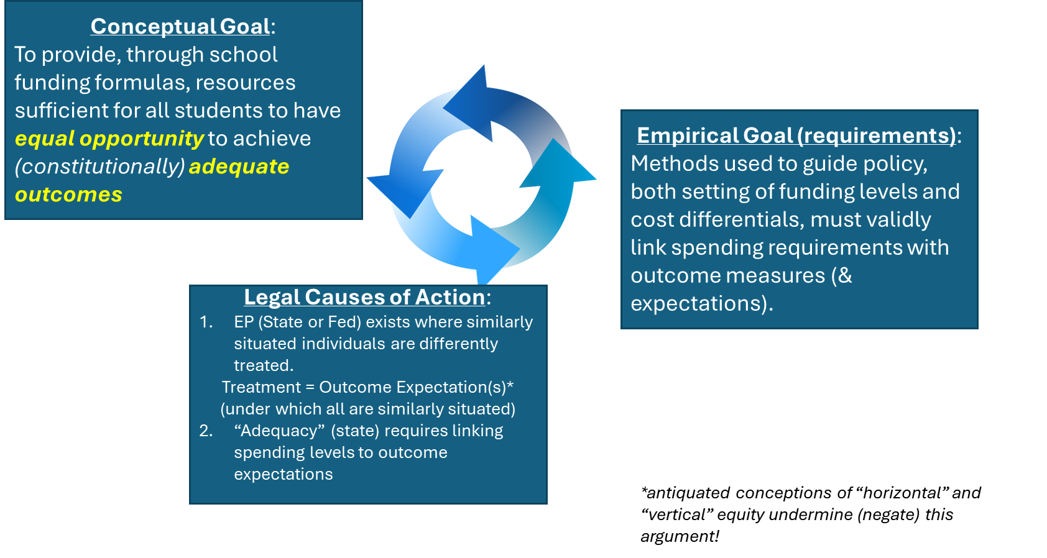
Unifying concepts, methods & causes of action under U.S. law
SchoolFinance101.com
SchoolFinanceData.org
Notes:
This for another day!

Slide 9
Cost analysis methodologies
SchoolFinance101.com
SchoolFinanceData.org
Input Oriented
  Determine the personnel and non-personnel resources and corresponding costs associated with the educational services used to generate student outcomes. [Ingredients Method (Levin et al., 2018; Baker & Morphew, 2007)]
  Resource Cost Models or Ingredients methods
  Institutional production/delivery or student consumption
Outcome Oriented
  Evaluate aggregated spending per-student as a function of student outcomes and several cost factors including needs, labor price levels, scale of operations and other institutional characteristics. [Education Cost Function Analysis (Duncombe & Yinger, 2011; Levin et al., 2022)]

Slide 10
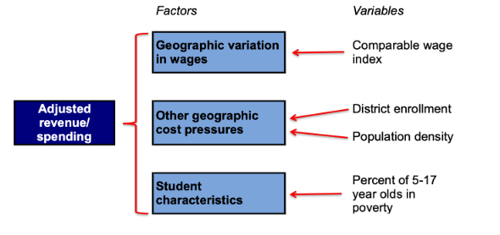
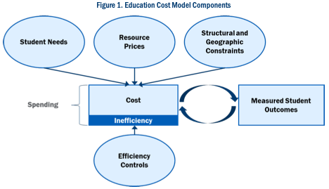
Modeling Differences in Spending & Cost
Progressiveness (What is?)
“Spending” Model
Predicted Cost (What should be?)
“Cost” Model
Q: How much does existing spending vary with respect to measures of need and cost?
Q: How much does existing spending vary with respect to measures of need and cost, holding outcomes constant?

Slide 11
Modeling Differences in Spending & Cost
Progressiveness (What is?)
“Spending” Model
Predicted Cost (What should be?)
“Cost” Model
Q: How much does existing spending vary with respect to measures of need and cost?
Q: How much does existing spending vary with respect to measures of need and cost, holding outcomes constant?

Slide 12
Modeling Differences in Spending & Cost
Progressiveness (What is?)
“Spending” Model
Predicted Cost (What should be?)
“Cost” Model
Q: How much does existing spending vary with respect to measures of need and cost?
Q: How much spending is needed, controlling for need and cost factors (and inefficiency), to achieve specific outcome goals?

Slide 13
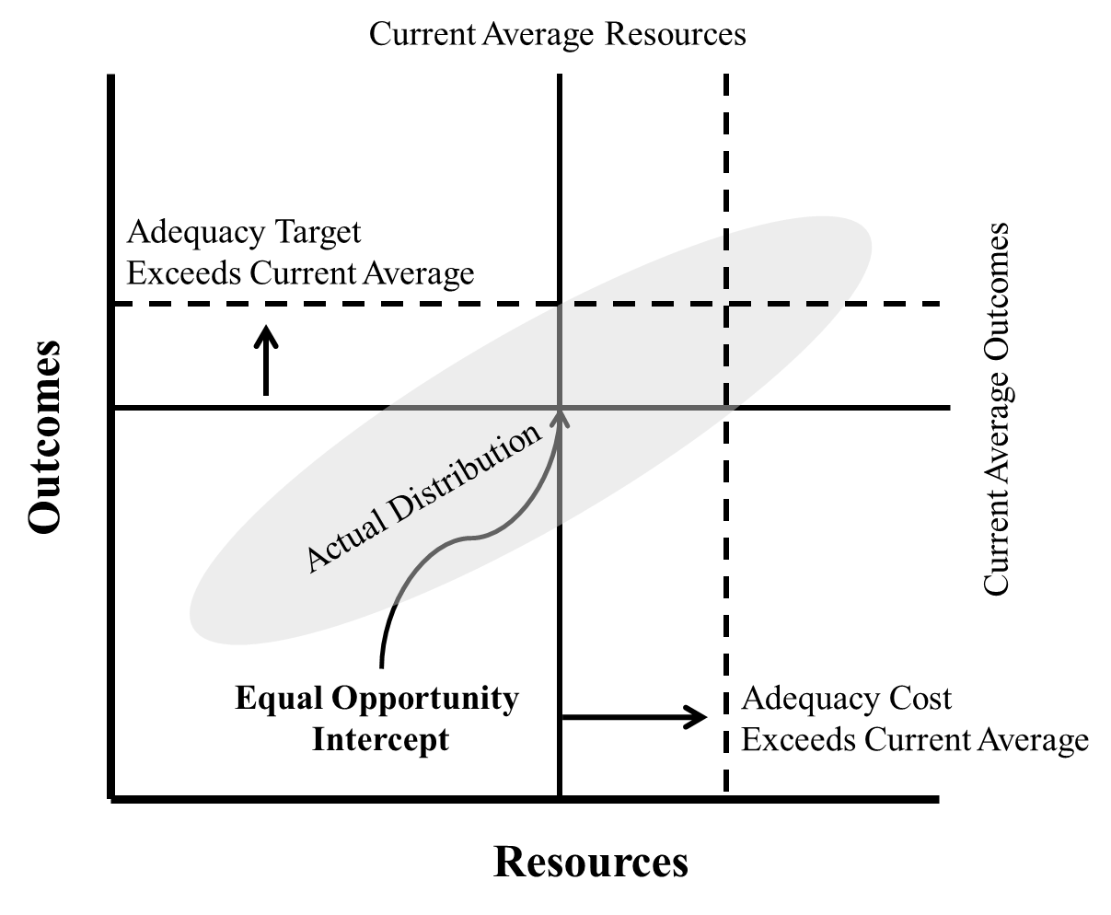
Equal Opportunity & Adequacy
SchoolFinance101.com
SchoolFinanceData.org
More adequate resources (fully controlling for cost factors) lead to higher outcomes
  And, it costs more to achieve higher outcomes
Equal educational opportunity can be centered around current average outcomes achieved at current average spending (& average efficiency), whether those outcomes are adequate or not
Adequacy requires defining outcome goals and operationalizing them as empirical targets.

Slide 14
Illustration of outcome-oriented approach to cost analysis
SchoolFinance101.com
SchoolFinanceData.org
Model using multiple years of data on all schools and/or districts in a state (or nation)
  13,000 Local Education Agencies
  Across 50 State Systems
  12 years of data
Identifying the statistical relationships represented by each connection in the figure (based on the best available data from state and federal sources)
Using that model to project the spending needed to achieve a given level of outcomes
  Across all children
  Across all settings

Slide 15
Distribution of Funding Gaps and Outcome Gaps in the U.S.
SchoolFinance101.com
SchoolFinanceData.org

Slide 16
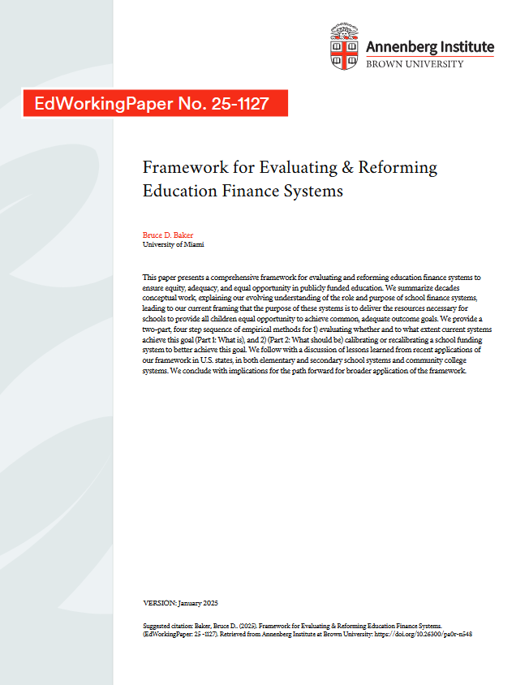
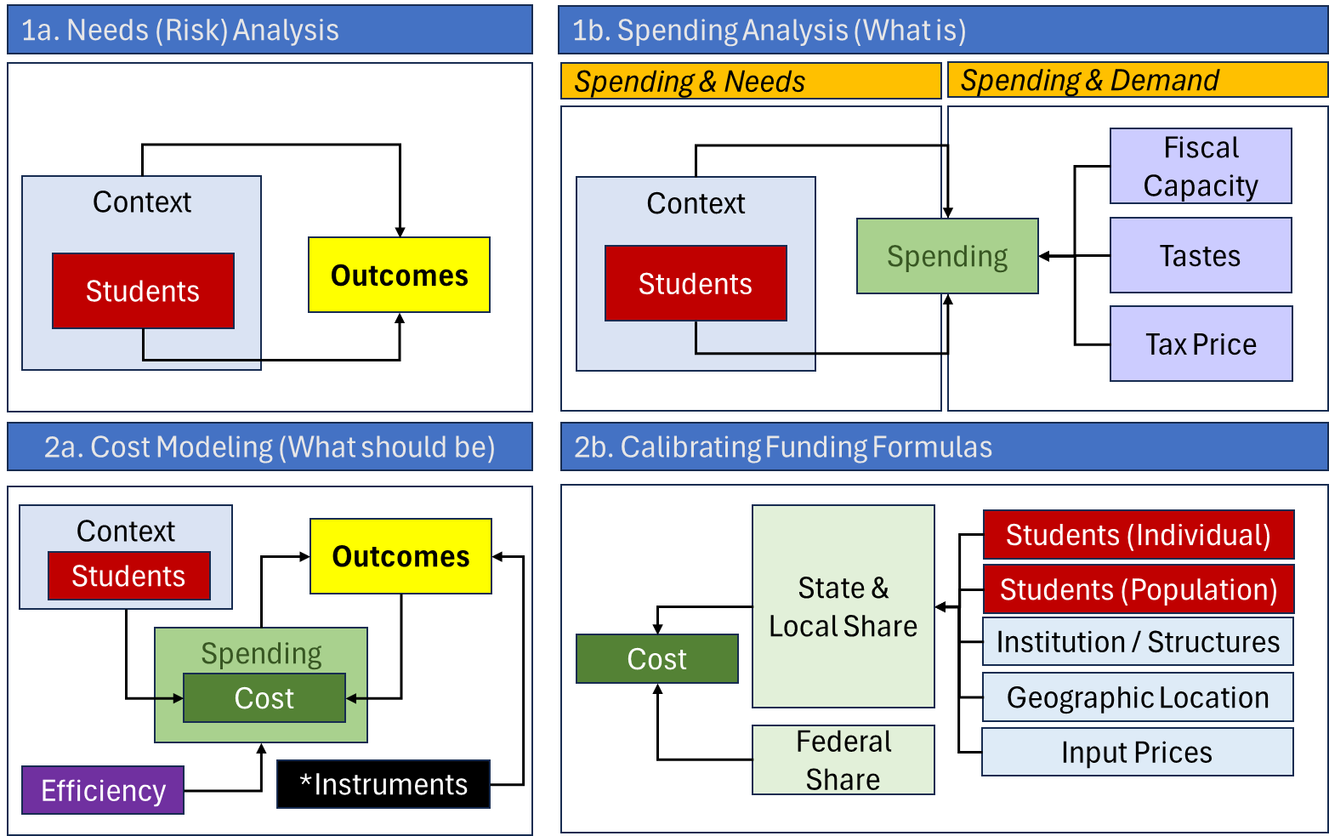
Framework for Outcome
Oriented Analysis
SchoolFinance101.com
SchoolFinanceData.org

Slide 17
Framework for Outcome
Oriented Analysis
SchoolFinance101.com
SchoolFinanceData.org

Slide 18
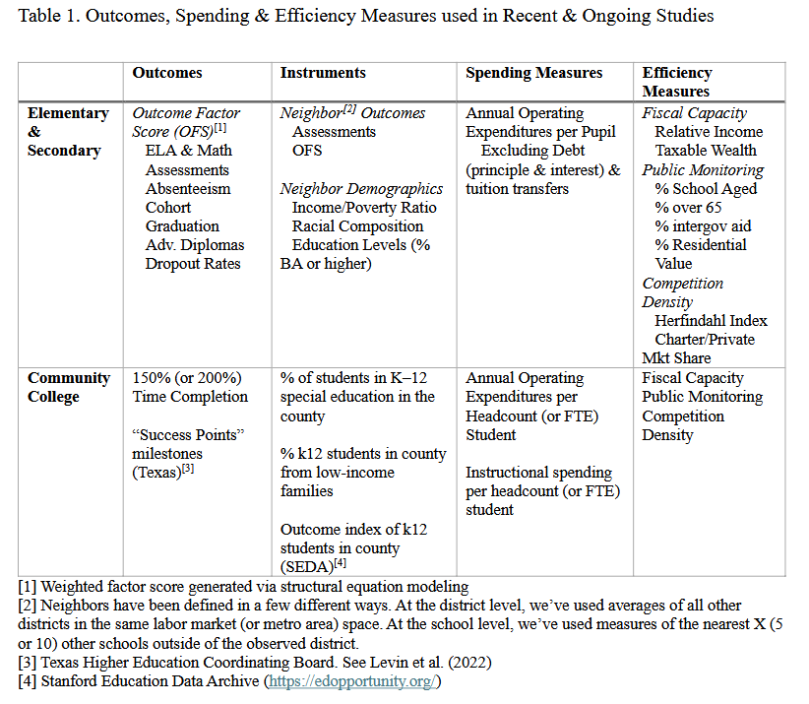
Selecting Measures
SchoolFinance101.com
SchoolFinanceData.org
Creating comprehensive outcome measures
Creating comprehensive spending measures (of attributed & allocated funds for mission centers)
Identifying/constructing relevant instruments
Exploring/identifying efficiency measures

Slide 19
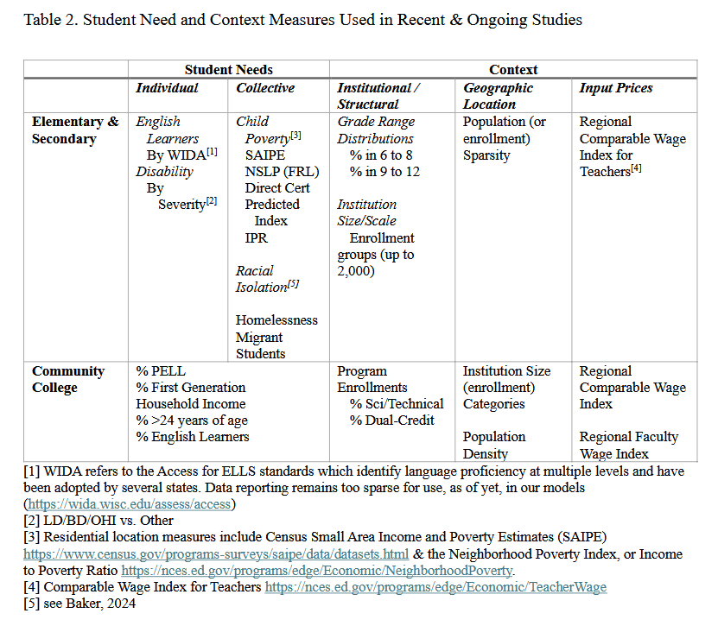
Identifying Student Needs & Context Measures
SchoolFinance101.com
SchoolFinanceData.org
Student need measures should be those that explain the largest shares of variation in the outcome measures
  The goal is to identify those factor that present the greatest individual or collective “risk” of lower educational outcomes in order to identify the costs of mitigating that risk
Context measures typically include
  Institutional characteristics
  Geographic characteristics
  Labor market characteristics

Slide 20
Elements of a Comprehensive Study
Step 1: Education Cost Model (ECM)
Estimate ECM to determine:
Base per-pupil cost of providing adequate education
Additional cost-based funding adjustments to account for cost factors, including student needs, resource price levels, scale of operations, and other contextual characteristics
Variation in adequate cost with respect to different target level goals for outcomes included in the model
Step 3: Resource Cost Model
Convene panels of expert educational practitioners (PJ panels) to:
Propose resource configurations for schools to meet desired outcome goals, including civic engagement, arts/enrichment/cultural growth goals, mental health, etc. which may not be reflected in cost modeling goals.
Propose how those resource needs (schooling inputs) need to vary by: student needs, resource price levels, scale of operations, and other contextual characteristics
Step 2: Identify Efficient Schools and Districts
Use estimated ECM to identify sample of schools/districts serving different student populations in different contexts and operating above, below, and at statewide average efficiency to:
Determine adequate cost projections for sampled schools/districts
Develop resource profiles for sampled schools/districts, including staffing ratios for different types of key staff and per-pupil spending for categories of non-personnel resources
Explore differences in how schools/districts that are more versus less efficient allocate resources
Step 4: RECONCILIATION & Formula development
Compare/evaluate and reconcile findings from Steps 1, 2 and 3.

Slide 21
Summary
SchoolFinance101.com
SchoolFinanceData.org
Increased longitudinal data availability enables cost modeling
  Harmonized outcomes
  Student characteristics
  Context & institutional characteristics
Cost models are producing increasingly consistent, robust results
Applications in both elementary & secondary as well as post-secondary (U.S. Community Colleges) settings
Can be used to evaluate school funding systems
Can be used to inform, redesign/recalibrate school funding formulas
  Toward equal opportunity & adequacy goals
  To calibrate basic levels of funding & weights or cost adjustments

Slide 22
Recent Applications of Cost Modeling
SchoolFinance101.com
SchoolFinanceData.org
Peer Reviewed Articles & Working Papers
Baker, B. D. (2024). How and Why Racial Isolation Affects Education Costs & the Provision of Equal Educational Opportunity. EdWorkingPaper No. 24-1047. Annenberg Institute for School Reform at Brown University.
Baker, B. D., Weber, M., & Srikanth, A. (2021). Informing Federal School Finance Policy with Empirical Evidence. Journal of Education Finance, 47(1), 1-25.
Levin, J., Baker, B., Lee, J., Atchison, D., & Kelchen, R. (2022). An Examination of the Costs of Texas Community Colleges. REL 2023-142. Regional Educational Laboratory Southwest.
Kolbe, T., Baker, B. D., Atchison, D., Levin, J., & Harris, P. (2021). The additional cost of operating rural schools: Evidence from Vermont. AERA Open, 7, 2332858420988868.
Zhao, B. (2022). Estimating the cost function of Connecticut public K–12 education: implications for inequity and inadequacy in school spending. Education Economics, 1-32.
Gronberg, T. J., Jansen, D. W., & Taylor, L. L. (2017). Are charters the best alternative? A cost frontier analysis of alternative education campuses in Texas. Southern Economic Journal, 83(3), 721-743.
State Studies
Colorado: https://www.cde.state.co.us/cdedepcom/schoolfinancecostmodelingadequacystudyreport
Oregon: https://olis.oregonlegislature.gov/liz/2025R1/Downloads/CommitteeMeetingDocument/291280
D. Atchison, B.D. Baker, J. Levin, S. Fatima, A. Trauth, A. Srikanth, C. Herberle, N. Gannon-Slater, L. Junk, K.: Wallace (2023) Assessment of Delaware Public School Funding. https://education.delaware.gov/wp-content/uploads/2023/12/23-22933_1_Delaware_Full_Report-FMT-ed103023-Version-2.pdf
Baker, B.D., Atchison, D., Levin, J., Kearns, C. (2020) New Hampshire Commission to Study School Funding, Final Report: https://carsey.unh.edu/sites/default/files/media/2020/09/20-12685_nh_final_report_version_v5_draft_1.pdf
Kolbe, T., Baker, B.D., Atchison, D., Levin, J. (2019) Pupil Weighting Factors Report. State of Vermont, House and Senate Committees on Education. https://legislature.vermont.gov/assets/Legislative-Reports/edu-legislative-report-pupil-weighting-factors-2019.pdf

