Slide 1



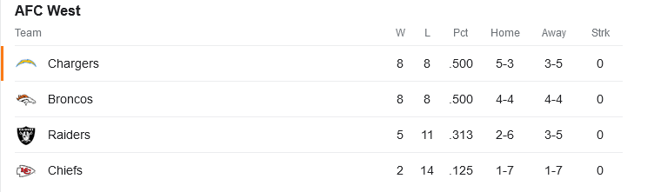

School Finance 101
2023 Version
Let’s Party Like it’s 2008!
Bruce D. Baker

Slide 2
Overview
Current Trends & Cutting through the BS
Toward a common understanding of school finance
Using SFID and NECM to inform school finance reform and litigation
State specific analyses with SFID and NECM
State specific projects, modeling and analyses to inform policy & reform
Summary

Slide 3
Current Status & Trends
Let’s party like it’s 2008!!!

Slide 4
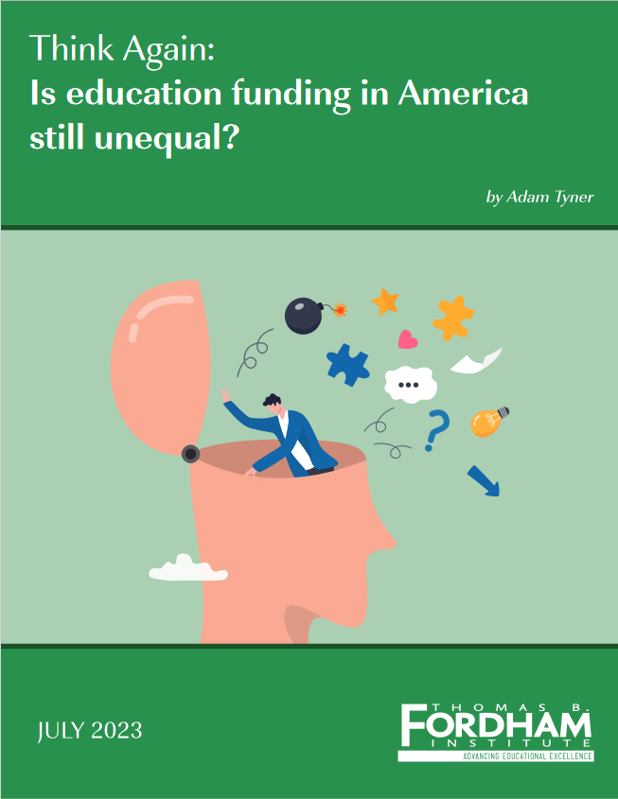
According to a Recent TB Fordham Institute Report https://fordhaminstitute.org/national/research/think-again-education-funding-america-still-unequal
School funding has risen dramatically over the last few decades, especially in schools serving more students from low-income families.
  The only state where spending in schools serving poorer students is still markedly lower than in those serving wealthier ones is Illinois, which enacted school funding reforms in 2017
  Because funding is already progressive, improving the outcomes of lower-performing students requires reforms to make schools more efficient using the funds they already have and/or allocating funding even more progressively.
School-finance reforms and, to a lesser extent, increases in federal education funding have eliminated the gaps between schools serving more- and less-affluent students, at least when those schools are within the same state.
“Adequacy” is an inherently subjective, unscientific concept. Consequently, what constitutes “adequate” funding will inevitably be contested and variable across communities.

Slide 5
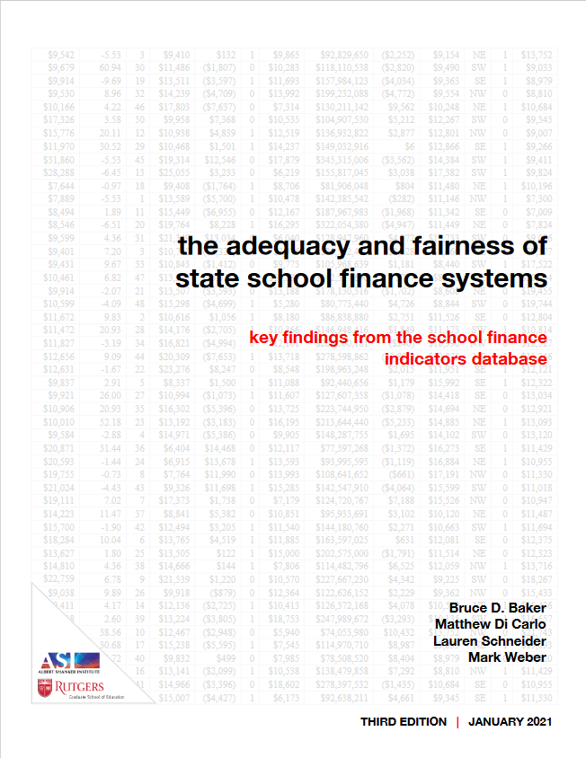
Indicators of State School Finance Systems
Educational Effort
  Education spending share of aggregate personal income
  Education spending share of gross domestic product (state)
Spending (revenue & key resource) Progressiveness
  Ratio of resources (per pupil) available in higher versus lower poverty settings (basically a regression slope)
    Descriptive regression model of “what is” (in terms of resource distribution)
    Method can be used between and/or within districts
  Per Pupil Spending, State & Local Revenue, Staffing Ratios
Relative Adequacy / Equal Opportunity
  Ratio of current spending to spending predicted to be needed (based on education cost model) to achieve national mean outcomes in reading and math.
    By including outcome measures, allows estimation of “what should be” for comparison with “what is”
Notes:
In collaboration with Matt DiCarlo at Shanker Institute and my former doc student Mark Weber and current doc student Ajay Srikanth, we’ve been working on a parsimonious set of indicators of state school finance systems.
While we have it down to 3 now, it’s really the first and third here that seem to matter most.
The first is state effort – how much of their economic capacity (measured 2 different ways) are states dedicating to k12 school funding? You’ll see how this matters on later slides. Yes, some states are richer than others and can spend more as a result. But some states – many states that have capacity simply don’t try and have put in less and less over time.
The third indicator is our combined relative adequacy and equal opportunity indicator which we have developed using cost modeling to determine the costs per pupil of achieving a common outcome target for every local school district in the country. From there, we can compare current spending to those cost predictions to evaluate the relative adequacy of existing funding toward achieving common outcome goals.
And, for a little more fun, we can raise and lower those outcome targets to see how that changes who’s in the over/under groups!

Slide 6
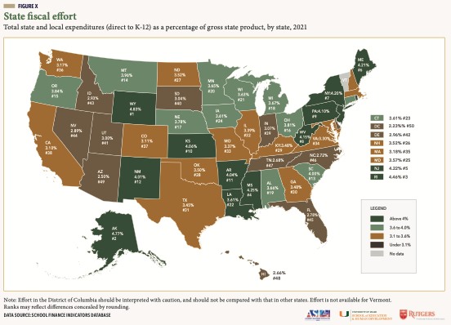
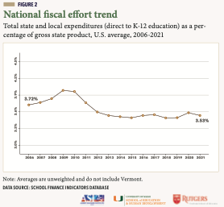
How hard are states trying?

Slide 7
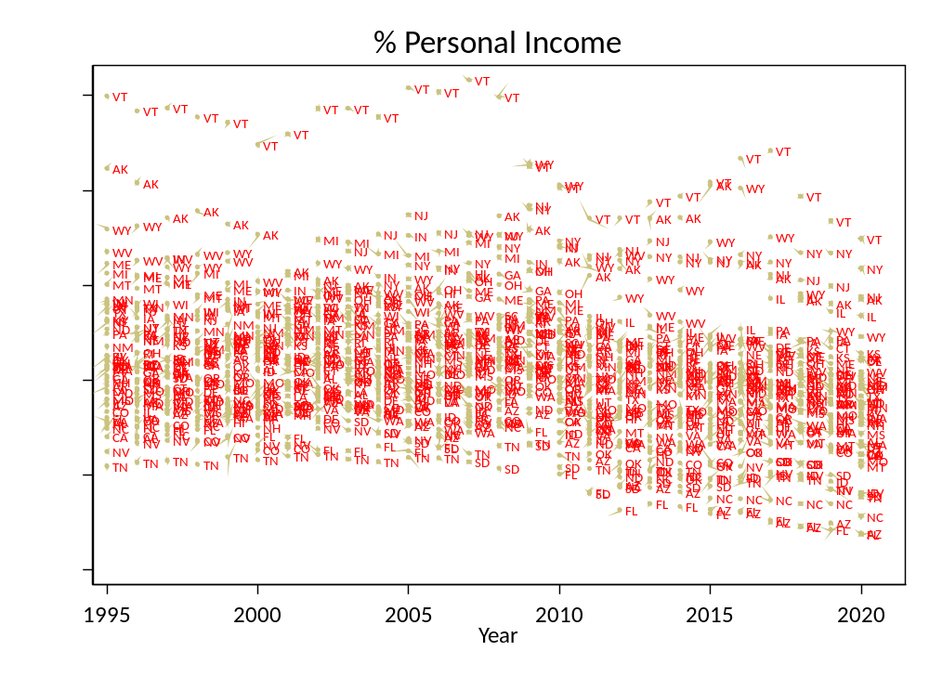
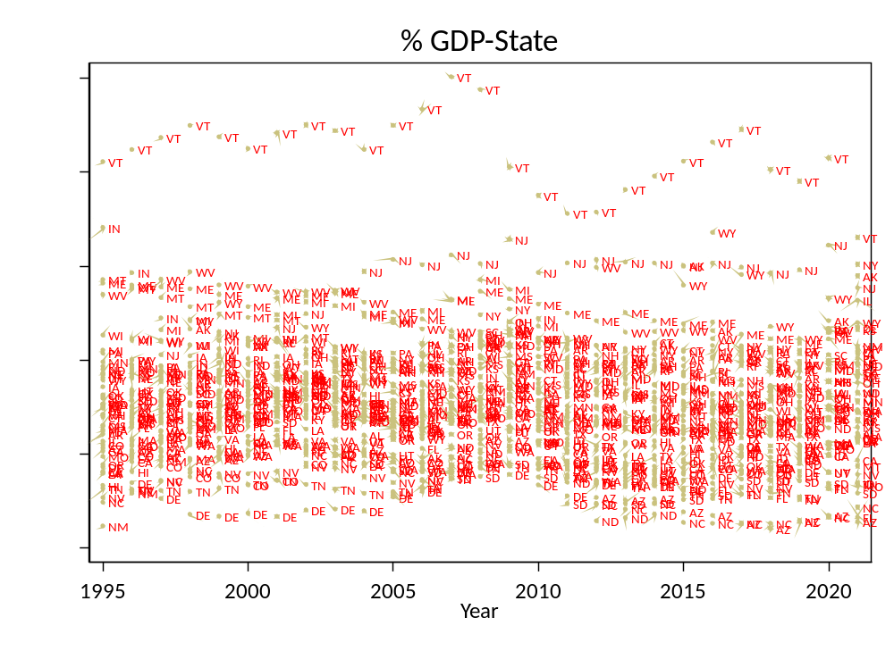
How Hard are States Trying?

Slide 8
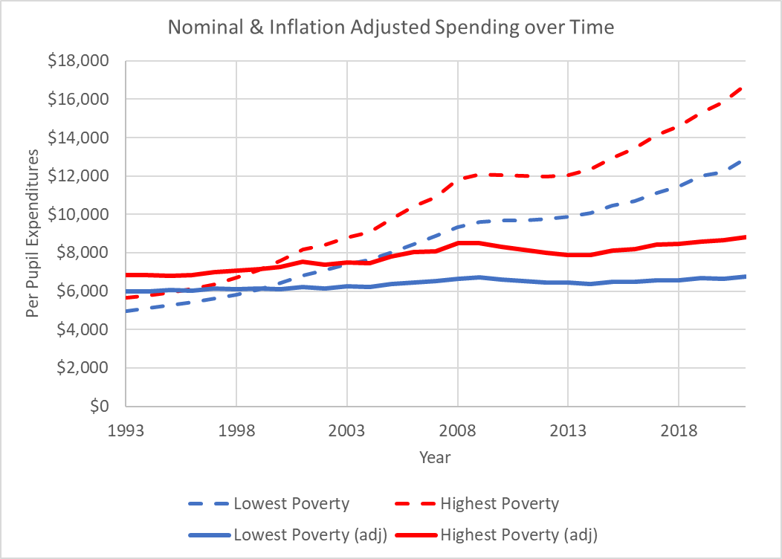
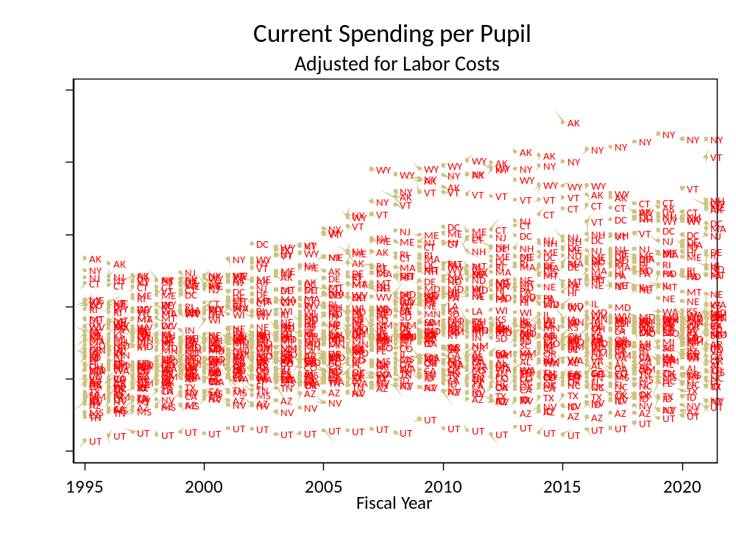
How Has Spending Changed over Time?

Slide 9
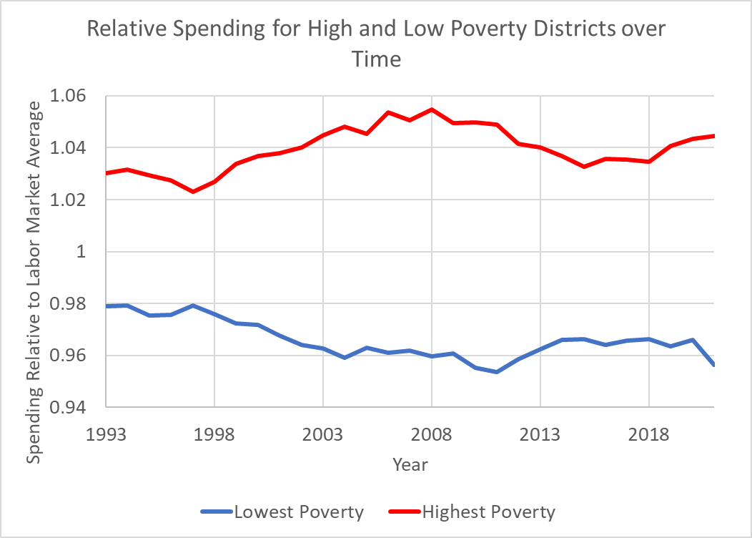
Spending Differences between Low & High Poverty Districts (in same metro)
Highest quintile of districts by poverty (within each state) on average spend about 4% above the average district and lowest poverty quintile of districts spend about 2% below the average district in the same metro area.
Note: That’s nowhere near what would be needed to provide equal educational opportunity! Nor is it systematic!

Slide 10
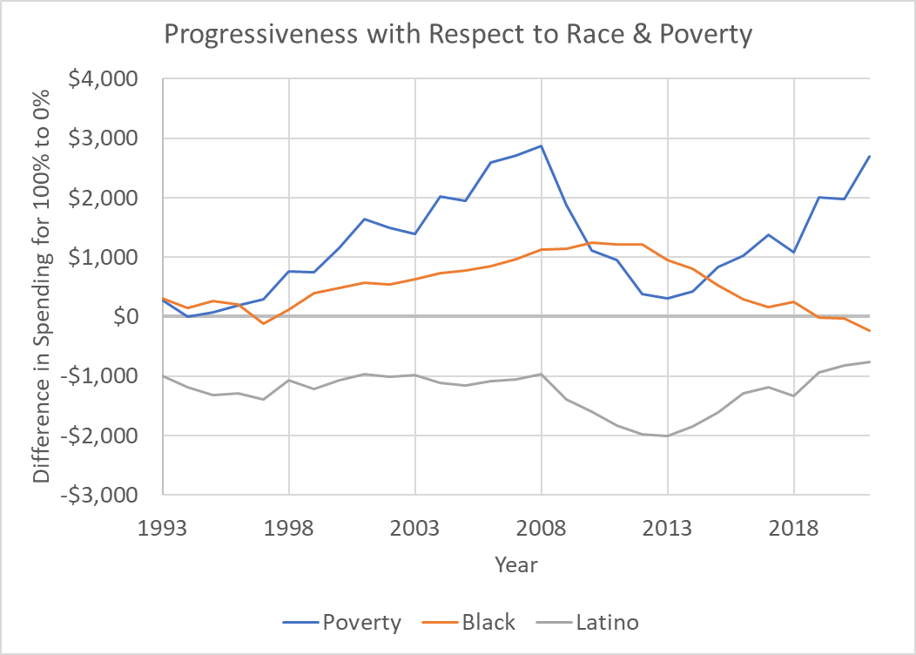
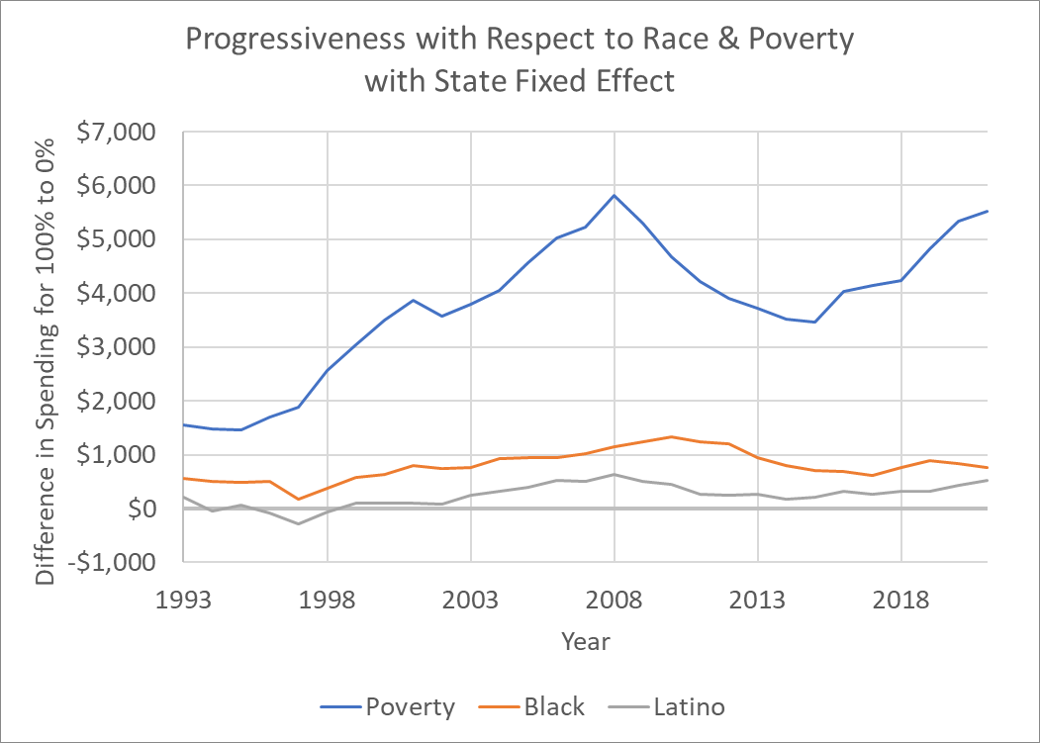
Overall & Within State Progressiveness by Race & Poverty
https://nepc.colorado.edu/review/education-funding

Slide 11
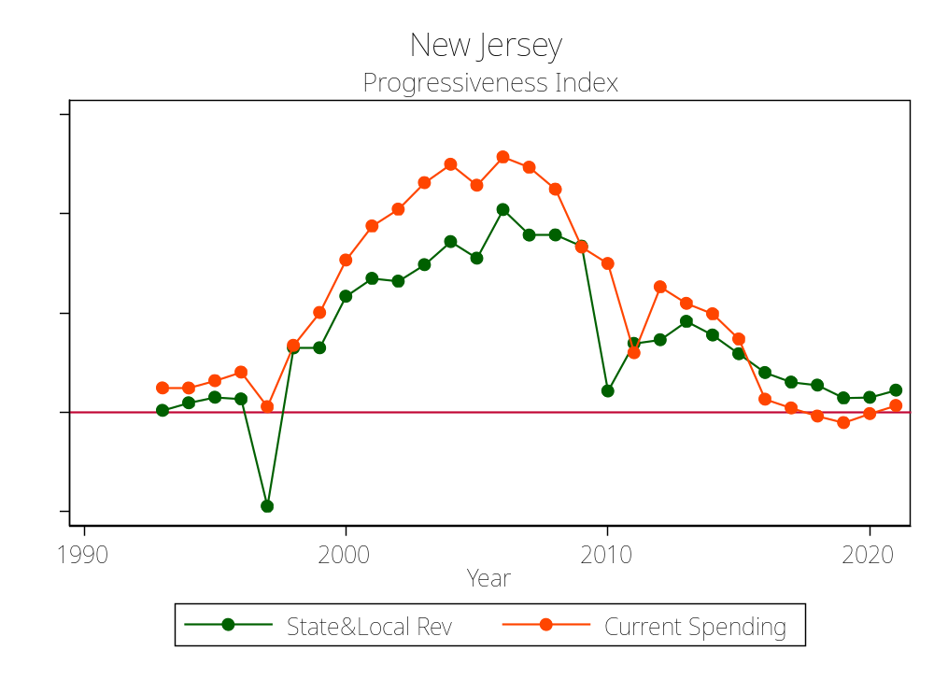
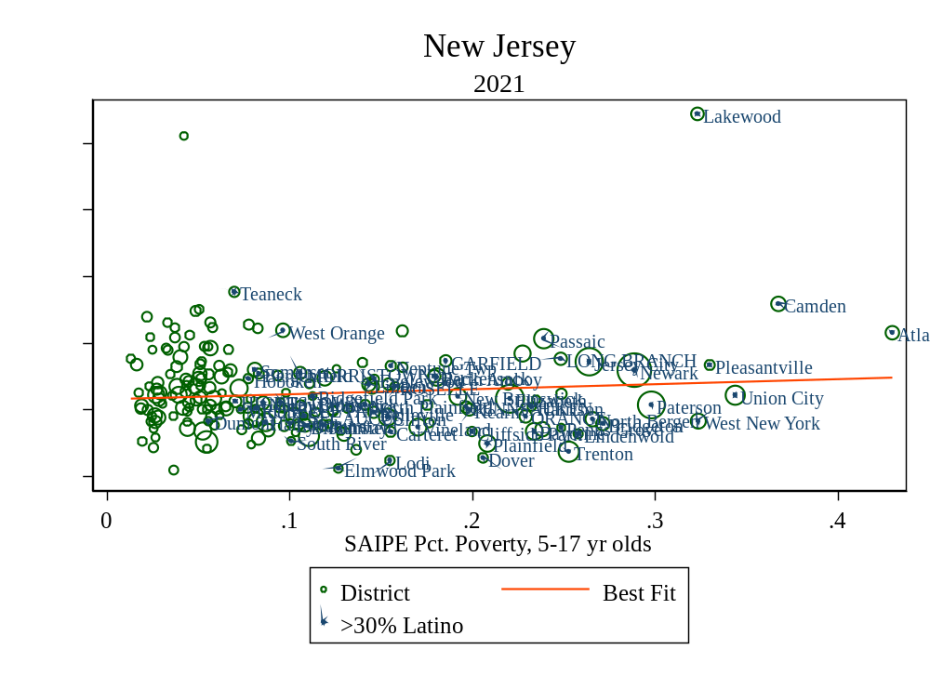
New Jersey Spending Progressiveness
https://en.wikipedia.org/wiki/Lost_Highway_(Bon_Jovi_album)

Slide 12
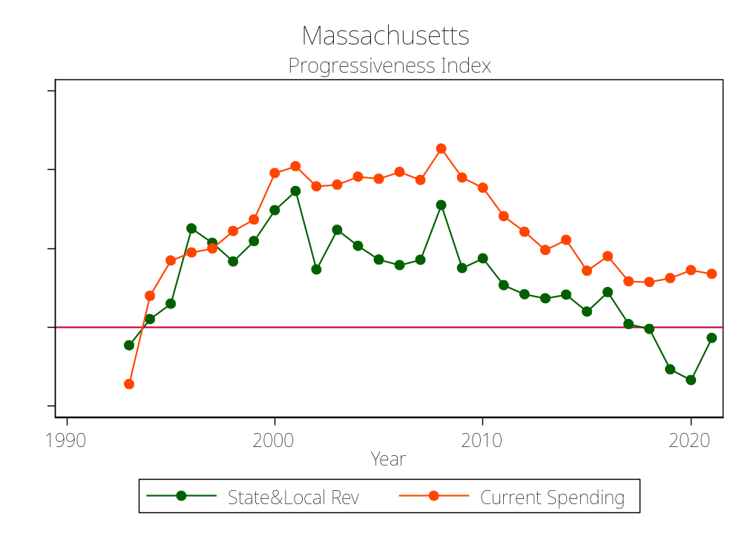
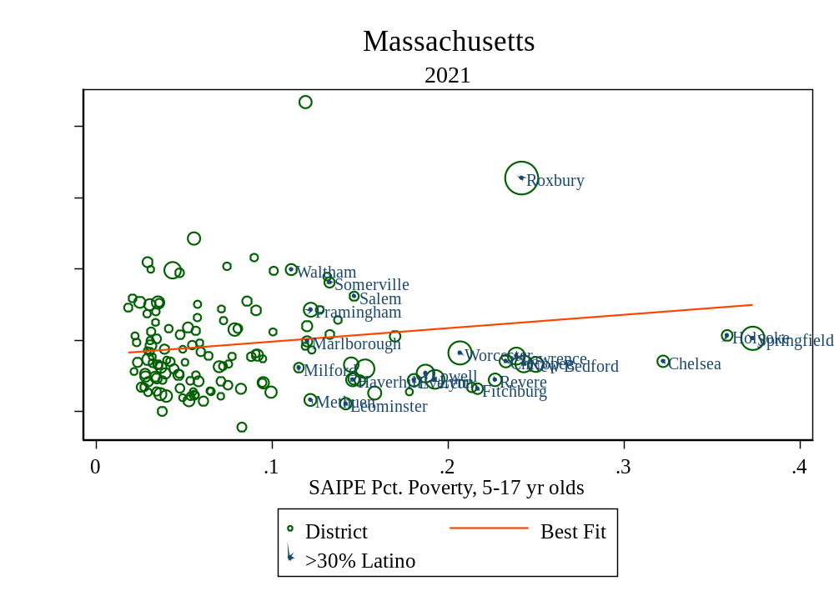
Massachusetts Spending Progressiveness

Slide 13
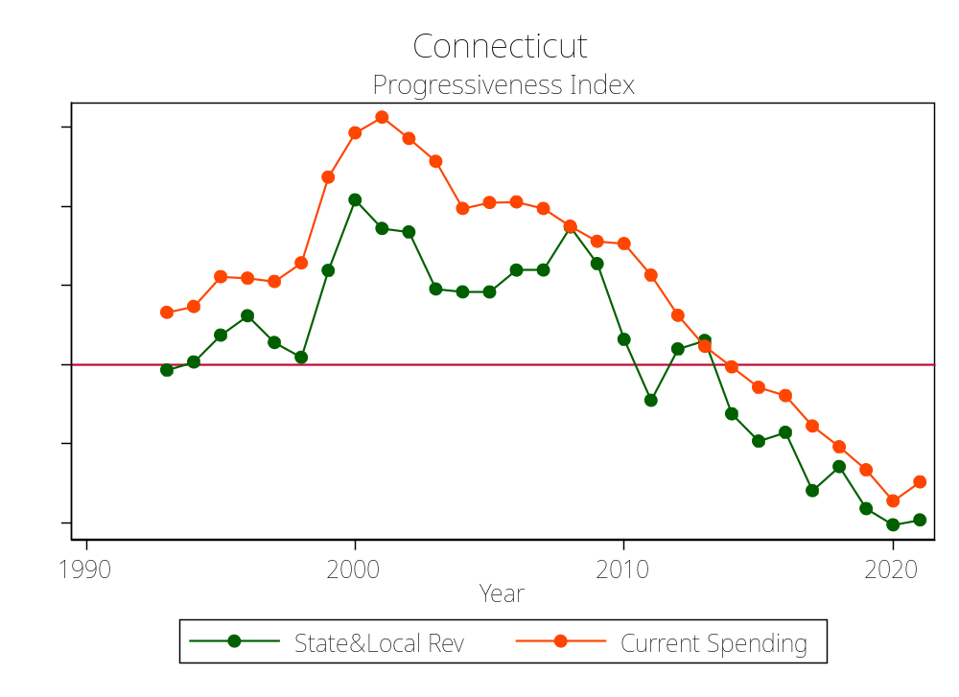
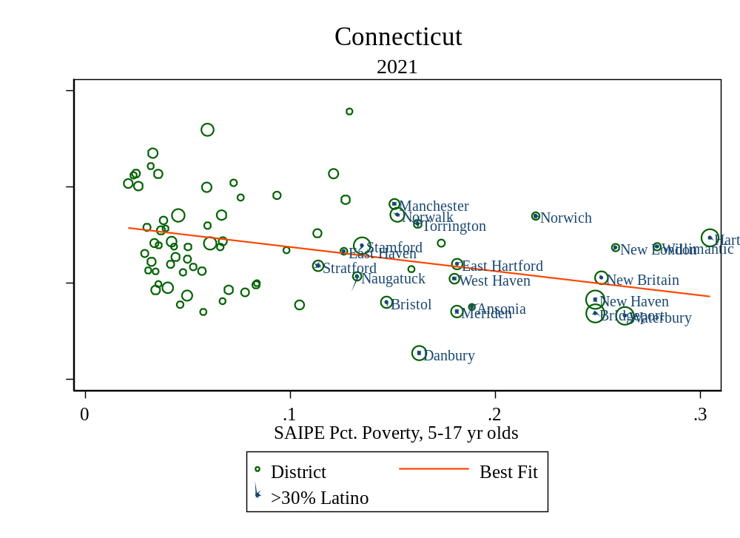
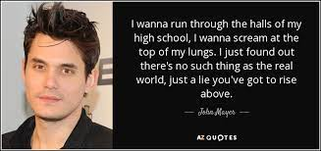
Connecticut Spending Progressiveness
Mayer’s HS – Warde HS, Fairfield

Slide 14
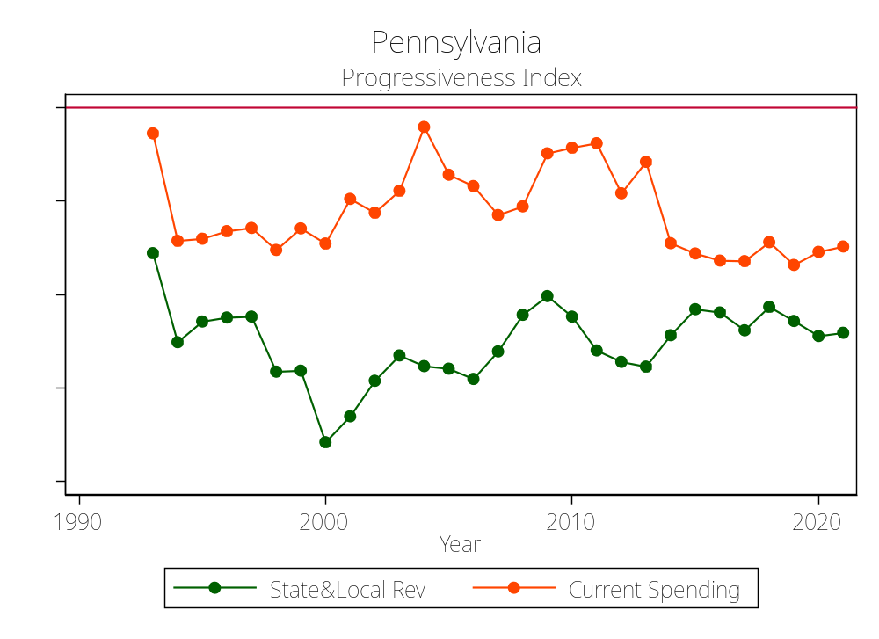
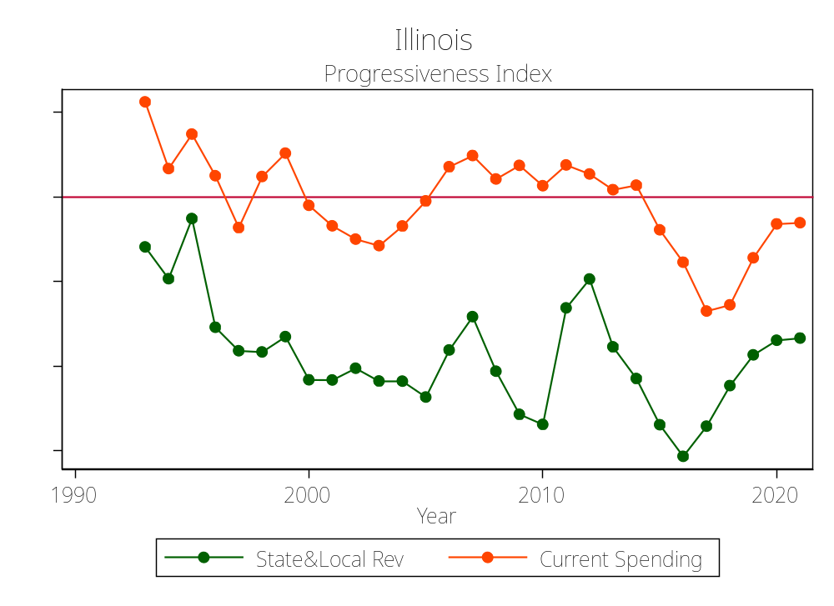

Equity Dumpster Fire States (Progressiveness)

Slide 15
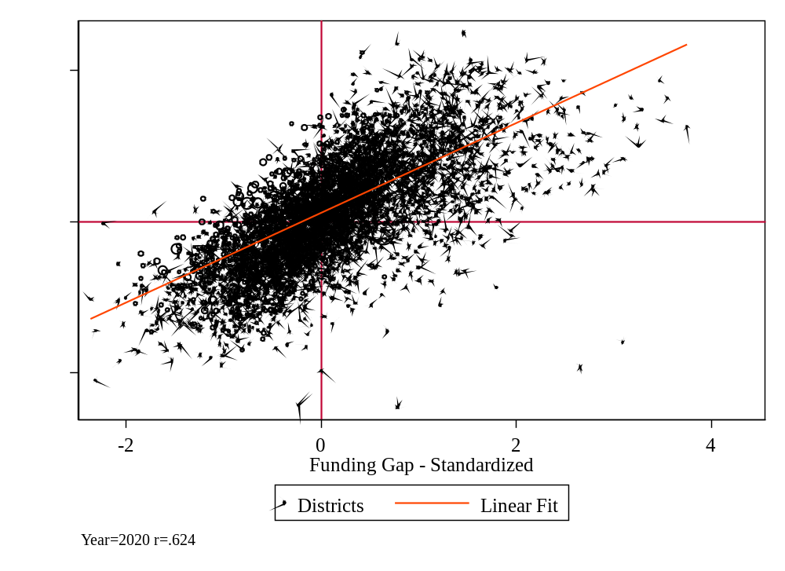
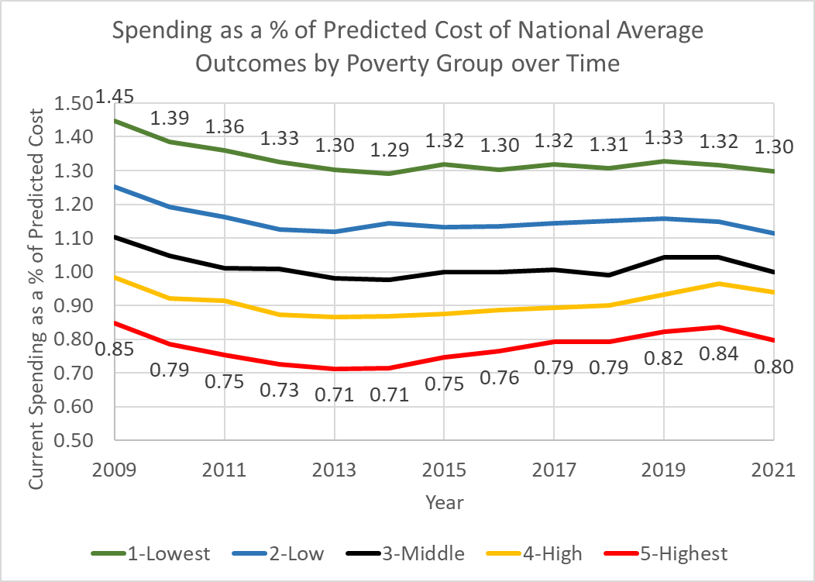
Equal Opportunity to Achieve a Common Outcome
From the National Education Cost Model

Slide 16
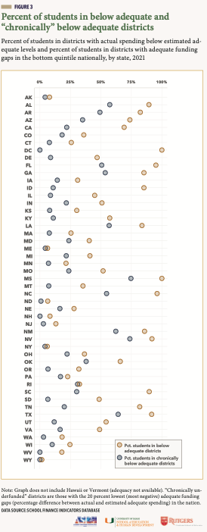
% of Kids in District Below *Adequate Funding
Percent of kids in districts with spending levels below spending they are predicted to need in order to achieve national average outcomes in grades 3 to 8 reading and math.
And the share of kids in districts where the funding gap is 20% of greater (chronically underfunded)

Slide 17
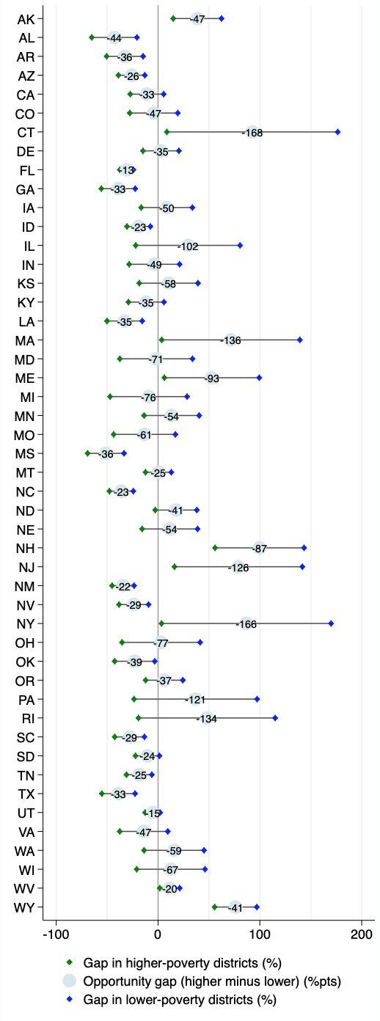
Equal Educational Opportunity
Some states are invariably inadequate!
In many cases, states where funding is on average more adequate, there exists much greater inequality of opportunity above that threshold

Slide 18
On the “subjectivity” of “adequacy”
About that smokescreen premise is that nobody really knows how much we should spend on schools – or … what’s adequate? It’s all just a guess or made up anyway.
The problem with this logic is that:
  educational adequacy is not some arbitrary determination of how much we want to spend, but rather a specification of the goals we expect schools and children to achieve.
    In some states, those goals have been determined to be constitutional rights (sometimes fundamental rights!)
  Every state – EVERY STATE – via legislation & regulation has established outcome goals and specified measures of those goals.
  It is incumbent on states to provide the resources necessary for all children, regardless of where they live and attend school, to have equal opportunity to achieve those goals.
  We can reasonably estimate / predict the spending levels required for doing so!
    And if we can, we must
    And if we don’t, knowing that we can, we are hiding behind ignorance as an excuse for systemic & persistent deprivation of those most vulnerable and in need.

Slide 19
Arizona Close Up
Arizona in the RTTB Era

Slide 20
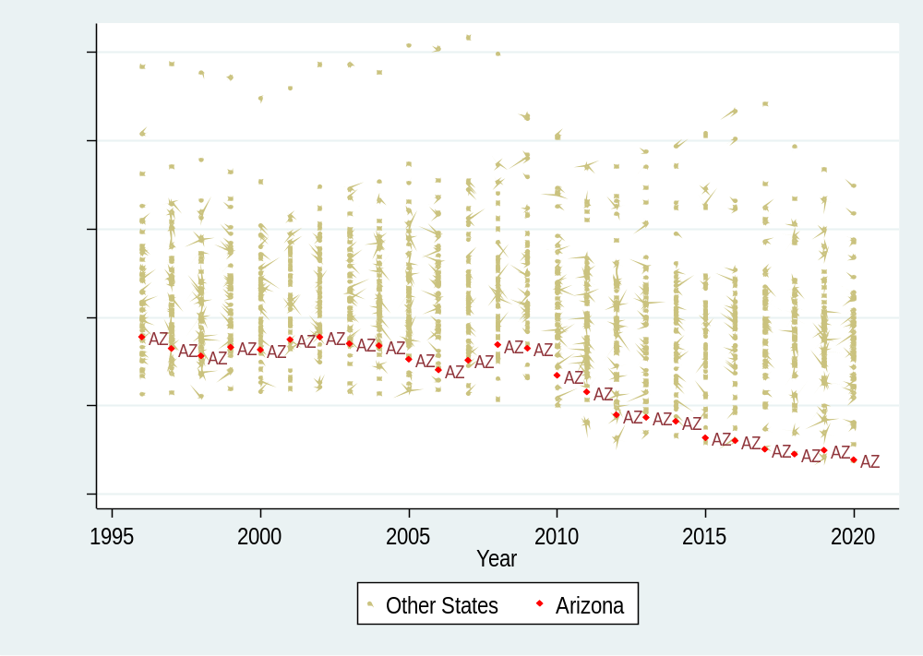
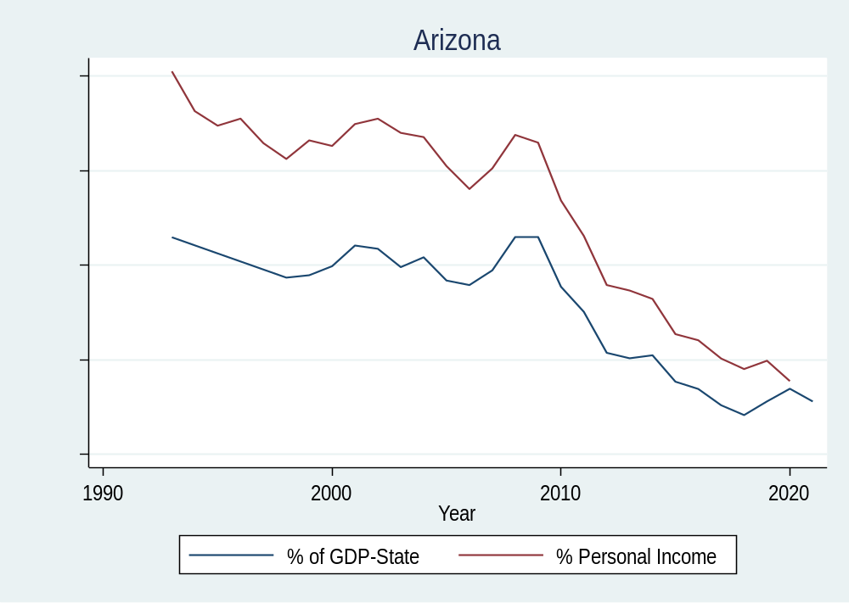
Arizona K12 Education Effort over Time
Data source: School Finance Indicators Database (State File)

Slide 21
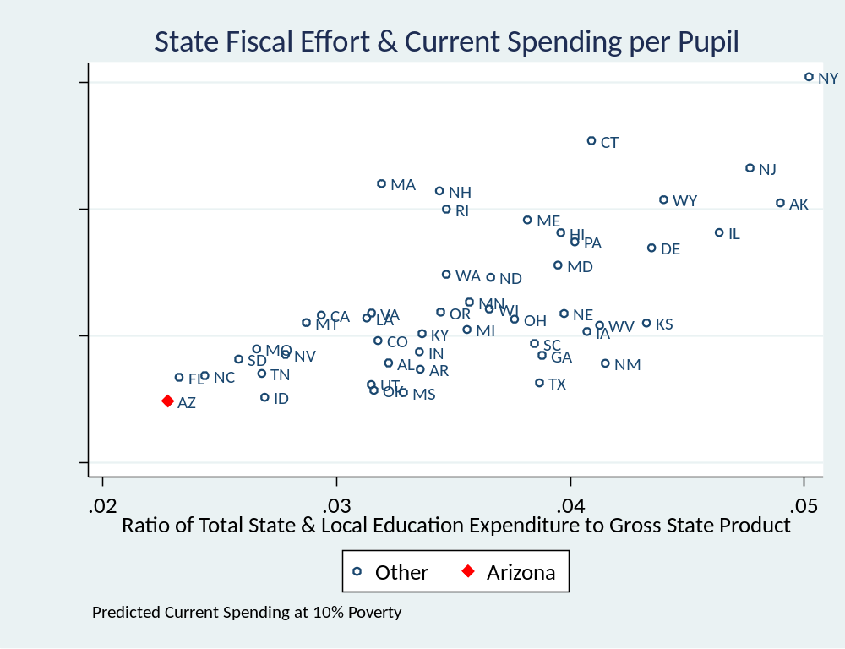
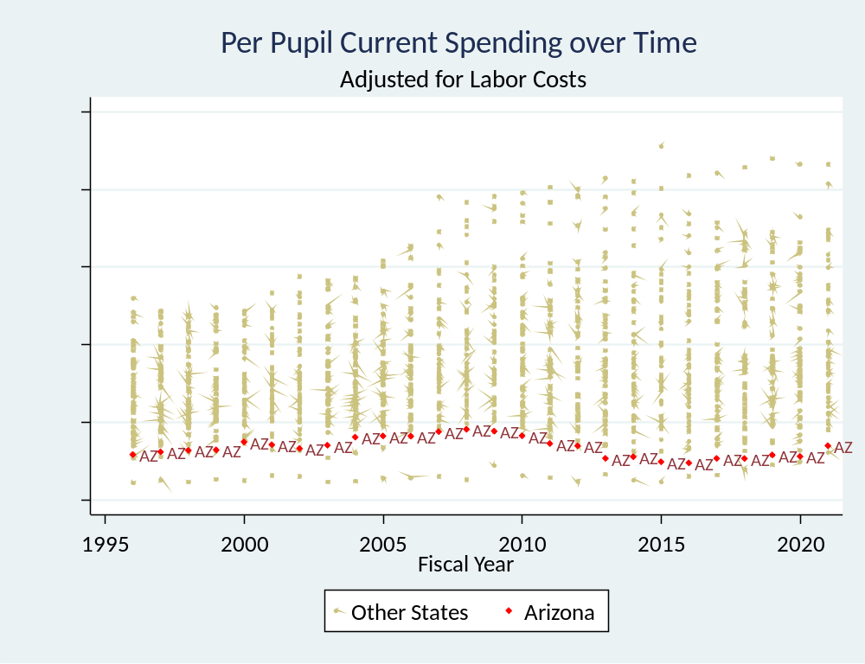
Low Effort Leads to Low Spending
Data source: School Finance Indicators Database (State File)

Slide 22
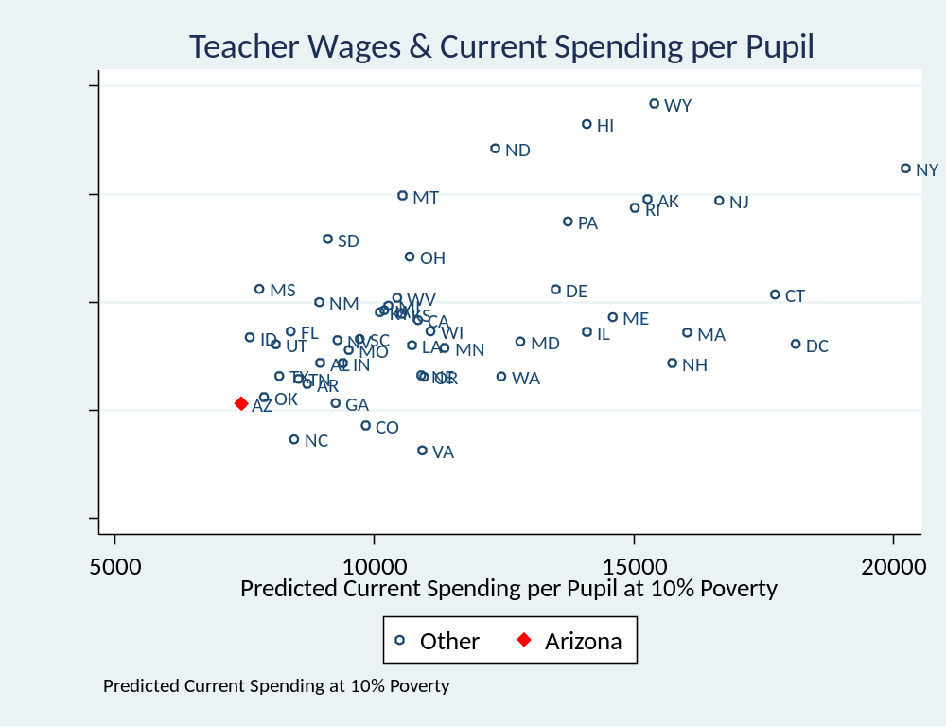
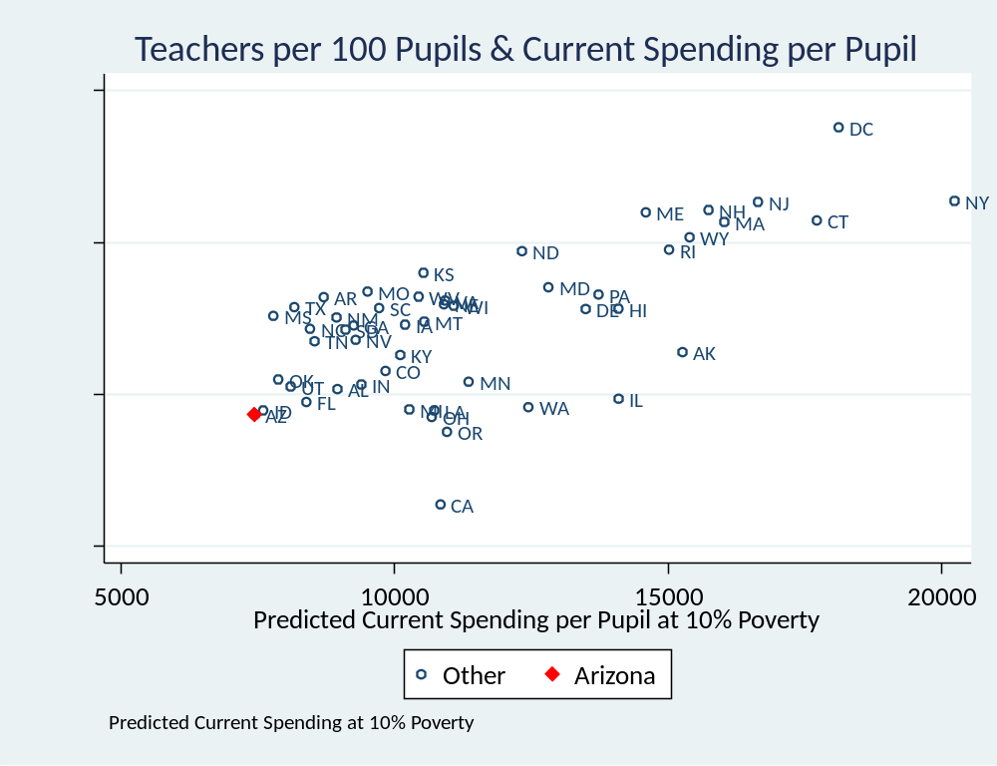
Leading to low staffing ratios & low wages
Data source: School Finance Indicators Database (State File)

Slide 23
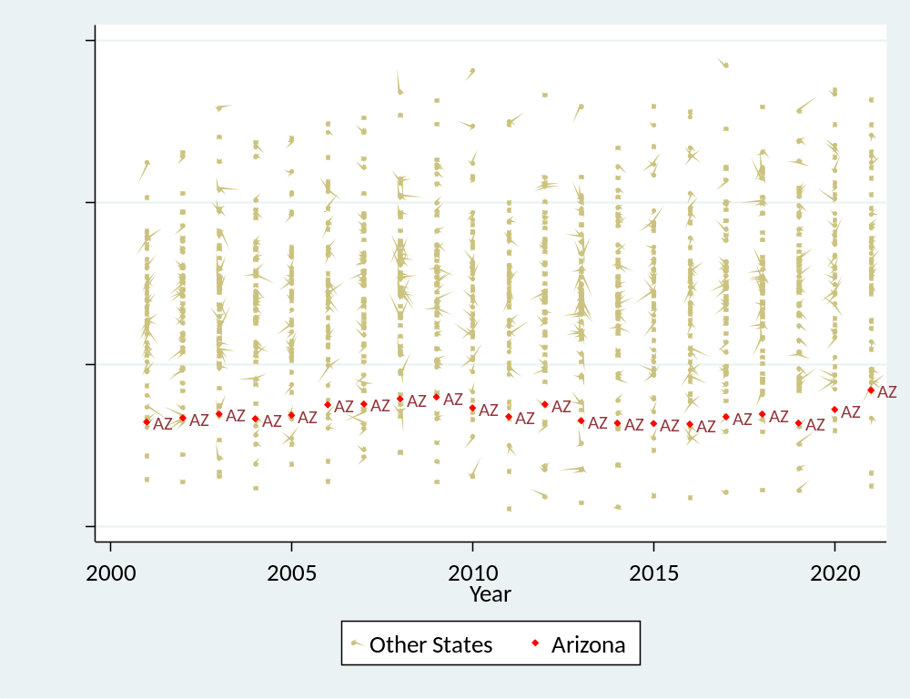
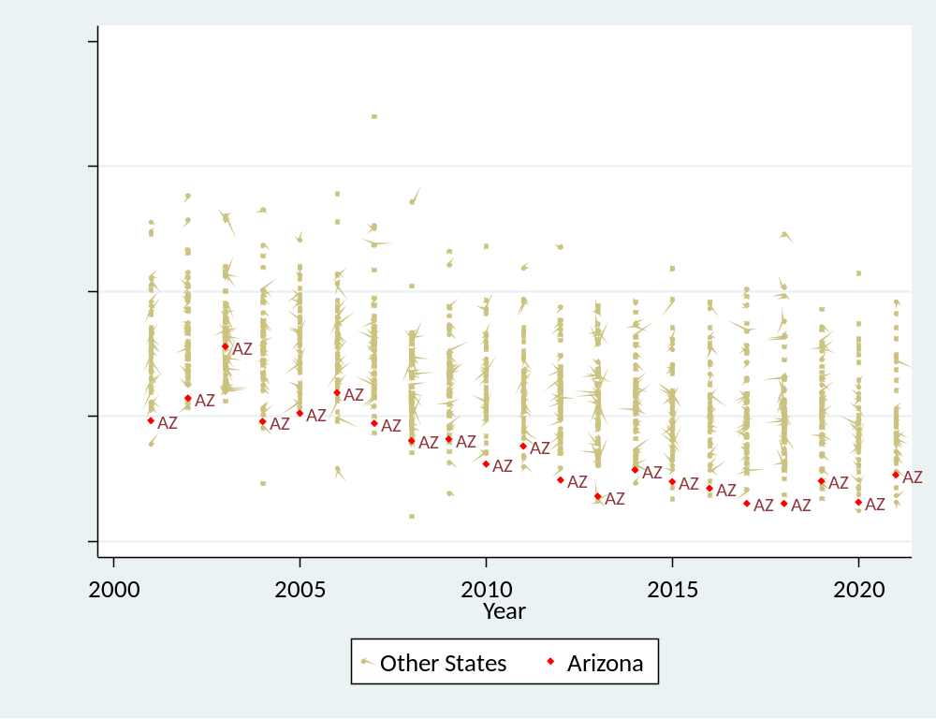
Leading to low staffing ratios & low wages
Data source: School Finance Indicators Database (State File)

Slide 24
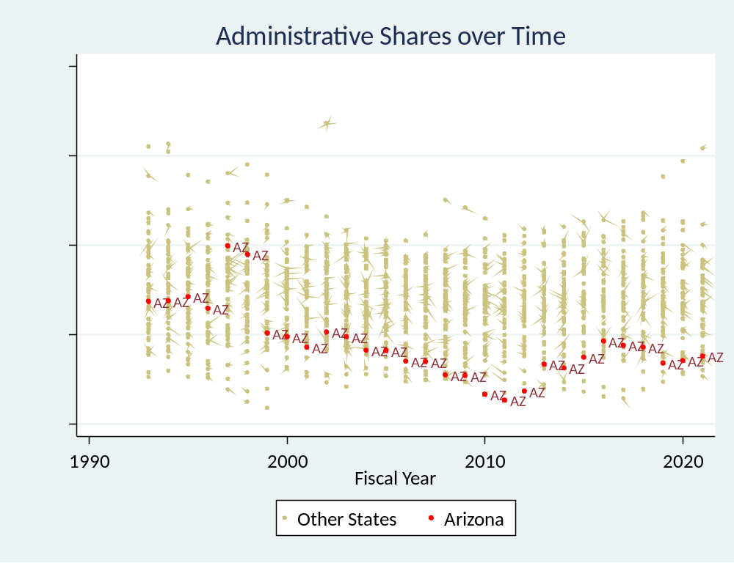
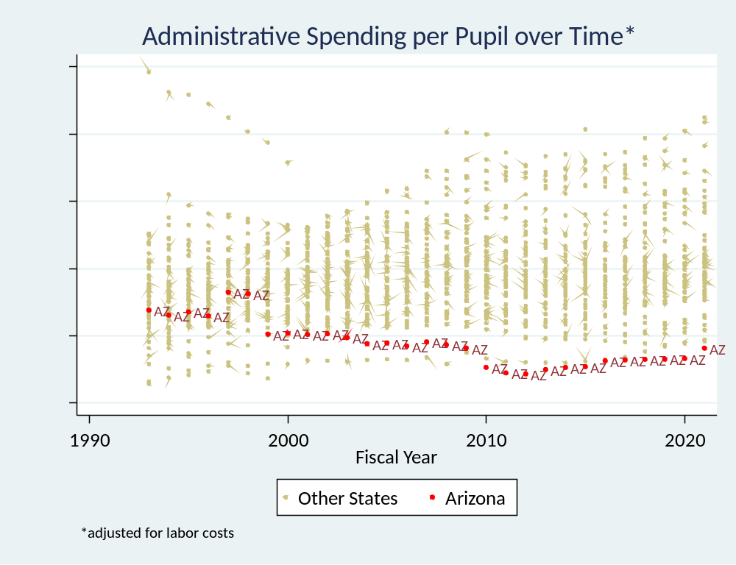
Not much available in admin spending to cut!

Slide 25
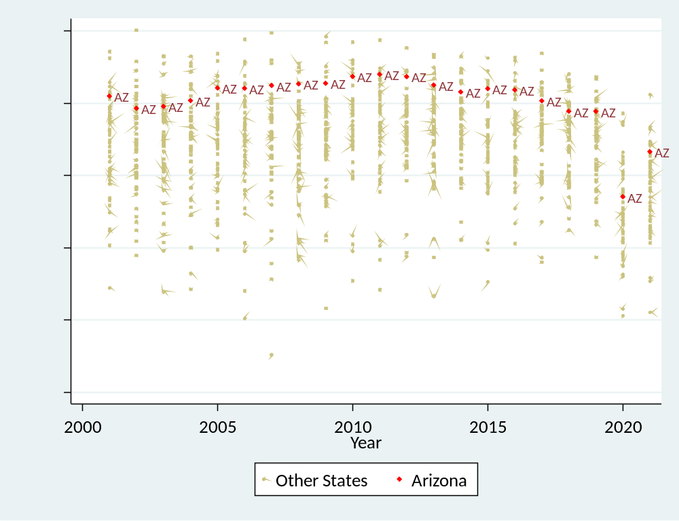
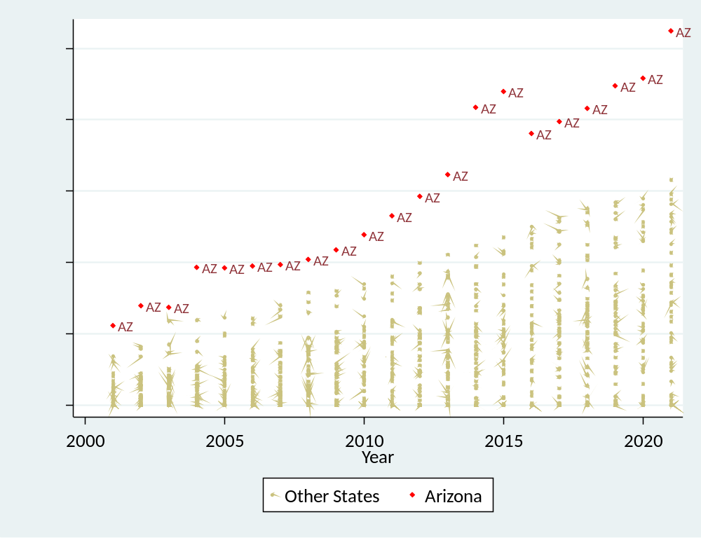
AZ has created a dispersed delivery system
Running two systems in the same space costs more, not less!
Data source: School Finance Indicators Database (State File)

Slide 26
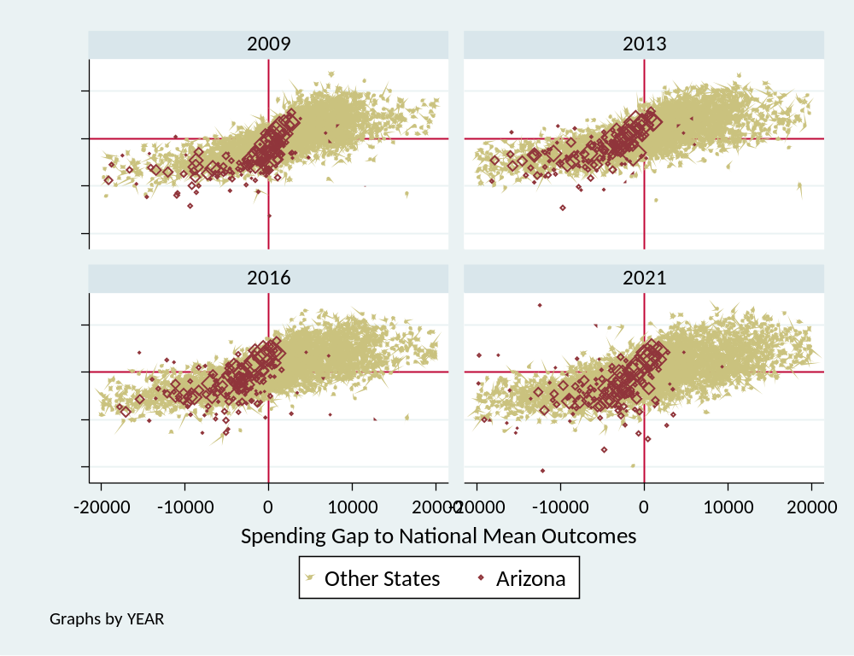
Most AZ children attend districts with funding less than adequate to meet national average outcomes
And most AZ districts perform as expected under those circumstances!

Slide 27
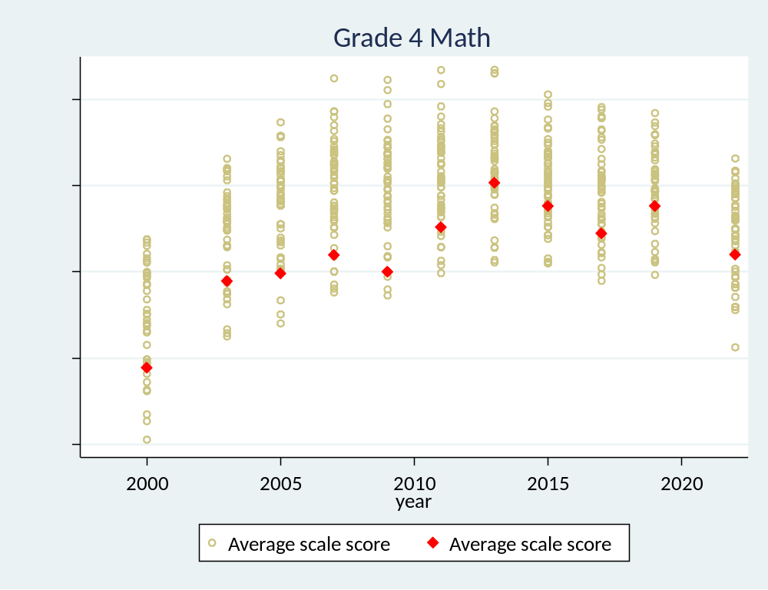
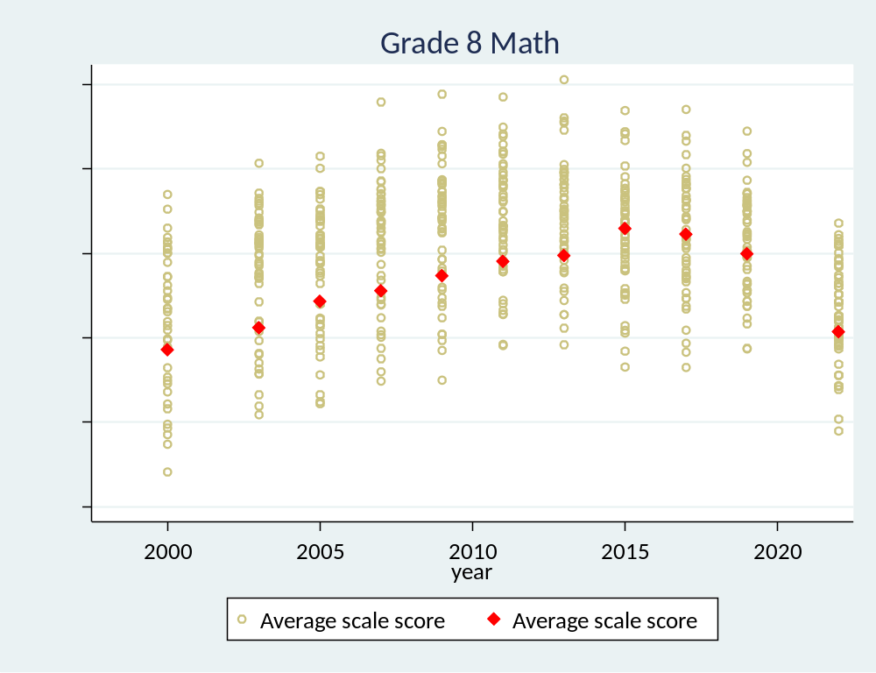
National Assessments (Math)

Slide 28
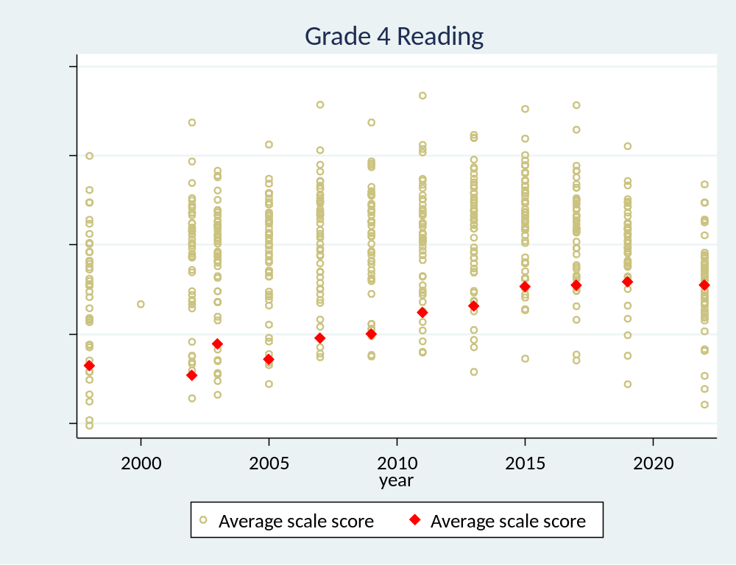
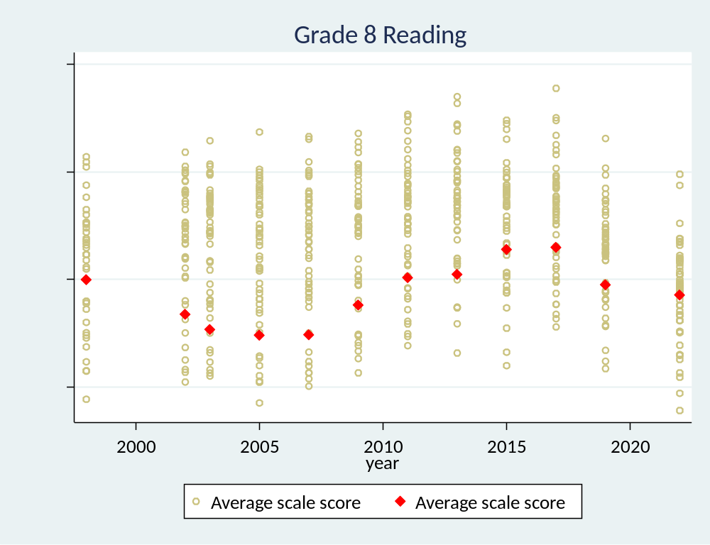
National Assessments (Reading)

Slide 29

Toward a Common Understanding
Conceptual Goal:
To provide, through school funding formulas, resources sufficient for all students to have equal opportunity to achieve (constitutionally) adequate outcomes
Empirical Goal (requirements):
Methods used to guide policy, both setting of funding levels and cost differentials, must validly link spending requirements with outcome measures (& expectations).
Legal Causes of Action:
EP (State or Fed) exists where similarly situated individuals are differently treated.
Treatment = Outcome Expectation(s)*
(under which all are similarly situated)
“Adequacy” (state) requires linking spending levels to outcome expectations
This Photo by Unknown Author is licensed under CC BY-NC-ND

Slide 30
Statement of Common Principles
Our framework for evaluating state K-12 finance systems begins with two basic premises:
  1a. Higher outcomes require more resources;
  1b. The cost of achieving a given outcome varies by student and context.
The importance of context (1b) is critical to our approach to evaluating states’ systems. By context, we mean not only the population a district serves (e.g., poverty), but also the labor market in which it is located, its size and other factors that can affect the “value of the education dollar.” Any serious attempt to compare funding between states or between districts within a given state must address the fundamental reality that the “cost of education” is far from uniform.
It follows directly from these two premises that the key question in evaluating finance systems is not how much states or districts spend but rather whether it is enough—i.e., whether resources are adequate.

Slide 31
Statement of Common Principles
Our second set of principles pertains to how we define “adequacy.” Since the core purpose of public schools is to educate and prepare all students:
  2a. We define adequacy as the cost of achieving student outcome goals;
  2b. We estimate costs in all states and districts with reference to the same outcome goals—for instance, funding should not be adequate to achieve high outcomes in one state or district and adequate to achieve more modest goals in another.
With regard to 2b, we of course recognize that states vary in terms of their academic standards and, thus, in the outcome goals that their finance systems are (at least in theory) expected to produce. Our purpose, however, is to evaluate all states’ systems in a comparable manner, and this requires a common outcome goal, within and between states. This means that estimated adequate spending levels will vary by district (see 1b), but those levels are all based on the same “benchmark” outcome goal.

Slide 32
Statement of Common Principles
Our third principle is in most respects methodological, but it is worth stating directly:
  3. The most appropriate approach to estimating costs across thousands of heterogeneous districts serving millions of diverse students is to estimate statistical cost models.
Insofar as the primary goal of any state finance system is to provide all students with an equal shot at achieving common outcomes, we use cost models to evaluate states on two “dimensions” or measures, which are the degree to which they:
  4a. Provide all students with enough funding to achieve a common (and hopefully desirable) outcome goal (i.e., statewide adequacy);
  4b. Ensure that no students have a greater chance of achieving those goals than do their peers elsewhere in the state (i.e., equal opportunity).
It is very important to note that these two measures—statewide adequacy and equal opportunity—are conceptually independent. That is, one can exist without the other. States’ systems, however, should ideally provide both adequate funding and equal opportunity—i.e., funding in all districts is above adequate levels by roughly the same proportional amount. Absent both, however, states should be evaluated on both dimensions separately.

Slide 33
Statement of Common Principles
The final element of our framework for evaluating states’ K-12 finance systems is designed to account for the aforementioned fact that both costs and the ability to pay those costs differ between states. Our fifth and final principle, therefore, is:
  5. States should also be evaluated on how much of their economic capacity—i.e., their ability to raise revenue—is devoted to their public schools (fiscal effort).
Some states’ economies are so small relative to their students’ needs that they are essentially unable to raise enough revenue to fund their schools adequately, whereas other states simply refuse to provide sufficient resources despite having the option to do so. Including effort in our framework allows us to differentiate the former from the latter states.

Slide 34
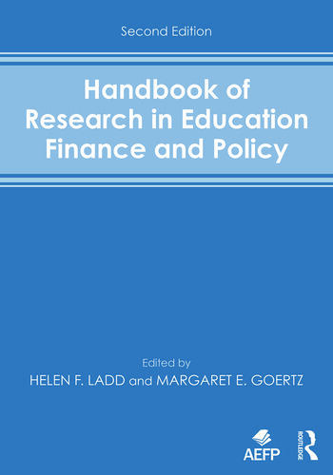
Goals of School Finance Systems
The goal of state school finance systems is to provide all children, regardless of where they live or attend school, equal opportunity to achieve common, adequate outcome goals
  Providing equal educational opportunity toward common goals costs different amounts in different settings, and across children (individually and collectively) by needs and contexts
    State accountability systems (for what they’re worth) set common goals - rate, rank and evaluate schools (and children) on whether they meet those goals
    A fair system requires funding sufficient to provide equal opportunity to meet these goals (which are often used for articulating constitutional rights).
14 Conceptions of Equity and Adequacy in School Finance
16 Measurement of Cost Differentials
Notes:
State school finance systems should be designed to enable local public schools to provide the programs and services needed for all children – whatever their backgrounds – wherever they attend school – to have equal opportunity to achieve adequate educational outcomes!
That unified framing can and should serve as a substitute for older conceptions of things like “horizontal” and “vertical” equity, which are problematic in a number of ways – especially when attempting to frame legal arguments.
The treatment, per se, is the expectation for all children that they have equitable access to outcome goals. Ideally, those outcome goals are adequate – though equal opportunity can be maintained even if the outcomes are not adequate.
Under this framework, all children are similarly situated (with respect to outcome expectations), but require different resources to have equal opportunity to succeed.
Failing to calibrate state school finance systems to provide equal opportunity to succeed on outcome standards set by the state is inherently unfair.
Recall when pundits were arguing that schools/districts with fewer resources just needed to be like the Oakland Athletics in the film/book Moneyball. They always failed to mention the book’s subtitle: The art of winning an unfair game.
It’s fine for baseball to be unfair, but not our children’s education.

Slide 35
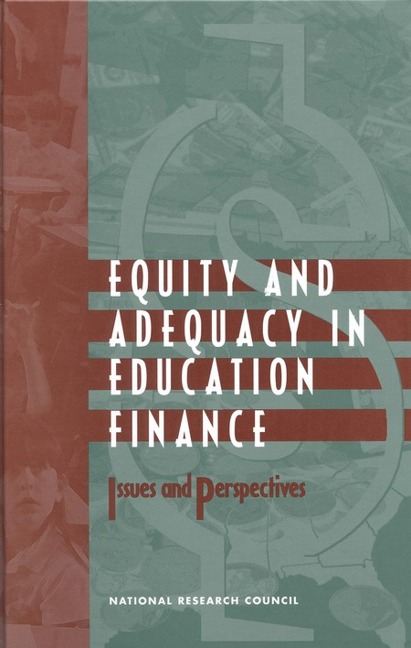
Basic Principles of “Costs” & “Equal Opportunity”
It costs more to achieve higher than lower outcomes
  All else equal, the per pupil spending required to achieve higher, and broader outcome goals is higher than the per pupil spending required to achieve narrower and/or lower goals
It costs more to achieve the same outcomes…
  With some children than others
    Collective, social context effects (poverty)
    Specific student needs (ELL, Disability)
  In some settings than others
    Economies of Scale – Small, sparsely populated remote school districts
    Regional variations in the competitiveness of wages (labor market effects)
16 Measurement of Cost Differentials
8
Performance Standards and Educational Cost Indexes: You Can't Have One Without the Other

Slide 36
Unifying concepts & methods
Conceptual Goal:
To provide, through school funding formulas, resources sufficient for all students to have equal opportunity to achieve (constitutionally) adequate outcomes
Empirical Goal (requirements):
Methods used to guide policy, both setting of funding levels and cost differentials, must validly link spending requirements with outcome measures (& expectations).
Legal Causes of Action:
EP (State or Fed) exists where similarly situated individuals are differently treated.
Treatment = Outcome Expectation(s)*
(under which all are similarly situated)
“Adequacy” (state) requires linking spending levels to outcome expectations
This Photo by Unknown Author is licensed under CC BY-NC-ND
*antiquated conceptions of “horizontal” and “vertical” equity undermine (negate) this argument!
Notes:
This for another day!

Slide 37
Using SFID & NECM to Inform Legislation & Litigation
School Finance Indicators Database & Reports

Slide 38
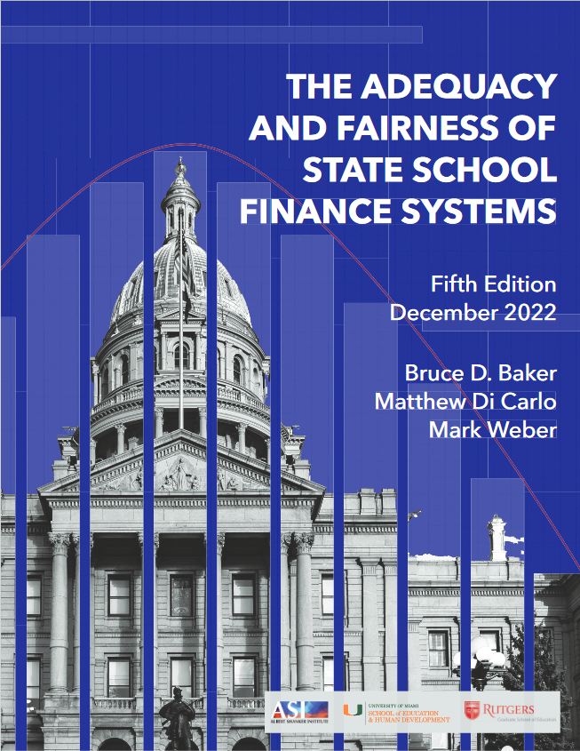
Indicators of State School Finance Systems
Educational Effort
  Education spending share of aggregate personal income
  Education spending share of gross domestic product (state)
Spending (revenue & key resource) Progressiveness
  Ratio of resources (per pupil) available in higher versus lower poverty settings (basically a regression slope)
    Descriptive regression model of “what is” (in terms of resource distribution)
    Method can be used between and/or within districts
  Per Pupil Spending, State & Local Revenue, Staffing Ratios
Relative Adequacy / Equal Opportunity
  Ratio of current spending to spending predicted to be needed (based on education cost model) to achieve national mean outcomes in reading and math.
    By including outcome measures, allows estimation of “what should be” for comparison with “what is”
Notes:
In collaboration with Matt DiCarlo at Shanker Institute and my former doc student Mark Weber and current doc student Ajay Srikanth, we’ve been working on a parsimonious set of indicators of state school finance systems.
While we have it down to 3 now, it’s really the first and third here that seem to matter most.
The first is state effort – how much of their economic capacity (measured 2 different ways) are states dedicating to k12 school funding? You’ll see how this matters on later slides. Yes, some states are richer than others and can spend more as a result. But some states – many states that have capacity simply don’t try and have put in less and less over time.
The third indicator is our combined relative adequacy and equal opportunity indicator which we have developed using cost modeling to determine the costs per pupil of achieving a common outcome target for every local school district in the country. From there, we can compare current spending to those cost predictions to evaluate the relative adequacy of existing funding toward achieving common outcome goals.
And, for a little more fun, we can raise and lower those outcome targets to see how that changes who’s in the over/under groups!

Slide 39
Let’s Explore “Equal Opportunity” & Adequacy
National Education Cost Model
  Predicts the per pupil spending levels needed for each district in the country to provide its students equal opportunity to achieve national average outcomes
    Does not assume that goal to be adequate
  Uses data on nearly every school district in the country, from 2009 to 2018 including nationally equated outcomes in reading and math (SEDA), school spending and a variety of economic and demographic characteristics
  Applies statistical methods outlined by Duncombe & Yinger in their 1999 National Research Council chapter (and published in numerous peer reviewed economic, public policy and education journals over the decades)

Slide 40
Context
Every state has established outcome expectations for students
  Most, for that matter express those outcome expectations in terms of college and career readiness goals
  Many have adopted assessments aligned with these goals
It is the outcomes that are expected of all children that constitute an “adequate” education
  however “subjective,” state legislatures, boards and departments have adopted such goals and measures and indicators of whether and to what extent they’ve been achieved
All children must be provided (via sufficient funding to provide for programs and services) equal opportunity to achieve those outcomes.
  Failure to do so, in many states (via judicial interpretation), violates state constitutional protections.
  Failure to do so – failing to provide kids what’s needed to succeed, for example, on high stakes exit exams (grad exams), may also violate substantive due process
  Racial disparities in EEO to Adequacy may raise other issues/concerns

Slide 41
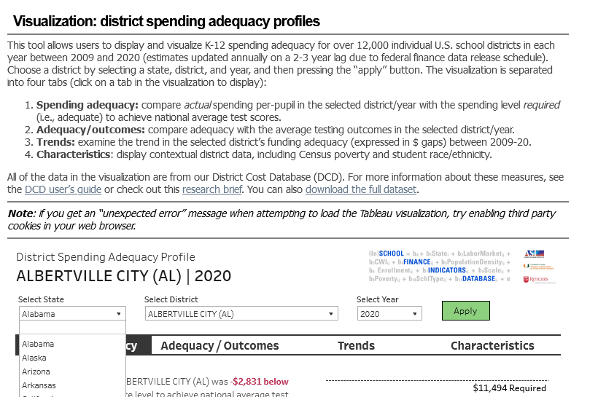
Exploring Adequacy & Equal Opportunity
https://www.schoolfinancedata.org/dcdviz1/

Slide 42
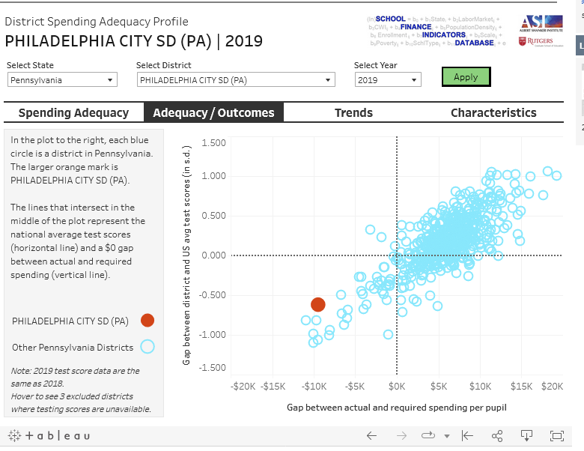
Using SFID Data Viz to inform Advocacy & Litigation
https://www.schoolfinancedata.org/dcdviz1/

Slide 43
Using SFID Data Viz to inform Advocacy & Litigation
https://www.schoolfinancedata.org/dcdviz1/
Districts with sufficient spending to meet or exceed national average outcomes, that do exceed national average outcomes
Districts lacking sufficient spending to achieve national average outcomes and fall below national average outcomes

Slide 44
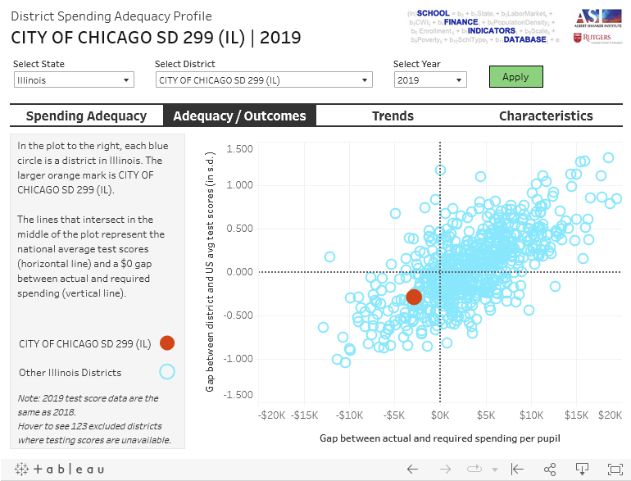
Using SFID Data Viz to inform Advocacy & Litigation
https://www.schoolfinancedata.org/dcdviz1/
Districts with sufficient spending to meet or exceed national average outcomes, that do exceed national average outcomes
Districts lacking sufficient spending to achieve national average outcomes and fall below national average outcomes

Slide 45
Using SFID Data Viz to inform Advocacy & Litigation
https://www.schoolfinancedata.org/dcdviz1/
Deep dive stories exploring inequalities?
Who really is “underfunded?”
(potential plaintiffs in litigation?)

Slide 46
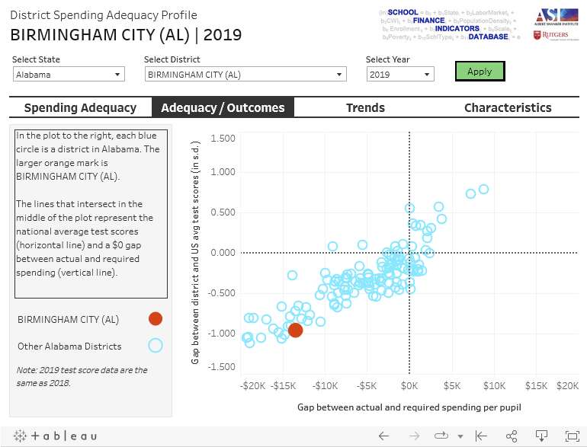
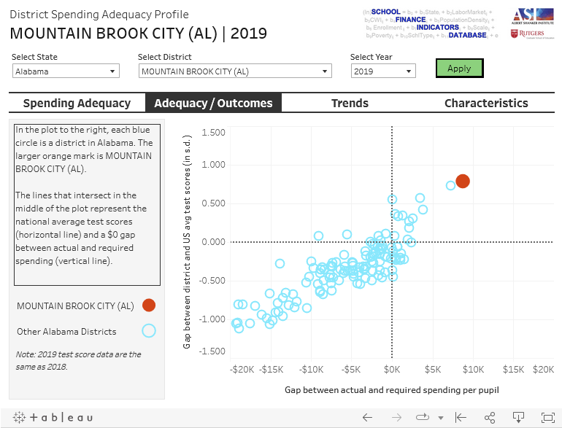
More Examples

Slide 47


More Examples

Slide 48


More Examples

Slide 49


More Examples

Slide 50

Clarifying causes, responsibility & remedy
https://www.schoolfinancedata.org/visualization1/

Slide 51
How is effort related to “equal opportunity?”
https://www.schoolfinancedata.org/visualization1/
State that tries (puts up effort) and raises enough of money to achieve outcomes (NJ)
State that tries (puts up effort) but simply can’t raise adequate funding (MS)
State that doesn’t try, and falls short on adequate funding to achieve national average outcomes (AZ)

Slide 52


Connecting the dots between funding & “real resources”

Slide 53


Resources: annual report and research briefs
ANNUAL REPORT
Summarizes the latest findings on the three “core indicators”
RESEARCH BRIEFS
Occasional analyses of different measures not included in the annual report or profiles.

Slide 54

Resources: one-page state profiles
The profiles summarize, visualize, and describe in clear language the key results for each state (and D.C.)
Focus on the “core indicators” of effort, adequacy, and progressivity
Comparisons with U.S. averages
Trends over time
Updated annually with latest data

Slide 55
State Specific Reporting with NECM

Slide 56
Recent State Reports using NECM Data
Virginia Joint Legislative and Audit Review Committee
  Used NECM models and estimates to evaluate the extent to which VA funding provides for equal opportunity and to propose alternative weights that would align better with NECM
  https://jlarc.virginia.gov/landing-2023-virginias-k-12-funding-formula.asp
Missouri Department of Elementary and Secondary Education
  Worked with me to use NECM to evaluate equal opportunity and adequacy of funding against two standards, to estimate alternative models and compare weights to existing formula.
  https://dese.mo.gov/media/pdf/missouri-school-funding-march-2023
New Jersey Policy Perspectives (NJPP) commissioned independent report
  https://www.njpp.org/publications/report/unlocking-academic-success-revitalizing-new-jerseys-school-funding-formula-for-student-achievement/
New York State Association of Small City School Districts

Slide 57

New Jersey: Comparing current formula versus predicted costs from NECM (at high outcomes)

Slide 58

New Jersey: Comparing current formula versus predicted costs from NECM (at high outcomes)

Slide 59

New Jersey: Comparing current formula weights versus predicted weights from NECM

Slide 60

New York: Comparing current formula versus predicted costs from NECM (at high outcomes)

Slide 61

New York: Comparing current formula versus predicted costs from NECM (at high outcomes)

Slide 62

Missouri: Comparing current formula versus predicted costs from NECM (at high outcomes)

Slide 63

Missouri: Comparing current formula weights versus predicted weights from NECM

Slide 64
Conducting State Specific Analyses
Linking Conceptual and Empirical Rigor to Evaluate State School Finance Systems

Slide 65

General Framework for Informing Funding Formulas
Steps 1a & 1b
1a. Risk (Needs) Analysis
1b. Spending Analysis
Context
Need & Cost
Demand & Capacity
Outcomes
Context
Fiscal Capacity
Students
Students
Spending
Tastes
Tax Price
Progressiveness
Neutrality
2a. Cost Modeling
2b. Translation to Formula
Steps 2a & 2b
Context
Outcomes
Weights Model
Formula Simulation
Students
Context
Spending
Cost
Cost
Students
Efficiency Factors
*Instruments

Slide 66

From related work in Vermont (2018)
https://legislature.vermont.gov/assets/Legislative-Reports/edu-legislative-report-pupil-weighting-factors-2019.pdf

Slide 67
More Basics
We can identify those factors – and the best measures of those factors – which most accurately predict “risk” that students will achieve lower outcomes (or have more difficulty achieving high/desired outcomes)
  There’s a large body of rigorous empirical evidence on this
We can estimate the additional costs associated with offsetting that risk (via appropriate statistical methods)
  There’s also a large body of rigorous empirical evidence on this
States (or the Federal Gov’t) can use these estimates to:
  Evaluate whether and to what extent existing school funding systems provide equal opportunity
  Guide the reform and redesign of those systems

Slide 68
Research to Policy / State Financing Models
Agency Rules / Regulations
“(re)Calibration” of Levers
[Lever Settings]
Policy Simulation
Weights Modeling
Legislated “Formula” Structure
[design features & levers]
Risk Analysis
Cost Modeling
Equity/ Spending / Demand Analysis

Slide 69

New Hampshire Simulation

Slide 70
Recent Applications of Cost Modeling
KANSAS
  Taylor, L., Willis, J., Berg-Jacobson, A., Jaquet, K., & Caparas, R. (2018). Estimating the costs associated with reaching student achievement expectations for Kansas public education students: A cost function approach. San Francisco, CA: WestEd. Retrieved from https://probstforprogress.com/wp-content/uploads/2018/03/kansas_adequacy_study_cost_function_approach_20180315_final.pdf
  Duncombe, W., Yinger, J. (2006) Estimating the Costs of Meeting Student Performance Outcomes Adopted by the Kansas State Board of Education. Prepared for the Kansas Legislative Division of Post Audit https://www.maxwell.syr.edu/uploadedFiles/cpr/research/cpr_research_education_finance_policy/Kansas_Report.pdf
VERMONT
  Kolbe, T., Baker, B.D., Atchison, D., Levin, J. (2019) Pupil Weighting Factors Report. State of Vermont, House and Senate Committees on Education. https://legislature.vermont.gov/assets/Legislative-Reports/edu-legislative-report-pupil-weighting-factors-2019.pdf
NEW HAMPSHIRE
  Baker, B.D., Atchison, D., Levin, J., Kearns, C. (2020) New Hampshire Commission to Study School Funding, Final Report: https://carsey.unh.edu/sites/default/files/media/2020/09/20-12685_nh_final_report_version_v5_draft_1.pdf
DELAWARE
  D. Atchison, B.D. Baker, J. Levin, S. Fatima, A. Trauth, A. Srikanth, C. Herberle, N. Gannon-Slater, L. Junk, K.: Wallace (2023) Assessment of Delaware Public School Funding. https://education.delaware.gov/wp-content/uploads/2023/12/23-22933_1_Delaware_Full_Report-FMT-ed103023-Version-2.pdf

Slide 71
Summing it all up!

Slide 72
Summary
We HAVE NOT broadly solved our state school finance equity or ADEQUACY problems
We have backslid since 2008
  Some states that had done well are no longer
  Some states remain persistent dumpster fires
Adequacy is not “elusive”
  Adequacy is defined in terms of outcome expectations
  Every state has set them
  We can reasonably estimate the costs to achieve them
    And how those costs vary from one child to the next and one location to the next

Slide 73
Summary
NECM can be used to evaluate equal opportunity and adequacy to an extent in states unwilling to engage in their own
  At relatively low cost, NECM data can be used to estimate state level or regional models for potentially more accurate, state specific results
State contracted studies are increasingly showing robust, consistent findings even in states where we would expect problems with states’ own data (Vermont, New Hampshire, Delaware).
There are correct (and incorrect) conceptions of educational equity, adequacy and equal opportunity
  And there are correct, better, worse and wrong methods for evaluating costs and policy design toward meeting those goals

Slide 74
Extra Stuff

Slide 75

Maryland Kirwan/Blueprint
Kirwan/Blueprint spending targets, which are based largely on input oriented analysis, overstate costs and needs in affluent suburbs (Howard County) but understate costs of equal opportunity in Baltimore City.

Slide 76

Illinois “Evidence Based” Model
Illinois’ new “Evidence Based” school funding model substantially understates the additional costs of providing equal opportunity in high need settings, setting a spending bar for the City of Chicago that is only marginally higher than that of it’s most affluent suburban neighbors.
EB Model “effective” weight on % Free or Reduced = .273

Slide 77


Alternative Cost Model Estimates
Vermont & Connecticut
Cost modeling on Connecticut schools by authors from the Federal Reserve of Boston produce similarly strong adjustment for poverty as our own models in Vermont and New Hampshire

Slide 78

Kansas
Cost model results by two separate authors, 12 years apart, produced similar cost predictions for Kansas public school districts.
https://carsey.unh.edu/sites/default/files/media/2020/06/20-11882_5._primer_statevignettes_kansas_air_formatted_v5.pdf

Slide 79
Selected Peer Reviewed Cost Modeling Studies
Recent
  Kolbe, T., Baker, B. D., Atchison, D., Levin, J., & Harris, P. (2021). The additional cost of operating rural schools: Evidence from Vermont. AERA Open, 7, 2332858420988868.
  Zhao, B. (2022). Estimating the cost function of connecticut public K–12 education: implications for inequity and inadequacy in school spending. Education Economics, 1-32.
  Gronberg, T. J., Jansen, D. W., & Taylor, L. L. (2017). Are charters the best alternative? A cost frontier analysis of alternative education campuses in Texas. Southern Economic Journal, 83(3), 721-743.
Older major works
  Duncombe, W., & Yinger, J. (2005). How much more does a disadvantaged student cost?. Economics of Education Review, 24(5), 513-532.
  Baker, B. D. (2011). Exploring the sensitivity of education costs to racial composition of schools and race-neutral alternative measures: A cost function application to Missouri. Peabody Journal of Education, 86(1), 58-83.
  Duncombe, W., & Yinger, J. (1998). School finance reform: Aid formulas and equity objectives. National Tax Journal, 51(2), 239-262.
  Duncombe, W., & Yinger, J. (2000). Financing higher student performance standards: the case of New York State. Economics of Education Review, 19(4), 363-386.
  Duncombe, W., & Yinger, J. (1997). Why is it so hard to help central city schools?. Journal of Policy Analysis and Management: The Journal of the Association for Public Policy Analysis and Management, 16(1), 85-113.
  Imazeki, J., & Reschovsky, A. (2004). Is No Child Left Behind an un (or under) funded federal mandate? Evidence from Texas. National Tax Journal, 57(3), 571-588.
  Gronberg, T. J., Jansen, D. W., & Taylor, L. L. (2012). The relative efficiency of charter schools: A cost frontier approach. Economics of Education Review, 31(2), 302-317.

