Slide 2
Modeling the Costs of
Education Outcome Goals
Educational Adequacy
& Equal Educational Opportunity

Slide 3
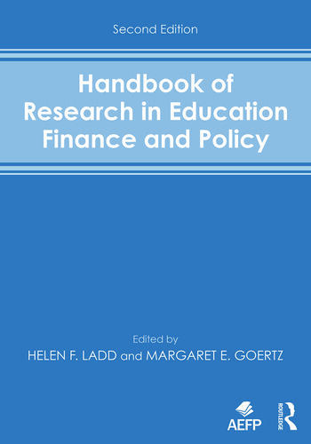
Goals of School Finance Systems
The goal of school finance systems is to provide all children, regardless of where they live or attend school, equal opportunity to achieve common, adequate outcome goals
  Providing equal educational opportunity toward common goals costs different amounts in different settings, and across children (individually and collectively) by needs and contexts
  In the U.S., State accountability systems set common goals - rate, rank and evaluate schools on whether they meet those goals
  A fair system requires funding sufficient to provide equal opportunity to meet these goals (which are often used for articulating constitutional rights)
14 Conceptions of Equity and Adequacy in School Finance
16 Measurement of Cost Differentials
Notes:
State school finance systems should be designed to enable local public schools to provide the programs and services needed for all children – whatever their backgrounds – wherever they attend school – to have equal opportunity to achieve adequate educational outcomes!
That unified framing can and should serve as a substitute for older conceptions of things like “horizontal” and “vertical” equity, which are problematic in a number of ways – especially when attempting to frame legal arguments.
The treatment, per se, is the expectation for all children that they have equitable access to outcome goals. Ideally, those outcome goals are adequate – though equal opportunity can be maintained even if the outcomes are not adequate.
Under this framework, all children are similarly situated (with respect to outcome expectations), but require different resources to have equal opportunity to succeed.
Failing to calibrate state school finance systems to provide equal opportunity to succeed on outcome standards set by the state is inherently unfair.
Recall when pundits were arguing that schools/districts with fewer resources just needed to be like the Oakland Athletics in the film/book Moneyball. They always failed to mention the book’s subtitle: The art of winning an unfair game.
It’s fine for baseball to be unfair, but not our children’s education.

Slide 4
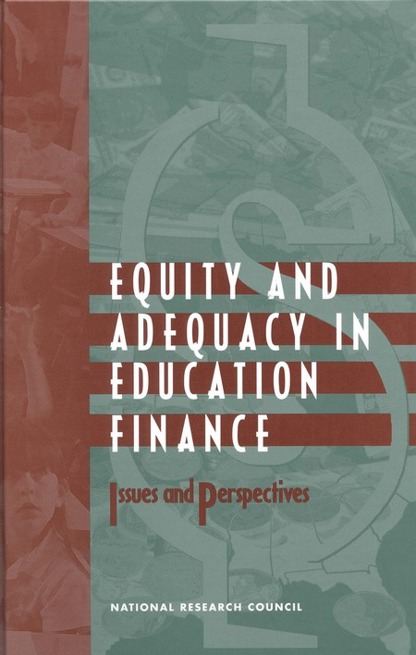
Basic Principles of “Costs” & “Equal Opportunity”
It costs more to achieve higher than lower outcomes
  All else equal, the per pupil spending required to achieve higher, and broader outcome goals is higher than the per pupil spending required to achieve narrower and/or lower goals
It costs more to achieve the same outcomes with some children than others
  Collective, social context effects (poverty)
  Specific student needs (ELL, Disability)
It costs more to achieve the same outcomes with some children than others in some settings than others
  Economies of Scale – Small, sparsely populated remote school districts
  Regional variations in the competitiveness of wages (labor market effects)
16 Measurement of Cost Differentials
8
Performance Standards and Educational Cost Indexes: You Can't Have One Without the Other

Slide 5
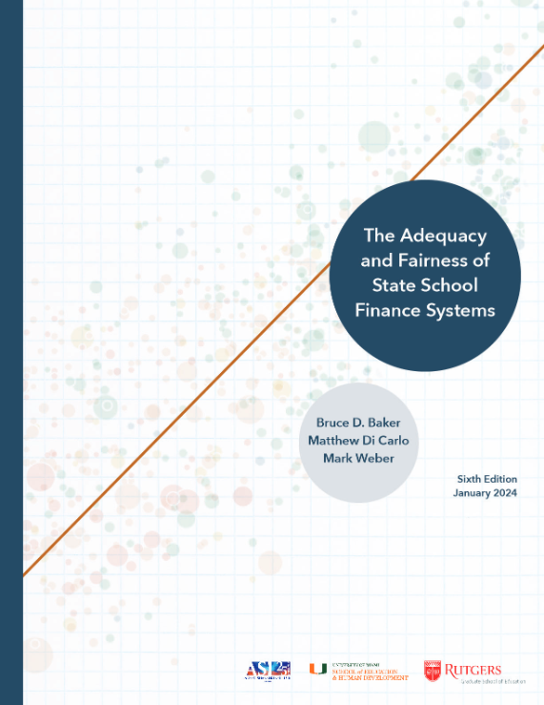
U.S. School Finance Indicators Database
Adequacy
  Funding with respect to (cost of achieving) Outcome Benchmark
Equal Opportunity
  within states to achieve common outcomes across contexts by race & poverty
Effort
  Share of state capacity spent on k-12 education, where capacity is measured by: GDP-State and Aggregate Personal Income

Slide 6
Cost analysis methodologies
Input Oriented
  Determine the personnel and non-personnel resources and corresponding costs associated with the educational services used to generate student outcomes. [Ingredients Method (Levin et al., 2018; Baker & Morphew, 2007)]
  Resource Cost Models or Ingredients methods
  Institutional production/delivery or student consumption
Outcome Oriented
  Evaluate aggregated spending per-student as a function of student outcomes and several cost factors including needs, labor price levels, scale of operations and other institutional characteristics. [Education Cost Function Analysis (Duncombe & Yinger, 2011; Levin et al., 2022)]

Slide 7
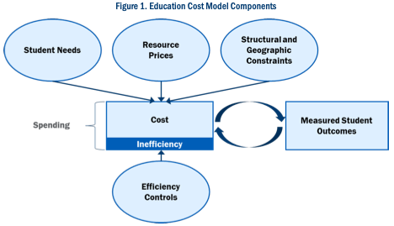
Illustration of outcome-oriented approach to cost analysis
Model using multiple years of data on all schools and/or districts in a state (or nation)
  13,000 Local Education Agencies
  Across 50 State Systems
  12 years of data
Identifying the statistical relationships represented by each connection in the figure (based on the best available data from state and federal sources)
Using that model to project the spending needed to achieve a given level of outcomes
  Across all children
  Across all settings
Notes:
Bruce

Slide 8
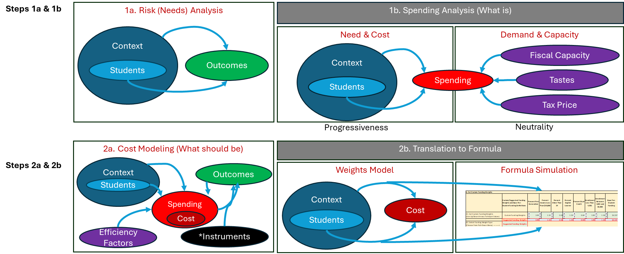
General Framework for Outcome Oriented Analysis
4 step Process

Slide 9
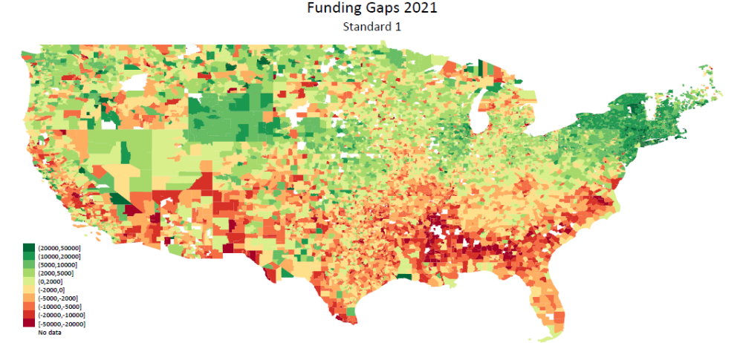
Current spending compared to spending needed to achieve national mean outcomes

Slide 10
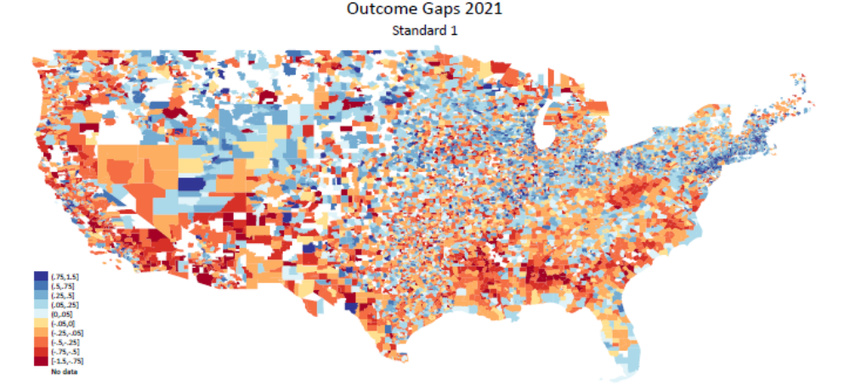
Outcome Gaps to National Mean

Slide 11
Summary
Increased longitudinal data availability enables cost modeling
  Harmonized outcomes
  Student characteristics
  Context & institutional characteristics
Cost models are producing increasingly consistent, robust results
Applications in both elementary & secondary as well as post-secondary (U.S. Community Colleges) settings
Can be used to evaluate school funding systems
Can be used to inform, redesign/recalibrate school funding formulas
  Toward equal opportunity & adequacy goals
  To calibrate basic levels of funding & weights or cost adjustments

Slide 12
“This case, of course, is about the rest of those children”
Kansas District Court Judge Terry Bullock, December 19, 2003

Slide 13
Recent Applications of Cost Modeling
Peer Reviewed Articles
Baker, B. D., Weber, M., & Srikanth, A. (2021). Informing Federal School Finance Policy with Empirical Evidence. Journal of Education Finance, 47(1), 1-25.
Levin, J., Baker, B., Lee, J., Atchison, D., & Kelchen, R. (2022). An Examination of the Costs of Texas Community Colleges. REL 2023-142. Regional Educational Laboratory Southwest.
Kolbe, T., Baker, B. D., Atchison, D., Levin, J., & Harris, P. (2021). The additional cost of operating rural schools: Evidence from Vermont. AERA Open, 7, 2332858420988868.
Zhao, B. (2022). Estimating the cost function of Connecticut public K–12 education: implications for inequity and inadequacy in school spending. Education Economics, 1-32.
Gronberg, T. J., Jansen, D. W., & Taylor, L. L. (2017). Are charters the best alternative? A cost frontier analysis of alternative education campuses in Texas. Southern Economic Journal, 83(3), 721-743
State Studies
KANSAS
  Taylor, L., Willis, J., Berg-Jacobson, A., Jaquet, K., & Caparas, R. (2018). Estimating the costs associated with reaching student achievement expectations for Kansas public education students: A cost function approach. San Francisco, CA: WestEd. Retrieved from https://probstforprogress.com/wp-content/uploads/2018/03/kansas_adequacy_study_cost_function_approach_20180315_final.pdf
  Duncombe, W., Yinger, J. (2006) Estimating the Costs of Meeting Student Performance Outcomes Adopted by the Kansas State Board of Education. Prepared for the Kansas Legislative Division of Post Audit https://www.maxwell.syr.edu/uploadedFiles/cpr/research/cpr_research_education_finance_policy/Kansas_Report.pdf
VERMONT
  Kolbe, T., Baker, B.D., Atchison, D., Levin, J. (2019) Pupil Weighting Factors Report. State of Vermont, House and Senate Committees on Education. https://legislature.vermont.gov/assets/Legislative-Reports/edu-legislative-report-pupil-weighting-factors-2019.pdf
NEW HAMPSHIRE
  Baker, B.D., Atchison, D., Levin, J., Kearns, C. (2020) New Hampshire Commission to Study School Funding, Final Report: https://carsey.unh.edu/sites/default/files/media/2020/09/20-12685_nh_final_report_version_v5_draft_1.pdf
DELAWARE
  D. Atchison, B.D. Baker, J. Levin, S. Fatima, A. Trauth, A. Srikanth, C. Herberle, N. Gannon-Slater, L. Junk, K.: Wallace (2023) Assessment of Delaware Public School Funding. https://education.delaware.gov/wp-content/uploads/2023/12/23-22933_1_Delaware_Full_Report-FMT-ed103023-Version-2.pdf

